Slide 1


Deaf-Blind Child Count: Data accuracy & using the data feedback file
Presenter: Robbin Bull, DB Child Count Coordinator
January 8 & 15, 2020
(Repeated content)
The contents of this presentation were developed under a grant from the U.S. Department of Education, #H326T180026. However, those contents do not necessarily represent the policy of the U.S. Department of Education, and you should not assume endorsement by the Federal Government. Project Officer, Susan Weigert.

Slide 2
Outcomes for Today
Greater understanding of National child count reporting process
Increase knowledge about data management best practices
Improved strategies for cleaning DB child count data
Increase confidence in working with state data records/files
Notes:
1. Understanding the process for new and “old”
2. Valid and reliable data are needed to show program effectiveness (
3. Using data to guide decisions

Slide 3
What will not be covered:
Detailed review of Deaf-Blind Child Count Reporting Process
  Refer to September 2019 Child Count Kick-Off presentation
  Find Annual Child Count Reporting Resources on website

Slide 4
Quick review of submission details
Data can be collected in any spreadsheet or database program.
Must be submitted as an Excel readable file (.xls, .csv, .xlsx)
Data due May 5, 2020
Data MUST be submitted via the National Center website via the secure portal. Visit the Annual Resources for Reporting the Child Count web page for submission instructions.
Include Data Notes with submission – details helpful to understand your data trends
Notes:
[POLL – What data system do you use?]

Slide 5
Data Notes
Example 1:
We added 28 new students. We had to remove 23 students who had aged-out, moved, died or were otherwise ineligible.
I have a number of students who are not being reported for Part B funds (888). Most of these are due to parents who have refused services and withdrawn their children to "home-school" them with no special education/involvement from school. A few have graduated or received certificates but are still under 21.
For the students that I removed, I wasn’t sure what to put for one of them on the Part B exiting. I was told the student moved out of a particular district and I have been unable to locate their new placement, I put “6 Moved – Known to be continuing.” I wasn’t sure if that was completely accurate, but I didn't know that they had "dropped out" either.

Slide 6
Data Note examples (cont.)
Example 2:
In our state we allow the 3 years olds to stay on IFSP until Aug. 31 of the year they turn 3, that is why many times they are still counted in Part C. Same thing for our children that turn 21---they can stay on the IEP until they graduate.
Example 3:
There was a decrease in the number of children 6 to 21 in educational setting of residential facility due to a data entry error that was discovered. The error was corrected in this year’s submission.

Slide 7
Why are we doing this?
We need confidence that the data means the same thing across the nation in order to direct TA and make decisions based on what the data are showing.
Gives us:
    Ability to ask good questions
    Ability to interpret what the data mean
    Accurate data to answer the questions
    Ability to analyze data in meaningful ways
    Ability to decide on appropriate actions

Slide 8
Checking data for accuracy and completeness
Investigate Missing Data
  Is it unknown or an error?
Confirm Data Format and Ranges
  Are codes out dated?
  Were alpha used instead of numbers?
  Are data in wrong category for age of child?
Check for Data Entry Errors
  Are there entries that don’t belong?
  Was some data missed during entry?
Determine where problem originated
  Data system and/or forms never updated?
  Mis-match form/data system?
  Export error?

Slide 9
Fields that cannot be blank
Identification Code
Child Number
Birth Year
Birth Month
Birth Day
Hearing Loss
Vision Loss
DB Project Exiting
Part C Exiting
Part B Exiting

Slide 10
Resources to have on hand
Instructions and/or Quick Reference Code sheet
  Reference code values and labels
DBCC Change Log
  Crosswalk of outdated values to newer values
All can be found on the Annual Child Count Reporting Resources page.

Slide 11
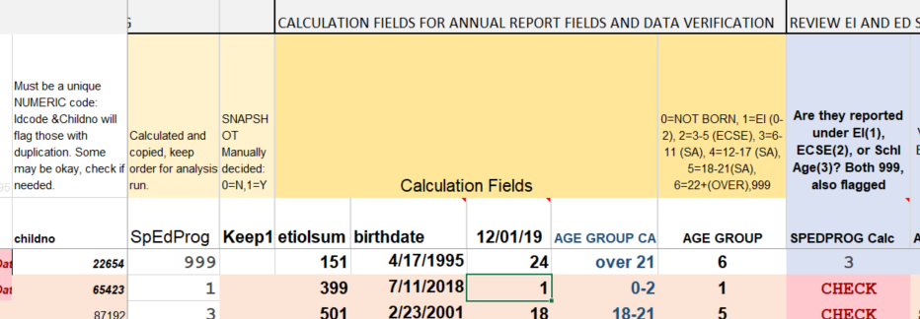
Getting oriented to the Data Feedback File (DFF)
Overview of Instructions
  Read through fully once
  Focus on Section 2
Review Heading Rows of Spreadsheet
  Different types of fields (data, calculation, flag)
Notes:
Showing Spreadsheet

Slide 12
What is file showing me?
Review how flags work
  Colored rows
  Colored cells
  Colored text
Header gives detail as well
Notes:
Showing Spreadsheet

Slide 13
Review Part C and Part B
Change data with age transition
  Part C and Part B Codes
  EI and Ed Setting Codes
  Part C and Part B Exiting Codes
Exiting data is important!
  IDEA exiting and DB Project exiting data determine if counted on national report
Notes:
POLLS!!

Slide 14
Ed Setting “New Codes” vs. “Old Codes”
Reminder: We cross-walked any new codes to the old codes for national reporting purposes for 2018 and 2019
DFF checks against old codes, so if used new codes, may have some false flags
Be familiar with what is on your forms, in your data system and spot check in your exported file

Slide 15
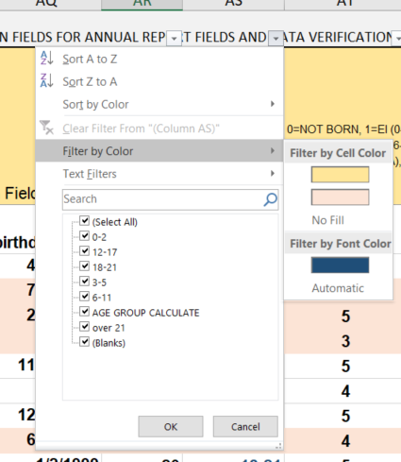
Filters are very helpful!
  Filter By specific values or color
Notes:
Need to unmerge cells if want to filter column that has headings with merged cells.

Slide 16
Additional tips
Hiding columns you do not need to look at during data checks can help view columns needing to be checked.
SORTING data by age may be helpful. Sort by Birth Year, Birth Month, Birth Day to get the most accurate results.

Slide 17
Send data in for updated file
Contact me if you want to send your data in for an updated feedback file
Use submission portal for sending file for updated feedback file

Slide 18
Tools available to review data
Annual Online Report - Filter your data - compare with National, get report of all individual state data in downloadable report
  Quick look at your state data, and quick charts and tables
  Allow you to download and generate state level reports
Interactive Online Maps - Quickly look at your child count across years with pop up longitudinal graph, drill down by number or percent.
  Nice graphics for reports/presentations
  Percentage tables
Longitudinal Data File - Hearing Loss by Vision Loss (2010-2017)
  Individual state tables and charts as well as national
  Generate trend reports, charts and graphs
EI&R Self-Assessment Guide - Guide, but pre-populated data tables are also helpful.
  Compare your state against Part C proportions (Table 1)
  Compare your state against national DB proportions (Table 2)
  Compare your state against national DB age distribution (Table 3)
  Compare percent change between ages against national DB (Table 4)
More details about using these tools are on our website.
Notes:
Poll – which tools do you use?
https://nationaldb.org/wiki/page/11/79
Demonstrate easy chart from state Excel file.

Slide 19
DBCC Needs Assessment Workgroup
2006 was the last major review of data fields
What revisions are necessary? What are desired?
Workgroup recommendations will be presented to field for feedback

Slide 20

I’m Here to Help!
Don’t hesitate to contact Robbin with questions.

