Slide 1
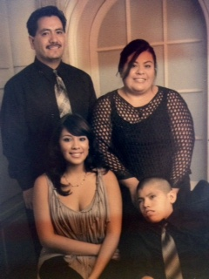
A Parent’s Story
Myrna Medina
Family Engagement Specialist, California
Deafblind Services

Slide 2
Purpose
Professionals will gain awareness of the situations/concern/issues families are facing.
Families will learn that their stories are important and their feelings matter, and be empowered to move forward.
Professionals and families will learn that the key to success is supporting one another.

Slide 3
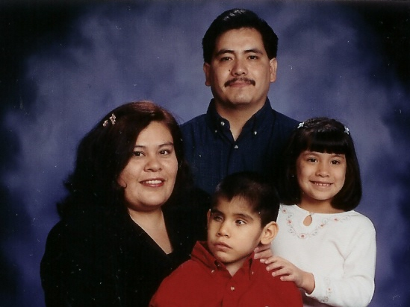
My family

Slide 4

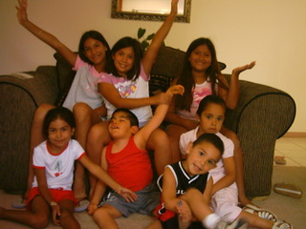

More about my family
  Our dreams

Slide 5
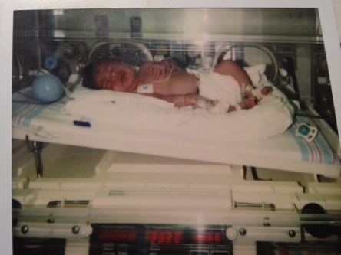
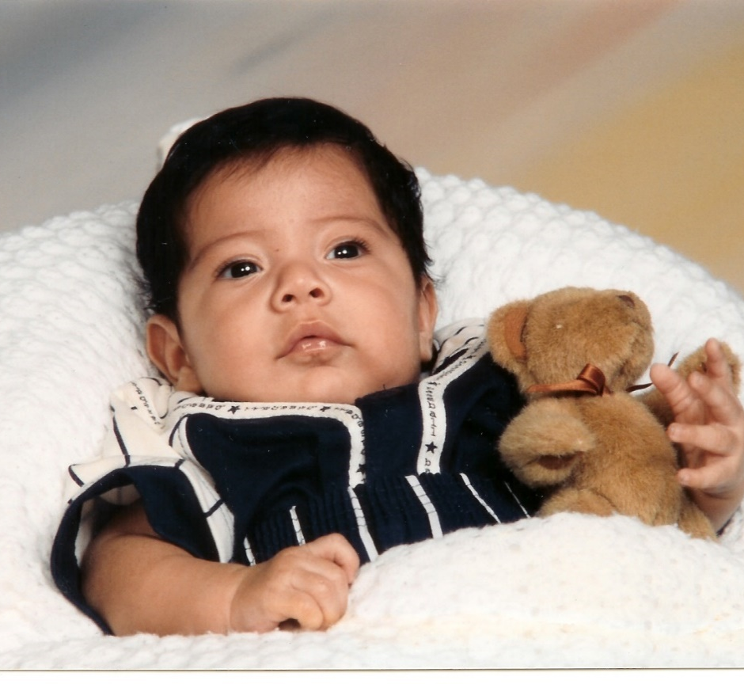
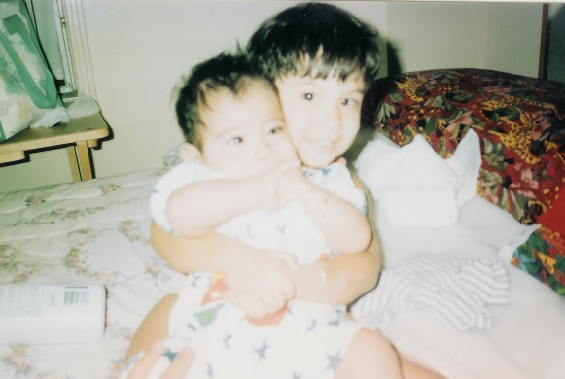
My story: The journey begins

Slide 6

Emotions
Emotions help us to adjust and go on with our lives.
Emotions do not occur in any particular sequence or predictable stages. They vary from person to person in intensity as well as duration.

Slide 7
Examples of emotions/coping with grief
Shock
Depression
Denial
Bargaining
Guilt
Grieving
Process
Fear
Anger
Isolation
Blame
Hope
Acceptance

Slide 8

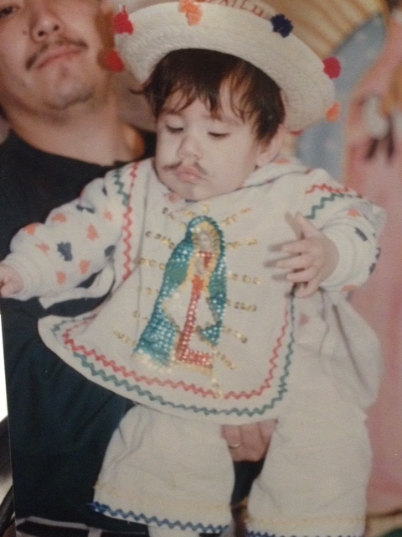

More about the grieving process
Finding the magic cure
Early intervention services
“The more the merrier”

Slide 9
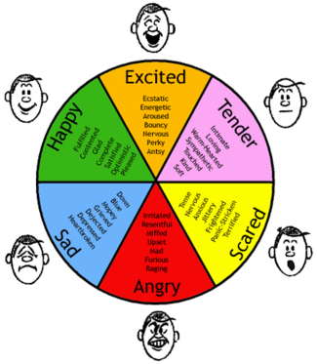
Understanding the grieving process
Emotions:
Are natural and normal
Are not experienced in any predictable order
Recur during one’s life; often triggered by developmental milestones
Vary in intensity, according to individual circumstances
May occur unexpectedly
Are not clear cut

Slide 10

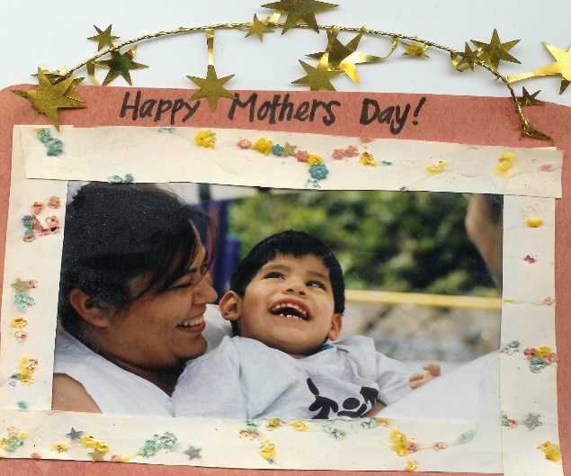

Dealing with ups and downs: Acceptance
Diagnosis:
Too many tests
Too many names/labels
Unknown cause
Same child

Slide 11
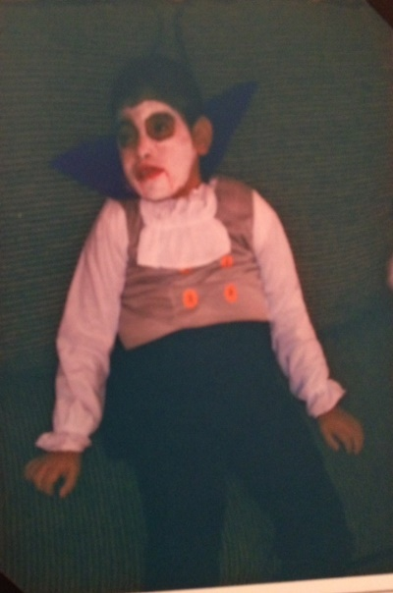
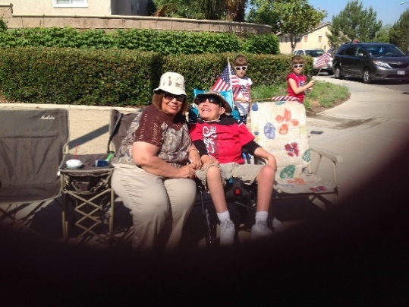
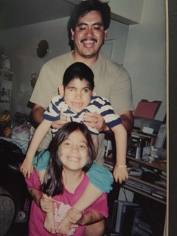
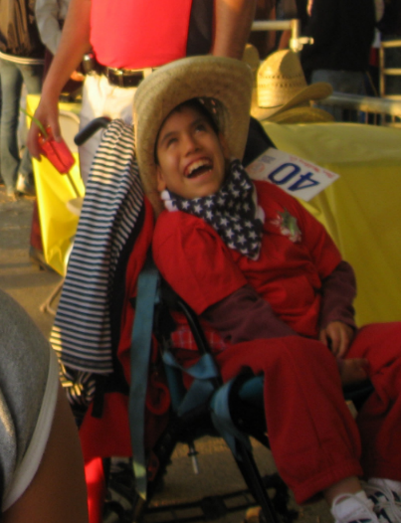
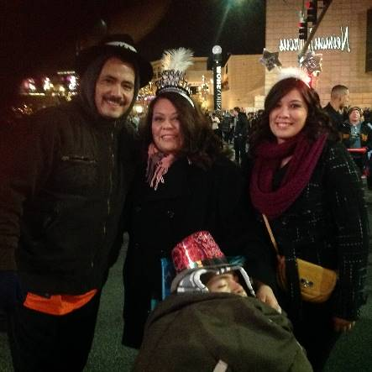
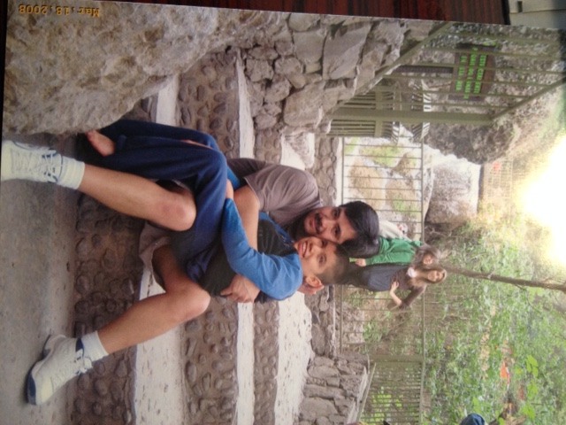
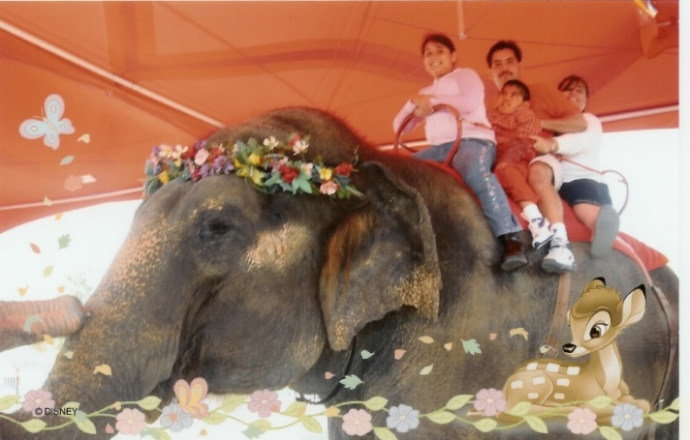
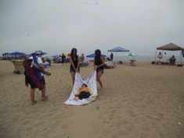
“Live day by day and enjoy life”

Slide 12
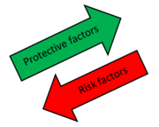
Influencing factors throughout this journey
Medical issues
Special needs/challenges
Social integration
Anxieties and fears and the stress of separation and even death
Cultural beliefs and family dynamics
Protector instincts
Child’s adulthood

Slide 13
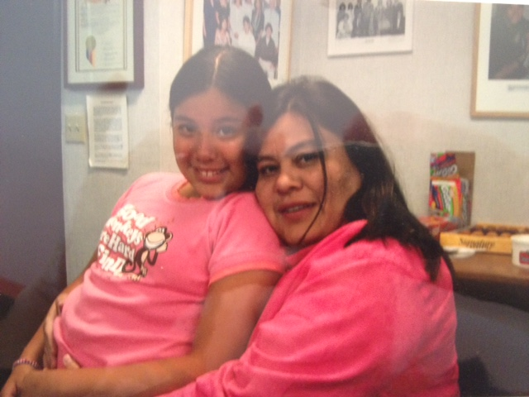
Predictable issues for families of children with special needs
Adjustment
  New roles and responsibilities of family members
  Constraints on family activities
  Siblings
  Financial issues
  Socialization
  Inclusion

Slide 14

Coping: Moving Forward
Family Support
  Immediate family
  Extended family
  Friends
Spiritual Support
  Church, meditation/quiet time
Professional Support
  Doctors, teachers, service providers (child’s new family)
Psychological Support
  Recognize your own feelings, anxieties, fears, and desires
  Allow yourself to grieve fully; do not be afraid to show emotions
  Attend support groups
  Take one day at a time

Slide 15
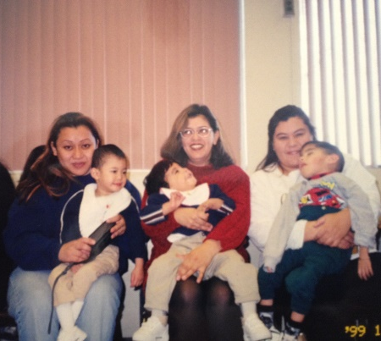
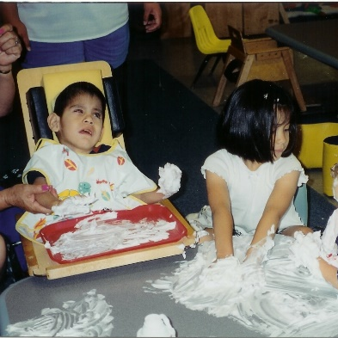
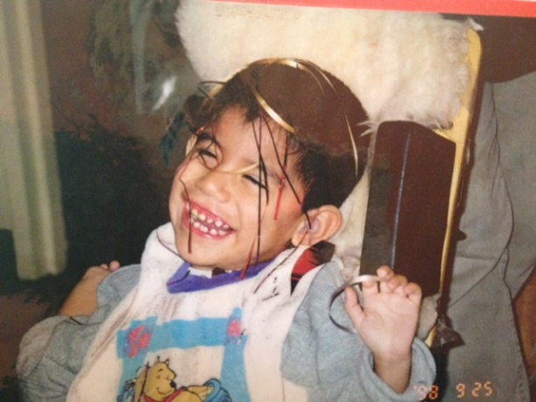
The journey continues:
Early intervention
Navigating the system
  Services
Characteristics
  Family oriented
  Parental involvement
  Welcoming environment
  Support system

Slide 16

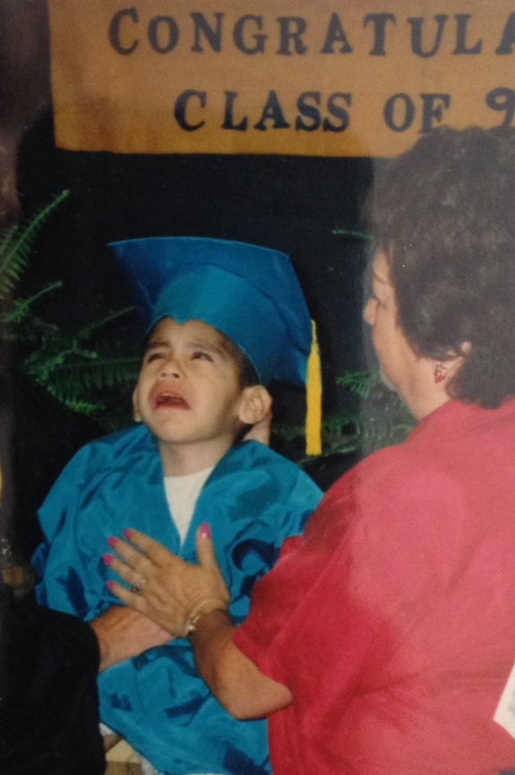

Transition to school system
Scary process
Reminder of child’s challenges
Knowing the law
Student’s focus

Slide 17
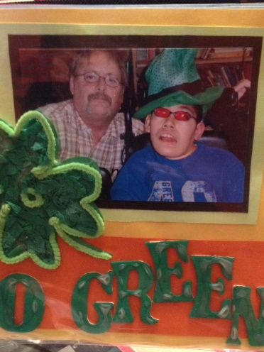
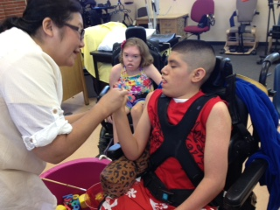
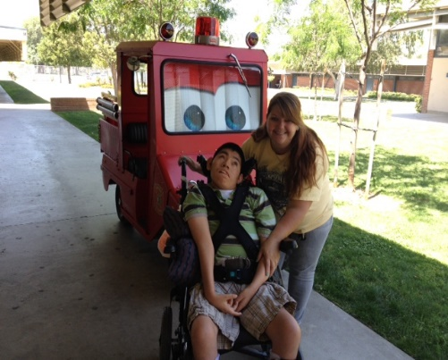
Is there a perfect world/ program?
Finding the perfect program
Finding the perfect teacher
Finding the right services/supports
Parent involvement
Conflict resolution
Advocacy

Slide 18


And the journey continues:
Transition to adult life
Again . . .
Challenges
Emotions
Supports
Expectations

Slide 19


A note to professionals!!! (1 of 2)
Every family is unique
  Composition
  Culture
  Lifestyle
Different types of boundaries
  Rigid and flexible
Family members fulfill a variety of functions to help
Family members experience grief at different stages & intensity

Slide 20

A note to professionals!!! (2 of 2)
Parents need to be viewed as capable parents
They need assurance they will receive current and accurate information
They need guidance
Keep in mind parents might have been influenced by good or bad past experiences
Parents of children with special needs experience higher levels of stress

Slide 21
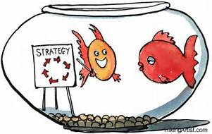
Tips for Parents and Professionals
Building positive collaboration

Slide 22

Support strategies for service providers
Be friendly
Understand the family’s situation
Connect or provide the family with information about other families in similar situations
Invite the family to participate in family support groups, workshops and trainings.

Slide 23
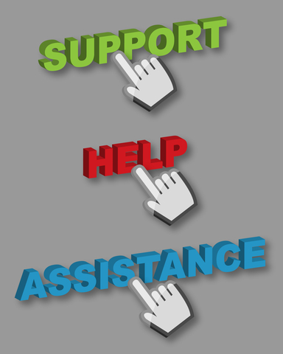
More support strategies for service providers
Be a good, effective listener to what parents have to say
Promote communication/collaboration
Provide family with guidance and information regarding specific issues
Be sensitive and respectful of family’s beliefs and culture
Avoid getting overly involved
Build rapport

Slide 24


Helpful tips for parents
Be a parent. . .
Understand your parental responsibilities
  KNOW YOUR CHILD
    Diagnosis
    Medical needs
    Educational needs
    Strengths and weaknesses
    Likes and dislikes, etc. . .
  UNDERSTAND YOUR OWN PERSONAL NEEDS
    Emotional and health needs
    Financial needs
    Family needs

Slide 25


More helpful tips for parents
  TAKE AN ACTIVE ROLE IN YOUR CHILD’S EDUCATION
  (equal partner)
    Be prepared
    Be informed
    Be available
    Ask questions
    Expect answers
  PROMOTE COLLABORATION AND COMMUNICATION
    Decision making
    Provide important information (child’s history, expectations, concerns, etc.)
    Share information (evaluations, medical reports, etc.)

Slide 26

And more helpful tips for parents
Open and maintain lines of communication via. . .
  Email
  Telephone calls
  Text
  Daily journal
  In person
Get to know your child’s team, their roles and responsibilities

Slide 27

Parent don’ts
Don’t. . .
lose your focus on “your child”
forget your priorities
let anyone decide for you
forget about your other needs
forget to be “you”
Don’t forget to be a parent!!!!!

Slide 28
A family story
“Never underestimate the power of a story. A well-told story has the potential to touch hearts and change minds. While impersonally delivered facts can easily be forgotten or dismissed, a story lingers and mingles with the other stories that shape our shared human experience.”

Slide 29
Words of wisdom
“No one brings to the table the same experiences or thoughts. They are unique and it is necessary to share them, so others can begin to understand or have another reference point. There won’t always be agreement, but better understanding. A new way of thinking about something can be powerful and may change things for the next person.”
- Kara, parent

Slide 30
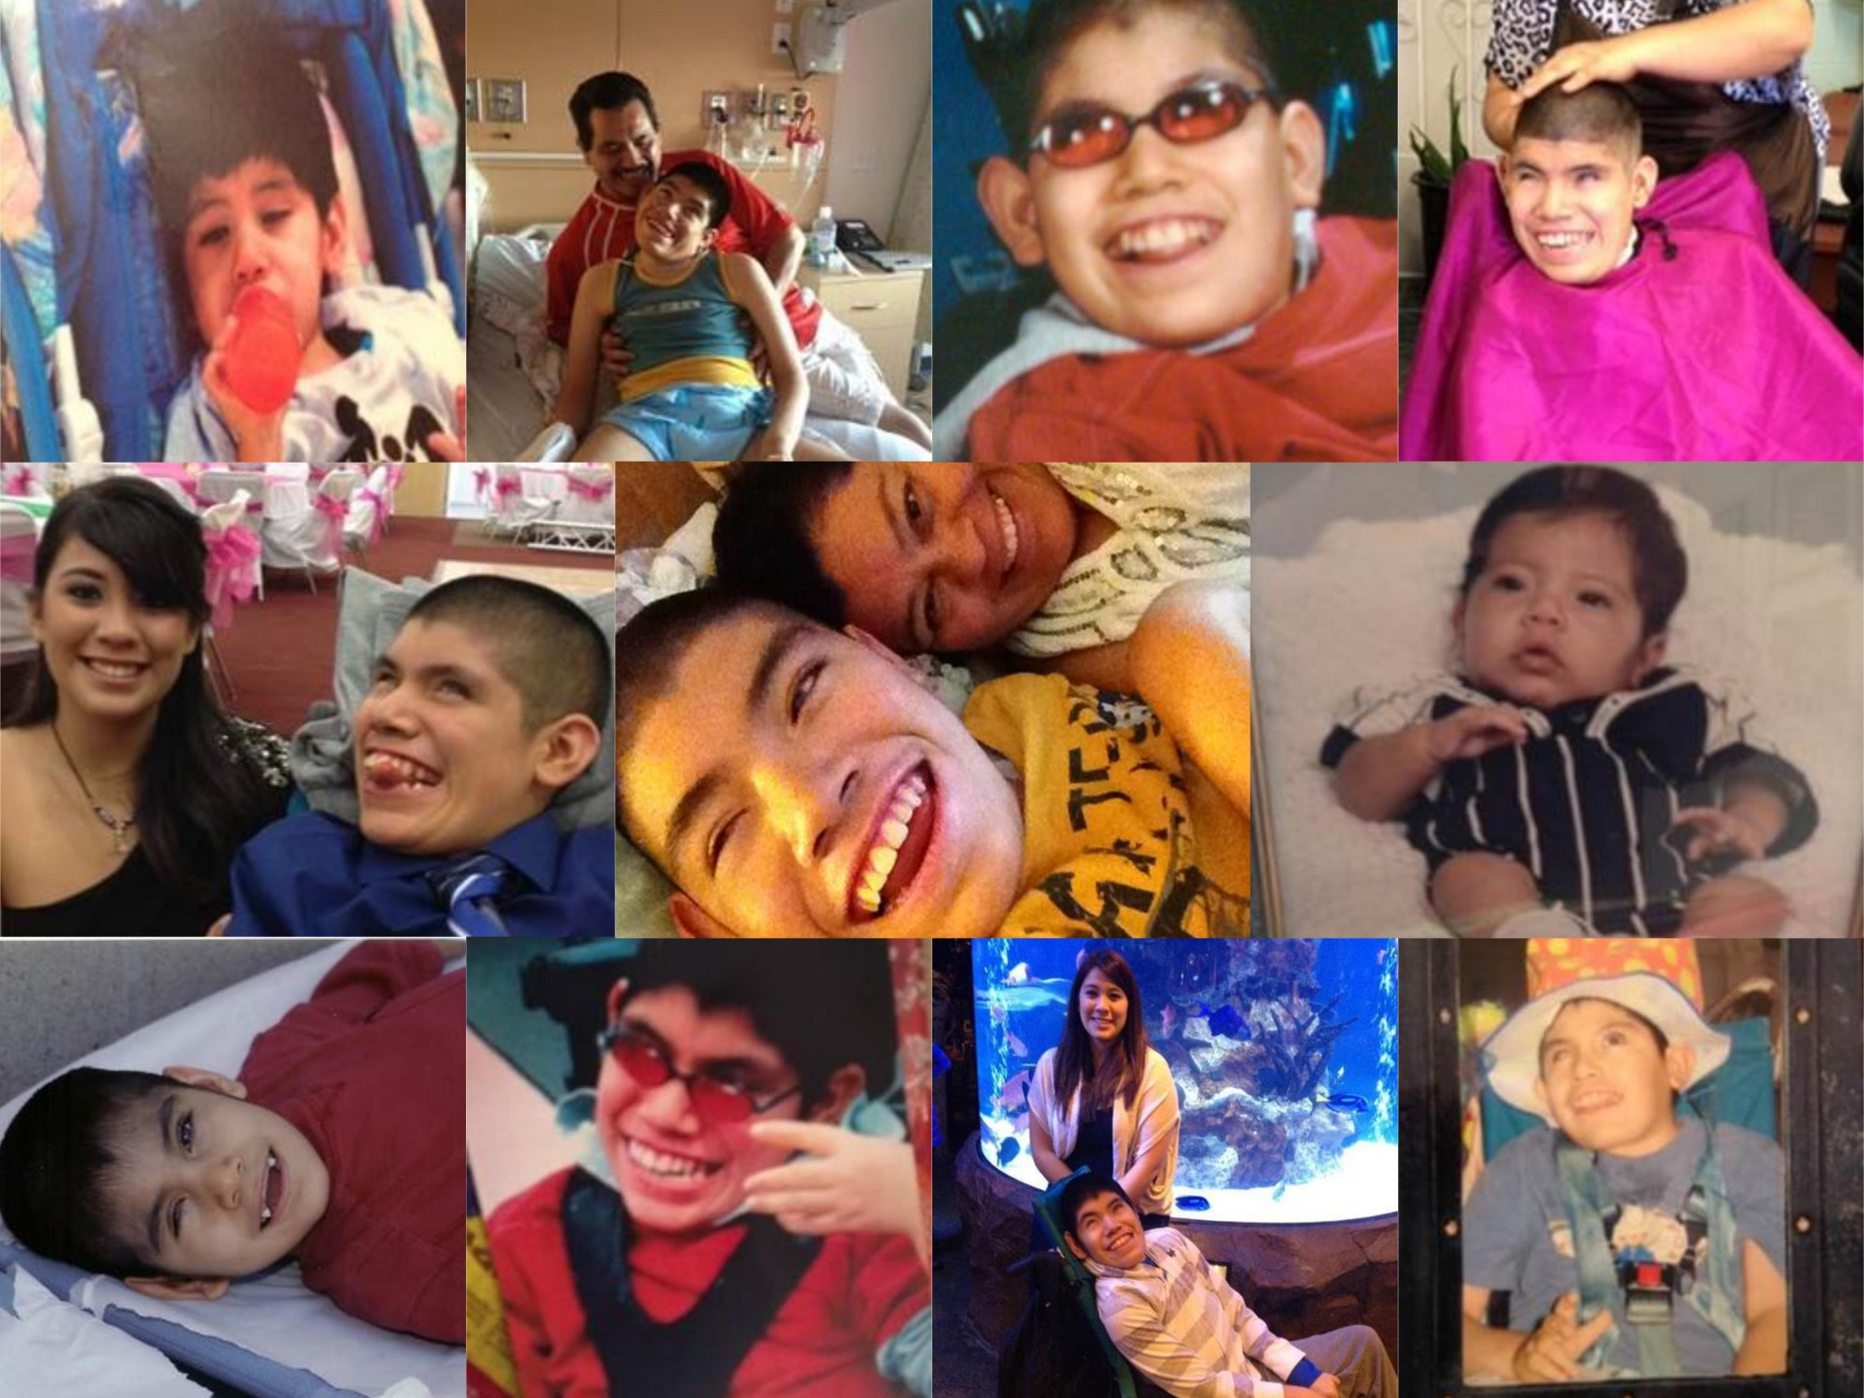
Photo montage

Slide 31
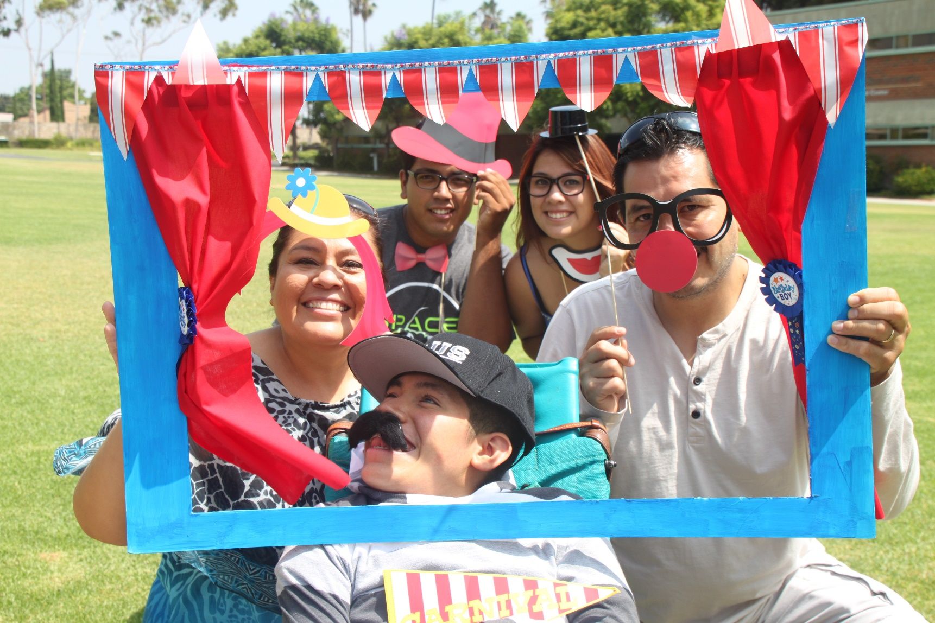
At the end, it has been a wonderful, learning Journey!!!

Slide 32
Thank You!
Online Evaluation
http://sgiz.mobi/s3/a-parent-s-story-webinar-evaluation

