Slide 1
Drivers Ed:
Decision Support Data Systems
(DSDS)
Notes:
Welcome to Drivers Ed: Decision Support Data Systems. The Drivers Ed series provides a quick overview of each Active Implementation Driver along with best practices and an opportunity to take the driver for a test drive.

Slide 2
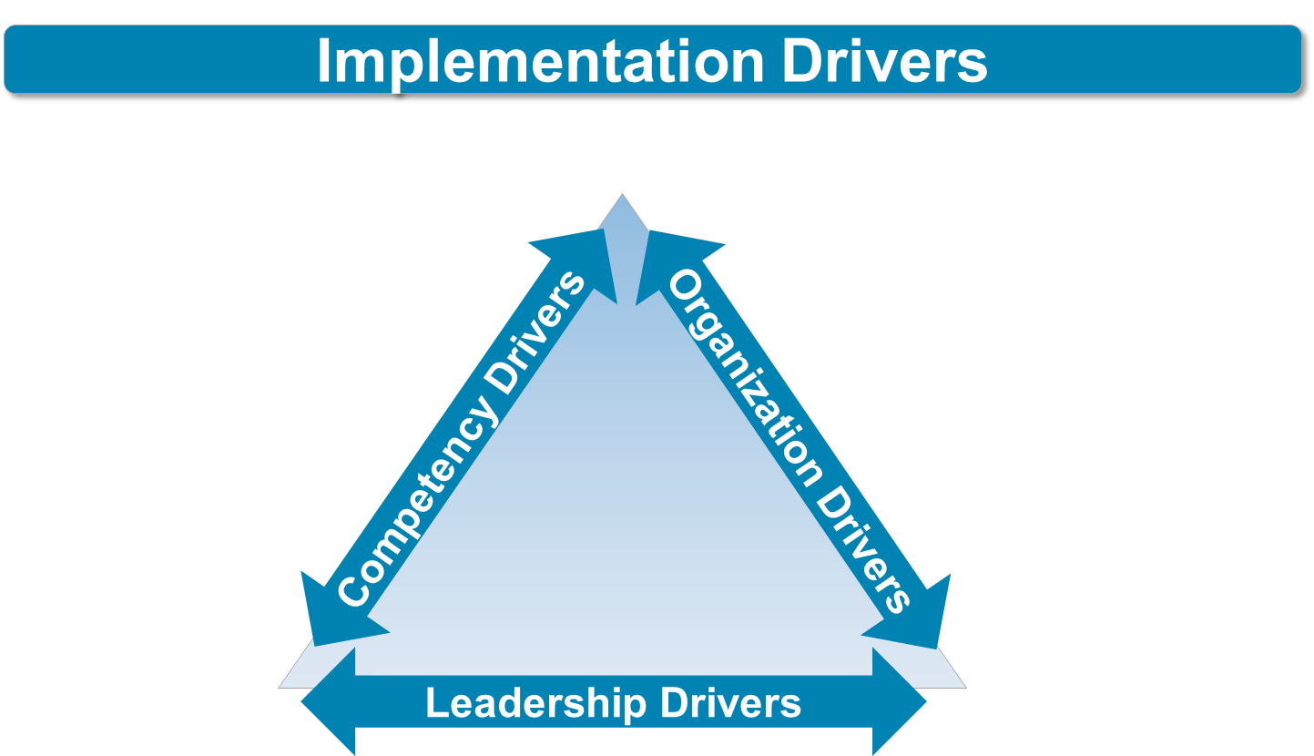
Systems
Intervention
Facilitative
Administration
Decision Support
Data System
Notes:
Implementation Drivers are key components of capacity and infrastructure that influence a program’s success. They are the core components needed to initiate and support change. There are three types of Implementation Drivers: Competency Drivers, Organization Drivers, and Leadership Drivers. Organization Drivers are the organizational components necessary to create and support new ways of work. Organization Drivers include: Decision Support Data Systems, Facilitative Administration, and Systems Intervention.
In this short lesson we’ll provide an overview of Decision Support Data Systems, and then give you an opportunity to apply the concepts presented.
2

Slide 3
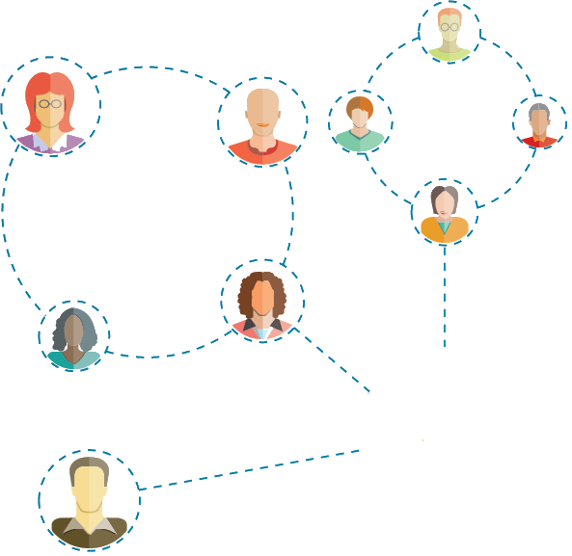




identifying
collecting
analyzing
DECISION SUPPORT DATA SYSTEM
☑
☒
?
☑
Notes:
What is a DSDS?
A Decision Support Data System (DSDS) is a system for identifying, collecting, and analyzing data for decision-making by program administrators and practitioners. These systems allow teams to detect, prevent, and address barriers to implementation. DSDS also communicate program impact and challenges to staff, stakeholders, and funders.

Slide 4
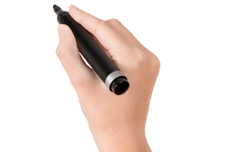
1) Fidelity data
2) Outcome data
3) Programmatic data
Getting Started
Types of DSDS Data
Notes:
Decision Support Data Systems (DSDS) enable agencies and organizations to make informed and intentional decisions about implementation.
Decision Support Data Systems (DSDS) gather fidelity data, outcome data, and programmatic data. Let’s discuss each type of data.

Slide 5
process data
1) Fidelity data are
Content
Competence
Context
Is the practitioner following the guidelines of the program?
Are the prerequisites and conditions for the program to operate are met?
Is the practitioner demonstrating the skill?
Notes:
Fidelity data are process data. Fidelity data measure content, competence and context.
Content data measures whether a practitioner is following the guidelines of the program. For example, compliance to model standards like the number of lessons in a curriculum. The organization uses this data to guide changes in the selection, training and coaching of staff.
Competence data measures the extent to which the practitioner demonstrates skill in the delivery of services. For example, whether a teacher demonstrates the ability to monitor student learning and provide feedback.
And finally, Context data measures the extent to which the prerequisites and conditions for the program to operate are met (for example, if the program must be delivered in a home setting).
We need fidelity data to help us know if the innovation is being implemented as intended.

Slide 6





2) Outcome data are
results data
Measures of the impacts of the innovation
Innovation
Outcome Data
Outcome Data
Literacy Scores
Parenting Skills
Notes:
Outcome data are results data. They are measures of impacts of the innovation. For example, are children’s literacy scores improving after children receive the innovation? Are parents demonstrating stronger parenting skills after participating in the program? We need outcome data to know if we are producing results, and if so, how much or how little.

Slide 7

3) Programmatic data are
administrative data
Notes:
Finally, programmatic data are relevant to administration of the program. For example, numbers related to staffing or budgeting for the program.

Slide 8
identifying
collecting
analyzing
Fidelity data
Diagnose issues -
understand if there is a process or performance issue, or an issue with the program and its fit.
Outcome data
Programmatic data
Action Planning
Notes:
Programs need all of these types of data. Likewise, DSDS data and information need to be reliable, valid, and timely, as well as actionable. We use the data to diagnose issues that emerge during implementation, and understand if there is a process or performance issue, or an issue with the program and its fit. We call this action planning.

Slide 9




DECISION SUPPORT DATA SYSTEM
Policy Makers
State Leadership
Administrators
Building/District
Administrators
Action Plan
Practitioners
Teachers
Notes:
A functional DSDS uses data for implementation action planning, not just reporting to funders or legislators.
To be useful, data need to be collected, analyzed, and reported over time. In addition, to support decision making throughout the organization, DSDS reports and access should be made available at multiple levels in the organization.
For example, in education:
Teachers could access data to monitor student progress, make educational decisions, and to see how their own practices are improving through the fidelity assessment lens.
Administrators could look across building level, grade level or curriculum area data to detect systemic issues that need to be broadly addressed.
Leadership teams could identify masterful teachers who can support their colleagues by demonstrating excellence in instructional practices.

Slide 10
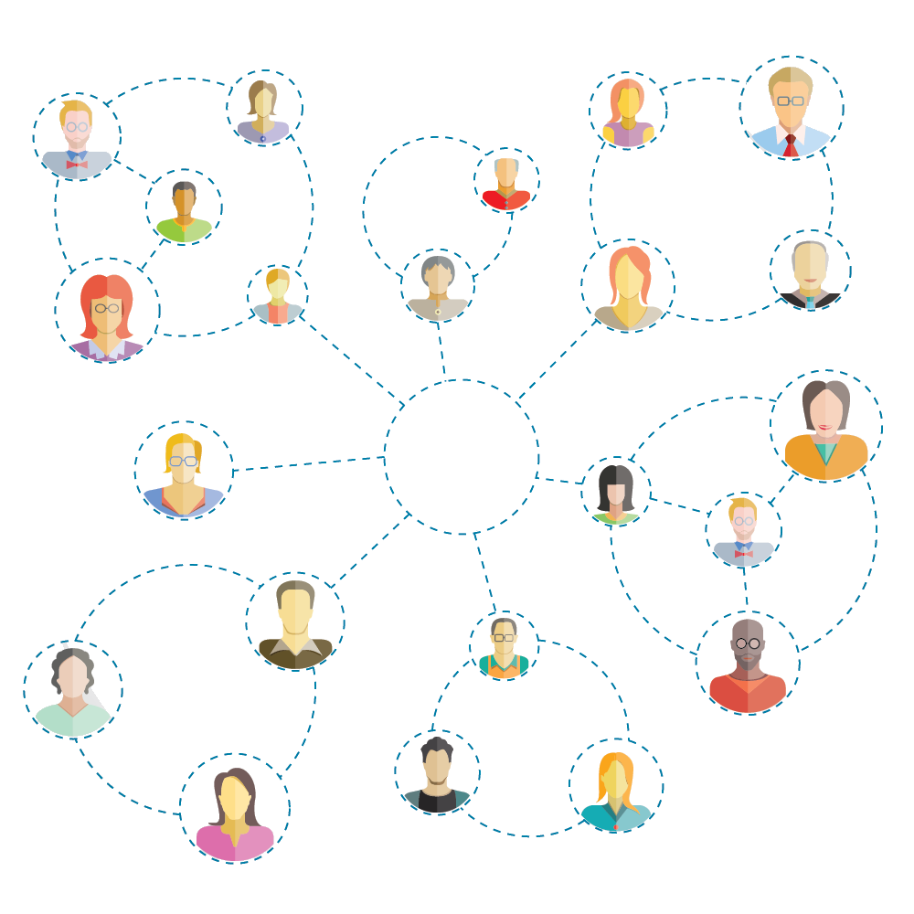



Notes:
So, you can see, in addition to identifying challenges, DSDS also identify what is working well. Data are used to celebrate strengths and successes in the program with staff, community stakeholders and funders. These data are also used to operationalize that success across the system.
For example, in one community, a health services home visiting program’s data demonstrated significant reductions in preterm birth for enrolled participants. The home visiting program shared this information with staff, stakeholders and their funder to demonstrate the program’s impact and affirm the team’s hard work. Sharing data to promote a program’s success can build internal program buy-in, as well as external stakeholder commitment.

Slide 11
Quick Reflection
How does your organization currently use data to drive decision-making?
What type of data do you review? Who reviews this data and how often?
Are the data and information useful? Does it assist with decision making?
Continue >
Notes:
So how do we get started with a new or improved Decision Support Data System?
Before we get into details, consider a few questions about how you currently use data to make decisions in your organization.
How does your organization currently use data to drive decision-making?
What type of data do you review? Who reviews this data and how often?
Are the data and information useful? Does it assist with decision making?
Reflect on these questions for minute, then click the continue button.

Slide 12
Making it Happen
DSDS Best Practices
Notes:
Now let’s take a look at three simple steps to help your decision support data system get started, and get better.

Slide 13






Making It Happen
DSDS Best Practices
Step 1: Develop the DSDS
  Ensure there is someone accountable for the DSDS, and they are supported.
  Build DSDS use into the organization.
Notes:
Step 1: Develop the DSDS
First, ensure there is someone accountable for the DSDS, and that they are supported.
To get started, ensure a person or team is accountable for coordinating the content, quality, and timeliness of the data system to support implementation decisions. This person/team must have adequate resources to develop, deploy and manage the DSDS, like sufficient time and access to key stakeholders.
Next, build DSDS use into the organization.
Ensure the DSDS data are useful, reliable, valid, and reported in a timely manner. DSDS data and information are collected systematically and prepared for use so that they are accurate, relevant, and accessible. Data collection and use should be built into regular practice routines.

Slide 14

Making It Happen
DSDS Best Practices
Step 1: Develop the DSDS
  Ensure there is someone accountable for the DSDS, and they are supported.
  Build DSDS use into the organization.
TIPS
Determine what questions and decisions need to be answered.
Identify what data will help to answer the questions.
Determine the simplest way to get the data.
Develop systems to collect the data and make the data accessible to support decision making.
Notes:
You want to be certain to gather the right data. To get started, first determine what questions and decisions need answered/supported on a regular basis. Then, identify what data will help to answer the questions and support decisions. And, determine the simplest way to get the data. Then, develop systems to collect the data and make the data accessible to support decision making.

Slide 15
Making It Happen
DSDS Best Practices
Step 1: Develop the DSDS
Step 2: Gather the Data and Improve the DSDS
TIPS
Get Organized - Organize and streamline data collection procedures as you go.
Be Iterative – If possible, build on existing systems. Then add components overtime. And, continue to improve how data are assessed.
Do Testing - Pay attention to usability. Access to data, reporting and analysis should be user-friendly. Test your DSDS with the staff who will use the system.
Keep it Simple - Continue developing simple questions and simple answers. The best data are data that are used.
Notes:
Step 2: Gather the Data and Improve the DSDS
During data collection, continue to improve the decision support data system. Here are a few tips on continuing to improve your data gathering.
Get Organized - Organize and streamline data collection procedures as you go.
Be Iterative – If possible, build on existing systems. Then add components overtime. And, continue to improve how data are assessed.
Do Testing - Pay attention to usability. Access to data, reporting and analysis should be user-friendly. Test your DSDS with the staff who will use the system.
Keep it Simple - Continue developing simple questions and simple answers. The best data are data that are used.

Slide 16

Making It Happen
DSDS Best Practices
Step 1: Develop the DSDS
Step 2: Gather the Data and Improve the DSDS
Step 3: Use the Data
•Summarizing
•Communicating
•Sharing
•Analyzing and action planning
Notes:
Step 3: Use the Data
It may sound obvious. But the last step is to actually use DSDS data for decision-making.
Data for decision making process includes:
Summarizing the data (e.g., quarterly at a minimum);
Communicating data summaries clearly in reports to staff;
Sharing data summaries with key stakeholders; and
Analyzing the data and developing action plans to improve program implementation.

Slide 17
Look
What data are we looking at today?
What are the data telling us?
How might we need to adjust or pivot our strategy based on this data?
How will we know these adjustments had the intended effect or benefit?
Who will be responsible for making this adjustment and in what timeframe?
Think
Act
Action Plan
Continue >
Notes:
Again, DSDS data should be actionable. When analyzing data and doing action planning here are 5 questions to guide your decision making process. We also need to identify who will be responsible for making the improvements and in what timeframe.
Review the questions here, then press continue.
What data are we looking at today?
What are the data telling us?
How might we need to adjust or pivot our strategy based on this data?
How will we know these adjustments had the intended effect or benefit?
Who will be responsible for making this adjustment and in what timeframe?

Slide 18

Next Up
Apply It Now
Goto Simulation
Skip Simulation
The Active Implementation Hub, AI Modules and AI Lessons are an initiative of the
State Implementation & Scaling-up of Evidence-based Practices Center (SISEP) and
The National Implementation Research Network (NIRN) located at
The University of North Carolina at Chapel Hill’s FPG Child Development Institute.
http://implementation.fpg.unc.edu
Notes:
So, there you have a quick overview of decision support data systems, as well as some guidance on starting and improving a DSDS.
This concludes the narrated portion of the lesson. Next, we want to give you an opportunity to apply some of the concepts outlined in this lesson.
In the next set of slides, you will be guided through a short case simulation. First you will be setting up an Action Planning meeting using data from a DSDS with a leader of a school system. Then, you will be facilitating part of an actual meeting. As you go through the simulation, select the best response possible to the options provided. Once done, we’ll offer links to a best DSDS practice handout, as well a few additional resources to assist you in your DSDS initiative.

Slide 19


Before: branch1
You are having a phone conversation to set an action planning session with the District leader. Select the best response:
BEFORE THE
ACTION PLANNING
SESSSION
“Who all is needed for the planning session?”
a) “Please schedule it with your district leadership team.”
b) “Please schedule it with your district implementation team.”
c) “We need individuals who are knowledgeable about the current uses of innovations and supports for innovations in schools in the district, including representatives of district leadership”
Notes:
You are having a phone conversation to set up an action planning session with the District leader and he/she asks,
“Who all is needed for the planning session?”
Select the best response
“Please schedule it with your district leadership team.“
“Please schedule it with your district implementation team.”
“We need individuals who are knowledgeable about the current uses of innovations and supports for innovations in schools in the district, including representatives of district leadership.

Slide 20

Before: branch1a
a) “Please schedule it with your district leadership team.”
b) “Please schedule it with your district implementation team.”
c) “We need individuals who are knowledgeable about the current uses of innovations and supports for innovations in schools in the district, including representatives of district leadership”
BEFORE THE
ACTION PLANNING
SESSSION
Close.
You want to ensure that individuals knowledgeable about the current uses of and supports for innovations in schools are the respondents.
Try Again
Notes:
<option b, “Please schedule it with your district leadership team.“ is highlighted>
Close.
You want to ensure that individuals knowledgeable about the current uses of and supports for innovations in schools are the respondents.
Try again.

Slide 21
Before: branch1b
a) “Please schedule it with your district leadership team.”
b) “Please schedule it with your district implementation team.”
c) “We need individuals who are knowledgeable about the current uses of innovations and supports for innovations in schools in the district, including representatives of district leadership”
BEFORE THE
ACTION PLANNING
SESSSION
Close.
It is also important to note that representatives from district leadership are needed.
Try Again
Notes:
<option a, “Please schedule it with your district implementation team.” is highlighted>
It is also important to note that representatives from district leadership are needed.
Try again.

Slide 22

Before: branch1c
a) “Please schedule it with your district leadership team.”
b) “Please schedule it with your district implementation team.”
c) “We need individuals who are knowledgeable about the current uses of innovations and supports for innovations in schools in the district, including representatives of district leadership”
BEFORE THE
ACTION PLANNING
SESSSION
Yes.
Good job emphasizing the need of individuals who are knowledgeable about
the current uses of and supports for innovations in schools.
Continue
Notes:
<option c, “c) “We need individuals who are knowledgeable about the current uses of innovations and supports for innovations in schools in the district, including representatives of district leadership.” is highlighted>
Yes. Good job emphasizing the need of individuals who are knowledgeable about the current uses of and supports for innovations in schools.
Continue.

Slide 23
Before: branch2
The District leader continues.
Select the best response:
BEFORE THE
ACTION PLANNING
SESSSION
“Do I need to prepare anything for this meeting?”
a) “Yes, please do so.”
b) “No. No preparation is necessary.”
c) “Yes, we will need information from the Decision Support Data System that your school system uses. We will want to consider fidelity data related to the program, any data available about student outcomes, and implementation data.
Notes:
The District leader continues. Select the best response:
“Do I need to prepare anything for this meeting?”
“Yes, please do so.”
“No. No preparation is necessary.”
c) “Yes, we will need information from the Decision Support Data System that your school system uses. We will want to consider fidelity data related to the program, any data available about student outcomes, and implementation data.”

Slide 24
Before: branch2a
a) “Yes, please do so.”
b) “No. No preparation is necessary.”
c) “Yes, we will need information from the Decision Support Data System that your school system uses. We will want to consider fidelity data related to the program, any data available about student outcomes, and implementation data.
BEFORE THE
ACTION PLANNING
SESSSION
Close.
It is important to say that data will be needed for action planning. More guidance about what to prepare will be helpful.
Try Again
Notes:
< option a, ““Yes, please do so.”“ is highlighted>
Close. It is important to say that data will be needed for action planning. More guidance about what to prepare will be helpful.
Try again.

Slide 25
Before: branch2b
a) “Yes, please do so.”
b) “No. No preparation is necessary.”
c) “Yes, we will need information from the Decision Support Data System that your school system uses. We will want to consider fidelity data related to the program, any data available about student outcomes, and implementation data.
BEFORE THE
ACTION PLANNING
SESSSION
Close.
Action Planning cannot take place without data to inform decisions. Data from the DSDS is needed for this school system to participate in action planning.
Try Again
Notes:
< option b, “No. No preparation is necessary.” is highlighted>
Close. Action Planning cannot take place without data to inform decisions. Data from the DSDS is needed for this school system to participate in action planning.
Try again.

Slide 26
Before: branch2c
a) “Yes, please do so.”
b) “No. No preparation is necessary.”
c) “Yes, we will need information from the Decision Support Data System that your school system uses. We will want to consider fidelity data related to the program, any data available about student outcomes, and implementation data.”
BEFORE THE
ACTION PLANNING
SESSSION
Good job.
Data from the DSDS is needed for this school system to participate in action planning. Action planning cannot take place without data to inform decisions.
Continue
Notes:
< option c, “Yes, we will need information from the Decision Support Data System that your school system uses. We will want to consider fidelity data related to the program, any data available about student outcomes, and implementation data.” is highlighted>
Good job. Data from the DSDS is needed for this school system to participate in action planning. Action planning cannot take place without data to inform decisions.
Continue.

Slide 27
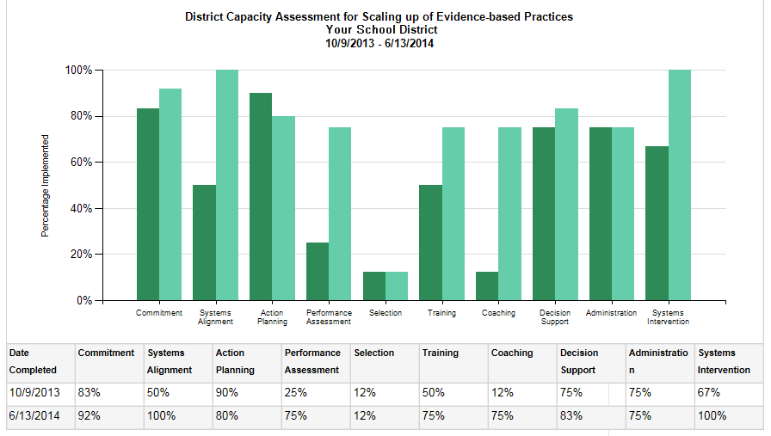

Wrapup: branch1p2
You are now in the Action Planning session and facilitating the data analysis and decision making process. Select the best response:
DURING THE
ACTION PLANNING
SESSSION
“Thank you for joining today. Let’s take a look at our current data
and put some action planning together.
a) “Great results, as you can see on this graph.”
b) “Note some of the strengths seen in the data; for example, the DSDS
subscale. What are areas of opportunity for action planning?”
c) “Let’s first look for areas of weaknesses.”
Notes:
You are now in the Action Planning session and facilitating the data analysis and decision making process.
Select the best response:
“Thank you for joining today. Let’s take a look at our current data and put some action planning together.”
a) “Great results, as you can see on this graph.”
b) “Note some of the strengths seen in the data; for example, the DSDS subscale. What are areas of opportunity for action planning?”
“Let’s first look for areas of weaknesses.”

Slide 28
Wrapup: branch1p2a
DURING THE
ACTION PLANNING
SESSSION
a) “Great results, as you can see on this graph.”
b) “Note some of the strengths seen in the data; for example, the DSDS subscale. What are areas of opportunity for action planning?”
c) “Let’s first look for areas of weaknesses.”
Almost.
General praise is recommended first, followed by specific behavioral descriptions.
Try Again
Notes:
<option a, “Great results, as you can see on this graph.” is highlighted>
Almost.
General praise is recommended first, followed by specific behavioral descriptions.
Try again.

Slide 29
Wrapup: branch1p2b
DURING THE
ACTION PLANNING
SESSSION
a) “Great results, as you can see on this graph.”
b) “Note some of the strengths seen in the data; for example, the DSDS subscale. What are areas of opportunity for action planning?”
c) “Let’s first look for areas of weaknesses.”
Good.
You provided general and specific praise, and at the same time
moved the group to action planning in a positive manner.
Continue
Notes:
<option b, “Note some of the strengths seen in the data; for example, the DSDS subscale. What are areas of opportunity for action planning?” is highlighted>
Good.
You provided general and specific praise, and at the same time
moved the group to action planning in a positive manner.
Continue.

Slide 30
Wrapup: branch1p2c
DURING THE
ACTION PLANNING
SESSSION
a) “Great results, as you can see on this graph.”
b) “Note some of the strengths seen in the data; for example, the DSDS subscale. What are areas of opportunity for action planning?”
c) “Let’s first look for areas of weaknesses.”
Oops.
General praise is recommended first, followed by specific behavioral descriptions.
Try Again
Notes:
<option c, “Let’s first look for areas of weaknesses.” is highlighted>
Oops. General praise is recommended first, followed by specific behavioral descriptions.
Try again.

Slide 31
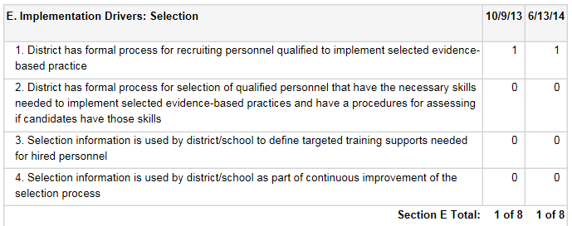





Wrapup: branch2
Additional results are displayed from ‘Selection’.”
DURING THE
ACTION PLANNING
SESSSION
Continue
“In looking at this data and thinking about our work, I recommend that we start with some action planning around our selection practices.”
“I agree. It’s a good place to start.”
Notes:
Additional results are displayed from “Selection.”
<screen shot>
<Team member 5>
“In looking at this data and thinking about our work, I recommend that we start with some action planning around our selection practices.”
<Team member 1>
“I agree. Its good place to start.”
<the other Team members give affirming expressions>
Continue.

Slide 32
Wrapup: branch2p2
Select the best response:
DURING THE
ACTION PLANNING
SESSSION
“In looking at this data and thinking about our work, I recommend that we start with some action planning around our selection practices.”
“I agree. It’s a good place to start.”
a) “OK. I am hearing that Selection is an area for some action planning. What are some right next steps? Looking at our notes, we identified...”
b) “Are there other areas you would also identify for action planning?”
c) “Great. Thanks for identifying that area and thanks for coming today. Let’s follow-up after the meeting via email.”
Notes:
Select the best response.
a) “Ok. I am hearing that Selection is an area for some action planning. What are some right next steps? Looking at our notes, we identified……”
b) “Are there other areas you would also identify for action planning?”
c) “Great. Thanks for identifying that area and thanks for coming today. Let’s follow-up after the meeting via email.”

Slide 33
Wrapup: branch2a
DURING THE
ACTION PLANNING
SESSSION
a) “OK. I am hearing that Selection is an area for some action planning. What are some right next steps? Looking at our notes, we identified...”
b) “Are there other areas you would also identify for action planning?”
c) “Great. Thanks for identifying that area and thanks for coming today. Let’s follow-up after the meeting via email.”
Fantastic.
Identifying items and moving into action planning
is the ultimate goal of a DSDS planning session.
Continue
So, you want to guide the team to decision making. Again, here are 7 questions to guide your process. These are in the lesson handout as well.
1. What does “it” look like now?
2. Are we satisfied with how “it” looks?
3. What would we like “it” to look like?
4. What would we need to do to make “it” look like that?
5. How would we know if we’ve been successful with “it”?
6. What can we do to keep “it” like that?
7. What can we do to make “it” more efficient & durable?
(Sugai, 2004)
Notes:
<option a, “Ok. I am hearing that Selection is an area for some action planning. What are some right next steps? Looking at our notes, we identified……” is highlighted>
Fantastic.
Identifying items and moving into action planning is the ultimate goal of a DSDS planning session.
So, you want to guide the team to decision making. Again, here are 7 questions to guide your process. These are in the lesson handout as well.
1. What does “it” look like now?
2. Are we satisfied with how “it” looks?
3. What would we like “it” to look like?
4. What would we need to do to make “it” look like that?
5. How would we know if we’ve been successful with “it”?
6. What can we do to keep “it” like that?
7. What can we do to make “it” more efficient & durable?
(Sugai, 2004)
Continue.

Slide 34
Wrapup: branch2b
a) “OK. I am hearing that Selection is an area for some action planning. What are some right next steps? Looking at our notes, we identified...”
b) “Are there other areas you would also identify for action planning?”
c) “Great. Thanks for identifying that area and thanks for coming today. Let’s follow-up after the meeting via email.”
DURING THE
ACTION PLANNING
SESSSION
Almost.
You want the team to identify several areas for action planning, but also need to get the specifics for the area identified (such as the selection here).
Try Again
Notes:
<option b, “Are there other areas you would also identify for action planning?” is highlighted>
Almost. You want the team to identify several areas for action planning, but also need to get the specifics of what for the area identified (such as selection here).
Try again.

Slide 35
Wrapup: branch2c
a) “OK. I am hearing that Selection is an area for some action planning. What are some right next steps? Looking at our notes, we identified...”
b) “Are there other areas you would also identify for action planning?”
c) “Great. Thanks for identifying that area and thanks for coming today. Let’s follow-up after the meeting via email.”
DURING THE
ACTION PLANNING
SESSSION
Oops!
The goal of the DSDS planning sessions is to facilitate decision making. You need to move the Team into action planning as soon as possible.
Try Again
Notes:
<option c, “Great. Thanks for identifying that area and thanks for coming today. Let’s follow-up after the meeting via email.” is highlighted>
Oops!
The goal of the DSDS planning sessions is to facilitate decision making. You need to move the Team into action planning as soon as possible.
Try again.

Slide 36

Followup
DURING THE
ACTION PLANNING
SESSSION
Almost done. Now it’s time to follow through.
Here are some reminders for following up with team members after the meeting.
DSDS Planning Sessions Follow-up Checklist
Summarize notes and observations.
Remind the team of the date set to meet for continued action planning.
Remind the team to produce an action plan.
Send data and related notes to the team/respondents no later than
5 business days after the planning session.
Finish
Notes:
Almost done. Now it’s time to follow through.
Here are some reminders for following up with team members after the meeting.
DSDS Planning Sessions Follow-up Checklist
Summarize notes and observations.
Remind the team of the date set to meet for continued action planning
Remind the team to produce an action plan.
Send data and related notes to the team/respondents no later than 5 business days after the planning session.

Slide 37
Learn More
Get Started | Get Better
Handout 28: Decision Support Data Systems | Module 2: Implementation Drivers
The Active Implementation Hub, AI Modules and AI Lessons are an initiative of the
State Implementation & Scaling-up of Evidence-based Practices Center (SISEP) and
The National Implementation Research Network (NIRN) located at
The University of North Carolina at Chapel Hill’s FPG Child Development Institute.
https://nirn.fpg.unc.edu/ai-hub
Notes:
Learn More
Get Started
Handout 28: Decision Support Data Systems
https://nirn.fpg.unc.edu/resources/handout-28-dsds
Get Better
Module 2: Implementation Drivers
https://nirn.fpg.unc.edu/module-2

