Slide 1
Accessing Grade Level General Education Curriculum
Jessica Bowman, TIES Center / National Center on Educational Outcomes (NCEO)
Liz Hartmann, CAST / TIES Center
Gail Ghere, TIES Center / NCEO

Slide 2


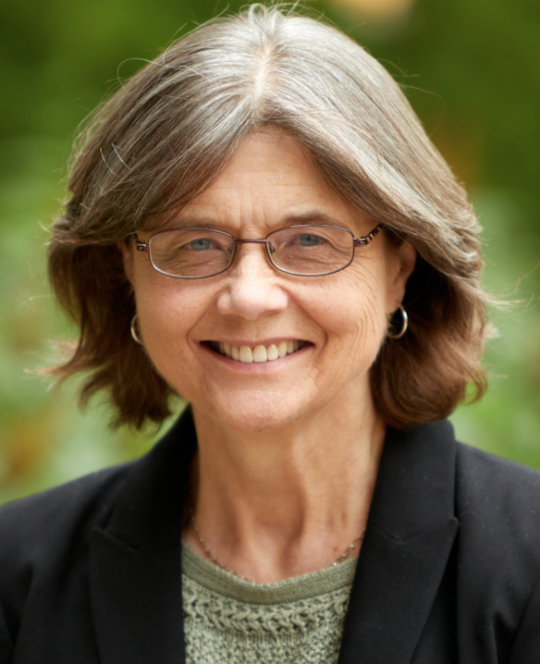
Introductions
Jessica Bowman
Liz Hartmann
Gail Ghere
National technical assistance center on inclusive practices and policies with a focus on students with significant cognitive disabilities.
tiescenter.org /nceo.info
Notes:
Chat - share your name, role, state, what you could give a 30 minute talk on with no planning

Slide 3
TIES Center -
What does TIES stand for?
Time (T)
  Increasing the number of students included in grade-level general education classrooms majority (at least 80%) of school day
Instructional Effectiveness (I)
  Collaboration across educators and specialized instructional support personnel to provide curriculum and instruction in general education classroom
Engagement (E)
Engagement
  Engagement with general education curriculum AND age-grade peers
Support (S)
Support
  Support at both state and district level and shared ethic of thinking inclusion first
Notes:
Chat - add links in chat, highlight some key points

Slide 4
Today, we will...
Discuss key components for providing access and progress in the grade-level general education curriculum, with specific application for students who are deaf-blind.
Discuss how to plan for and implement effective academic instruction both in-person and in the current environment of hybrid distance learning
Focus on collaboration with families
Discuss and share ideas

Slide 5
Laws: Access to general education standards and curriculum
IDEA ’04 (30 years of research and experience)
  IEP must include:
    present levels of academic achievement and functional performance
    Measurable academic and functional goals, enabling involvement and progress in the general education curriculum
    Special education, related services, supplementary aids and services, program modifications/supports for involvement and progress the general education curriculum
Every Student Succeeds Act (2015) includes:
  All students’ instruction aligns with grade level standards
  Alternate academic achievement standards that are aligned with the state standards
  Increase access to the general education curriculum
Notes:
Karger, Joanne, Esq. (2005). Access to the General Education Curriculum for Students with Disabilities: A Discussion of the Interrelationship between IDEA ’04 and NCLB. Wakefield, MA: National Center on Accessing the General Curriculum. Retrieved [insert date] from http://aem.cast.org/about/publications/2005/ncac-curriculum-access-idea04-nclb.html
We know this isn’t reality, but this is the direction, our intent is to put forth a vision with some specifics

Slide 6
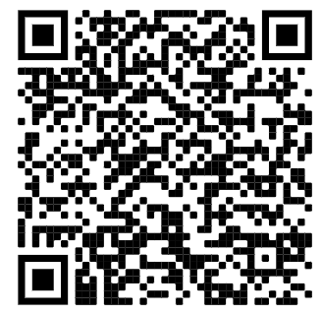
Key Principles
Students receiving special education services are general education students first.
Special education services are supplementary services.
The importance of the Least Dangerous Assumption
All students need to access and to make progress in their grade-level, general education standards
The alternate academic achievement standards (AAAS) are performance targets for the alternate assessment. They are not the “ceiling” for what students can achieve. The AAAS are not the standards used for instructional planning.
Notes:
Add link to chat

Slide 7
Grade-level academic standards
Content standards define the goals of instruction for all students in a grade, including students with the most significant cognitive disabilities and English learners (including English learners with the most significant cognitive disabilities)
Regardless of the student's disabilities and access needs, all instruction starts from the same content standards, regardless of the student's disabilities. Expectations for how much a student will master of the grade-level curriculum can be modified.

Slide 8
STOP and SHARE (1)
What connections are you making with these laws and principles to the education of learners with deaf-blindness?
Opportunities?
Challenges?
Notes:
Poll question

Slide 9
Collaboration is Essential
Access to the general education curriculum, grade-level materials, and peers
Roles of general educators, special educators, and therapists
Learners with deaf-blindness may have many members on their educational teams
Time to collaborate is limited
How can we better support collaboration, especially given the added challenges of distance or hybrid learning?

Slide 10
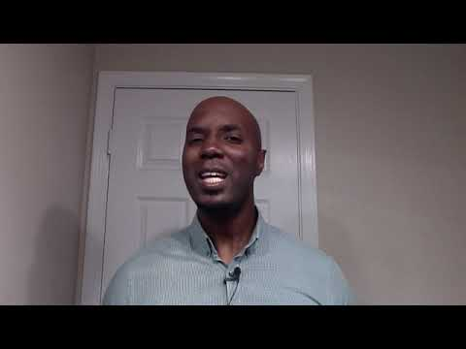
TIES 5-15-45 tool overview
Notes:
This will be our organizer
Add in video on Hansley overview
Think about one student you work with as we work through the format of the 5-15-45

Slide 11
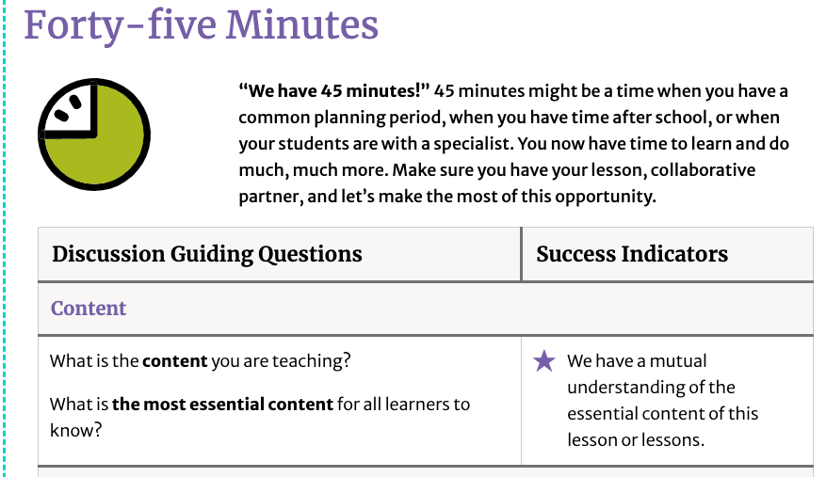
TIES 5-15-45 tool (1 of 3)
Notes:
This will be our organizer, focusing on the 45 min tab

Slide 12
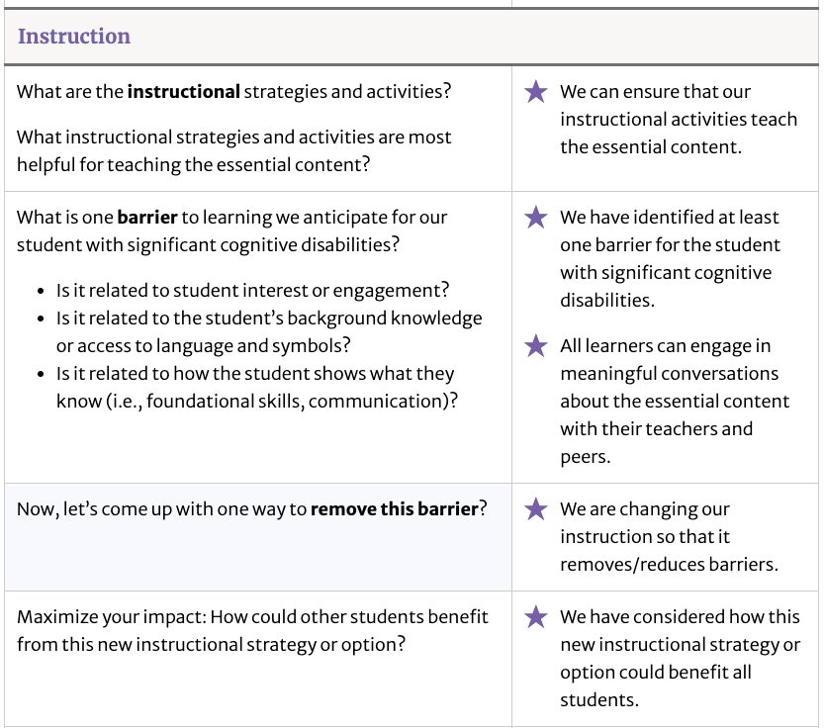
TIES 5-15-45 tool (2 of 3)

Slide 13
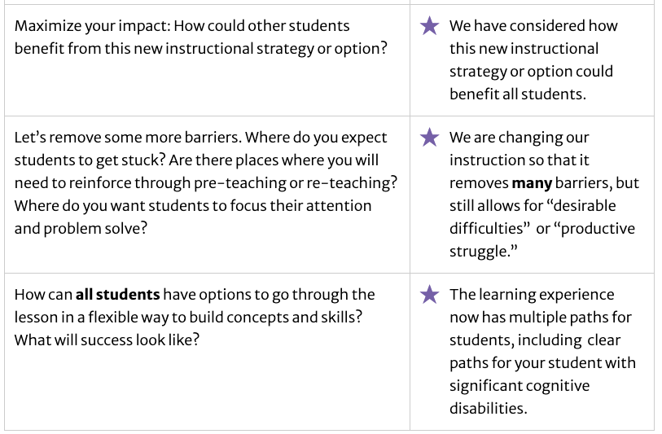
TIES 5-15-45 tool (3 of 3)

Slide 14

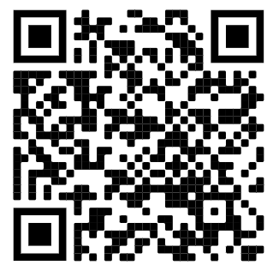
STOP and EXPLORE
Click through to the 45 minute printable
(tip: you will need to click the blue “make a copy” button)
What resonates with you?
How might you use this tool for collaboration with learners who are deaf-blind?
Notes:
Put link in the chat
Put poll up

Slide 15
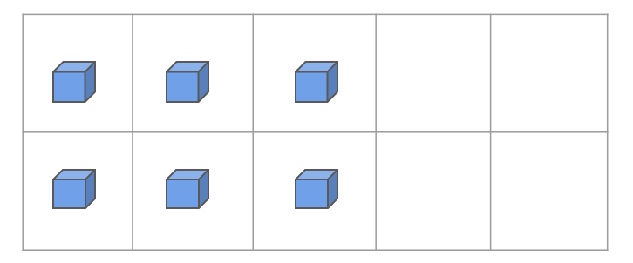
What is the content of the lesson?
2.OA.C.3 Determine whether a group of objects (up to 20) has an odd or even number of members, e.g., by pairing objects or counting them by 2s; write an equation to express an even number as a sum of two equal addends.
3 + 3 = 6
Sum of two equal addends is an even number
Pairing objects

Slide 16
Grade-level standards
Grade-level standard
2.OA.C.3: Determine whether a group of objects (up to 20) has an odd or even number of members, e.g., by pairing objects or counting them by 2s; write an equation to express an even number as a sum of two equal addends.
Alternate academic achievement standard: Equally distribute even numbers of objects between two groups.

Slide 17
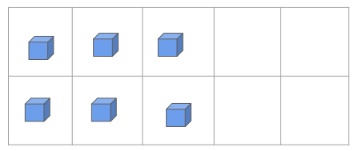
What’s the most essential content for learners to know?
Use concrete materials to model the meaning of odd and even numbers.
Know that writing an equation to express an even number as the sum of two equal addends is the same as using doubles (e.g., 4 + 4 = 8, 7 + 7 = 14).
Ability to skip count by twos.
3 + 3 = 6
Sum of two equal addends is an even number
Pairing objects
Notes:
In this example, the bolded text in the first bullet is the essential content that was identified by the general education and special education teacher for their student who has a significant cognitive disability.

Slide 18
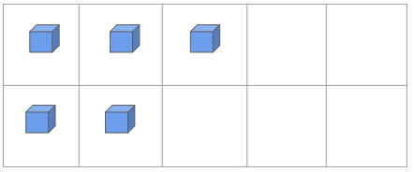
Instructional strategies
What instructional strategies and activities are most helpful for teaching the essential content?
Using models to identify numbers as even or odd
Broken calculator activity - with a partner, students investigate how to create an even number on the calculator without using any even keys (0, 2, 4, 6, 8).

Slide 19
How to provide access to standards for a student who is deaf-blind
Example student:
Rose is an active and social 2nd grader who experiences CHARGE syndrome
Core team adapting instruction for Rose:
Special education teacher
Intervener
General education teacher
Teacher of the Visually Impaired

Slide 20
STOP and SHARE (2)
What barriers to learning do you anticipate in this lesson for a student, like Rose, who is deaf-blind?
Notes:
Poll

Slide 21
Identifying barriers
What are the barriers for learning for Rose our student who is deaf-blind?
Access to mathematical concepts, representations, and language
Familiarity and skill using mathematical models and tools (calculator)
Access to peer cues and peer communication
Demonstrate knowledge in multiple means
How can we remove these barriers?

Slide 22
Removing barriers
Access to mathematical concepts, representations, and language | Familiar manipulatives, high contrast Focus on numbers 1-6
Familiarity and skill using mathematical models and tools | Pre-teach calculator skills Prioritize practice of a subset of numbers
Access to peer cues and peer communication | Smaller peer group Key vocabulary list for intervener and Rose

Slide 23
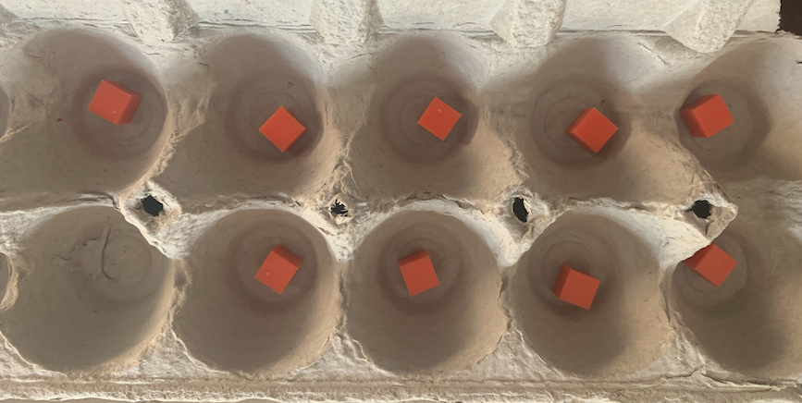
Access to mathematical concepts, representations and language (1 of 2)
9 is odd

Slide 24
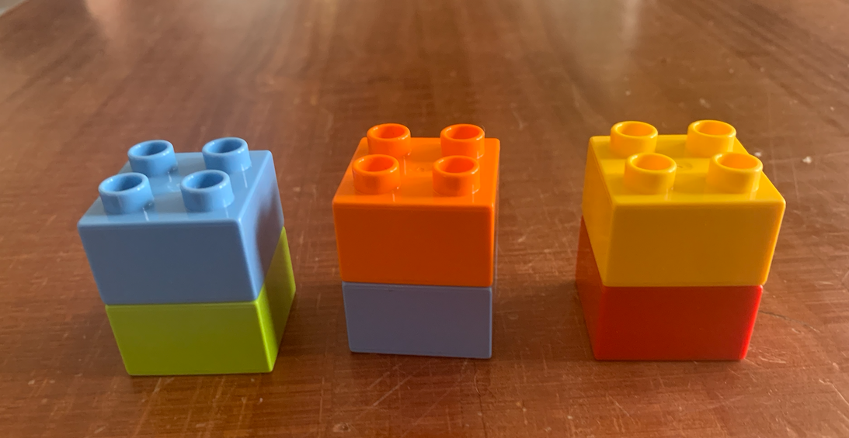
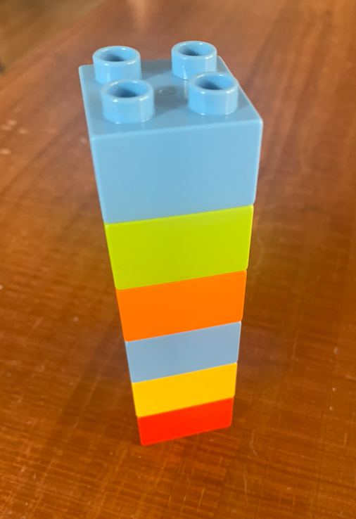
Access to mathematical concepts, representations and language (2 of 2)
6 is even
Notes:
Add photo of manipulatives with ten frame
Could also use legos stacked

Slide 25
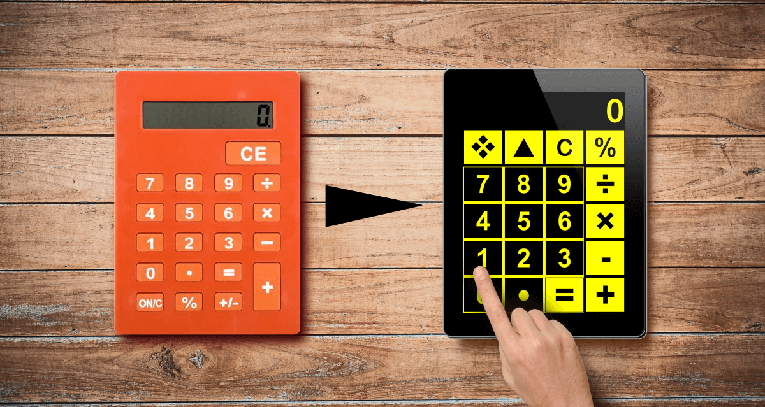
Familiarity and skill using mathematical models and tools

Slide 26
Access to peer cues and peer communication
What is one barrier to learning we anticipate for our student with significant cognitive disabilities? Is it related to student interest or engagement? Is it related to the student’s background knowledge (e.g., vocabulary)? Is it related to how the student shows what they know (e.g., how they communicate?) | Access to peer cues and peer communication | Student use of a key vocabulary list EVEN ODD BLOCK EQUATION
Notes:
Jessica will add

Slide 27
STOP and SHARE (3)
What solutions can you think of to remove these barriers?
Access to mathematical concepts, representations, and language
Familiarity and skill using mathematical models and tools
Access to peer cues and peer communication
Notes:
poll

Slide 28
Examples

Slide 29
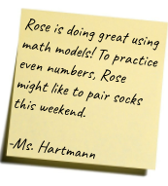

Rose’s Math IEP Goal
Rose will make progress in using concrete models to demonstrate understanding of concepts being taught in her grade-level mathematics class including numbers, operations, measurement, and geometry.

Slide 30


TIES’ Distance Learning Series
Series of Distance Learning articles focused on and students with significant cognitive disabilities in inclusive classrooms
For special educators, general educators and parents
DL #21: Distance Learning and Deafblindness: Learning from Parents (Liz Hartmann and Kristi Probst)

Slide 31
This is an interesting time!
What have we learned? (1 of 3)
What is working?
  Parents:
    Appreciation for celebrating the small victories!
    Being creative and weren’t afraid to try new or unexpected things
    Teachers who provided guilt-free options to opt out or save a lesson for another day
  Teachers:
    Having greater collaboration with families than in the past
    Small group instruction
    Slowing down the pace of the curriculum
    Learning how to support students in a virtual environment
More info: TIES Center > Distance Learning Series > DL21

Slide 32
What have we learned? (2 of 3)
What are the challenges for PARENTS?
  Wrongly assuming that schools weren’t required to teach children with deafblindness when distance learning happened
  Unilaterally assuming that a child could not participate because of some “bar” that was set, such as could not participate in a video call because of level of vision or hearing loss
  Instructional teams placing high demands on expectations for parents
  Providing materials or lessons without adequate support for how to use them
* More info: TIES Center > Distance Learning Series > DL 21

Slide 33
What have we learned? (3 of 3)
What are the challenges for Teachers?
  Student interaction with each other is reduced
  Student and staff trauma and anxiety
  Logistics of online instruction
  Structures, routines and expectations clarified
  Examples!!
More info: TIES Center > Distance Learning Series > DL21

Slide 34
STOP and SHARE (4)
What have you noticed in the last month?
What are the new challenges parents and teachers are facing?
What success stories can you share?

Slide 35
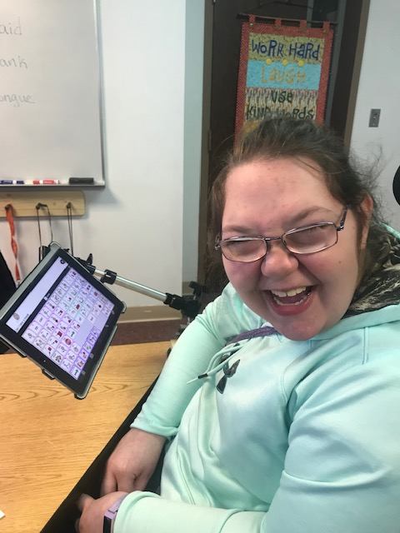
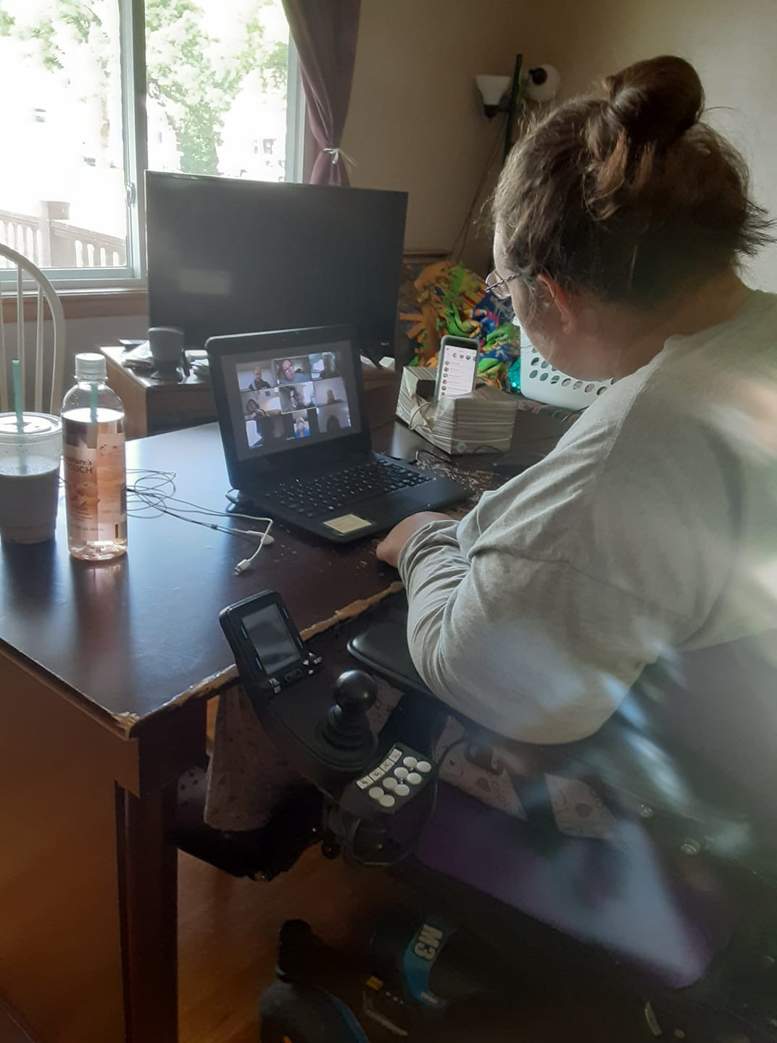
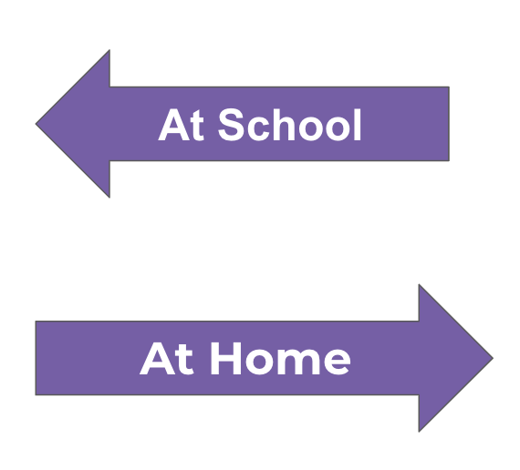
Planning instruction during distance learning and hybrid learning

Slide 36
The 5C Process (1 of 2)
More info: TIES Center > Distance Learning Series > DL 17
Used to plan for instruction at school, in distance learning and in hybrid learning
Instructional team (including parents) collaborate:
  Five steps--
    Learning Components
    Collaboration
    Continuity
    Collect data
    Capacity building
Outcome--aligned instructional program
  Learning Matrix for School
  Learning Matrix for Home

Slide 37
The 5C Process (2 of 2)
Principle #1: Learning Priorities Don’t Change. They are student specific
  When in different instructional environments:
    IEP Goal(s) may need to be modified
    The How, When, and Where of the IEP goals will need to change
Principle #2: All Students are General Education students first
  IEPs do not represent a student’s full curriculum.
  Access and progress in the general education curriculum and the IEP comprise a student’s program

Slide 38
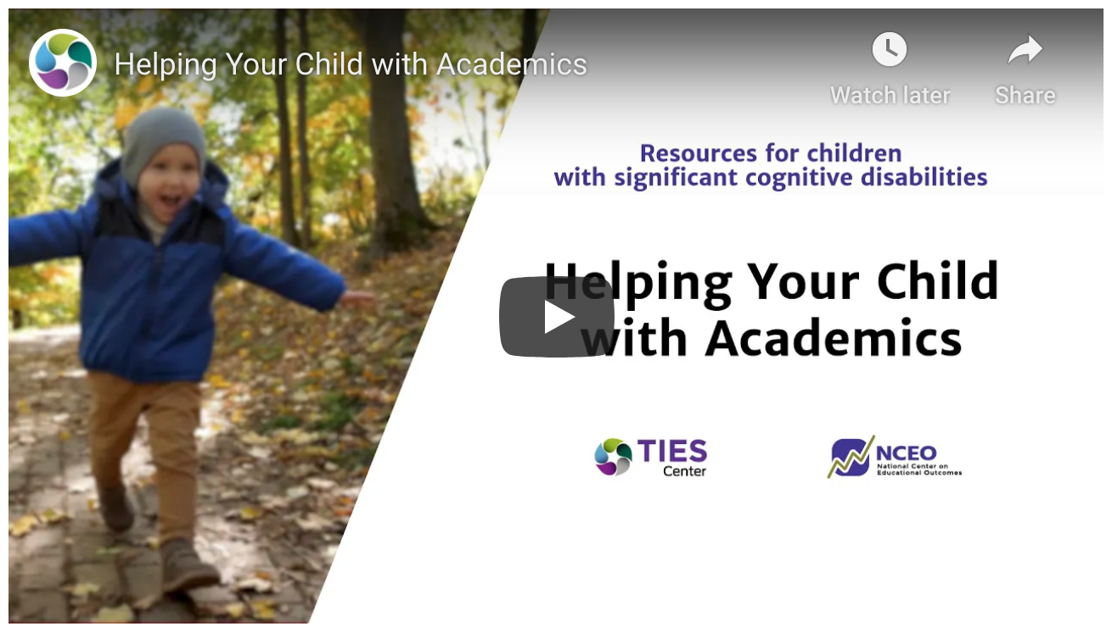
Helping Your Child with Academics at Home
TIES Center / NCEO video series for supporting your child at home
Notes:
In this video you’ll see some deafblind supports, be on the lookout

Slide 39
In summary:
The importance of providing access and progress in the grade-level general education curriculum for all students
Educators can start with the content standards, identify barriers and solutions to provide access for students who are deaf-blind
Collaboration between special education, general education and families is key both during in-person and distance learning

Slide 40
STOP and SHARE (5)
What have you learned today?
What is one takeaway from this webinar you will share with a colleague or team member?
What success stories can you share?
Any suggestions for our next webinar on early literacy and numeracy?

Slide 41

Thank you! Call for further action in support of learning for all:
See you at our next NCDB webinar “Early Literacy and Numeracy for Students who are Deaf-Blind” on 11/18
Please share the TIES Center website: tiescenter.org and resources with colleagues and families.
Check out our Facebook page!
Interested in providing feedback or contributing to the inclusive Distance Learning Series for students with significant cognitive disabilities? Please contact: tiescenter@umn.edu
We appreciate your feedback!

Slide 42
Please complete the Accessing Grade Level General Education Curriculum
Evaluation Survey

Slide 43



Final Slide
The contents of this presentation were developed under a grant from the U.S. Department of Education, #H326T180026. However, those contents do not necessarily represent the policy of the U.S. Department of Education, and you should not assume endorsement by the Federal Government. Project Officer, Susan Weigert.

