Slide 1
Assessment and Instruction of Students Who are Deafblind: What is the State of our Evidence?
Webinar for NCDB
& DVI-DB
Susan M. Bruce, Ph.D.
Boston College

Slide 2
Where did the evidence for this presentation come from?
Analysis for the CEEDAR Center of articles published between 1967-2013 on 12 topics
More in depth analysis on just communication and literacy addressed in articles appearing 1990-2015 (Bruce, Nelson, Perez, Stutzman, & Buchanan (2016).
Addition of sub-topic of accommodations in assessment for Bruce, S. M., Luckner, J. L., & Ferrell, K. A. (in review of minor revision). Assessment of students with sensory disabilities: Evidence-based practices.

Slide 3
What is the CEEDAR CENTER?
CEEDAR stands for: Collaboration for Effective Educator Development, Assessment, and Reform
  Technical assistance project (federally funded)
  Includes commitment to identify evidence-based practices (also known as “essential components”)
  Interested in the preparation of students with disabilities for higher education and career readiness
  Over course of 5 year grant, will collaborate with individuals in 20 states
      With state departments of education over licensing
      With personnel preparation programs
      With local school districts to support program evaluation

Slide 4
Innovation Configurations
Identification of evidence based practices from the existing literature (research studies, practice literature) on teaching students with disabilities
Innovation configurations currently completed: two on reading (K-5 and 6-12 grades), writing, math, transition, universal design for learning, culturally responsive teaching, principal leadership, content learning with technology, use of technology in preparation of pre-service teachers, severe disabilities, sensory impairments, improving challenging behaviors of students with severe disabilities, classroom and behavior management for Tier 2 and Tier 3 strategies, English Language Learners, literacy instruction for students with multiple and severe disabilities.

Slide 5
Our Analysis Process for Sensory Disabilities Innovation Configuration
Examined publications about research studies and practice literature in 12 topic areas for Deaf/Hard of Hearing, Visual Impairment, and Deafblindness (1967-2013)
NOTE: Calculated the level of evidence for each practice that EMERGED from analysis of the literature
  Thus some important practices were not identified because there were no studies and a lack of professional literature.
  (Ferrell, Bruce, & Luckner, 2014)

Slide 6
Identifying the Level of Evidence
See document: The CEEDAR Center Evidence Standards
4 levels of evidence:
  Strong
  Moderate
  Limited
  Emerging

Slide 7
Defining Evidence Levels
Strong: 1+ strong causal design + 1+ moderately strong –or- 5 single subject design -or- 5+ correlational studies
Moderate: 3+ moderately-strong causal designs -or- 3 single-subject designs (with 20+ participants and 2+ different research teams) -or- 3 correlational designs -or- 2+ meta-analyses or syntheses (with quality indicators for syntheses)
Limited: At least 1 causal design study -or- 1 single-subject design study -or- 1 correlational study -or- 1 meta-analysis or synthesis (with quality indicators for syntheses)
Emerging: Primarily relying on professional literature other than research studies

Slide 8
Reviewing Findings: Administration
Each educational team should include one member who is knowledgeable about effective assessment and instructional approaches for students who are deafblind. EMERGING
Small instructional groups should be provided to ensure access, engagement, and sufficient instructional feedback. EMERGING

Slide 9
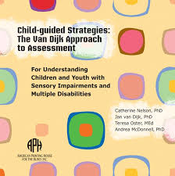
Reviewing Findings: Assessment
Informal assessment instruments and procedures are essential to capturing the student’s abilities and needs. The sole use of formal instruments is inappropriate. EMERGING
  Dynamic Assessment, including child-guided
  Curriculum-Based Assessment

Slide 10
Assessment, cont.
Conduct assessments across multiple and natural environments with input from multiple adults. EMERGING
Identify the strengths and needs of the family as part of early childhood assessment. EMERGING

Slide 11
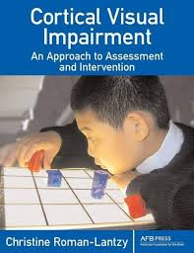
Assessment, cont.
Conduct functional vision assessment, functional hearing assessment, and learning media assessment (including learning channels) with each student. (FVA includes assessment of cortical visual impairment.) EMERGING

Slide 12
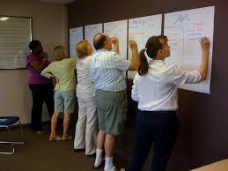
Assessment, cont.
Use person centered assessment approaches to identify meaningful outcomes and necessary educational supports. EMERGING
  maps, MAPS, PATH, PFP
Be very cautious when identifying additional disabilities in students who are deafblind. The diagnostic criteria used with other students may not be applicable. EMERGING

Slide 13
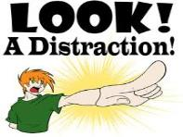
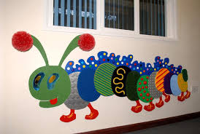
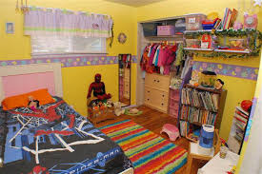
Assessment, cont.
Assess the visual, auditory, and tactile characteristics of each environment the student engages in (or may engage in) to:
  determine potential impact on student
  support communication programming
  plan appropriate adaptations and accommodations.
  EMERGING

Slide 14
Update on Assessment Topic: Evidence-Based Accommodations Categories: Deafness
Extended time, interpreting test directions, interpreting test items, reading items aloud, student signs response, and small group administration (Cawthon, 2010, Cawthon & Wurtz, 2010). Teachers select accommodations based on subject area and student’s level of knowledge (Cawthon, 2011)

Slide 15
Assessment Accommodations Update: Visual Impairments/Blindness
Identified accommodation categories: substitutions (as in objects for pictures), enhancements (such as color or size), layout/set-up (such as how space was used), directions, and response (Zebehazy, Zigmond, & Zimmerman, 2012).
-or-
Presentation, time (think visual fatigue), setting, response and aids (including enlargement and braille) (Steer, Gale, & Gentle, 2007)

Slide 16
Assessment Accommodations Update: VI, cont.
Most commonly allowable in state assessments TIMING -administration on multiple days, extended time or frequent breaks-for fatigue and accommodations such as providing verbal descriptions). CONTEXT/SETTING-small group administration, lighting. RESPONSE-scribe, WP, brailler, recording response in booklet instead of separate sheet, use of tape recorder, e-notetaker, handwriting guide. PRESENTATION-30 accommodations listed-braille, large print, reading of test directions or test items as most common.
l/3 of states did not specify allowable accommodations for students with visual impairments-allowing teachers greater flexibility (Smith & Almato, 2012)

Slide 17
Accommodations Update-Deafblind
Horvath, Kampfer-Bohach, & Kearns (2005): Nine students in three states: disconnect between accommodations on IEP, what was used in classroom, and what was used when conducting assessments.
Stone, Cook, Latitusis & Cline (2010) (Sample included students who are deafblind-otherwise deaf sample): Need for greater consistency in enlargement of materials and need to present text in formats students are familiar with.
Can we build from the evidence in DHH and VI?
What assessment resources do you want to share?

Slide 18
Reviewing Findings: Early Identification and Early Intervention
Early identification and early intervention should be provided to reduce the developmental disadvantages posed by deafblindness. MODERATE
Students who are deafblind require highly specialized and individualized services provided by collaborative teams that respect the role of family in optimizing outcomes. MODERATE

Slide 19
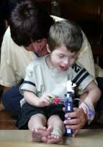
Early Identification and Early Intervention, cont.
Young students will benefit from caregiver preparation to:
  recognize the child’s cues for interactions
  establish routines to elicit anticipation (think schedules)
  provide contingent responses.
  MODERATE
  What early intervention resources do
  you want to share?

Slide 20

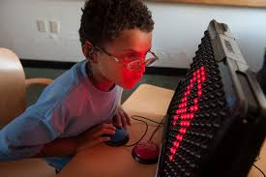
Reviewing Findings: Assistive Technology
Select assistive technology based on assessment of each student. EMERGING

Slide 21
Assistive Technology: Cochlear Implantation
Students who are deafblind experience unique benefits, risks, and potential outcome predictors from cochlear implants. The team member with deafblind expertise should know this research.
STRONG
When reporting benefits (or lack of benefits) of cochlear implants, consider non-speech outcomes including improved awareness of environmental sounds or increased responsiveness. STRONG

Slide 22
Reviewing Findings: Communication
Communication development and social interactions should be emphasized every day in the context of natural environments. LIMITED
Communication programming should address forms/modes, intents/functions, content, context, and pragmatics. EMERGING
Apply child-guided approaches to support communication development and different types of dialogues. LIMITED

Slide 23
Communication, cont.
Apply systematic approaches to increase the rate and variety of communicative intents/functions expressed. MODERATE
Implement individualized communication programming that reflects knowledge of the student’s level of communication. EMERGING
  Communication Matrix
Improve adult communication partner skills through systematic demonstration and modeling. LIMITED

Slide 24
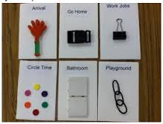
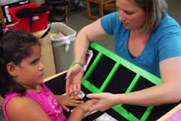
Communication, cont.
Tangible representations/symbols are a critical form of communication for prelinguistic students who are deafblind. MODERATE

Slide 25
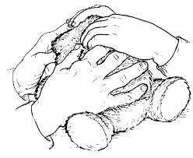
Reviewing Findings: Literacy
An expanded view of literacy (that goes beyond traditional reading and writing) is required to address the needs of students who are deafblind and prelinguistic. EMERGING
  Daily schedules/anticipation shelves as a literacy lesson.
Provide a literacy rich environment with hands on experiences to conceptually ground the literacy experiences. EMERGING

Slide 26
Related Publications on Evidence-Based Communication & Literacy Practices 2014-2016
Bruce & Borders (2015) situates findings largely from CEEDAR review in their appropriate theoretical groundings: Developmental, Behavioral, Social-Interactions (a theory from Deaf education that applies well to approaches in deafblindness).
Bruce & Borders (2015) presents the 5 primary CEEDAR findings in communication with associated references.

Slide 27
Update, cont.
Bruce, Nelson, Perez Stutzman, & Barnhill (2016) provides much greater detail on the research designs and findings on communication-and only addresses studies 1990-2015. So, if you read something in CEEDAR doc and want to know more detail, this is a good resource.
Framed all findings using the four aspects of communication: Form (mode), Function, Content, & Context
Included qualitative studies that were not eligible for CEEDAR review.
What communication and literacy resources would you like to share? (Please see “Communication Bill of Rights”)

Slide 28
Reviewing Findings: Social-Emotional
Identify the purpose fulfilled by unacceptable behaviors. EMERGING
  (Functional Behavioral Assessment-FBA)
Teach socially acceptable ways of communicating and other replacement behaviors for unacceptable behaviors. EMERGING
  (As reflected in Positive Behavior Support Plans)
Knowledge of the child’s etiology and the impact of deafblindness is critical to assessment and to planning individualized positive behavior support plans. MODERATE

Slide 29
Social-Emotional, cont.
Apply behavioral principles to reduce or eliminate stereotypies, self-injurious behaviors, and aggression toward others. MODERATE
Appropriate changes in the curriculum, environment, and the nature of adult responses can support positive change in behavior in children who are deafblind. EMERGING
Any resources you’d like to share?

Slide 30
Reviewing Findings: Mathematics
Use consistent wording for mathematical symbols and operations. EMERGING
When preparing to teach each math lesson, consider:
  student’s experiential knowledge
  vocabulary demands of lesson
  need to modify content
  need for manipulatives to support understanding
  need for adaptations to improve access and participation. EMERGING

Slide 31
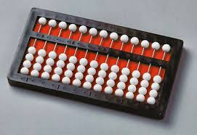
Mathematics, cont.
Provide instruction on the use of specialized mathematics equipment and specialized approaches, such as the abacus or mental math. EMERGING
Any resources to share?

Slide 32
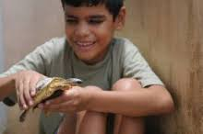
Reviewing Findings: Science
When preparing to teach each lesson, consider:
  student’s experiential knowledge
  vocabulary demands of the lesson
  the need for modification of content
  adaptations and accommodations
  non-visual means of presentation.
  EMERGING
  Any resources to share?

Slide 33
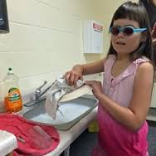
Reviewing Findings: Life Skills
Improve daily living skills through systematic instruction that includes task analysis and the application of behavioral principles (such as graduated guidance). STRONG
Any resources to share?

Slide 34
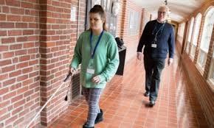
Life Skills: Orientation & Mobility
With the guidance of the Certified Orientation and Mobility Specialist (COMS), improve O & M skills through systematic instruction in the context of structured activities that are desirable and functional. LIMITED
O & M instruction for students who are deafblind must be modified (from what is offered to students who are visually impaired) by considering
  The impact of deafblindness
  Potential balance issues
  Unique communication needs
  Length or number of sessions (due to sequential communication when traveling). EMERGING
  Any resources to share?

Slide 35
Reviewing Findings: Transition
Vocational experiences during secondary education increase the likelihood of post-school employment. EMERGING
An interagency approach to Personal Futures Planning is critical to:
  capturing the strengths and needs of the individual
  planning natural and paid supports for all aspects of adult living. EMERGING
  Any resources to share?

Slide 36
Reviewing Findings: Placement/Inclusion
Collaborative teaming is essential to the successful inclusion of students who are deafblind. EMERGING
Paraprofessionals with specialized preparation or interveners are crucial to the success of children who are deafblind. EMERGING
Adults must create opportunities for reciprocal interactions between students who are deafblind and their peers and provide direction instruction about how to interact. EMERGING

Slide 37
Placement/Inclusion/Engagement:
Universal Design for Learning
The principles of universal design for learning (UDL) can be applied to enhance access, participation, and engagement. EMERGING
The three UDL principles (to be applied) are:
  Multiple means of representation (think receptive forms/modes)
  Multiple means of action and expression (think expressive forms/modes)
  Multiple means of engagement (think cues, environment…). EMERGING

Slide 38
What can we do with these findings?
For evaluation of syllabi in personnel preparation
For program evaluation (at individual student level)
In advocacy of individualized programming elements, team members, approaches, strategies
To plan inservice efforts to address staff areas of need

Slide 39
Summary of Highest Need Areas for Future Research
Math
Science
Literacy (especially reading and writing)
Transition
O & M
We need higher levels of evidence for assessment (including identification of categories of accommodations and informal assessment), administration, more research on assistive technology (other than CI)
Develop research evidence for essential components not addressed in this analysis

Slide 40
References
Please see the Innovation Configuration on Sensory Disabilities to see the full list of references (across the three disability areas).
Easiest to locate by:
  Google: CEEDAR Center-then click on “Innovation Configuration” heading within GOOGLE-as opposed to going to the CEEDAR site and locating it.

Slide 41
References for updated topics on accommodations, communication, literacy (not included in CEEDAR review)
Bruce, S. M., & Borders, C. (2015). Communication and language in learners who are deaf and hard of hearing with disabilities: Theory, Research, and Practice. American Annals of the Deaf, 160, 368-384.
Bruce, S. M., Nelson, C., Perez, A., Stutzman, B., & Barnhill, B. A. (2016). The state of research on communication and literacy in deafbindness. American Annals of the Deaf.
Bruce, S. M., Luckner, J. L., & Ferrell, K. A. (in review of minor revision). Assessment of students with sensory disabilities: Evidence-based practices.

Slide 42
References 2
Cawthon (2010). Science and evidence of success: Two emerging issues in assessment accommodations for students who are deaf or hard of hearing. Journal of Deaf Studies and Deaf Education, 15, 185-203.
Cawthon & Wurtz (2010). Predictors of assessment accommodations use for students who are deaf or hard of hearing. Journal of Educational Research & Policy Studies, 10, 17-34.
Cawthon (2011). Making decisions about assessment practices for students who are deaf or hard of hearing. Remedial and Special Education, 32,4-21.

Slide 43
References 3
Horvath, L. S., Kampfer-Bohach, S., & Kearns, J. F. (2005). The use of accommodations among students with deafblindness in large-scale assessment systems. Journal of Disability Policy Studies, 16,177-187.
Smith, D. W., & Amato, S. (2012). Sythesis of available accommodations for students with visual impairments on standardized assessments. Journal of Visual Impairment & Blindness, 106, 299-304.
Steer, M., Gale, G., & Gentle, F. (2007). A taxonomy of assessment accommodations for students with vision impairments in Australian schools. The British Journal of Visual Impairment, 25, 169-177. Note: Addresses U.S. schooling too.

Slide 44
References 4
Stone, E., Cook, L., Laitusis, C. C. & Cline, F. (2010). Using differential item functioning to investigate the impact of testing accommodations on an English-Language Arts assessment for students who are blind or visually impaired. Applied Measurement in Education, 23, 132-152.
Zebehazy, K. T., Zigmond, N., & Zimmerman, G. J. (2012). Performance measurement and accommodation: Students with visual impairments on Pennsylvania’s alternative assessment. Journal of Visual Impairment & Blindness, 106, 17-30.
All images are from Google Images

Slide 45
Questions and Answers
If your question requires a longer conversation than time allows today, please contact me:
  susan.bruce@bc.edu
  617-552-4239

