Slide 1
Parent advisory councils/ ambassadors
Sarah B. Ottow & Amy Melik
Confianza
www.ELLstudents.com
The contents of this presentation were developed under a grant from the U.S. Department of Education, #H326T180026. However, those contents do not necessarily represent the policy of the U.S. Department of Education, and you should not assume endorsement by the Federal Government. Project Officer, Susan Weigert.

Slide 2
Welcome!
Introduction
About Confianza
About our Webinar Series

Slide 3
Our Three-Part Webinar Series
Culturally Responsive Partnerships:
June 6, 2019 (Archived)
Informed Practice
June 21, 2019 (Archived)
Parent Advisory Councils/Ambassadors
July 26, 2019

Slide 4
Goals for Session 1: Culturally Responsive Partnerships
Tips for examining your own identity and how that impacts connecting with families
Exploring where projects can look for state partnerships
Building up your support network

Slide 5
Goals for Session 2: Informed Practice
Dissemination strategies – how to effectively share information in ways that families will want to connect and attend
Technology tools to communicate with families
Once you find them, then what?

Slide 6
Goals for Session 3: Parent Advisory Councils/Ambassadors
Cultural perspectives on disability, family and education and how that informs our practice
Teach and empower Spanish-speaking families to understand Anglo-American culture
Supporting families once we draw them in
Empowering an advisory council to shape goals and outcomes

Slide 7
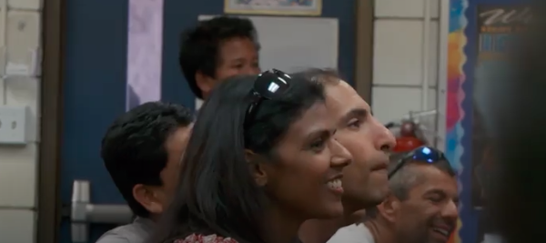
Pre-Webinar Video
Parents leading other parents example
https://www.teachingchannel.org/video/getting-parents-involved

Slide 8
Go Beyond the Surface
SURFACE CULTURE:
Food, dress, music, language, arts, holidays
DEEP CULTURE:
Concepts of time, childrearing, disability, friendship, age, gender, personal space, body language
Notes:
What is culture? It is a shared system of meanings, beliefs, values and behaviors through which we interpret our experiences. Culture is learned, collective and changes over time. Culture is generally understood to be "what we know that everyone like us knows."

Slide 9
Cultural Perspectives on Disability, Family and Education
Research cultural perspectives on disability yet resist stereotyping
Puerto Rican example
Mexican-American example
Pacific-American example
Chinese-American example
Korean example
Native American and Native Hawaiian example
Collaborate as a team as much as possible
From Confianza’s Navigating an ELL Label, A Spec. Label or Both

Slide 10
POLL:
Which Spanish-speaking cultures have you worked with? (how families have identified themselves)
American/U.S.
Mexican or Mexican-American
Central American (Guatemalan, Honduran, Nicaraguan, Costa Rican, Panamanian)
Caribbean (Puerto Rican, Dominican, Cuban)
South American (Columbia, Venezuela, Ecuador, Peru, Bolivia, Paraguay, Chile, Argentina, Uruguay)
Spanish (from Spain)
Don’t Know

Slide 11
Teach and Empower Spanish-Speaking Families to Understand Anglo-American Culture
Build bridges between languages and cultures
Ask about hopes and dreams
Hispanic vs. Latino and other identity terms
Start with where they are with a strengths-based mindset
Create co-learning experiences

Slide 12
Bicultural and Bilingual Identities: Acculturate vs. Assimilate

Slide 13
Introducing Amy Melik
Equity-focused curriculum with a social justice lens
Empowering family, community and school groups
Approached, Focused and Consistent: Equitable Family Engagement
ELL Teacher/Coordinator, Teaching Tolerance Board Member, Confianza Consultant

Slide 14
Supporting Families Once We Draw Them In
Step One: Be Approachable and Capture Families’ Voices
Step Two: Create Focus through Vision, Norms and Goals
Step Three: Be Consistent and Empowering through Gradual Release
From Confianza’s Approachable, Focused and Consistent: Putting Equitable Family Engagement at the Forefront of School Communities

Slide 15
Vision Examples
“The Bilingual Parent Advisory Council (BPAC) will promote a family and school engagement environment for bilingual parents that promotes supporting families of bilingual students through outreach, advocacy, empowerment of bilingual parent voice, and promoting a school community that is culturally responsive.”
“The Parent Equity Council (PEC) will provide a forum for parents to discuss and advocate for a community that is inclusive and provides opportunities for all students to be successful.”
“With the support of parents, staff and students, our group exists to advocate for the creation of an environment that embraces student individuality through the development of social, emotional, and cultural competence.”
From Confianza’s Approachable, Focused and Consistent: Putting Equitable Family Engagement at the Forefront of School Communities

Slide 16
Norms Example
-Communicate clearly and listen carefully
-Refrain from using names. Talk about issues, not people.
-Utilize a talking piece to ensure equity of conversation.
-Assume positive intent. Ask for clarification.
-Honor time limits on our agenda
-Allow for student centered conversations to occur before or after our meeting time
-Make decisions on the basis of consensus
From Confianza’s Approachable, Focused and Consistent: Putting Equitable Family Engagement at the Forefront of School Communities

Slide 17
Goal Examples
“Our team will support creating awareness for culturally responsiveness in schools by supporting a school identity festival and monthly cultural exhibitions in school assemblies.”
“We will support parent workshops on three topics this school year that support bridging the achievement gaps between communities in our school.”
“We will work with the school counselors to create multilingual resources to help high school families complete FAFSA applications.”
From Confianza’s Approachable, Focused and Consistent: Putting Equitable Family Engagement at the Forefront of School Communities

Slide 18
Empowering an Advisory Council to Shape Goals and Outcomes
One case study to share
Gradual release towards
ambassadorships
From Confianza’s Approachable, Focused and Consistent: Putting Equitable Family Engagement at the Forefront of School Communities

Slide 19
POLL: Which strategy for parent councils might you want to try?
Vision
Norms
Goals
Gradual Release

Slide 20
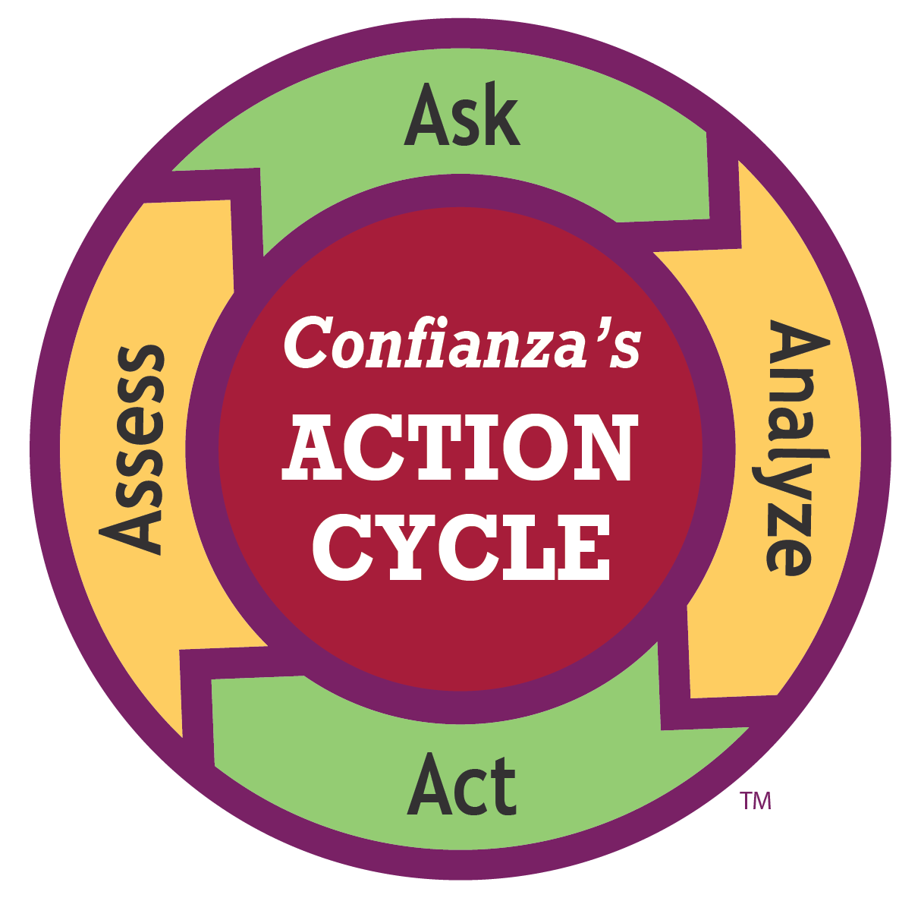
Let’s Take Action!

Slide 21
Follow-Up Resources
Navigating an ELL Label, Special Education Label or Both
https://ellstudents.com/blogs/the-confianza-way/navigating-an-ell-label-a-sped-label-or-both?
Approachable, Focused and Consistent Family Engagement
https://ellstudents.com/blogs/the-confianza-way/approachable-focused-and-consistent-putting-equitable-family-engagement-at-the-forefront-of-school-communities
Reading for Social Justice
https://www.tolerance.org/magazine/publications/reading-for-social-justice

Slide 22
Recommended Guidebook about English Learners
25% off with code OTTOW25
https://www.learningsciences.com/authors/sarah-b-ottow/the-language-lens-for-content-classrooms

Slide 23
Feedback Survey Link: http://sgiz.mobi/s3/PAC-and-Cultural-Ambassadors

