Slide 1
Conducting Action Research in Deafblindness
Webinar for NCDB & Susan M. Bruce, Ph.D.
DVI-DB Boston College

Slide 2
Goals of this presentation
Participants will understand and be able to apply the basic principles of action research in their work with children and young adults who are deafblind
Participants will become familiar with some of the literature about action research studies in deafblindness
Participants will have resources to learn more about action research in deafblindness

Slide 3
Introduction

Slide 4
What is action research?
Problem solving form of research
The intervention is not static
Analysis is ongoing and impacts changes in the intervention (suitable to complex learners, complex problems, and complex contexts)
The intervention changes according to findings
Cycles of planning, action, and reflection (action research cycles)

Slide 5
The Action Research Cycle
The cycle includes:
Act
Observe
Reflect
Plan

Slide 6
Types of action research
Classroom (also known as teacher research or practitioner research)
Collaborative
Critical
Participatory
(Hendricks, 2016)

Slide 7
Classroom Action Research
Issue of importance involving one or more students
Builds on abilities –what the practitioner knows the student can do.
Principles of classroom research can be applied outside of classrooms-to other settings
May examine learning of students or teachers/therapists
Examples
Whole class: How do we support students to interact with each other and not just with adults?
Individual: How can we teach Joe to answer in the affirmative (as in nodding head, signing “yes”….)

Slide 8
Action Research - Exploring
The text: action research – exploring possibilities in teaching and learning.

Slide 9
Collaborative Action Research
Involves someone outside of the classroom-an outside expert who brings knowledge about action research or the identified problem of concern
Colleagues
University partner
Community group
Success is dependent on:
Voluntary participation
Clearly established roles and responsibilities
Clear communication
Timelines-the action plan (discussed later)

Slide 10
Critical Action Research
Focuses on inequities; strong social justice orientation
Also involves collaborators outside your setting (often members of community-advocates with experience on the topic of importance)
Example:
What can we do to make our municipal buildings more accessible to individuals who are deafblind?
How can we make community events (such as story hour at the library) engaging for children who are deafblind?

Slide 11
Participatory Action Research
Individuals who are deafblind identify the problems of importance to study
Individuals who are deafblind are co-researchers and co-writers – their type and level of co-participation is self-determined.
Self-determination and advocacy are foundational to participatory action research
Emancipatory research may be considered a subset of participatory action research. Some consider it a 5th type of action research-the funding and POWER is held by individuals who are deafblind.
PAR more appropriate to adults

Slide 12
Identifying the Problem to Study
Based on your observations of students
Based on your data about student performance
Based on teacher journals
Based on parent concerns
Are there actions you can take to address this problem? Are there definable outcomes? If “yes” to both – you have a problem that can be translated into a researchable question.
Don’t select a problem that is too big or broad (such as Why isn’t my student learning?)

Slide 13
Examples of identified problems in authentic AR in DB Studies
Adolescent students in our school do not interact with younger students. One even runs away from younger students, possibly because they are unpredictable.
Our secondary students with visual impairments and deafblindness are asking their parents about service dogs (including guide dogs) and the parents are worried because they are not yet helping with their pets at home.
Calvin very seldom initiates communication.

Slide 14
Forming a good research question
Do not use questions that can be answered with “yes” or “no.”
Be as specific as possible and you may want to use sub-questions to get at the specifics.
Take ownership of your research question: Use “I”, “my”, “we”, or “our”

Slide 15
Examples of research questions from a collaborative action research study
Socialization study involving dyadic interactions of different-aged students
How will interactions between older students with CHARGE syndrome and young students with mixed etiologies of deafblindness change over time, in the context of an engineered interaction space?
Sample sub-questions: What socialization goals will older students select? What types of feedback will older students give each other (after viewing the interaction videos)?

Slide 16
Examples of Research Questions from Collaborative Action Research Study
Positive Behavior Support study that generated individualized behavior profiles with supports
What positive behavior supports are most effective with each of the young adults who are deafblind?
Sample sub-questions: Which strategies are important to preventing a negative behavior and which are important to addressing a negative behavior (proactive/reactive)?

Slide 17
Examples of Research Questions from a Participatory Action Research Study
PAR study in Washington DC
How will participant/co-researchers describe effective change agents?
How will participant/co-researchers describe their own development as change agents?
How will participant/co-researchers think about their various advocacy roles (self and political)

Slide 18
Planning the Intervention
Review your existing data before developing your intervention. Consider what has been tried already.
Develop an initial intervention that addresses your research question(s)
Change your intervention in response to data.
Consult professional journals and websites for ideas about interventions.
Collaborate with colleagues about interventions.

Slide 19
Fidelity of your intervention
Consistency in delivery of the intervention-across people and intervention sessions/lessons
Joint lesson plans
Training on the intervention
Checklists
Videotape staff delivering the intervention. Review and rate for fidelity.

Slide 20
Examples of Interventions from AR Studies in DB (1 of 2)
Humane Education Study: An after school course on humane education with key experiences with a service dog (feeding, brushing teeth, picking up waste, play, walking…)
Socialization Study (different aged dyads): Using structured play spaces, goal-setting, preview and review of goals, student self-evaluation to improve interactions of adolescent students with elementary students-dyadic interactions.

Slide 21
Examples of Interventions from AR studies in DB (2 of 2)
Positive Behavior Support Study: Applying principles of Cognitive Behavior Therapy and literature on environmental considerations/arrangements and sensory needs of students who are db, and individualized profiles to improve behavior
PAR study-course on advocacy and becoming a change agent (included experience with developing a policy brief and participant/co-researchers meetings with congressmen/women)

Slide 22
Create an Action Plan for your Intervention

Slide 23
Identifying Data Sources
Field notes
Observation videos or notes
Pre/Post tests or surveys
Pre/post interviews
Teacher and therapist journals about the intervention
Task analyses
Written documents created outside of study: IEP, behavior plans
Written documents created for the study: action plans, profiles on communication or behavior….

Slide 24
Environmental Engineering & Sensory Sensitivity: Sample Flip Chart Data from Staff Discussion of Joe (Positive Behavior Support study)
Environmental Engineering
Working on teaching him to remove himself from the environment
Asking him, “it’s going to be real loud – do you want to leave?”
Disregarded area that is his area – showing him how much space he has – what space is “his”
Last year – sitting at desk and/or doing his schedule were triggers.
Being “jostled” by others
Being active – likes
Making backpack heavier (sensory)
Discontinued “signing in” for workroom – trigger – begins crying
Likes wearing a uniform/badge/costume/hat
Begin doing the activity and often he will join in even after saying “no”
Sighted guide – with cross body handshake for safety of others. Sometimes he will ask for handshake.

Slide 25
Data Source-Photograph: Exploring Norm’s Crate from the Humane Education Study

Slide 26
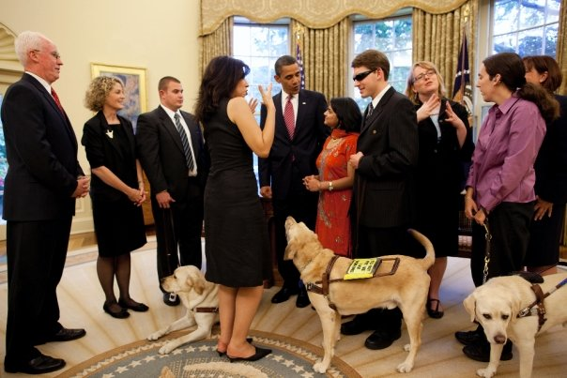
Data Source-Photo: PAR Participant/Co-researchers Engaging in Political Advocacy

Slide 27
Collecting Data
Before collecting data: Do you need consent forms from parents?
Who will collect the data?
Where will it be stored (in a way that protects student privacy?)
How often will it be shared and reviewed with each other?
In collaborative action research studies involving multiple interventionists-how will you know when it might be time to change the intervention?

Slide 28
Goal of Data Analysis
The goal of any data analysis is to “reduce vast amounts of data into smaller, more manageable sets of information” (Mertler, 2017, p. 171).

Slide 29
Analyzing Quantitative Data
Deductive process
Gather all of your quantitative data sources
Create displays of your data (line graphs, bar graphs…)
Take notes about how each data source relates to your research question(s)
Quantitative data may be simple counts

Slide 30
Quantitative Analysis: Very basic descriptive statistics
Measures of central tendency:
Mean (average)
Mode (most common score/rating)
Median (score in middle) (not often relevant to AR in DB)
Measures of variability:
Range of scores (such as 4-20 minutes on task)
Standard deviation (distance from mean-not often relevant to AR in DB)

Slide 31
Analyzing Qualitative Data
Inductive process
Read and re-read your data source (such as journal or observation notes).
Write memos/notes about the data
Identify key themes/categories
Be clear about the connection between each theme and your research question(s)
Account for all data.
Trustworthiness of your findings-have colleagues review your analysis. Member checks when possible. Keep clear records of your analysis.

Slide 32
Identifying key findings
Your key findings should all directly connect to your research question(s)
Quantitative findings may include simple counts. For example, counting how many times a child engaged in a particular positive or negative behavior.
Qualitative findings will help you to get to the “whys” behind what is occurring-these findings will help you to see the influence of context (including adults and peers in the setting).

Slide 33
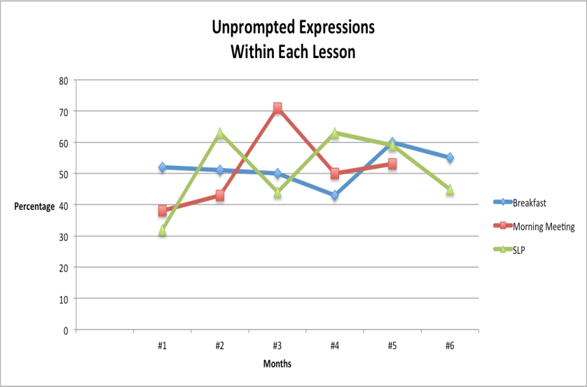
Example of Quantitative Findings on Communication Initiations of Boy with CHARGE

Slide 34
Sample of Qualitative Data on Teaching Strategies from the Same Study
Provide highly motivating context
Create opportunities to communicate (with exs.).
Close physical proximity of communication partner
Repeated naming of the representation/symbol
Pair objects with line drawings
Drop background color of line drawings-to draw his attention to the drawing itself

Slide 35
Sample Qualitative Data from the Positive Behavior Support Study: 8 Themes
Provide structure (physical space and lessons)
Support students to cope with anxiety
Address students’ sensory needs
Support on task behavior
Support transitions between activities and environments
Support mature behavior (defined as adult-like & cooperative-we used mature behavior sheets & self evals)
Establish and maintain a positive climate
Adult language supports positive behaviors

Slide 36
Importance of collaboration

Slide 37
Reflecting and taking action(s) based on findings: Subsequent action cycles
Example from the socialization study with different age dyads
Joint attention issues were apparent, such as: gaining visual attention of peer, impact of positioning on peer attention, allowing appropriate amount of wait time (due to visual latency).
Changes in intervention included more sitting at table with peer and teaching one adolescent to count silently for wait time.

Slide 38
Reflecting and taking actions based on findings: Subsequent action cycles
Communication Initiations study-changing representation to encourage initiation-the data told us he was more accurate in selecting a line drawing if it did NOT have the feature of color. So, we removed color.

Slide 39
Keep Calm

Slide 40
Disseminating Findings
Share findings with immediate team members
Share findings at staff meetings
Present at your school or at conferences
Full feature article, research report, or practice report for Journal of Visual Impairment & Blindness
Article for Visual Impairment & Deafblind Education (VIDBQ) (previously DVI Quarterly)
Article for DbI Magazine (DbI = Deafblind International)
Possibly for websites such as NCDB or Perkins
Other ideas?

Slide 41
Resources and References (1 of 3)
Bruce and others (2016-2017). Series of 6 articles on how to conduct action research with individuals who are deafblind—in DbI Magazine.
Bruce, S. M., Feinstein, J. D., Kennedy, M., & Liu, M. (2015). Humane education for students with visual impairments: Learning about working dogs. Journal of Visual Impairment & Blindness, 109, 279-290.
Bruce, S. M. & Parker, A. T. (2012). Young deafblind adults in action: Become self-determined change agents through advocacy. American Annals of the Deaf, 157, 16-26.

Slide 42
Resources and References (2 of 3)
Bruce, S. M. & Pine, G. J. (2010). Action research in special education: An inquiry approach for effective teaching and learning. New York: Teachers College Press.
Bruce, S. M., Zatta, M., Gavin, M. & Stelzer, S. (2016). Socialization and self-determination in different age dyads of students who are deafblind. Journal of Visual Impairment & Blindness, 110, 149-161.
Deafblind International-Research Network-Action Research Work Group (Contact me if you’re interested in joining the network and this research group.)

Slide 43
Resources and References (3 of 3)
Hendricks, C. (2016). Improving schools through action research: A reflective practice approach (4th edition). Upper Saddle River, NJ: Pearson.
Mertler, C. A. (2017). Action research: Improving schools and empowering educators. Fifth Edition. Los Angeles: Sage.
Nannemann, A. C., Bruce, S. M., & Covelli, A. (2017). Positive behavior supports for a young woman with CHARGE syndrome. Journal of Visual Impairment & Blindness, 111, 175-180.

