Slide 1


Introduction to Accessing the Grade Level General Education Curriculum
Susan Weigert
Sam Morgan
Tracy Evans-Luiselli
March 2, 2022

Slide 2
Agenda
Welcome (Sam Morgan)
Access to the GEC Overview (Susan Weigert)
State Example (Tracy Evans-Luiselli)
Next Steps (Kristi Probst and Emma Nelson)

Slide 3
Welcome
Sam Morgan, National Center on Deaf-Blindness

Slide 4
Objectives
  Participants will gain knowledge of academic content standards and alternate achievement standards (access points) when accessing the GEC
  Participants will gain knowledge of high-quality practices on supporting students who are deaf-blind to access the GEC
  Participants will gain knowledge of resources to support students who are deaf-blind to access the GEC

Slide 5
Accessing the GEC
Susan Weigert, OSEP

Slide 6

Shake it out

Slide 7

A State Level Example of
Entry Points and Access Skills
Tracy Evans Luiselli, Ed.D.
New England Consortium
on Deafblindness

Slide 8
Lost in Space: Learning the Language
Different terminology across states . . .
Standards
Domain/Topic Area
Cluster
Strand
Entry Point
Access Skill
“Lost” on SEA Websites and Webinars
Differences Across and Within States (districts)
Differences Across Providers
Public vs. Private School Perspectives

Slide 9
Landing the Ship . . .
Shifting Our Perspective -
“TA to Support Access to GEC should focus
on how and not if or when”
*Starting Point
Collaborate with the TEAM and Gen Ed Teachers
Provide TA to support access
Assume Competence
(NCDB - Literacy)

Slide 10
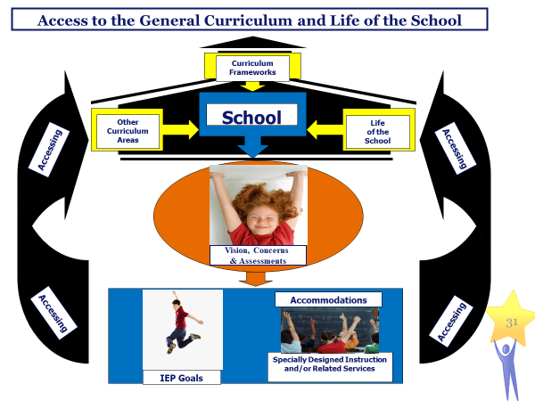
Access to the General Curriculum and Life of the School

Slide 11
Prior TA Focus . . .
Child Assessment (Assessment Tools and Practices for Children who are Deafblind – Communication Matrix, AEPS, INSITE Checklist, Skill Inventories/Checklists, *MA MCAS-ALT Survey)
Specially Designed Instruction (DB Practices)
Communication Approaches and Calendar Systems
Wait Time
HUH and Tactile Strategies
Social Skills Development and Inclusive Practices
Sensory Access

Slide 12
Today’s TA Focus . . .
Initial Conversations:
Grade Level Learning Standards
Sensory Needs
Present Levels of Performance (PLEP)
Accommodations to access general education curriculum
*Specially Designed Instruction… link to entry points/access points (DB Practices using Systematic Instruction)
Calendar Systems
Wait Time
HUH and Tactile Strategies
Social Skills Development and Inclusive Practices
Experience Books
Accommodations for Supporting Sensory Access

Slide 13
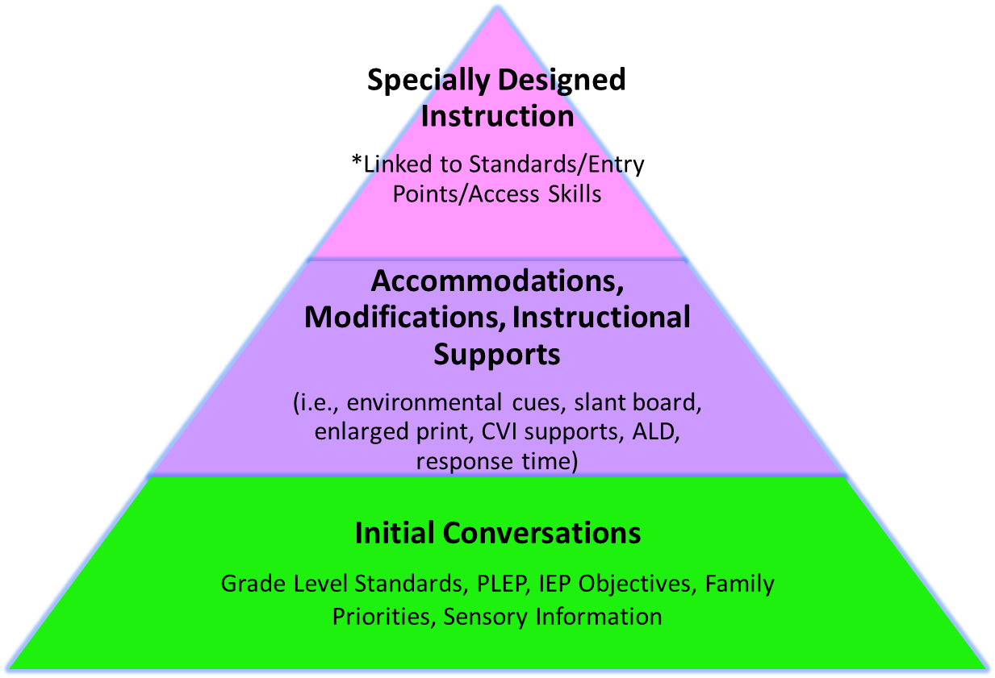
TA Focused on Supporting Access to GEC

Slide 14
MCAS Alt Survey - “TA Gold Mine”
MCAS Alt Survey - For students taking the MCAS Alt
Use as basis for selecting an entry point or access skill
Helpful in determining current level of knowledge, skills, and abilities to select challenging entry points.
Find your state’s resources for beginning initial discussion about entry points/access skills!

Slide 15
Student Example: Lija - 4th Grader
Background:
Seven years old, lives with her family, enjoys outdoor play with younger siblings
Loves Blippy on YouTube, slurps from family dog
Vocalizes to express likes and dislikes
Eye gaze process, attention on zoom 40-45 minutes
Health: Meningitis 18 months, trach, g-tube, seizures
Sensory: CVI and moderate/severe HL (aided)

Slide 16
Student Example: Lija - 2nd Grader
Content Area: Science & Technology
Strand: Earth and Space Science Standards
Standard: Earth’s Systems 1-ESS1-1
Use observations of the Sun, Moon, and stars to describe that each appears to rise in one part of the sky, appears to move across the sky, and appears to set
Entry Point: Use pictures and/or drawings to collect observations related to a topic.
Access Skill: Match picture to picture of Earth, Moon, Sun, Stars, Solar System – using Eye Gaze and Vocalization
Accommodations: Zoom and PPT; up to an array of 3; point with yellow cursor and ask Y/N - label; wait up to 5 seconds; intervener provides med support as indicated

Slide 17
Lija (2 of 2)
Specially Designed Instruction
Pre-teach new vocabulary and concepts using objects
Provide object/picture in all curriculum areas (calendar)
Routine review using object/picture bucket with word labels
Methodology/Delivery of Instruction
Strategies for introduction of new activities
Wait time up to 5-6 seconds for eye gaze on object, slightly off midline
Praise at end of session and choice for “break”
Weekly report to parents to ensure reinforcement and home routine
Performance Criteria:
Test only on vocabulary and concepts (objects/pics)
Goal Attainment Scale to measure skill acquisition and generalization across people, materials, and settings.

Slide 18
Template Tier 3 TA - GEC
Readiness Assessment/Agreements
Roles and Responsibilities of Team Members
Conversation about “IEP Worthy” Goals and Objectives
TA Process:
  Standard
  Entry Skill
  Access Skill
  Accommodations
  Specially Designed Instruction (Intervention Plan)
  Methodology/Delivery of Instruction
  Performance Criteria
  Progress Monitoring
  Feedback & Coaching

Slide 19
NEC Intervention Plan (handout)
Team Interview
Routine/Intervention Plan
Accommodations & Modifications
Implementation
Feedback & Coaching

Slide 20
Work In Progress & Challenges
More field testing needed
Connecting to SEA Personnel & Training
Consultant “comfort level”
“Readiness Angst”
Impact of COVID
Transient – current demands on schools/staff/families
Consistent focus over time
Providing TA to students with COMPLEX Health Care Needs

Slide 21
Next Steps
Evaluation Link
Overview of Session 2
  State Examples
  Breakouts: Discussion & Reflection
Reflection: In Preparation for Next Week…
  What do you know about providing TA on accessing the general education curriculum (GEC)?
  What activities are you doing in your state on this topic?
  What components related to accessing the GEC and alternate achievement standards are still unclear?

Slide 22

The contents of this presentation were developed under a grant from the U.S. Department of Education, #H326T180026. However, those contents do not necessarily represent the policy of the U.S. Department of Education, and you should not assume endorsement by the Federal Government. Project Officer, Susan Weigert.

