Slide 1


Putting it into Practice: Examples from the TA Network on Accessing the General Education Curriculum
Kayla Coburn and Julie Maier, CA
Katy Ring, IA
Juanita Rodriguez, PR
Chevonne Sutter, NV
March 9, 2022

Slide 2
Agenda
Welcome
Katy Ring (Iowa)
  Reflection
Chevonne Sutter (Nevada)
  Reflection
Breakout Session 1
Julie Maier and Kayla Coburn (California)
  Reflection
Juanita Rodriguez (Puerto Rico)
  Reflection
Breakout Session 2
Closing and Next Steps

Slide 3
Objectives
Participants will gain knowledge of high-quality practices on supporting students who are deaf-blind to access the GEC
Participants will gain knowledge of resources to support students who are deaf-blind to access the GEC

Slide 4

Iowa’s TA Approach
Katy Ring, Director, Iowa Deafblind Services

Slide 5
My Objectives Today
Show what the Iowa Deafblind Project is trying to do with the framework outlined by our Department of Education
Discuss the barriers we still face in implementation

Slide 6
Iowa’s Revamped TA Process
Includes:
Needs assessment
TA readiness factors
Setting outcomes with the team-measurable ADULT behavior outcomes
Team ownership
*Shout out to Sam Morgan and Julie Durando for helping IA with our TA process!!*
Tip: If you can get your project training on adult SEL and best coaching practices: do it!

Slide 7
Iowa’s Specially Designed Instruction (SDI) Framework
SDI Framework Link to Iowa Department of Education
Key Points:
All students are general education students first
The standards should drive Diagnose, Design, and Deliver
Diagnosis, Design, Deliver, and Engage helps address our students’ unique needs as learners who are deafblind

Slide 8
How Do We Apply This?
Diagnose | Design | Deliver | Engage
Vision & Hearing Assessments | Accommodations | Monitor | Access!
Etiology | Calendar systems | Formative assessment | Build positive relationships
Communication Matrix | Routine development | Instructional decision-making | Family communication
Preference Assessments | Communication goals & methods | Revisit & refine
ECC Assessments | Gesture dictionaries
 | Touch cues
 | Object book/boxes

Slide 9
Example
Let’s walk through an example together…

Slide 10
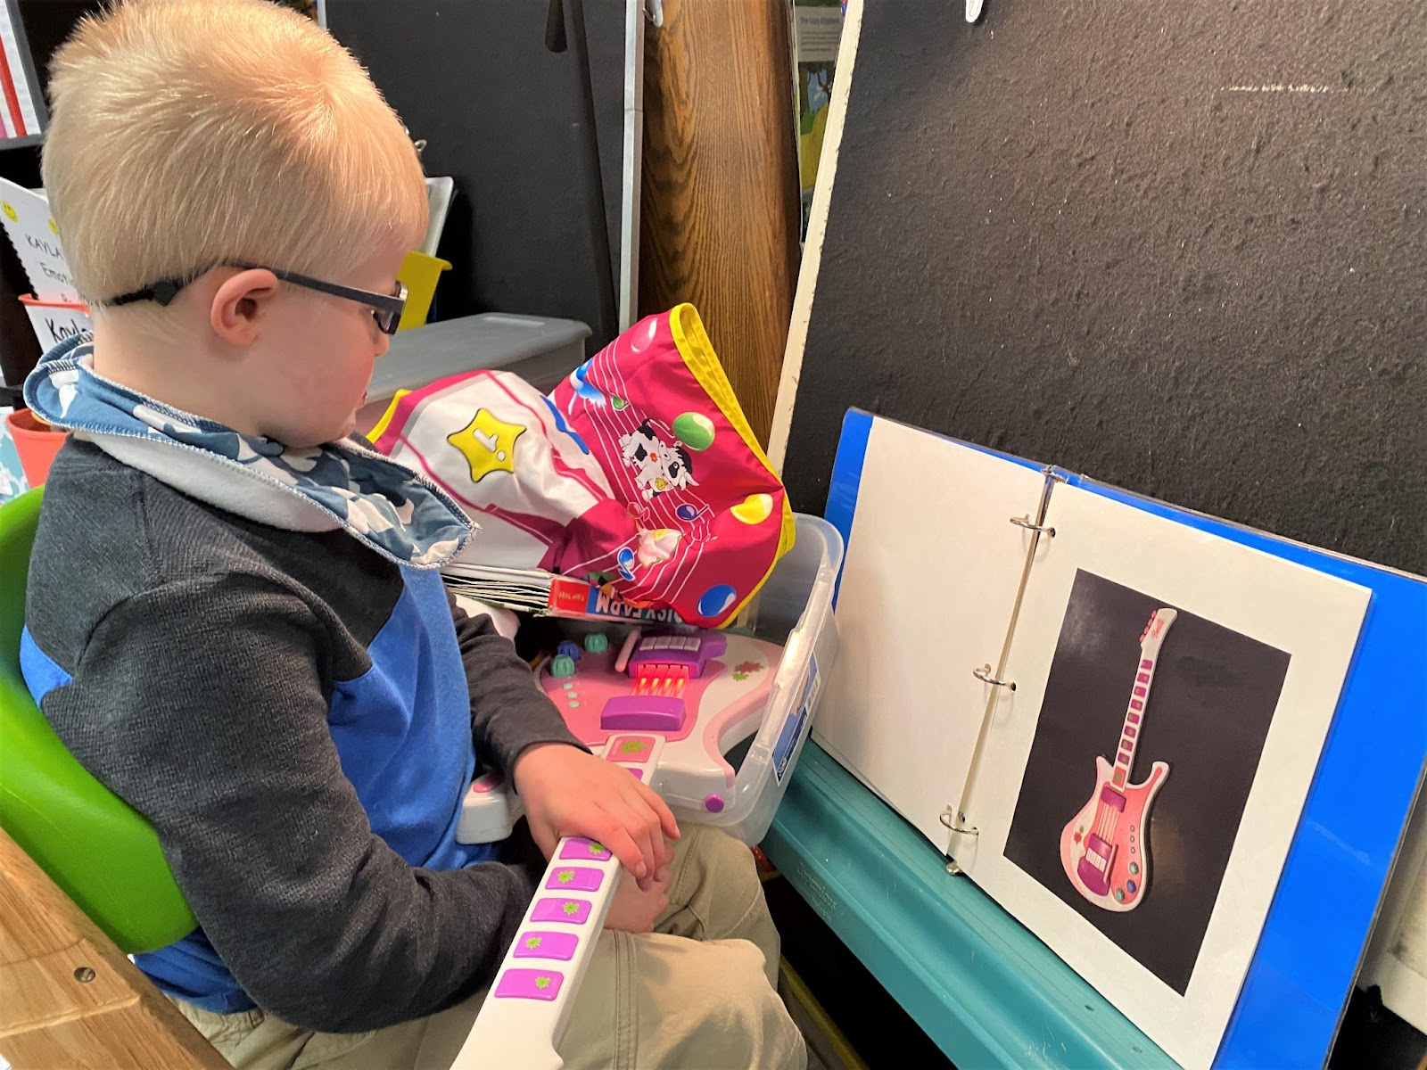
IEP Goal: Receptive Language Skills
EE: Understands Words Associated with Objects, Engages in Shared Reading

Slide 11
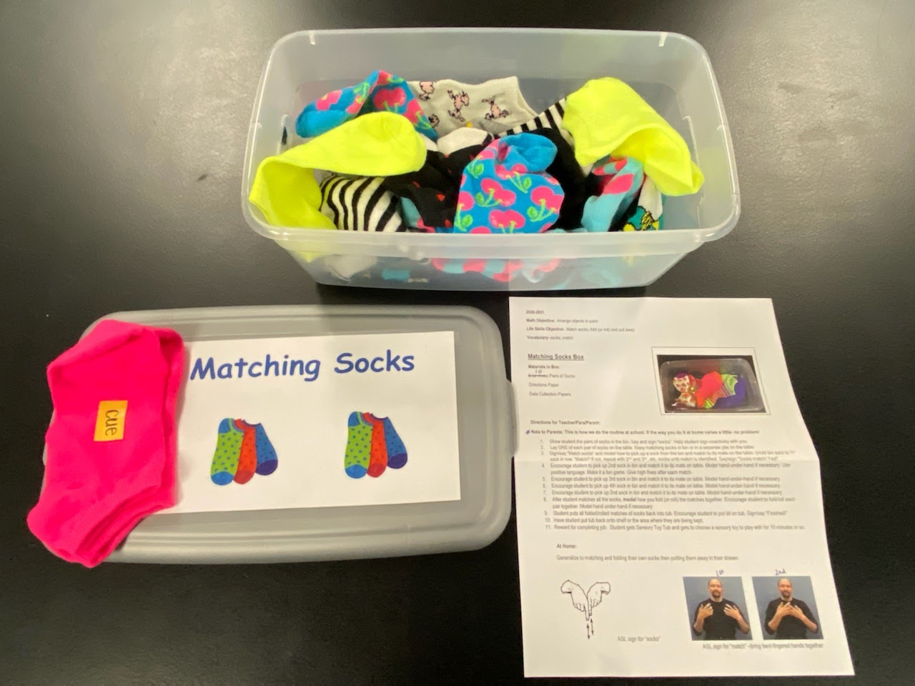
IEP Goal: New Job Routine
EE: Math – Matching, Arranging
ECC: Laying Out Socks, Stacking, Folding/Rolling

Slide 12
Barriers We Continue to Face
Expecting teams to implement deafblind strategies without first providing training on those strategies. It takes awhile to get to Design and Deliver.
Staff turnover. We are always re-training.
The SDI Framework has not trickled down to special education teachers.

Slide 13
Barriers Cont.
Not everyone believes that our students are general education students first.
The “I am my position” problem.

Slide 14
Reflection #1
Consider:
What did you hear that resonated with you?
How might you use the SDI Framework in your TA on access to the GEC?

Slide 15


Access to the General Education Curriculum: Lesson Plan Template
Nevada Dual Sensory Impairment Project
Chevonne Sutter, Ph.D., BCBA-D
University of Nebraska, Reno March 9, 2022

Slide 16
Objective
Introduction to a lesson planning tool developed by Nevada to assist educators in increasing access to the general education curriculum for ALL students

Slide 17
Background
Planning for access to the general education curriculum is a process with multiple components
  Common for project to provide assistance for one or a few of those components at a time (e.g., selecting meaningful goals and objectives, symbol assessment, collaborative practices, response prompting and systematic instruction, communication, assistive technology)

Slide 18
Context for Differentiated Lesson Planning Tool
Have not used within the context of our intensive TA in its entirety
Has been relatively widely disseminated to teachers throughout the state in the last couple of years in the context of targeted TA (e.g., district/state trainings, university courses)
Originally developed for a district-level special education teacher training in response to need

Slide 19
Differentiated Lesson Plan Components
Domain, Objective, and Standard
Specify key terms/vocabulary
Specify students by literacy/symbol level
Specify supervising adults
Specify IEP data sheets to be used
Specify materials for each student
Specify augmentative and alternative communication
Specify other assistive technology
Specify specific strategies to help students make meaning of lesson (before, during, and after)
Specify assessment measures for EACH student

Slide 20
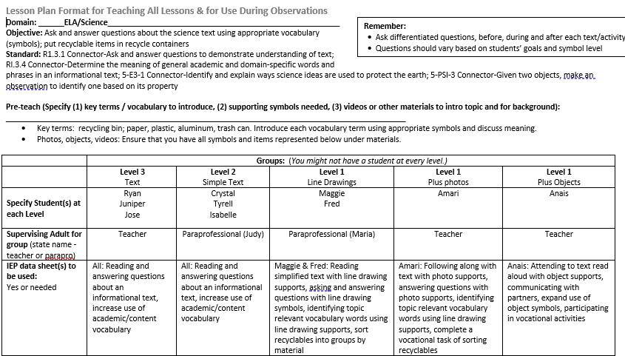
Sample Differentiated Plan (Objective)
Developed by Demchak, Prudente, and Stutter, 2018

Slide 21
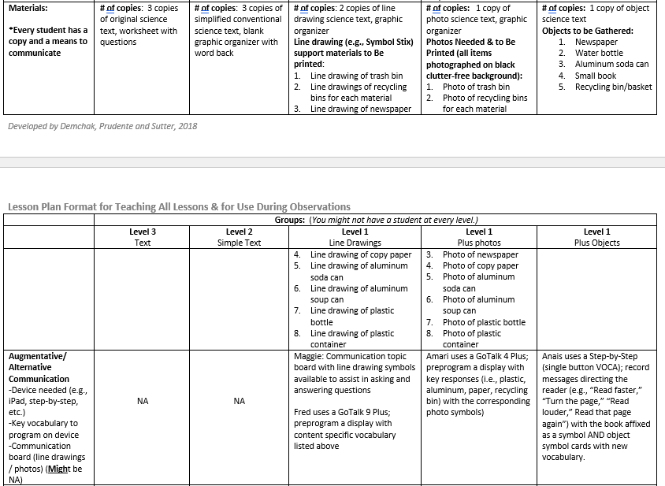
Sample Differentiated Plan (Materials)

Slide 22
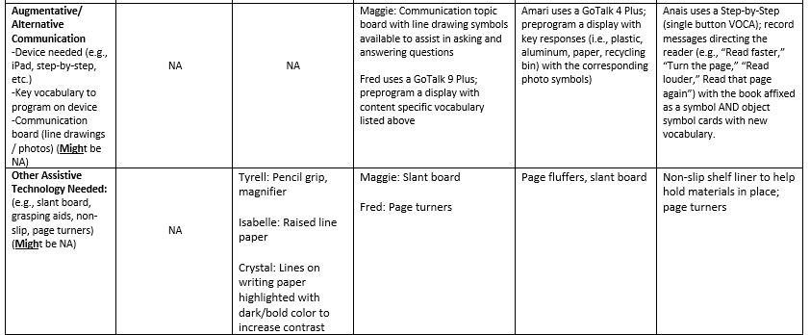
Sample Differentiated Plan (AAC & AT)

Slide 23
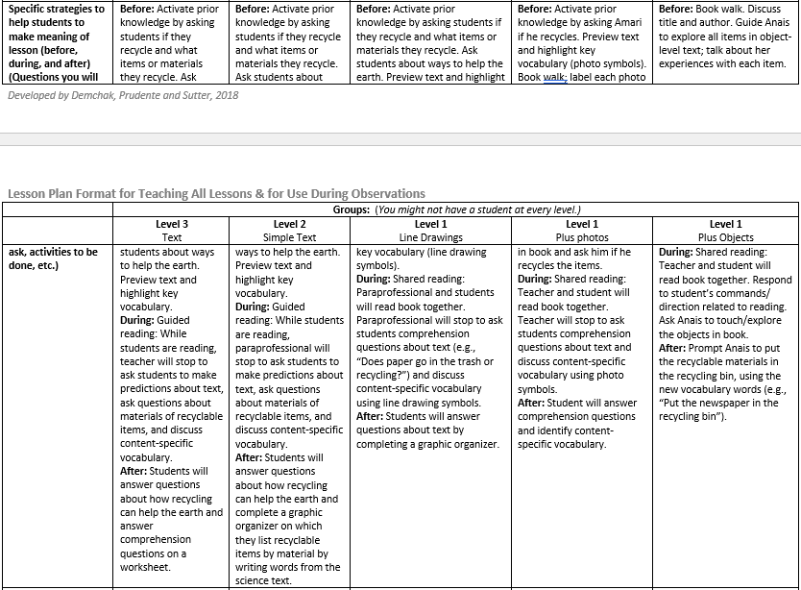
Sample Differentiated Plan (Specific Strategies)

Slide 24
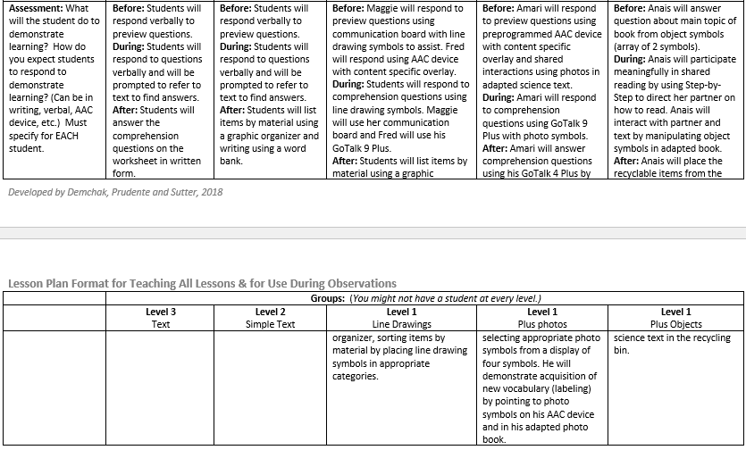
Sample Differentiated Plan (Assessment)

Slide 25
Essential Component #1
Identify the skill you want to teach (and/or link to the connector standards)
What is the essence of this skill?
Why are you teaching the skill?
What is the purpose?

Slide 26
Essential Component #2
2. Identify individual student symbol levels/literacy stages (e.g., objects, photo symbols, line drawings, conventional text) and develop appropriate symbols for each
Student at the object level of symbolic understanding
  Possible symbols: Actual objects, whole objects, partial objects, miniature objects, texture or other tactile cues
Student at photo level
  Possible symbols: Photos of actual items, stock photos
Student at conventional text level (further differentiation required)
  Possible symbols: Stamps, plastic letters, letter cards or word banks, written letters with pencil and paper

Slide 27
Essential Component #3
3. Identify instructional strategies that match the task and the characteristics of individual students. Might be different for each student within a single lesson
Shaping
Chaining
Response prompting procedures
Task analysis
Peer-assisted learning strategies
Naturalistic interventions

Slide 28
Essential Component #4
4. Identify IEP objectives for which instruction can be embedded in larger lesson. Might be targeting content standards and might be individualized functional objectives. For example, within one lesson, the teacher might target:
Asking and answering questions to demonstrate understanding of a text
Increase turn-taking in communicative exchanges using object symbols

Slide 29
Reflection #2
Consider:
What did you hear that resonated with you?
How might you use the differentiated lesson plan in your TA process?

Slide 30
Breakouts
Notes:
Kristi
Now Haylee is going to put you all into breakout rooms. You will have 20 minutes in your groups. See you all back here in 20 minutes.

Slide 31

Access to the General Education Curriculum:
Challenges and Opportunities
Kayla Coburn and Julie Maier,
California Deafblind Services
Notes:
Kayla

Slide 32
Our Objectives
Learn about challenges and opportunities related to general education curriculum access we’ve identified in our state.
Explain how CDBS provides information and support related to access to the general education curriculum at all levels of our TA process.
Share examples of resources and support we have offered to educational teams during the TA process.

Slide 33
Snapshot of Our Student Population
Students participating in state assessments:
Regular state assessment: 29
Regular state assessment with accommodations: 125
Alternate assessment: 314
Not required by grade or age or parental opt-out: 486 (28 were parental opt-out)

Slide 34
California’s GEC Initiatives
General Education Access and Standards:
Emphasis on access for all students. Promotes use of UDL and collaboration between educators.
IEP goals aligned to grade-level standards.
Common Core Standards for ELA and Math
Next Generation Science Standards
Yearly Assessments:
Smarter Balanced Assessment
Alternate Assessment: California Alternate Assessment

Slide 35
“The danger of basing educational planning solely on a team’s expectations of a student’s future life is that the vision may be too small.”
-Diane Browder (2012)
Browder, D. (2012). Finding the Balance: A response to Hunt and McDonnell. Research & Practice for Persons with Severe Disabilities. 37(3).

Slide 36
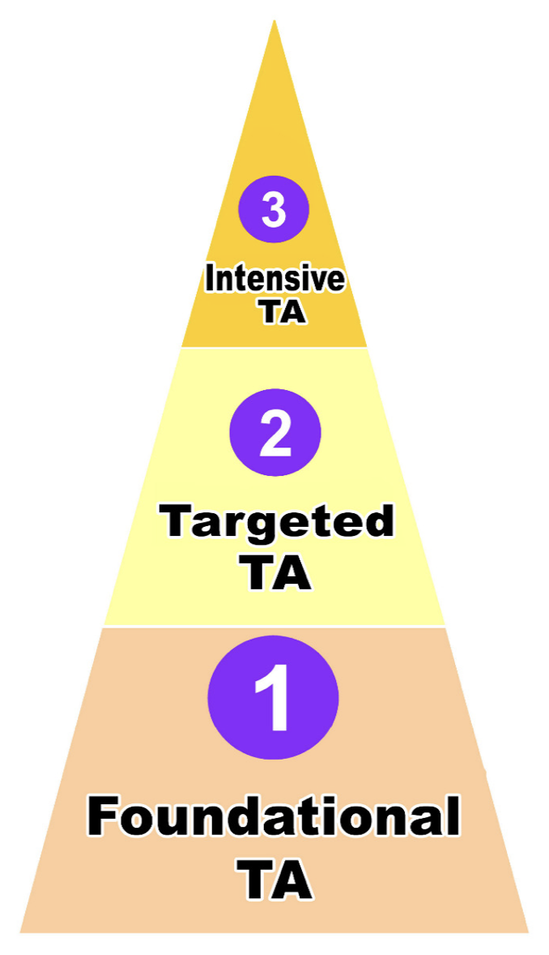
Our updated TA Process (1 of 2)
Our new TA process is focused on determining a team’s readiness for receiving technical assistance.
Everyone who requests technical assistance starts at foundational level and moves forward to next level if the team demonstrates readiness to actively engage in TA.

Slide 37
Our updated TA Process (2 of 2)
Foundational (F): Provide CDBS and other online resources. Initial discussion with team about needs and capacities.
Targeted (T): Team demonstrates interest in learning more. Targeted training for team specific to identified needs.
Intensive (I): Team demonstrates commitment and capacity to implement specific strategies. Onsite visit with ongoing coaching and monitoring. TA plan includes action items tied to Common Measures (Communication, Access to GEC, Transition).

Slide 38
Challenges
Large state with diverse student population and current credentialed teacher shortage.
Curriculum selection based on program or district, not individual child’s needs.
Professionals’ mindset about student’s capabilities and potential.
Variability in teachers’ and service providers’ training, knowledge, and skills related to identifying meaningful access points and goals for students with extensive support needs.

Slide 39
Opportunities
Literacy trainings for professionals and families (F)
CDBS staff developed and use a list of resources related to literacy and numeracy to share during TA (F)
Pre-service trainings in VI, D/HH, and ESN programs (F)
Consult on development of IEP goals during TA (T or I)
Educators knowledge of core vocabulary and emergent literacy practices (T or I)
Potential for partnering with other organizations in our state focused on GEC access (F)
Teacher of the Deafblind CoP members could serve as mentors (T)

Slide 40
Example: Middle School Student
Resources shared in Foundational TA:
Engagement in GEC Curriculum | Communication
Learning Environment: Practice Guide: Preparing the Learning Environment Establish clear routines: CDBS Article: Routine-based Learning Deafblind Learning Modules: Routines for Participation and Learning, Calendars (this is also an important communication resource) Curricular activities ideas: Paths to Literacy is website with lots of suggested activities for students with emerging communication and literacy skills. Detailed and includes photos and examples. Specific sections to consider for MM: · Emergent Literacy · Multiple Disabilities · Tactile Math Ideas | Communication Skills Assessment: Communication Matrix: The Communication Matrix is a free assessment tool to help families and professionals easily understand the communication status, progress, and unique needs of anyone functioning at the early stages of communication or using forms of communication other than speaking or writing. Fact Sheet: Object Communication: This fact sheet describes why and how to use objects in everyday routines to help your child develop language and concepts about the world. Fact Sheet: Using Cues to Enhance Communication Fact Sheet: Creating a need to communicate

Slide 41
Example: Elementary-aged student goals
To encourage visual or tactile interest and with an adapted book with a clear repeated line or chorus, A. will independently activate a switch to participate in a shared reading experience by completing the repeated line at least one time during the activity.
Given an anticipation calendar of tactile objects paired with spoken language and a touch cue or sign in her visual field, A. will indicate readiness for beginning the next activity by facial expression (smile, open mouth, etc.) or body movement for at least 6 transitions during a school day, on 3 out of 4 days.

Slide 42
Example: High School student IEP goal (1 of 2)
CCSS: 11-12.RI.2 Determine two or more central ideas of a text and analyze their development over the course of the text, including how they interact and build on one another to provide a complex analysis; provide an objective summary of the text.
Essential understanding: Identify the central idea or key detail of a text.
Goal: K. will increase literacy skills by touching 1 tactile object relating to a text or chapter being read when prompted with 1 body/touch cues and 1 verbal cues in 3 of 3 opportunities.

Slide 43
Example: High School student IEP goal (2 of 2)
CCSS: 11-12.L.3 Apply knowledge of language to understand how language functions in different contexts, to make effective choices for meaning or style, and to comprehend more fully when reading or listening.
Essential understanding: Use a range of vocabulary to convey ideas and opinions.
Given hand under hand support, after listening to an adapted grade-level text, K. will answer six (6) questions with two-choice options relating to the topic using core words cards LIKE or NOT with 80% accuracy.

Slide 44
Tracking Intensive TA Goals
Developed and recently started using an Intensive TA Planning Form (pilot study phase).
Big thank you to NYDBC for sharing this helpful example.
Sample form is in the Basecamp Folder.

Slide 45
References
The Common Core: Supporting Students with Disabilities—What Educators Need to Do. (n.d.). CA Department of Education. https://www.cde.ca.gov/sp/se/cc/swd-commoncore-educators.asp
Browder, D. (2012). Finding the Balance: A response to Hunt and McDonnell. Research & Practice for Persons with Severe Disabilities. 37(3).
Hunt, P., McDonnell, J., & Crockett, M. A. (2012). Reconciling an ecological curricular framework focused on quality of life outcomes with the development and instruction of standards-based academic goals. Research & Practice for Persons with Severe Disabilities. 37(3).

Slide 46
Reflection #3
Consider:
What did you hear that resonated with you?
How might you offer support around the IEP and goal writing process (in the way that aligns with your state TA processes)?

Slide 47

Technical Assistance to Teachers, Assistants and a Mother of a Puerto Rican Student:
Accessing the Puerto Rico General Education Curriculum
Juanita Rodriguez
Puerto Rico Deaf-Blind Project

Slide 48
Puerto Rico Deaf-Blind Project
Number of students with deaf-blindness served as of 2021 = 34
TA is provided as per request from families, teachers, or other school personnel.
  Marta Sanabria – Associate Director
  Juanita Rodriguez – Coordinator

Slide 49
Who Is Ryan? (1 of 2)
16 years old
Youngest of two sons, born to Yvette and Moises
He is in the 10th grade in a public school in the southern part of the Island (PR). Access the GEC, in addition to Adapted Physical Education.
Eligible for special education services under deaf-blindness category.
Originally, Ryan was placed in a classroom for students with multiple disabilities.

Slide 50
Who is Ryan? (2 of 2)
He also received home schooling, prior to elementary school
Elementary Placement: Special education classroom for D/B (one to one setting).
Deaf-blindness is due to Kernicterus. As such, he has Cortical Visual Impairment, auditory neuropathy spectrum disorder (ANSD), severe cerebral palsy, dystonia.
The dystonia impede physical movements, including articulatory muscles, preventing his speech.

Slide 51
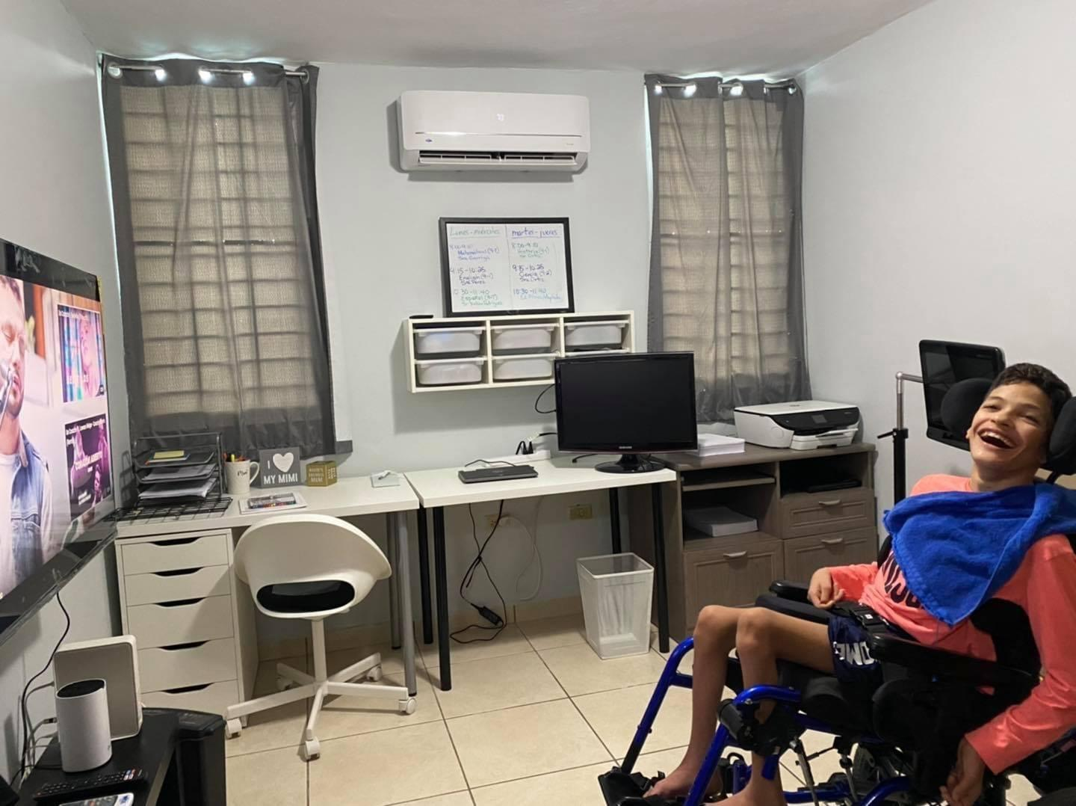
This is Ryan in his room at home

Slide 52
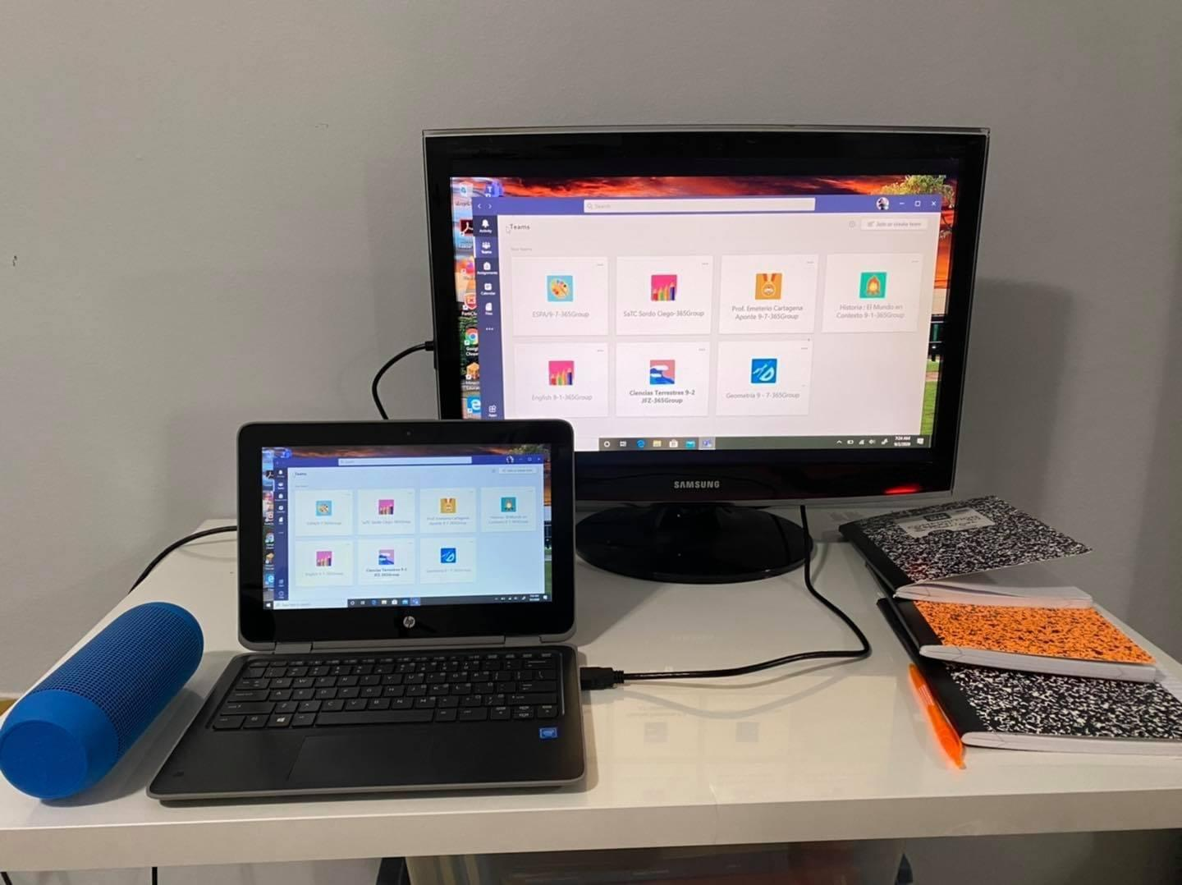
A closer look at Ryan room.
It includes a laptop connected to a larger screen to fits his visual needs

Slide 53
Excerpts of IEP (1 of 4)
Comments on his health: Ryan suffers from reflux, severe constipation, and dystonia. He was recommended to use eye glasses and hearing aids, in accordance with specialists.
He gets tired frequently, depending on the activity and the frequency.
(This information was translated from Spanish for the purpose of this presentation, as it was written in his IEP).

Slide 54
Excerpts of IEP (2 of 4)
Description of Ryan's functioning:
Actual General Academic Level: Academic function is average if compared with other students of his same age; with assistive technology, modifications, and support.
During academic year 2020-2021, the student will be included in Science, Mathematics and English. The content will be modified to fit his needs.
(This information was translated from Spanish for the purpose of this presentation, as it was written in his IEP).

Slide 55
Excerpts of IEP (3 of 4)
Ryan receives individualized instruction to meet his learning needs to access information.
He communicates in gestures, weeping, smiles, and eye contact.
He uses a Tobbi communicator.
(This information was translated from Spanish for the purpose of this presentation, as it was written in his IEP).

Slide 56
Excerpts of IEP (4 of 4)
Math: Numerals and operation
Goal 1:
Apply math concepts (represent, estimate, computer, relate numbers, and numeric systems)
Select and interpret units in formulas
Select and interpret the scale in a graphic
(This information was translated from Spanish for the purpose of this presentation, as it was written in his IEP).

Slide 57
Technical Assistance Focus
Ryan needs assistance in communication. His mother collaborated in the identification of his preferred mode of communication.
Teacher was instructed on the communication system used by the students ( the two-hand system).
He has to be able to communicate in a regular classroom to participate and interact with classmates.

Slide 58
TA to Teachers
Revision of IEP to change his placement to a regular 7th grade (GEC) with the modifications and accommodations needed.
TA to content area teachers on how to teach Ryan using his unique communication system.
How to ask questions of Ryan?
How to evaluate Ryan?
TA: Orientation to Ryan’s classmates to facilitate his interactions in the classrooms (Math, Science,..). Ryan wants to have friends among classmates.

Slide 59
TA to Teachers and Classmates (1 of 2)
Ryan had been attending regular classes since the 7th grade, accessing the GEC with a teacher assistant, accommodations, and modifications recommended to fit his communication needs.
Evaluations are modified to allow him to respond with Yes/No answers.
Additionally, teachers use two alternatives (one for each hand) to request Ryan’s participation in the class.

Slide 60
TA to Teachers and Classmates (2 of 2)
Additional time to take tests.
Additional time to answer questions in the classroom.
TA is offered to teachers, other school personnel and classmates in accordance with Ryan’s academic and social needs.

Slide 61
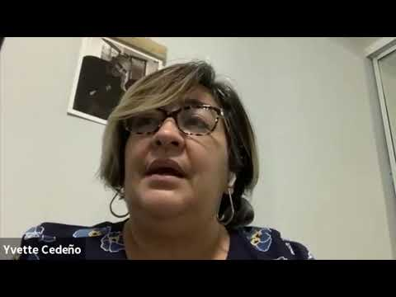
Ryan’s Mother: Mrs. Yvette Cedeno

Slide 62
Presuming Competence
“Presuming competence means to assume [that a person] has the capacity to think, learn, and understand—even if you don’t see any tangible evidence that such is the case. It’s assuming they are not inherently incapable; they just need the right supports and systems to help them succeed.”
https://blog.theautismsite.greatergood.com/presume-competence/

Slide 63
Reflection #4
Consider:
What did you hear that resonated with you?
How do you/how might you speak with educational teams about presuming competence/the least dangerous assumption?

Slide 64
Breakouts

Slide 65
Evaluation
Evaluation Link

Slide 66
Final Thoughts
Thank you for joining
We are just starting this journey
  Contact:
    Kristi Probst (kristi.probst@hknc.org)
    Emma Nelson (emma.nelson@hknc.org)
Change the paradigm
Let’s forge forth together!

Slide 67
THANK YOU!

Slide 68

The contents of this presentation were developed under a grant from the U.S. Department of Education, #H326T180026. However, those contents do not necessarily represent the policy of the U.S. Department of Education, and you should not assume endorsement by the Federal Government. Project Officer, Susan Weigert.

