Slide 1

Deaf-Blind Immersion Experience
Michael Richards
Coordinator, Deaf-Blind Immersion Experience

Slide 2
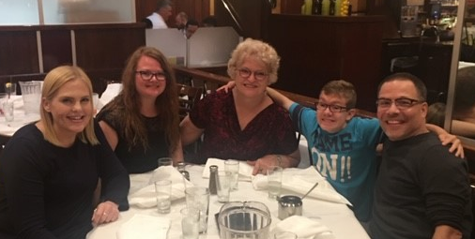
Deaf-Blind Immersion Experience (DBIE)
Begins with formation of the team
Provides person-centered assessment and training
Functional skills in home, work and community
Hands on coaching for staff and family members
Open to people of all ages

Slide 3
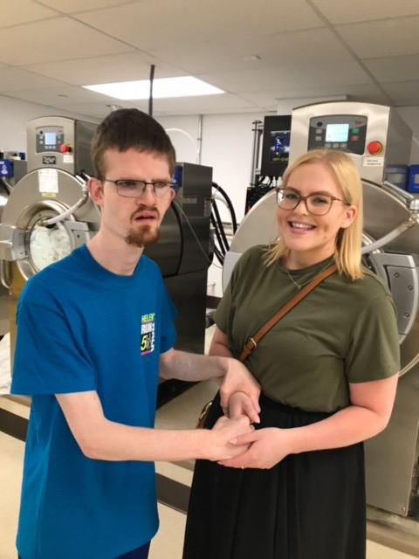
Pre-Employment Transition Services
(PRE-ETS)
Job exploration
Work based learning
Workplace readiness training
Self – advocacy

Slide 4
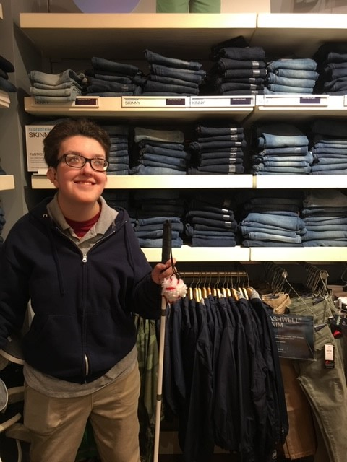
Job Exploration
Begins with personal futures planning
Team meetings to discuss preferences and experience
DBIE team helps with job “matchmaking” ideas
Work schedule prepared

Slide 5
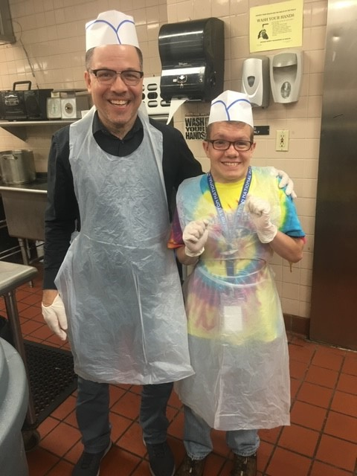
Work-Based Learning
Task analysis of job duties
Staff instruction in individual’s communication mode
Identification of strengths and needed supports
Soft skills

Slide 6
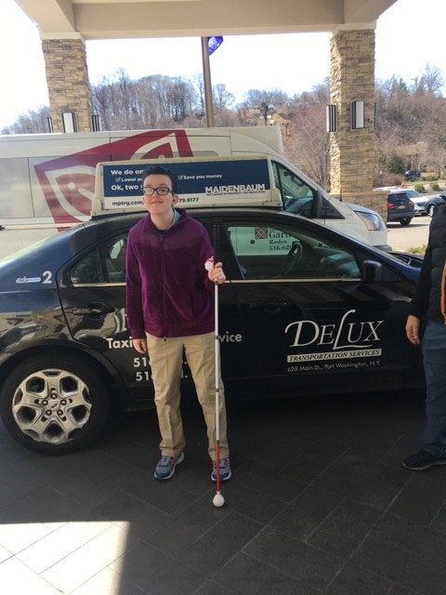
Workplace Readiness Training
Independent Living skills (i.e. grooming, time, meals)
Communication skills (i.e. communication cards)
Technology for communication, work tasks
Mobility travel & safe navigation at work site

Slide 7
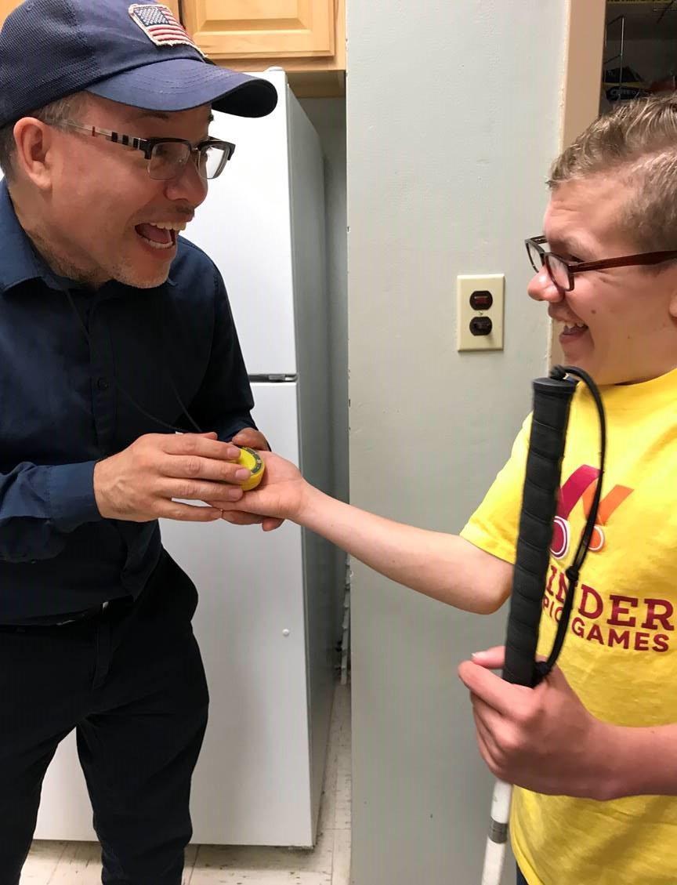
Self-Advocacy
Team highlights strengths in all areas
Communicate expectations
Encourage independence
Provide positive reinforcement

Slide 8
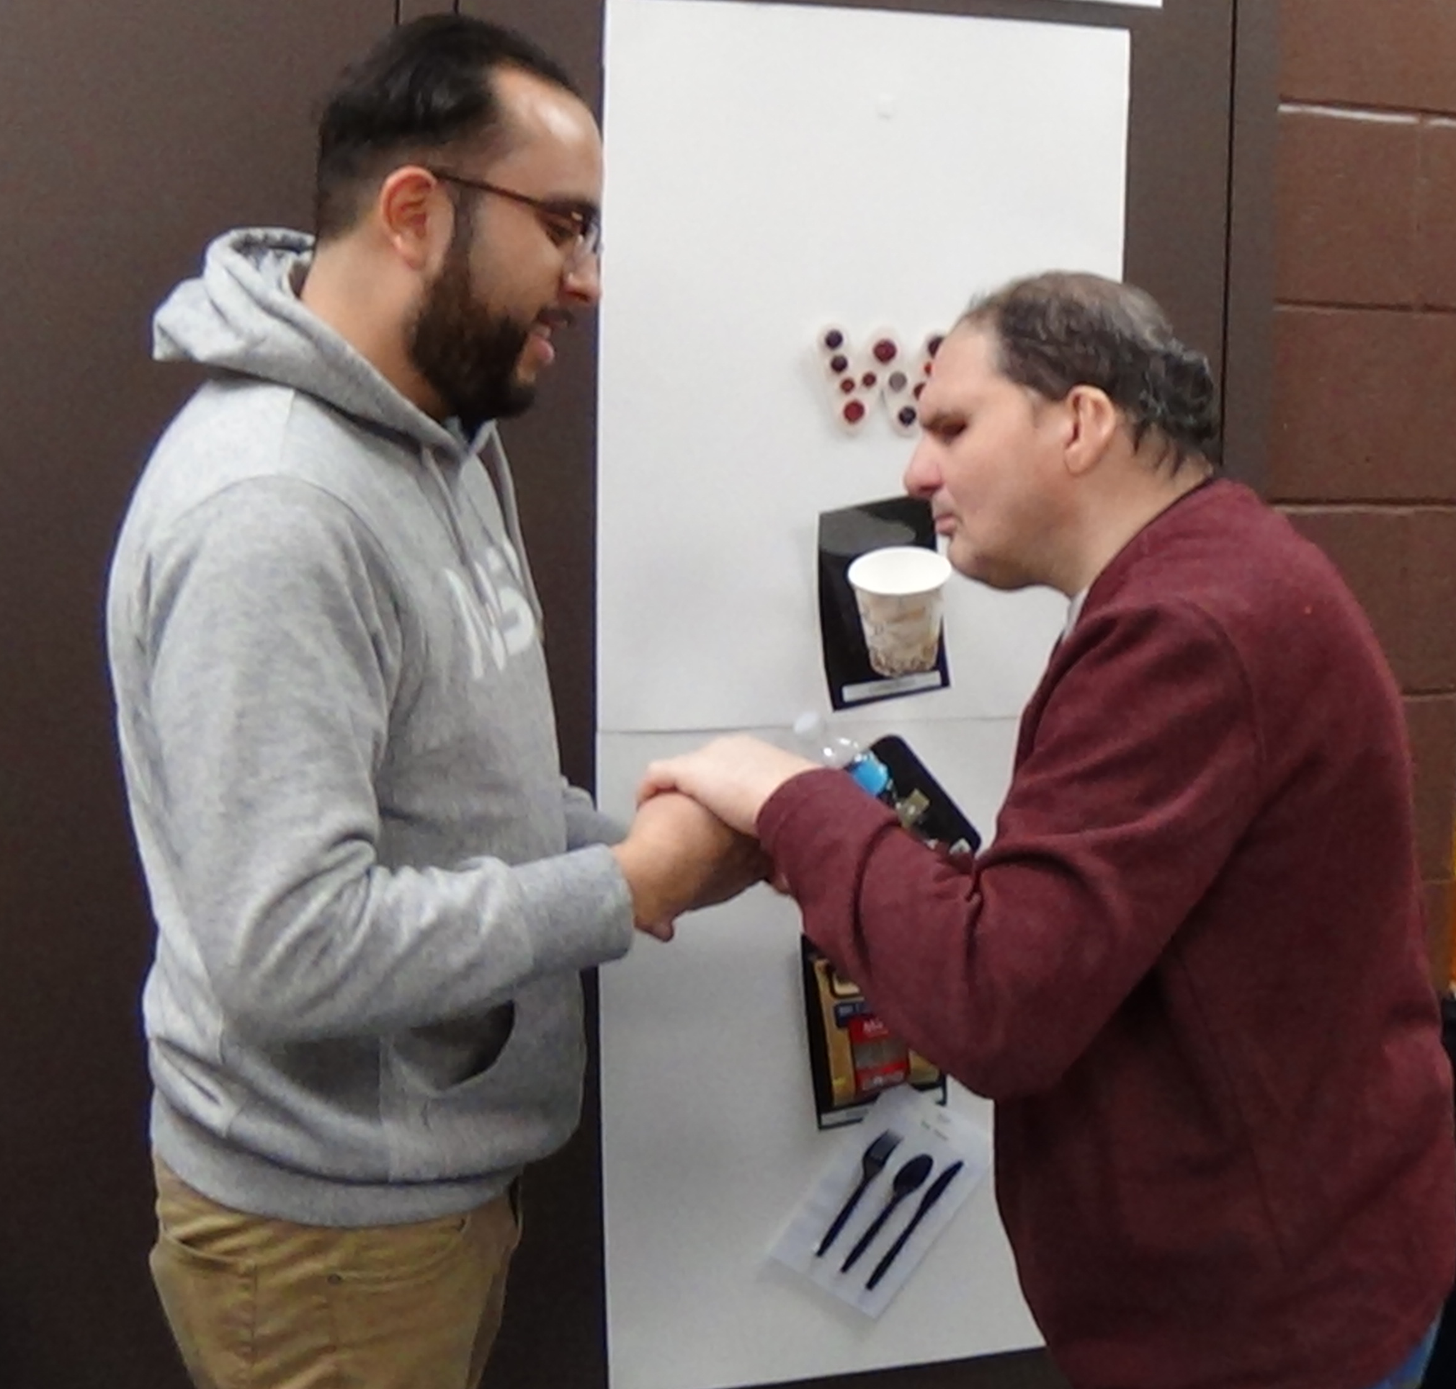
Application of DBIE
Action planning throughout the experience
Community of practice
  quarterly meetings
Follow up
  calls, emails, visits

Slide 9
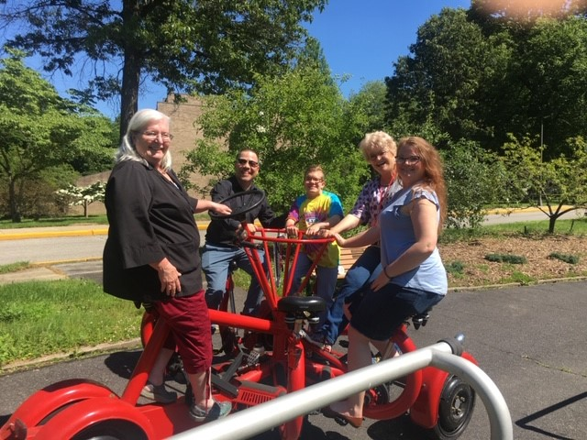
T.E.A.M.
T - ackling trials together
E - veryone’s efforts energizes
A - cknowledging another's assets
M – easuring minute milestones

