Slide 1


Identifying Learner Preferences and Utilizing Results in Designing Instructional Communication Programs
Dr. Susan M. Bashinski
sbashinski@missouriwestern.edu
Dr. Sarah Ivy
sivy@fsu.edu

Slide 2
Overview
Purpose and focus of today’s webinar
Research on preference assessment
Case Study: Conducting a variety of preference assessments for a learner with deafblindness
Using preferences to promote communication development

Slide 3
Purpose and Focus
Over-arching goal:
To demonstrate how the use of data from a learner’s preference assessment can be effectively combined with the results from a learner’s communication skills assessment to build the foundation for an appropriate, powerful communication program

Slide 4
Purpose and Focus (cont.)
Many learners with deafblindness move more slowly through the developmental phase of using a variety of behaviors intentionally—but NOT in an intentionally communicative way
Young children who are neurotypical generally move through this phase relatively quickly—and without direct instruction!
Development of intentional communication is a critically important, but very challenging task

Slide 5
Two Key Concepts
Notes:
UNINTENTIONAL behaviors require significant interpretation from the partner…
INTENTIONAL behaviors simply need the partner to provide / assign communicative purpose for them!

Slide 6
Two Key Concepts - #1
Behavior IS communication!
Notes:
UNINTENTIONAL behaviors require significant interpretation from the partner…
INTENTIONAL behaviors simply need the partner to provide / assign communicative purpose for them!

Slide 7
Key Concept #1
Two primary ways to view the overt behaviors learners demonstrate….
through a “BEHAVIORAL” filter
or
through a “COMMUNICATION” filter.
Which filter do YOU use?

Slide 8
Two Key Concepts - #2
Intentionality Development
Defined as:
Deliberate pursuit of a goal, as well as the means to obtain the goal
Notes:
Pivotal point!

Slide 9
Key Concept #2
Two primary elements for characterizing a learner’s overt behaviors, in terms of “INTENTIONALITY....”
Intentional behavior
Intentional communication (means to have impact on another person, not just objects)

Slide 10
Sequence of Intentionality Development
For the purposes of today’s webinar, we shall identify and focus on these primary stages:
(Nonintentional [or preintentional])
Intentional behavior
Intentional unconventional communication
Transition to conventionality
Transition to intentional conventionality

Slide 11
Nonintentional / Preintentional
In this stage, a learner is neither deliberately pursuing a goal nor aware of a means to obtain the goal
Behaviors are idiosyncratic
A communication partner must interpret the learner’s behaviors as if they were intentional (Consistent, repeated interpretations by partners, over time, will shape intentionality.)
Notes:
Reflexive behavior
Apparently random behavior
Behavior state – we won’t be covering this today, though it IS critically important to communication programming for learners at this stage of development.

Slide 12
Intentional Behavior
Behavior IS under the learner’s control (i.e., intentional)
Behavior is NOT used to communicate intentionally
Behavior IS meaningful in context
The learner does not realize she can use these behaviors to control another person’s behavior.

Slide 13
Intentional Unconventional Communication
Behavior IS intentionally communicative
Intentional communication means to have an impact on another person, not just on objects
NOT symbolic
“Unconventional” because these forms are not acceptable to use as grow older

Slide 14
Transition to Conventionality
Behavior IS used to intentionally communicate
Conventional gestures / vocalizations
Communicative messages are understood by members of the same culture
Communicative forms are socially acceptable to use as grow older

Slide 15
Transition to Intentionality Conventionality
Partner’s responsibility for success of a communication interaction is diminished
Communicative context is important, but less so than in the nonsymbolic stage
Learner is likely to demonstrate concrete symbolic expressions (i.e., with 3-D objects)

Slide 16
Important Points
As we move now to a critical examination of PREFERENCE ASSESSMENT, it is critical to remember that….
Communication is both a skill and a sensorimotor experience
And how very important it is to….
Maximize the learner’s sensory access.

Slide 17
Questions?
Before we continue….

Slide 18
Importance of Preferences
Incorporating preferences in instruction can be both motivating and reinforcing
  Increase engagement and interest
  Use reinforcers to increase skill level
  Decrease problem behaviors
*Students with deafblindness often have a limited repertoire of preferences

Slide 19
Preference Assessment Methods
Indirect Assessments
Interviews
Observations
Direct Assessment
Single Stimulus
Multiple Stimulus with and without Replacement
Pairwise or forced choice
Free Operant
Reinforcer Assessment
Research shows direct assessments are more accurate than indirect assessments
Parents tend to inaccurately predict preference for unfamiliar items (Kenzer & Bishop, 2011)

Slide 20
Findings from Virues-Ortega et al. (2014)
Related to Sensory and Motor Disability
Teacher concern about adapting PA methods for learners with profound disabilities, particularly with VI, motor disability (MD), and difficult behaviors
Participants included learners with VI (7 studies) or deafness (1 study), but not deafblindness
Eye gaze and emotional behaviors (indirect responses) used more frequently for learners with VI and/or MD
Pairwise assessments most often used for VI/MD

Slide 21
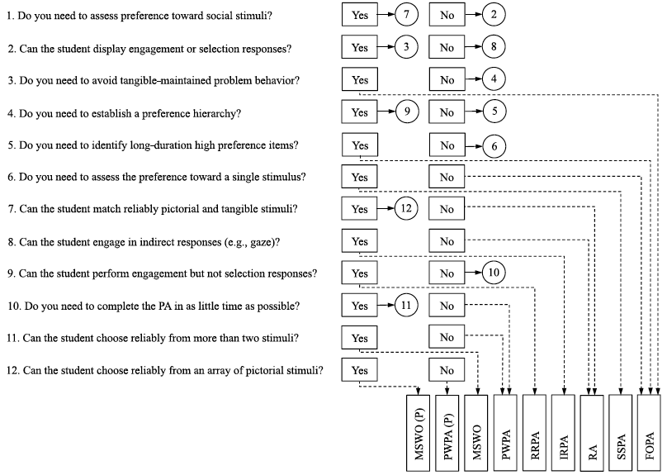
Decision Making:
Type of results needed (e.g., tangible, hierarchy), student characteristics (purely behavioral), time constraints
Virues-Ortega et al., 2014

Slide 22
Case Study: John
7 Years old
Chromosomal anomalies
20/200 or worse with correction
Binaural hearing loss (at least 70dB)
Able to actively reach, grasp, manipulate
SIB-R showed age equivalence of 5-7 months
Majority of John’s behaviors seem to be intentional, though only a small percentage to be intentional unconventional communication
Music, lights, scratching, rolling, kicking

Slide 23
Scenario 1:
engagement or selection response requires intentionality, which student does not have
Notes:
This is in terms of INTENTIONALLY COMMUNICATIVE responses, right? (I do NOT believe he generally demonstrates those!)

Slide 24
Scenario 2:
IRPA: Indirect/idiosyncratic response PA
engagement or selection does not require intentionality, and student can select with reach and grasp

Slide 25
Scenario 3:
IRPA: Indirect/idiosyncratic response PA
DB precludes student’s ability to “select” without exploration, therefore we rely on engagement measured by emotional response

Slide 26
Preference Assessment Procedures
(adapted from Picture Exchange Communication System)
Interviews with parents and teacher
Free play observations at home and school
Single stimulus preference assessments
  Selection responses
  Indices of happiness, protest, and rejection
*Parents also predicted preferences from direct assessment

Slide 27
Research Questions
Can the manualized Picture Exchange Communication System (PECS) preference assessment procedures be used to identify tangible preferences for a unique learner with deafblindness?
Can the preference assessment procedures be adapted to obtain useful information regarding learner preferences?

Slide 28
Interviews
List up to 10 items for each category. Include only those items that your student or child currently enjoys (or dislikes for the final category). Then number each item from most to least preferred (with most preferred being 1) within each category.
Then rank order items/activities across categories.
Category:
Things your student/child likes to eat
Things your student/child likes to drink
Social games your student/child likes (Peek-a-boo, chase, tickles, etc.
Places your student/child chooses to do during free time
Activities your student/child likes (watching television, spinning, sitting in a special chair, squeezes, etc.)
People your student/child recognizes and enjoys being with
Items, activities your student/child DOES NOT like

Slide 29
Interview Results
Rank | Parents | Teacher | Summary
1 | Grandpa (tickles, snuggles, bounces) | Tickles | Proprioceptive: tickles, snuggles, bounces, deep pressure, drums
2 | Music (gospel, deep voice, country) | Floor time (mat) | Proprioceptive: tickles, snuggles, bounces, deep pressure, drums
3 | Floor time (carpet, tile) | Floor time (tile) | Proprioceptive: tickles, snuggles, bounces, deep pressure, drums
4 | Tickles | Scratching textures | Tactual: breeze, water stuff, scratching textures, floor time
5 | Peek-a-boo | Repetitive movement | Tactual: breeze, water stuff, scratching textures, floor time
6 | Sweet potatoes | Swinging | Tactual: breeze, water stuff, scratching textures, floor time
7 | Snickerdoodle cookies | Close contact, deep pressure | Vestibular: repetitive movement, swing
8 | Grapes | Drums | Vestibular: repetitive movement, swing
9 | Grandma’s potato salad | Water stuff | Auditory: music, drums
10 | Meatloaf | Parachute (breeze) | Food

Slide 30
Activities in Free Play
Colorful, easy to grasp, O-ball
Shiny mylar pom pom
Rattle
Lever toy
I want to observe your child/student in a free play situation to see how she/he might choose to spend his/her time. Your child/student does not have to play with these items. This is free play. He can spend his time playing anything he wants. Please help your child/student only if he needs help. If your child/student requests to play with you, you can play with him as you typically would. We want this to be as natural as possible. Are you ready?

Slide 31

Single Stimulus Assessments (1st)
Allow student to experience item for 15-30 seconds
  This will depend on the access abilities of the student and the qualities of the item. Allow student to experience all qualities of the item (see item descriptions) allowed by the student’s abilities. Show student how to operate item if appropriate. Keep focus on item, not social interaction. The intent is to get the student to understand the properties of the item. If student uses item in an inappropriate manner, block and/or redirect after 2s.
Record if student:
Rejected (If reject, go to next trial)
Had no reaction
Showed signs of pleasure
Reaches for within arm distance

Slide 32

Single Stimulus Assessments (2nd)
Stop operation of item and pull item away from student out of arms reach (do not grab item), still within line of vision, for 5 seconds
Record if student:
Tried to obtain when out of reach
Protested when you stopped the experience

Slide 33

Single Stimulus Assessments (3rd)
Present item in accessible manner for up to 20 seconds, but do not force or prompt student to take the item
  Alert student to the presence of the item, either visually, auditorily (e.g., turn on/off quickly, crinkle wrapper), or tactually (e.g., quickly touch to students hand and pull away). Be thorough in your attempt. The intent is to let student know item is available, but that he/she has to indicate desire for item.
Record if student:
Reaches for within arm distance
Take item again

Slide 34

Single Stimulus Assessments (4th)
Release item if apprehended, but do not praise student for accepting. If taken, shape student behavior as needed to interact with the item in an appropriate manner. If student uses item in an inappropriate manner, block and/or redirect after 2s. Retrieve item within 20 seconds (again, do not grab item – you may prompt student that you are going to take item).
Record if student:
Shows signs of pleasure
Protests when taken away
Overcomes minor obstacles

Slide 35



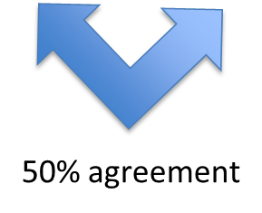
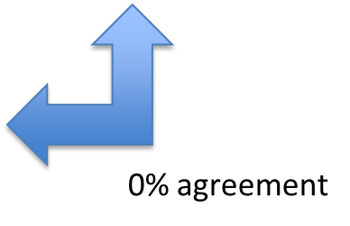
Agreement Among Assessments for “Highly Preferred” and “Non-Preferred”
Teacher
Clapper toy
Pom Pom
Lotion
Fan
Tambourine
Sound machine
Parents
Bubble toy
Massager
Tambourine
Sound machine
Fan
Cymbals
Direct PA – T1
Preferred:
Clapper toy
Kazoo
Fan
Bubble toy
Button book app
Light up ball
Non Preferred:
Tambourine
Slinky
Pom Pom
Direct PA – T2
Preferred:
Sound machine
Tiger
Tambourine
Minion toy
Non Preferred:
Nothing

Slide 36


Agreement Among Assessments for “Highly Preferred”
Teacher
Clapper toy
Pom Pom
Lotion
Fan
Tambourine
Parents
Bubble toy
Massager
Tambourine
Sound machine
Fan
Direct PA – Total Score
Sound machine
Tiger
Fan
Light up ball
Kazoo
Single stimulus assessment did not differentiate relative preference
Assessments appear to be highly dependent on time or partner
Did parents inaccurately predict preferences?

Slide 37
So…Let’s Begin to Connect this Preference Work to Communication…
Children and young adults who experience deafblindness, particularly young children, typically initiate little exploration
In fact, many children need to be invited out of their own bodies, to join “us” in the world
In the case of a learner who also experiences significant motor challenges, the lack of exploration is further exacerbated

Slide 38
So…Let’s Begin to Connect this Preference Work to Communication… (cont.)
In these instances, direct assessments (as recommended by Virues-Ortega et al., 2014) need to be supplemented with unstructured observation
Potential communication partners need to observe, and record, any intentional overt behavior in which a child routinely engages

Slide 39
Questions?
Before we continue….

Slide 40
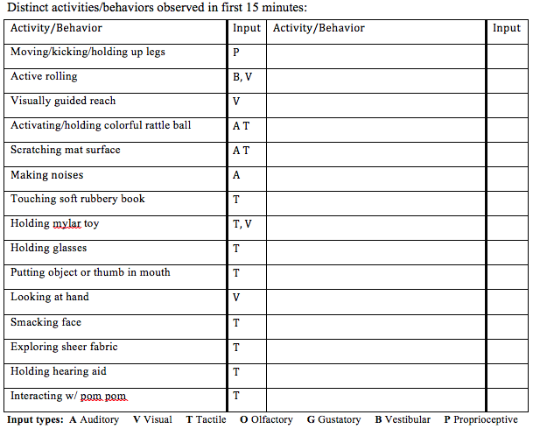
Systematizing Observations
Activity/Behavior (Input)
Moving/kicking/holding up legs (P)
Active rolling (B,V)
Visually guided reach (V)
Activating/holding colorful rattle ball (A T)
Scratching mat surface (A T)
Making noise (A)
Touching softly rubbery book (T)
Holding mylar toy (T, V)
Holding glasses (T)
Putting object or thumb in mouth (T)
Looking at hand (V)
Smacking face (T)
Exploring sheer fabric (T)
Holding hearing aid (T)
Interacting w/ pom pom (T)
Input types: A Auditory, V Visual, T Tactile, O Olfactory, G Gustatory, B Vestibular, P Proprioceptive

Slide 41

Using Momentary Time Sampling

Slide 42
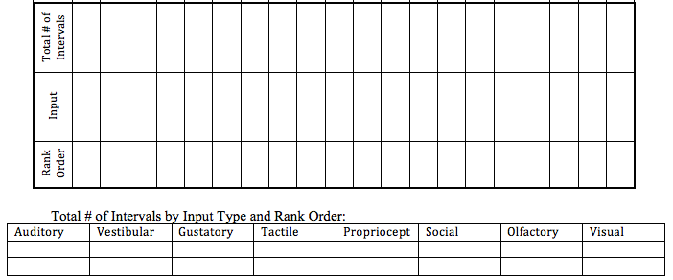
Summarizing Preferences

Slide 43
School Observation
Observer 1
Holding glasses
Scratching mat surface
Putting object or thumb in mouth
Moving/kicking holding up legs
Holding a mylar toy
Observer 2
Scratching mat surface
Holding glasses
Putting object or thumb in mouth
Smacking face
Holding a mylar toy
Inter-observer Agreement: 95.3%
Tactile 2. Auditory 3. Visual

Slide 44
Home Observation
Observer 1
Sucking thumb
Playing with hands
Moving/kicking/holding up legs
Holding head up
Looking at hands
Observer 2
Sucking thumb
Moving/kicking/holding up legs
Playing with hands
Looking at hands
Making noises
Inter-observer Agreement: 93.0%
Tactile 2. Proprioceptive 3. Vestibular 4. Visual
1. Tactile 2. Proprioceptive 3. Visual 4. Vestibular

Slide 45
Questions?
Before we continue….

Slide 46
Communication Assessment
For the purposes of illustration in this webinar, we’ll use the Communication Matrix for Parents and Professionals (Rowland, 2013) to illustrate how sensory and communication assessment can—and SHOULD:
Inform one another (e.g., incorporate learner preferences within env. context, choices, etc.)
Be utilized for programmatic decision-making
Notes:
Communication Matrix very consistent with the constructs of intentionality, as we have been using these throughout the seminar

Slide 47
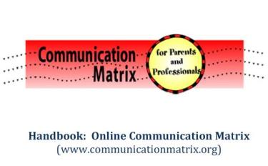
Communication Assessment Methods: Function Categories
Over-arching function categories:
Refuse
Obtain
Social
Information

Slide 48
Communication Assessment Methods: Levels of Communication Development
Levels of Communication Development
    Nonsymbolic, pre-intentional
    Intentional behavior
    Intentional, unconventional communication
    Transition to intentional conventionality (plus 5, 6, and 7…)

Slide 49
Communication Assessment Methods
Results Profile

Slide 50
Using Preferences to Promote Communication Development
Listen with your eyes,
and hands, and heart….
Talk with more than your mouth….
&
Keep the learner’s preferences in mind!

Slide 51
Using Preferences to Promote Communication Development (cont. 1)
For a learner who experiences deafblindness and / or multiple, complex disabilities, the way in which she receives info. might be different from the way she expresses info.

Slide 52
Using Preferences to Promote Communication Development (cont. 2)
Communication begins with nonsymbolic behavior—unintentional or intentional!
Observe a learner during unstructured time
Follow the learner’s lead
Offer items / activities that incorporate features preferred by the learner
Embellish potential communicative signals
OFTEN…..
Nonsymbolic skills must be directly taught

Slide 53
Enhancing Partner Sensitivity:
Key Partner Behaviors
Positive ATTITUDE
EXPECTATION that the learner is communicating
Key response behaviors
(i.e., RESPONSIVITY to subtle cues from a learner)
4. ATTUNEMENT to the learner (Janssen, Riksen-Walraven, & van Dijk, 2003)

Slide 54
Enhancing Partner Sensitivity:
Key Partner Behaviors (cont.)
Cues to POTENTIALLY Intentional Communication:
Attention SHIFT (alternating attention)
PERSISTENCE
Changing of behavior (RECASTING)
TERMINATION of behavior, once a change is made (i.e., the goal is achieved)

Slide 55
Enhancing Partner Sensitivity:
NONSYMBOLIC EXPRESSIVE SIGNAL DICTIONARY
Each time _______ DOES this… | It will be interpreted to MEAN this… | ______’s partner will DO this… | ______’s partner will SAY this…
Christopher kicks his feet when his wheelchair tray is removed When Jennifer gets up from her seat, Susan follows her (around the room) with her eyes

Slide 56
Enhancing Partner Sensitivity:
NONSYMBOLIC EXPRESSIVE SIGNAL PHOTO / VIDEO
In addition to providing written guidelines for team members (to use to facilitate an early communicator’s further development), still photographs and / or short video clips should be compiled to illustrate the learner’s:
expressive signals
preferred objects / activities / positions
touch cues and object cues used by partners

Slide 57
Enhancing Partner Sensitivity:
NONSYMBOLIC EXPRESSIVE SIGNAL PHOTO / VIDEO (Cont.)
Photographs and / or short video clips should be included to illustrate how the learner expresses:
“I want to move / I’m uncomfortable”
“I’m scared / anxious”
“I’m happy / I feel great!”
“I don’t want / like this!”
“I like / want more”
“Do that again!”
“Hello” or “Good-bye”

Slide 58
Augment Input to Enhance Comprehension:
Key Partner Behaviors
Utilize MULTIPLE MODES of communication
MODEL use of the learner’s preferred modes of communication
Utilize TOUCH cues and OBJECT cues consistently, across team members
Pair the learner with a preferred PARTNER

Slide 59
Augmenting Input:
NONSYMBOLIC RECEPTIVE DICTIONARY ELEMENTS
TOUCH or OBJECT cue | It is used to commu- nicate this MEANING | ______’s partner will DO this… | What is expected from the LEARNER
Tap two times on Susan’s ankle Place bicycle handle grip on Christopher’s tray

Slide 60
Key Partner Behaviors:
Facilitating Communication Development
Partners’ consistent, repeated interpretations of a learner’s behaviors, over time, will shape communicative intentionality.

Slide 61
SUMMARY
To MAXIMIZE the effective of communication programming….
Arrange interactions with activities, objects, and / or people who are highly preferred by the learner
Involve highly responsive adults and peers
Incorporate experiences that involve movement and action
Utilize multi-sensory exploration in interactions, including touch
Implement routines regularly and consistently
Notes:
#3 – especially if the learner shows a preference for proprioceptive and / or vestibular stimuli!!!

Slide 62
SUMMARY (cont.)
To MAXIMIZE the effective of communication programming, seek out the following info.:
How does the learner want / like to be greeted?
In what way can each partner identify herself to the learner? (i.e., personal identifier)
How much time does the learner need to show his preference / respond?
What sensory inputs—BOTH type and features—does the learner most prefer?
What are the specific parameters of the learner’s vision, hearing, and motor abilities?
Notes:
#5 – Vision: distance, field, color, consistency of…
Hearing: volume, pitch, type (env / speech)

Slide 63
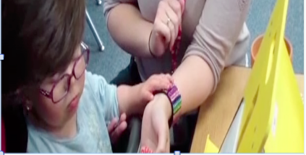
#2 – Personal Identifier

Slide 64
THANK YOU!
Please don’t hesitate to contact us,
if you have questions or comments.
Susan M. Bashinski, Ed.D.
sbashinski@missouriwestern.edu
816-271-5629
Sarah Ivy, Ph.D.
sivy@fsu.edu
850-644-7588

Slide 65
References
Janssen, M., Riksen-Walraven, M., & van Dijk, J. (2003). Toward a diagnostic intervention model for fostering harmonious interactions between deaf-blind children and their educators. Journal of Visual Impairment & Blindness, 97, 197-214.
Kenzer, A. L., & Bishop, M. R. (2011). Evaluating preference for familiar and novel stimuli across a large group of children with autism. Research in Autism Spectrum Disorders, 5, 819-825.
Rowland, C. (2013). Communication Matrix for Parents and Professionals. Retrieved from www.communicationmatrix.org
Virues-Ortega, J., Pritchard, K., Grant, R. L., North, S., Hurtado-Parrado, C., Lee, M. S. H., … Yu, C. T. (2014). Clinical decision making and preference assessment for individuals with intellectual and developmental disabilities. American Journal on Intellectual and Developmental Disabilities, 119, 151-170.

