Slide 1
Individualized Instruction in the Expanded Core Curriculum:
Please download Handouts to follow along!
An Introduction to Student Portfolios and Project-Based Learning
Rachel Anne Schles, M.Ed, TVI
University of Pittsburgh
July 18, 2018
National Center on Deaf-Blindness

Slide 2
Agenda
Why do we need to teach the ECC?
What does project- / inquiry-based learning look like?
How do we use project- / inquiry-based learning for ECC instruction for students with visual impairments, including deafblindness?
What are some benefits and challenges of implementing student portfolio goals around the ECC?
Notes:
In my presentation today I’m going to address the following concepts… but first, I just want to acknowledge how challenging our roles can be as TVIs, and how much we are expected to handle. You’ve heard my official bio, but what’s not there is the fact that my last year as a TVI I served 10-13 schools and 26 students, with several referrals coming in. I loved it, but it’s not easy. However, I really believe that for most of our students we don’t see often, having the type of IEP goal & instruction I’m about to explain allowed me to be more of a TVI instead of always addressing emergencies or not really knowing what to do with my students since I didn’t see some of them that often.

Slide 3
Background: Why teach the ECC?
compensatory & access skills
career education
independent living skills
orientation & mobility skills
recreational & leisure skills
self-determination skills
sensory efficiency skills
social interaction skills
technology/assistive technology
The Expanded Core Curriculum (ECC) is comprised of 9 skill sets
Developed for students with visual impairments, including students with deafblindness or additional disabilities

Slide 4
Background: Why teach the ECC? It’s the law!
IDEA mandates…
Academic and functional performance and outcomes must be address in the evaluation for an IEP (IDEA 300.304) and development of an IEP (IDEA 300.320).
For students with VI:
Functional Outcomes = Expanded Core Curriculum
How can we provide engaging & meaningful ECC instruction?
Notes:
When talking w/colleagues, it’s important to remember we need to spent time teaching students the ECC not because we know students benefit from it but because…
It’s the law! It is too easy to be a tutor instead of a TVI, or spend a lot of time putting out fires instead of building skill sets for the future.

Slide 5
Project- / Inquiry-Based Learning
Project Based Learning (PBL) challenges students to solve real-world problems.
Teachers provide mini-lessons throughout the process to guide students on content knowledge and developing a meaningful final product.
Key component for students w/VI—provides an Authentic Audience outside of themselves to share the results of their lessons w/TVI+COMS.
The 4 C’s
Critical Thinking
Collaboration
Communication
Creativity/Innovation
Resource: Buck Institute for Education: BIE.org

Slide 6
ECC & PBL – What does this look like in Action?
Sample Question
You are finally on your own at college! How can you, as a student with a visual impairment, communicate your needs to your professors and other school personnel while securing the accommodations and tools you need to succeed?
Lesson/mini projects might include: ADA & testing accommodations, dorm life/independent living skills, transportation, navigating campus, disability services, securing optical devices/technology, communicating with professors, and identifying social opportunities.
Handout 1
Page 1: Resources on PBL & ECC
Notes:
Before we can get started, we need to make sure the IEP instruction we develop is data-based…

Slide 7
First Comes Data: The Essential Assessments
What are the key components of the essential assessment (EA)?
Functional Vision (FVA)
Learning Media (LMA)
Expanded Core Curriculum (ECC)
Important resource:
EArubric.com
RIOT Model:
Record Reviews
Interviews
Observations
Testing

Slide 8
I finally found the time to conduct an assessment (& write the report)… Now what?
Balance immediate & long-term goals
Review students’ strengths & needs
Opportunities to collaborate while learning?
Are there high-interest/motivating topics you can use to work on areas of need?
Review “Bank of Activities” resource for ideas on activities

Slide 9
Case study 1: 4th grade student
4th grade student “Ginny” with albinism in general education classroom
Acuity - 20/200
Rarely advocating and not using accommodations & tools
Very upset about having albinism/VI and being different from family/peers
Reluctant to work with TVI
1 hour/week VI services (pull out)
IEP goals were self-advocacy and typing
The situation frustrating for both student and teacher.
Stop, Drop, and Regroup!

Slide 10
Case study 1: Continued
Completed an Essential Assessment (EA) (including observations, direct assessment, student, parent, and teacher interviews)
Findings/Results
Ginny not using tools & devices because they didn’t work for her! (recommended low vision exam)
She has splinter strengths & needs in all areas of the ECC
How to address in a comprehensive IEP goal?
The process of completing the assessments initiated a change in the student’s attitude—she was learning she had a voice.

Slide 11
Case study 1: Developing portfolio
Used EA data to develop specific PBL activities which targeted Ginny’s needs and interests, including her parents’ and teacher’s concerns
See Handout 2 for complete Portfolio Rubric
Activities included:
Developing brief statement to explain VI condition*
Understanding Accommodations (Pros & Cons)
Class Presentation +
Note to Substitute Teachers/Support Staff +
Preparing for Low Vision Exam
Social Skills (discussing impact of VI & identifying compensatory techniques) §
* Student requested activity
+ classroom teacher requested activity
§ parent requested activity

Slide 12
Student work sample 1: Letter to substitute teachers & Staff
Hello,
My name is Ginny and I have a visual impairment (Albinism). I wanted to tell you this just in case there is a book with pictures and I move up close. If there is something on the white board and I pull out something that looks like a mini telescope (AKA my monocular) don’t be alarmed! My monocular helps me see far away and the monitor on my desk helps me see the things on the smart board. Also if I don’t move up close it just means that I can see it and you don’t need to remind me to go close up. And one last thing, I am also very smart (and pretty) so you do not have to worry about anything.
Sincerely, Ginny
Notes:
Activities are all about students being able to demonstrate their own voice & choice!

Slide 13
Case study 1: summary
The Portfolio Projects allowed the student to have a say in what she was learning and immediately see how skills were relevant to her.
While still working on typing and self-advocacy!
Student engagement increased as time progressed, and projects always directly related to student interests:
Developed a screenplay to teach peers about the parts of the eye
Wrote & illustrated an original children’s book about a girl who did not want anyone to know she had a VI, and how she became comfortable with herself.
Made a bullet-pointed Pros/Cons list for Explaining Accommodations activity, and while the student felt she did less work because she used bullet points instead of paragraphs, she still met all the criteria for a 4 on that activity.
Notes:
Shared complete portfolio at 5th grade IEP meeting – great use of paperwork downtime while setting up IEP/printing, etc.

Slide 14
Case study 2: 11th grade student
11th grade student, “Nick” in honors/advanced classes
Acuity - 20/70 to 20/100
Advocating for needs in class
Tools/accommodations working well
1 hour/month of vision services (pull out)
Annual IEP due at the start of the school year, so TVI completed informal parent & student interviews
Questions focused on long/short-term goals
Used ECC Screening Tool/Checklist to guide conversation
(TVI did not complete a full EA assessment, only ECC assessment – and that’s ok!)

Slide 15
Case study 2: portfolio activities
Activities* included:
College Planning & Disability Services
Understanding Eye Reports
Mentoring a younger student w/visual impairment
Interviewing a professional w/visual impairment
*Activities encompassed VI and autism related accommodations: even though I’m the TVI, he is a whole person and needs to prepare for all appropriate accommodations post-secondary.

Slide 16
Case study 2: Student work sample 2 Accommodation Preferences / Disability services
Student listed all accommodations he uses/has available to him
Reference IEP
Categories:
near vision, distance vision, technology
Order of preference, including rationale or justification for use
Directly applied this document to college disability services application
Technology and Assistive Technology (Academic and personal use)
Tablet
a. Note taking
Keeps all my notes in one place, and backed up
b. Filling out assignments
My handwriting is extremely messy, no matter how much time I take
c. Research
Notes:
Right side of the screen, small excerpt from activity. Didn’t need to write a paragraph about each item, just to begin to be self-aware & making sure he knew the language to explain what he needed and why.

Slide 17
Case study 2: Summary & Next steps
ECC needs were not clearly evident because Nick was independent and successful in his academic classes
Informal assessment and the portfolio project allowed for meaningful use of the student’s direct VI services time
For similar students, 10th through 12th grade portfolios should focus on teaching students to be their own TVI post-secondary (college/jobs)
Explaining their VI and accommodations to professors/employers
Understanding their rights under ADA law
Accessing Voc Rehab/relevant resources wherever they’ll be attending college

Slide 18
Student Work Sample 3: Mentoring & Low Vision
Mentoring:
Allows students to learn about different accommodations or resources from peers while giving a truly authentic audience for PBL activities– also a real reason to [practice] talking about their disability and accommodations.
Video Clip:
4th and 1st grade students were paired up and recorded/exchanged about one video message a month.
In this video, the 4th grade student had recently had a low vision exam, and is giving advice to the 1st grader who is having a low vision exam for the first time later that month.

Slide 19
Mentoring Video Transcript
Video: Will Low Vision Exam
Hey Thomas, it’s me, Will, and, ah, I’m goin’, this video of how my, um, my appointment with Dr. Alibhai went, and some advice for you. One is, don’t be nervous. Two, I mean, he’s a really nice guy, so don’t be nervous. And, number 2, you get to try out all sorts of cool gadgets, and remember this thing? This is the monocular from one of my first videos? [holds monocular to his eye and focuses] Focus it like this, and put it over your eye. Dr. Alibhai is the guy that will prescribe you things like this. To prescribe means to, give the word to let you use it. Like your doctor will prescribe you medicine. And, yeah, so, he can, if you want to try out some monoculars you can, and you might be able to use one in school. So you don’t need to move closer to the SMARTboard anymore, you can move farther away [smiles]. And…Yeah, see ya!
Online Transcript: Will Low Vision Exam Transcript

Slide 20
Student Work Sample 4: IEP Statement & Participation
6th grade student with deafblindness
K-1 English literacy level
Developed statement with TVI (student dictated through ASL, TVI wrote in English, checking for student’s approval)
Student practiced statement with DHH classroom teacher (case manager)
Student presented (with flashcards & prompting) during annual IEP/transitioning to middle school meeting
Student’s Statement
I am a Deafblind student and I use sign language and optical devices help me see and communicate. I also like to cook, draw, and go to art and music classes. I also really like the Spanish language and soccer. Because of my vision, I like to use the Ruby and dome magnifier for reading, because it easier to see words and pictures. I like to use the monocular to see words on the board.

Slide 21
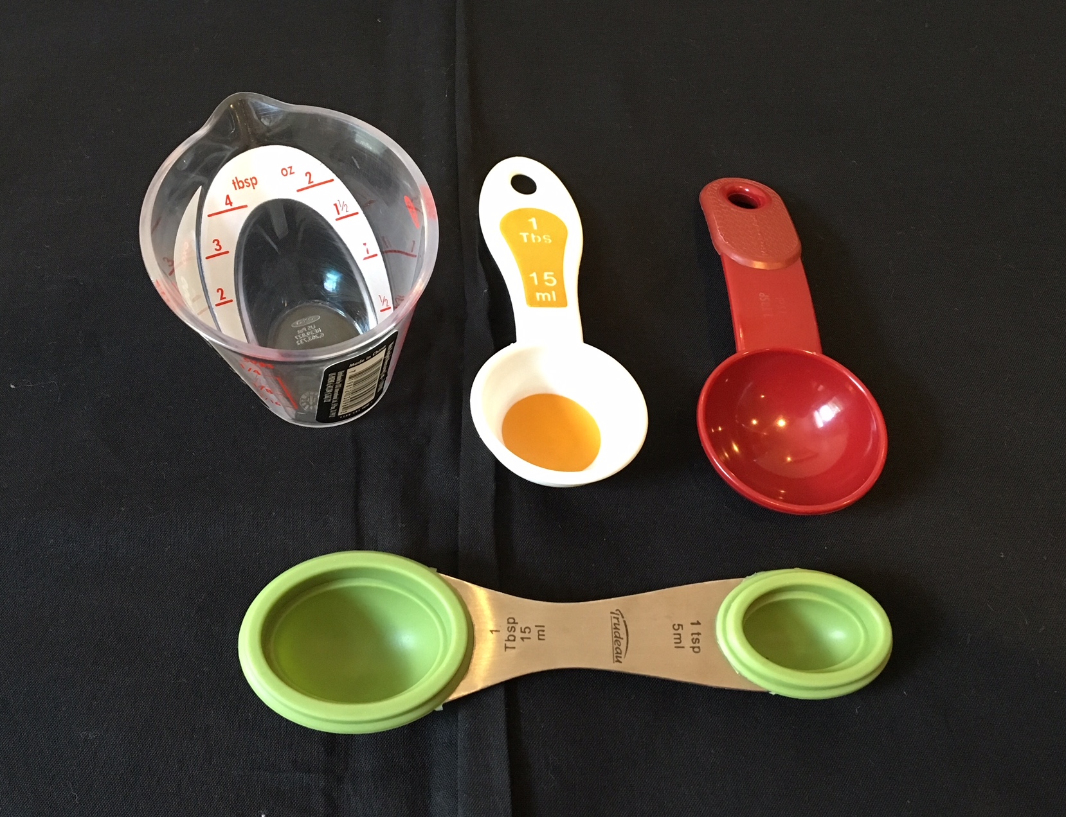
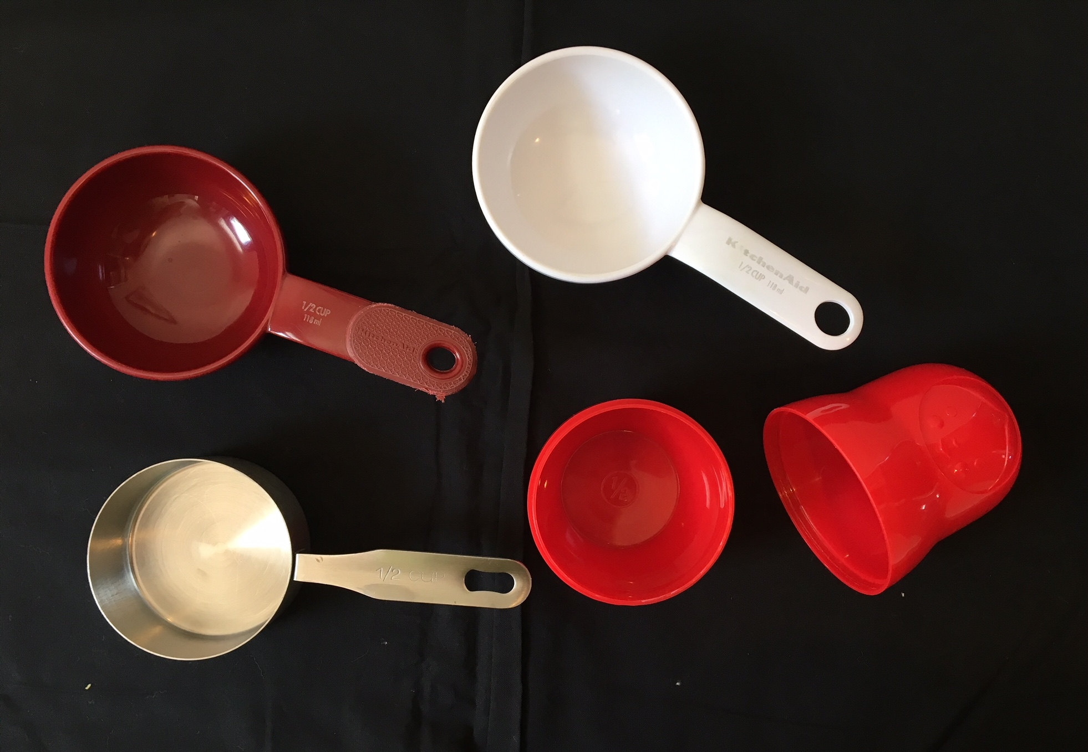
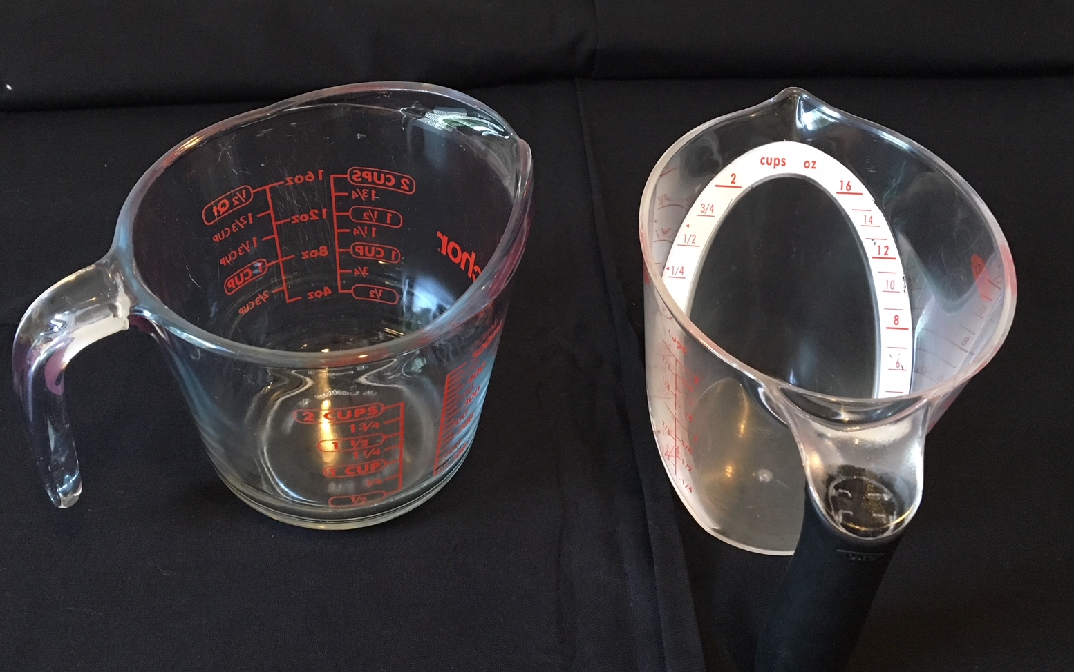
Student Work Sample 5: Independent Living skills: Making play-dough
“Jack” used his optical devices to read the recipe, while selecting his preferred tools
Jack needed to identify which measuring tools were easiest to use and why (noted for future home use and home economics in middle school)
He was given the option to repeat the activity later in the year with a peer, to incorporate more communication and collaboration *Playdough recipe in the comments section of this slide
Notes:
Play Dough Recipe
Step 1: Mix 2 cups flour and ¾ cups salt in a large bowl
Step 2: An separate bowl, mix of 1 generous Tablespoon of oil and your choice of food coloring.
Step 3: Add just over 1/3 cup water to the oil/food coloring mixture.
Step 4: Add ½ of the flour and salt mixture to the wet ingredients.
Step 5: Carefully stir until combined
Step 6: Sprinkle flour onto your workspace and knead the dough until it is soft and the color is smooth.
Step 7: Enjoy!

Slide 22
Portfolio projects for all students
Don’t forget to download and review the handouts!
Younger Students (Handout 3)
Students with Multiple Disabilities
Students who are Blind/Use Braille
Are just becoming aware they have a visual impairment
Instructional focus is modeling language to explain and explore accommodations
Select activities as appropriate
If possible, collaborate with team members to consider the student as a whole; develop an “All About Me” portfolio project
Most activities already apply to students in classroom settings
Consider incorporating braille/technology/ travel skills into lessons

Slide 23
Bank of Activities Resource
See Bank of Activities (Handout 1) for sample activities in all 9 areas of the ECC.
When developing a rubric for each student, consider long- and short-term needs.
Students may repeat some activities 2-3 times over the course of their school career as they mature/their accommodations & understanding about themselves evolves.
Every student should have a unique portfolio…but you don’t need to have a portfolio goal every year—traditional IEP goals are more appropriate to measure student progress in certain areas.
Include blank rows in the rubric for future activities so if new areas of concern arise during the IEP year, it can be incorporated into the current goal.

Slide 24
Portfolio goals & the IEP
* check out handout for sample IEP goals & language!
Bring draft portfolio rubric to the IEP, and review each item (briefly).
Be prepared to edit and revise the rubric based on IEP team feedback (also review portfolio individually with team members prior to the meeting).
By outlining the portfolio in the IEP meeting there is a transparency and credibility to what the TVI is teaching.
Increased respect for TVI’s time and effort.
TVI expectations are clear to the student: they often work for the best grade possible.
Do students do well (earn 3’s or 4’s) on activities?
Yes, because TVIs don’t move onto the next activity until the student has mastered the concepts in a given activity.

Slide 25
Implementation / service time
How do you determine IEP hours/service time recommendations when a student has a portfolio project IEP goal?
An IEP is a living document, reflecting students’ current strengths and needs through long and short term goals.
Consider the goal and rubric: how much time would you recommend for your student?
My opinion: September, December, and June likely contain little instructional time.
*June will be used to write letters to next year’s teachers
How do you determine IEP hours/service time recommendations when a student has a portfolio project IEP goal?
An IEP is a living document, reflecting students’ current strengths and needs through long and short term goals.
Consider the goal and rubric: how much time would you recommend for your student?
My opinion: September, December, and June likely contain little instructional time.
*June will be used to write letters to next year’s teachers.
Notes:
I want to have some real talk—I’ve done a portfolio goal when working with a student has little as 1 hour (1 session) month with a student. Far from ideal but gave us focus to make the most of the time we had.

Slide 26
Questions & Thank you!
Handout 1:
Rationale & Resources for ECC Portfolio Projects
Sample Text for IEP Goals
Bank of ECC Activities Resource
Handout 2
Example IEP Goal & Rubric for Elementary Student
Handout 3
Word Document Templates ready for editing!
Questions?
Final Thoughts?
Contact information:
Rachel Schles, raschles@gmail.com

