Slide 1
INTRODUCTION
TO
DEAF-BLINDNESS
[Your State Project Information Here]

Slide 2
[Your State Project Name Here]
Provides technical assistance and training to statewide agencies, families, community partners, teachers, and service providers of children and young adults with deaf-blindness (birth through 21 years of age)
Part of a network that includes state deaf-blind projects across the country and the National Center on Deaf-Blindness

Slide 3
Deaf-Blindness Defined
Deaf-blindness refers to combined hearing and vision loss that significantly limits children’s ability to get information from people and their surroundings
These losses can cause developmental delays in areas such as language, social skills, and mobility, but they do not necessarily limit the individual’s learning potential

Slide 4
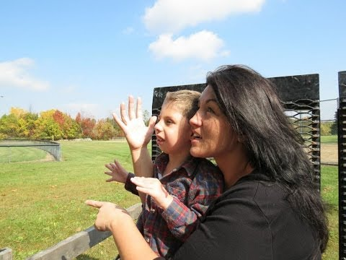
Video: Deaf-Blind Perspectives

Slide 5
Major Causes of Deaf-Blindness
Hereditary disorders (Usher syndrome, CHARGE syndrome, Down syndrome)
Prematurity and birth complications
Infections (cytomegalovirus, meningitis, etc.)
Injury or stroke

Slide 6
Co-Occurring Disabilities
Approximately 90% of children with deaf-blindness have one or more additional disabilities or health problems; 75% have two or more; 50% have three or more
For children with complex needs, hearing and vision loss may not yet be recognized or addressed
Classifications other than deaf-blindness are often listed as a child’s primary diagnosis on the Individualized Family Service Plan (IFSP) or Individualized Education Program (IEP)

Slide 7
Deaf-Blind Child Count
Child Count information (without names or identifying information) is submitted to the U.S. Department of Education
Assists with funding and planning technical assistance to meet the needs of children
Specific state referral information can be included here

Slide 8
Prevalence of Deaf-Blindness
Deaf-blindness is an extremely low incidence disability
Approximately 10,000 children and youth with deaf-blindness in the U. S.
There are approximately [##] children and youth with deaf-blindness in [YOUR STATE]

Slide 9
Incidence of Deaf-Blindness
Children with deaf-blindness are often the ONLY one in their school or community with this diagnosis
[MAP of your state here]

Slide 10
Early Identification and Referral
It is recommended that children with one diagnosed sensory impairment (hearing or vision) be evaluated in the other area
Referrals to medical and educational services should be made in a timely manner
DO NOT “wait and see”

Slide 11
Early Intervention
The early years are critical, especially in the areas of social-emotional and communication development
Early intervention services can help families understand their child’s sensory impairment and learn how they can support their child’s growth and development

Slide 12
Challenges of Deaf-Blindness
Anticipation
Motivation
Communication
Confirmation
Notes:
Anticipation: what is going to happen to me, where am I going, who is with me
Motivation: isolation and withdrawal; lack of exploration, interest in environment, and people
Communication: language development, turn-taking, interactions, socialization
Confirmation: this is how things work; when I do this, this thing happens; this thing does this action; this facial expression or this tone of voice means this

Slide 13
Communication & Connection (1 of 2)
Communication is . . .
Exchanging ideas, thoughts, and feelings
The way we connect with people
Often challenging for people with deaf-blindness

Slide 14
Communication & Connection (2 of 2)
Individuals with deaf-blindness may use a variety of body movements, gestures, vocalizations, pictures, objects, sign language (visual or tactile), speech, augmentative/alternative systems, and other means to communicate.

Slide 15
Assessment & Planning
Accurate assessment of communication skills, concept development, and optimal learning modalities is often challenging
Standardized instruments are not typically appropriate
A team approach, including the family and education professionals, is optimal

Slide 16
Assessment Resources
Assessing Communication and Learning in Young Children Who are DeafBlind or Who Have Multiple Disabilities (free, online)
The Communication Matrix (free, online)
HomeTalk- A Family Assessment of Children who are Deafblind (free, online)
Assessment (National Center on Deaf-Blindness)

Slide 17
Deaf-Blind Children Learn Differently
Traditional Learners
Learn most information incidentally by seeing and listening to what goes on around them
Deaf-Blind Learners
Incidental learning is difficult or does not occur
Hands-on experience and systematic instruction is essential

Slide 18
Learning Needs of Children Who Are Deaf-Blind
Hands-on experiences
Active movement and exploration of their environment
Predictable, accessible schedules, consistency
Use of residual hearing and sight
High expectations
Trusting relationships
Communication, communication, communication

Slide 19
Interveners
Provide support for social-emotional well-being
Provide support for development and use of communication
Provide access to sensory information
Connect the young learner to the world

Slide 20
Families
Family-professional partnerships are essential for promoting optimal outcomes for children with deaf-blindness
Parents should be supported in their role as advocates
Siblings often experience unique joys and frustrations and may benefit from sibling support programs

Slide 21
State Project Information
[Upcoming events]
[Contact Information]
[Your Project’s Website]
The contents of this presentation were developed under a grant from the U.S. Department of Education, [enter your project number]. However, those contents do not necessarily represent the policy of the U.S. Department of Education, and you should not assume endorsement by the Federal Government. Project Officer, [enter your project officer].
[Add project logo]

