Slide 1


INTERACTIONS WITH OBJECTS: Important Considerations for Learners with Deaf-Blindness
Susan M. Bashinski

Slide 2
LEARNERS’ INTERACTIONS WITH OBJECTS (1 OF 5)
All children must learn a number of different characteristics regarding objects.
Concept development, associated with objects, occurs from birth because of the constant flow of information a typically-developing baby experiences.

Slide 3
LEARNERS’ INTERACTIONS WITH OBJECTS (2 OF 5)
Typically developing children learn object concepts incidentally.
For the vast majority of children who experience deaf-blindness, however, these concepts must be DIRECTLY taught.

Slide 4
LEARNERS’ INTERACTIONS WITH OBJECTS (3 OF 5)
Basic characteristics include:
objects EXIST
objects have PERMANENCE
objects are DIFFERENT from one another
objects have a NAME
objects have a variety of CHARACTERISTICS
objects have a FUNCTION or USE

Slide 5
LEARNERS’ INTERACTIONS WITH OBJECTS (4 OF 5)
In addition to learning basic object concepts, many children who experience deaf-blindness need to learn to use objects as FORMAL CUES to the people, places, things, and activities that go on in their environments.

Slide 6
LEARNERS’ INTERACTIONS WITH OBJECTS (5 OF 5)
Using OBJECTS serves the purpose of “augmenting input” for a learner’s communication system…
Match input (i.e., object cues, other) to the learner’s abilities
Match feedback to the learner’s abilities
What abilities must be considered?
Notes:
We’ll talk about “Other” in another webinar recording.

Slide 7
MATCHING OBJECT CUES TO A PARTICULAR LEARNER
Does the learner have sufficient motor ability to actively explore / interact with the object in some meaningful way?
Does the learner have sufficient sensory ability to process the object’s features?

Slide 8
MATCHING OBJECT CUES TO A PARTICULAR LEARNER (CONT.)
Consider the learner’s preferences when selecting an object cue.
ALWAYS AVOID
the use of miniatures with a learner who has a significant vision loss!
Notes:
WHY???? Our reference, in understanding miniatures, is totally visual!

Slide 9
WHAT IS AN OBJECT CUE?
An OBJECT CUE is an object,
or a part of an object,
that is used to REFER to
a person, place, thing, or activity.

Slide 10
WHY USE OBJECT CUES?
The PURPOSE of an object cue
is to provide a concrete means of supporting conversational interactions
AND
facilitating language development.

Slide 11
CONSIDERATIONS IN CONSTRUCTING OBJECT CUES (1 OF 3)
It is important to remember that an object cue is used to refer to, or represent, an object.
As such, the cue must, in some way, be differentiated from the object itself.
Object cues / representations should be mounted on poster board, cut to a standard size.

Slide 12
CONSIDERATIONS IN CONSTRUCTING OBJECT CUES (2 OF 3)
Follow these steps:
Select objects
Cut poster board pieces
Glue each object to an individual piece of poster board
Coat the new object cue piece with clear glue, or a sealer of some sort.
Let it dry.
Apply Velcro to back of object cue piece.

Slide 13
CONSIDERATIONS IN CONSTRUCTING OBJECT CUES (3 OF 3)
Clearly write the meaning the object cue is used to convey on the poster board.
If possible:
  select an object to be used as a cue that is small in size
  select an object to be used as a cue that has an obvious tactile relationship to its referent

Slide 14
EXAMPLES OF OBJECT CUES
ACTUAL (WHOLE) objects
glass - to mean, “Lunch! Go to the table.”
bag - to mean, “Get your things to go home.”
sock - to mean, “Time to get dressed.”
bubble wrapping - to mean, “Take a break.”

Slide 15
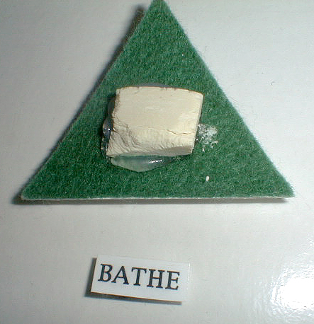
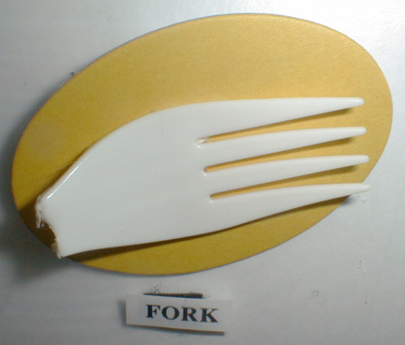
OBJECT CUES: ACTUAL (WHOLE) OBJECTS
Notes:
One of several objects utilized in routine
Object itself

Slide 16
EXAMPLES OF OBJECT CUES
PARTS of objects
top of plastic bottle - “Lunch! Go to the table.”
piece of backpack strap - to mean, “Get your things to go home.”
partial zipper - to mean, “Time to get dressed.”
bird feather - to mean, “Let’s go for a walk.”

Slide 17
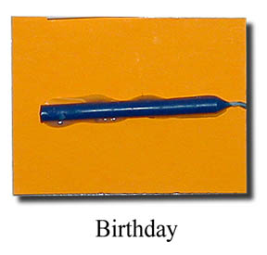
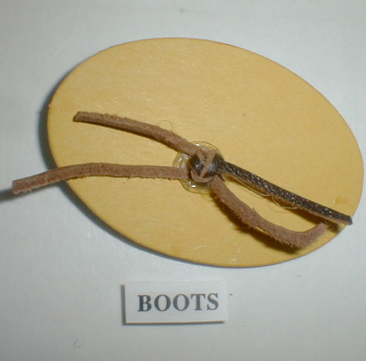
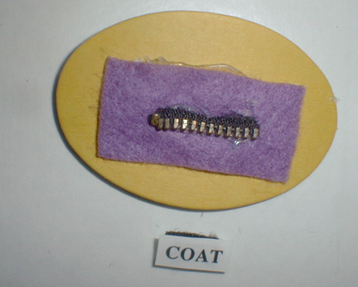
OBJECT CUES: PARTIAL
OBJECTS
Notes:
Piece of actual component part
One component of multi-component object (cake, icing, candles, presents, etc.)—IDENTIFYING (candles not on other cakes, etc.)
Actual element of object

Slide 18
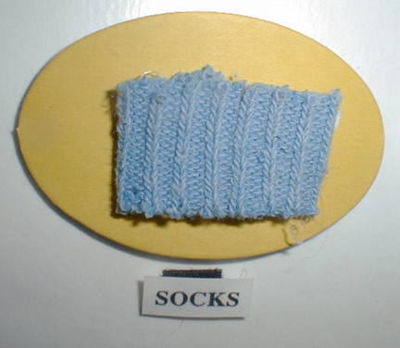
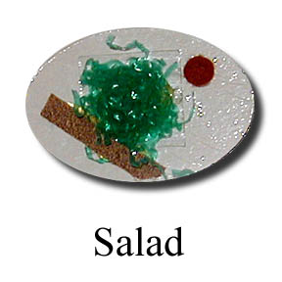
OBJECT CUES: TEXTURES
(i.e., object features)
Notes:
REAL (actual)
SIMULATED

Slide 19
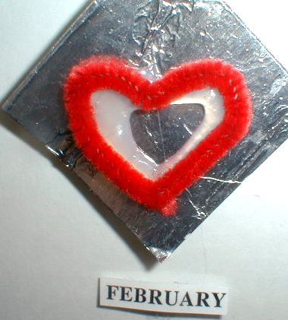
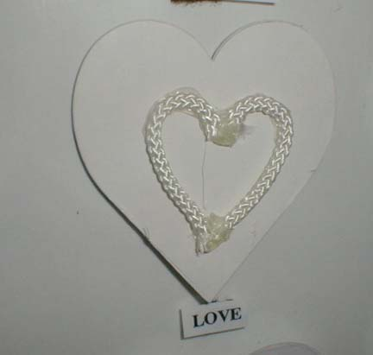
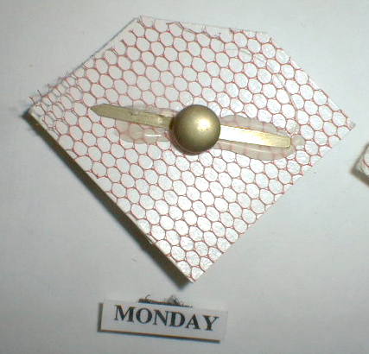
OBJECT CUES: TEXTURES
(i.e., abstract concepts)

Slide 20
CONSIDERATIONS IN USING OBJECT CUES
Share the object cue with the learner--that is, touch and handle the cue with the learner and engage in interaction about the object cue’s referent.

Slide 21
ADVANTAGES - OBJECT CUES
Requires only a simple motor response
Provide concrete, static communication form
Relatively low demand on learner’s:
  cognitive skills
  memory skills
  representational skills
Object cue may be reduced / made more abstract over time

Slide 22
DISADVANTAGES - OBJECT CUES
Object selection might be very challenging
Impossible to find objects to represent abstract and / or complex ideas
Not a conventional method for communicating
Interaction partners might not utilize object cues in a consistent manner
Whole object use might inhibit portability

Slide 23
OBJECT CUES
Ideas for STORAGE for Object Cues:
  http://www.objectsymbol.com

Slide 24
INTERACTION STRATEGIES FOR USING OBJECT CUES
Consider the learner’s preferences when deciding how to offer the object cue to her
Offer the object by touching the learner’s body part, then watching for a response
If necessary, repeat the offer
Accept a negative response, if that is what the she offers! (then offer something else)

Slide 25
INTERACTION STRATEGIES FOR USING OBJECT CUES (CONT.)
NEVER force the learner to accept an object cue, or to engage in exploring one!
Demonstrate how to explore the object cue’s surface, guiding the learner to do the same (i.e., use “tactile modeling”)
Offer object cues to the learner, gently--especially initially

Slide 26
RESOURCE: OBJECT CUES
See Project SALUTE: Successful Adaptations for Learning to Use Object Effectively http://www.projectsalute.net/Learned/Learnedhtml/ObjectCue.html
  “What We’ve Learned-Information Sheets”

Slide 27
Credits
Developed by the Distance Mentorship Project at the University of Kansas
Content by:
Susan M. Bashinski
Megan Cote
Rebecca Obold-Geary
2011-2013

