Slide 1


GESTURAL
DEVELOPMENT
Susan M. Bashinski

Slide 2
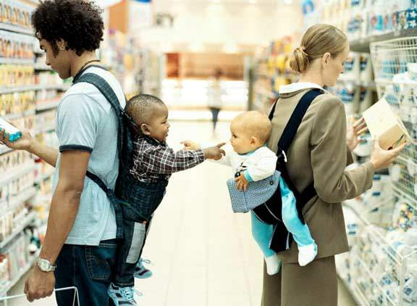
WHAT ARE NATURAL GESTURES?
Notes:
So what are natural gestures?
This very cute picture shows a common example of a natural gesture, a point,

Slide 3
WHAT ARE NATURAL GESTURES? (CONT.)
Elements of a culture’s nonverbal communication system
Nonsymbolic elements
(e.g., pointing, showing, giving, shrugging shoulders, extended open palm)
Typically learned incidentally, through everyday interactions
Remain in communication system, even after native speakers learn to communicate with symbolic means

Slide 4
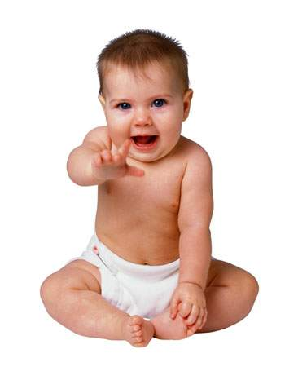
WHY TEACH NATURAL GESTURES?
Theoretical Reasons
Theoretical reasons:
  Developmentally occur prior to symbolic communication
  Thought to pave the way for symbolic communication
  Provide opportunities for linguistic input
Notes:
Gestures occur developmentally before symbolic communication and often it’s easier to learn developmentally earlier behaviors, like crawling before you walk or run etc.,
Thought to pave the way for symbolic communication. In fact there is a chapter by Butterworth in a book all about pointing titled “pointing is the royal road to language.’ I like this because it’s not the only way to language but many folks who are engaged in theoretical discussions of early communication and language development contend that gestures convey the early thoughts that are later mapped by language
Gestures also provide opportunities for linguistic input, so when a child points at something we almost always label it and we know from Tomasello’s work and others that children learn words best when they are jointly engaged with the referent and person and this is clearly the case when they are gesturing, in fact if you work with kids who are entering that vocabulary burst period, they seem to be actively recruiting that input in activities like joint book reading by pointing to the pictures and waiting for you to name them.

Slide 5
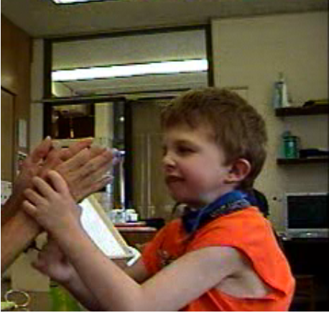
WHY TEACH NATURAL GESTURES?
Practical Reasons
Practical reasons:
  Readily understood by numerous partners
  No extra equipment is needed
  Can be used across many different contexts
  Evidence -base: easier to teach than some forms of symbolic communication
Notes:
Gestures occur developmentally before symbolic communication and often it’s easier to learn developmentally earlier behaviors, like crawling before you walk or run etc.,
Thought to pave the way for symbolic communication. In fact there is a chapter by Butterworth in a book all about pointing titled “pointing is the royal road to language.’ I like this because it’s not the only way to language but many folks who are engaged in theoretical discussions of early communication and language development contend that gestures convey the early thoughts that are later mapped by language
Gestures also provide opportunities for linguistic input, so when a child points at something we almost always label it and we know from Tomasello’s work and others that children learn words best when they are jointly engaged with the referent and person and this is clearly the case when they are gesturing, in fact if you work with kids who are entering that vocabulary burst period, they seem to be actively recruiting that input in activities like joint book reading by pointing to the pictures and waiting for you to name them.

Slide 6
NATURAL GESTURES
Very much influenced by:
Learner’s age
Culture
(Communication) Context

Slide 7
CATEGORIES OF GESTURES
I. Contact – within 6” of target
II. Distal – at a distance of 6” or greater
*The shift from use of only “contact” gestures to “distal” gestures represents a very significant achievement in communicative development.
(see Bruce, Mann, Jones, & Gavin (2007)-analysis of gestures expressed by children who experience deaf-blindness)

Slide 8
BRADY & BASHINSKI (2008) GESTURAL STUDY
Primary Research Question:
Does Adapted Prelinguistic Milieu Teaching (PMT) facilitate improved communication outcomes for children who have deaf-blindness?

Slide 9
ADAPTATIONS TO BASIC PMT STRATEGIES FOR LEARNERS WITH DB
Utilize predictable routines
Incorporate augmented input strategies, including touch cues and object cues
Utilize hand-under-hand strategies
Emphasize tactile and vestibular stimuli throughout interactions
Encourage dual focus / joint attention

Slide 10
ADAPTATIONS TO BASIC PMT STRATEGIES FOR LEARNERS WITH DB (CONT.)
Involve indication of directionality (of a communication act) through alternative orienting responses or whole body orientation--not just eye gaze
Incorporate environmental adaptations to facilitate the use of a child’s residual vision and hearing

Slide 11
KEY FINDINGS
ALL children (in BOTH the main study group and the replication group) demonstrated both an increased number and greater diversity in communication forms
Notes:
REPLICATION STUDY ADDED HERE

Slide 12
KEY FINDINGS 1 (Participant nearest mean growth)
Baseline FORMS | END: Intervention FORMS
Push object away | 3 Baseline forms, PLUS:
Drop item | Extend hand, palm up
Cry | Take partner’s hand to…
 | Give item to partner for help
 | “High five” greeting
 | Point
 | Clap hands

Slide 13
KEY FINDINGS 1 (continued…)
ALL children (in BOTH the main study group and the replication group) demonstrated increased diversity in communication functions
Notes:
REPLICATION STUDY ADDED HERE

Slide 14
KEY FINDINGS 2 (Participant nearest mean growth)
Baseline FUNCTIONS | END: Intervention FUNCTIONS
Protest | 2 Baseline functions, PLUS:
Reject | Greeting
 | Request action / turn
 | Request object
 | Request attention
 | Indicate choice
 | Direct attention / Comment

Slide 15
GESTURE DICTIONARY
Individual dictionaries were created for each learner
Dictionaries were distributed in both paper and video forms

Slide 16
SAMPLE: LEARNER DICTIONARY
Description of Form | Possible Function
Raise arm, hand open, for “high five” | Greeting
Raise arm, hand open, side-to-side wave OR Raise arm, palm under plam, following movement of fingers up and down | Good-bye
Extend hand, open palm up | Request turn / item
Take partner’s hand and move it to item / switch /location | Request item / help
Give / Push item to partner, for assistance | Request help
Tap on partner’s shoulder / forearm | Request attention
Shift gaze from item of interest to partner (esp. w/ voc.) | Comment/Indicate choice
Point (w/index finger) to item / person of interest / choice | Comment/Indicate choice
Push object away | Reject
Move item toward/ drop or push item into finished basket | Request “finished”
Close eyes (for sighted learner w/ limited movement) | Request “finished”

Slide 17
EXPRESSIVE GESTURES
EXTEND HAND, PALM UP
(REQUEST)

Slide 18
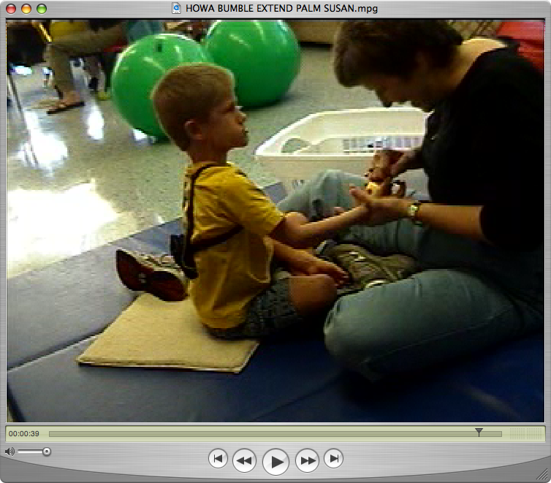
EXTENDED OPEN PALM REQUEST 1

Slide 19
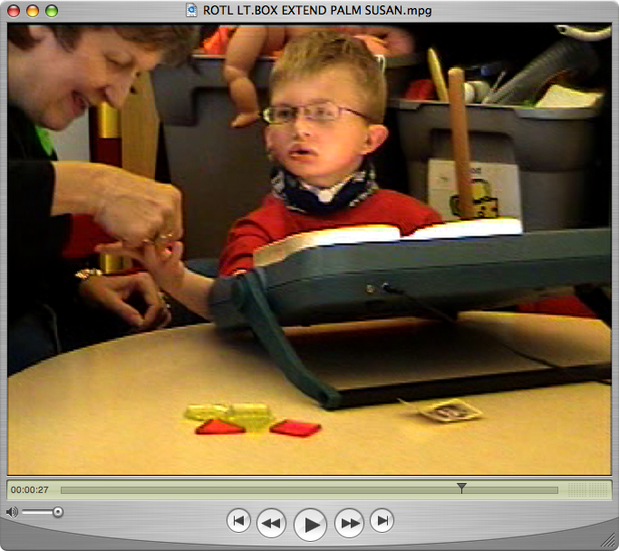
EXTENDED OPEN PALM REQUEST 2

Slide 20
EXPRESSIVE GESTURES
TAP PARTNER’S HAND
(REQUEST)

Slide 21
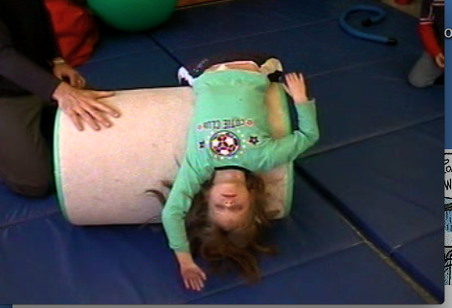
TAP PARTNER’S HAND(S) 1

Slide 22
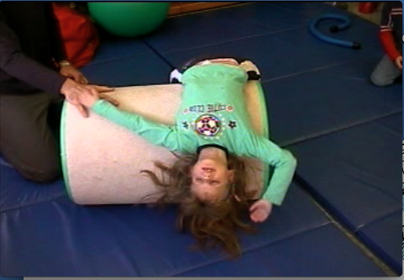
TAP PARTNER’S HAND(S) 2

Slide 23
EXPRESSIVE GESTURES
TAKE PARTNER’S HAND
(REQUEST)

Slide 24
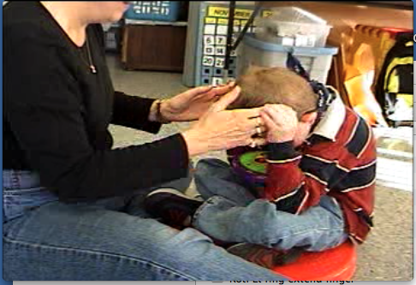
TAKE PARTNER’S HAND(S) 2

Slide 25
EXPRESSIVE GESTURES
GIVE FOR HELP
(REQUEST HELP)

Slide 26
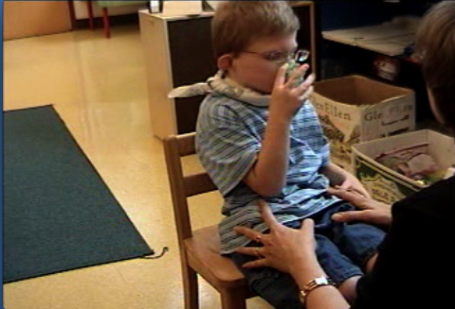
GIVE FOR HELP

Slide 27
EXPRESSIVE GESTURES
POINT
(COMMENT or
INDICATE CHOICE)

Slide 28
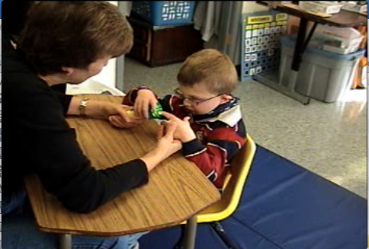
POINT, TO COMMENT

Slide 29
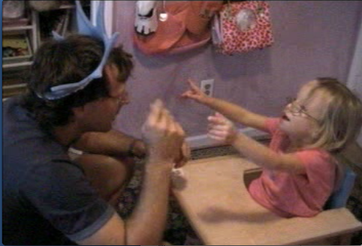
POINT, TO INDICATE CHOICE

Slide 30
EXPRESSIVE GESTURES
VOCALIZATION &
EYE CONTACT
(REQUEST CONTINUATION)

Slide 31
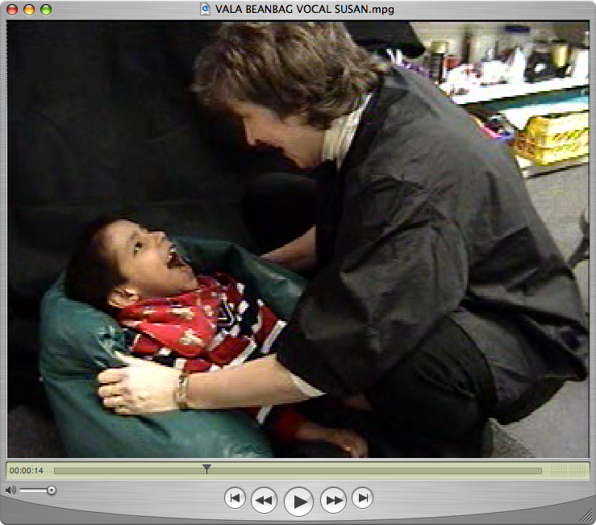
VOCALIZATION & EYE CONTACT

Slide 32
EXPRESSIVE GESTURES
EYE GAZE / CLOSE EYES
(TERMINATE)

Slide 33
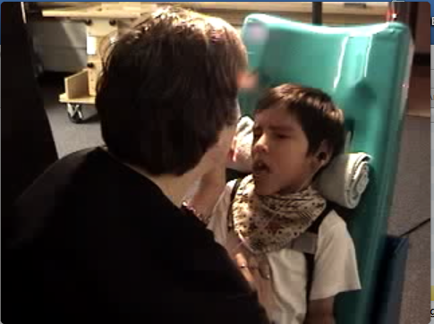
CLOSE EYES TO INDICATE “FINISHED” 1

Slide 34
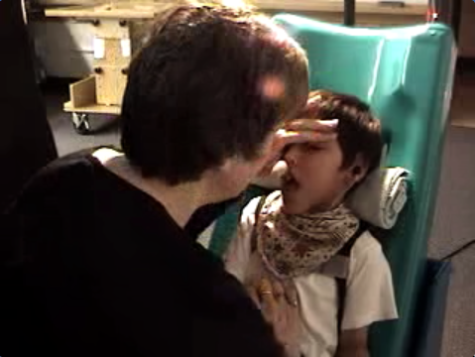
CLOSE EYES TO INDICATE “FINISHED” 2

Slide 35
EXPRESSIVE GESTURES
GREET

Slide 36
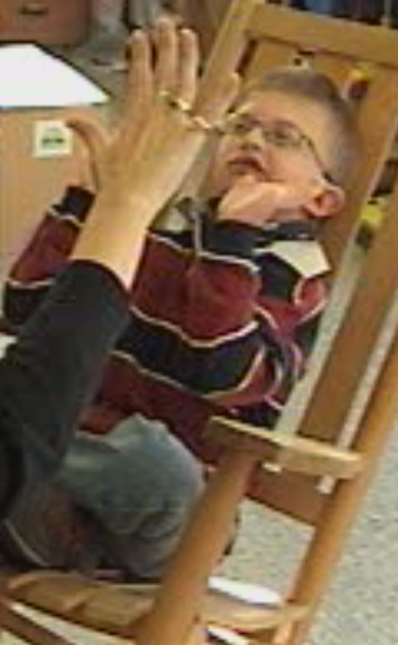
“HIGH FIVE” SOCIAL GREETING

Slide 37
EXPRESSIVE GESTURES
REQUEST ACTION / TURN

Slide 38
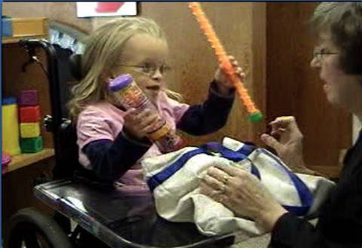
REQUEST ACTION / TURN

Slide 39
EXPRESSIVE GESTURES
REQUEST OBJECT

Slide 40
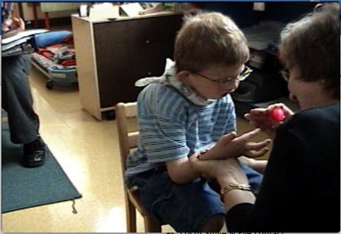
REQUEST OBJECT

Slide 41
EXPRESSIVE GESTURES
COMMENT
(REQUEST ATTENTION)

Slide 42
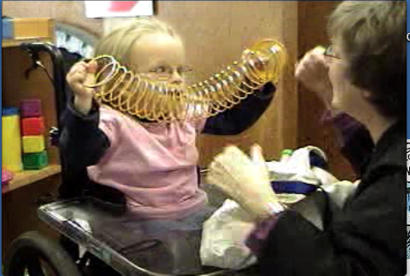
COMMENT – REQUEST ATTENTION

Slide 43
EXPRESSIVE GESTURES
MAKE CHOICE

Slide 44
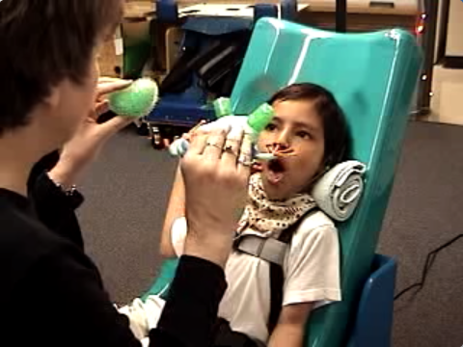
MAKE CHOICE 1

Slide 45
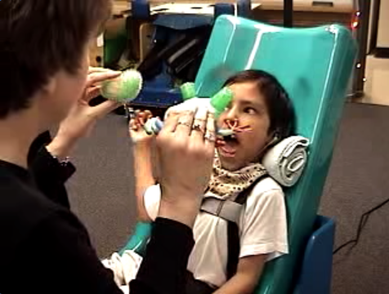
MAKE CHOICE 2

Slide 46
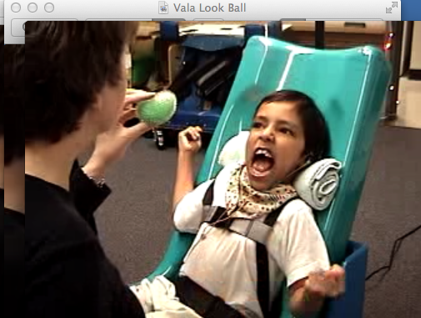
MAKE CHOICE 3

Slide 47
EXPRESSIVE GESTURES
MAKE CHOICE REVIEW

Slide 48
Looks at ball

Slide 49
Looks at frog

Slide 50
Looks at Susan

Slide 51
EXPRESSIVE GESTURES
REJECT / TERMINATE

Slide 52
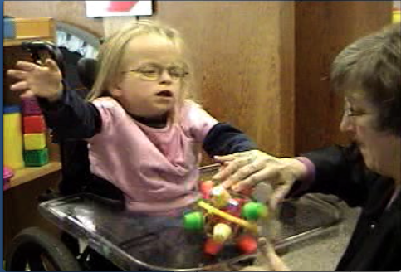
REJECT –PUSH AWAY

Slide 53
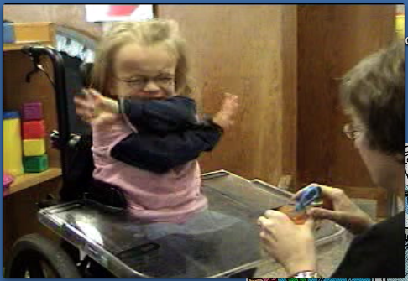
TERMINATE

Slide 54
SUMMARY / DISCUSSION
ADAPTED PMT was demonstrated to be:
Effective in helping children, who have DB, learn the power of communication prior to mastering symbolic forms
Effective in increasing diversity of individual learners’ nonsymbolic communication forms and functions--particularly for those learners who demonstrated relatively good motor skills
Effective in increasing prelinguistic (i.e., non- symbolic) communication rate

Slide 55
COMMUNICATION RATE
Increases in communication rate, for participants (n = 9) who do not also experience significant motor challenges, ranged from:
0.55 more CA / min. to 1.72 more CA / min.
(25 to 77 more comm. acts in a 45 min session)
Average Increase in communication rate, for these participants, was 1.31 more CA / minute
(59 more comm. acts in a 45 min session)

Slide 56
PREVIEW: ADAPTED-PMT SESSION
Go to NCDB site: www.nationaldb.org
Click on link, “Research to Practice”
Scroll down to “Practice Perspectives”
Click on “Teaching Prelinguistic Communication”
Read a narrative re: the application of A-PMT with one learner (Lance), p. 3
To view video clips of session excerpts with Lance, visit: https://nationaldb.org/pages/show/teaching-prelinguistic-communication?cms=true

Slide 57
REFERENCES
Brady, N. C., & Bashinski, S. M. (2008). Increasing communication in children with concurrent vision and hearing loss. Research & Practice for Persons with Severe Disabilities, 33, 1-12.
Bruce, S., Mann, A., Jones., C., & Gavin, M. (2007). The topography, rate, and function of gestures expressed by children who are deaf-blind. Journal of Visual Impairment & Blindness, 101, 637-652.

Slide 58
Credits
Developed by the Distance Mentorship Project at the University of Kansas
Content by:
Susan M. Bashinski
Megan Cote
Rebecca Obold-Geary
2011-2013

