Slide 1
Meeting the Needs of Proficient Communicators
Nancy O’Donnell and Deanna Peterson
September 30, 2020

Slide 2
Session Objectives
Participants will increase in their knowledge of strategies for identifying proficient communicators and their needs within the general education classroom setting.
Participants will increase in their knowledge of resources and strategies to use with proficient communicators who are congenitally deaf-blind.
Participants will increase in their knowledge of resources and strategies to use with proficient communicators with Usher syndrome.

Slide 3
Proficient Communicators
Presented by: Deanna Peterson Texas Deafblind Project,
petersond@tsbvi.edu
With the help of:
Robbie Blaha, Texas Deafblind Project,
blahar@tsbvi.edu
Notes:
Thank you to Linda and Kristi for inviting me to be a part of this discussion
And thanks to Nancy to partnering with Robbie and I to prepare this presentation
And thanks to Robbie for all her work in Texas and Nationally to help identifiy this group and create resources to help us better understand and support Proficient Communicators

Slide 4
Poll Question 1
How would you define “proficient communicator”?

Slide 5
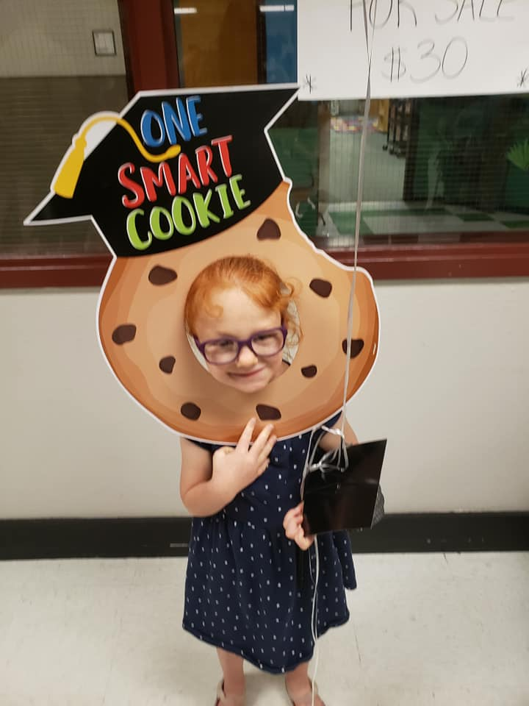
Proficient Communicators (1 of 7)
Historically, almost all of our Project’s TA requests were for emerging communicators.
The exceptions for on sites were students with Usher syndrome who were very different in their
communication and academic standing than emerging communicators.

Slide 6
Resources and Strategies
Our field, nationally and internationally, had developed many TA resources and strategies for emerging communicators.
HKNC led the way on developing resources to serve Usher syndrome and supported the Projects in technical assistance to district and school age families.

Slide 7
Poll Question 2
On a scale of 1-5, how confident are you in your knowledge and skill providing TA for students who are proficient communicators?

Slide 8
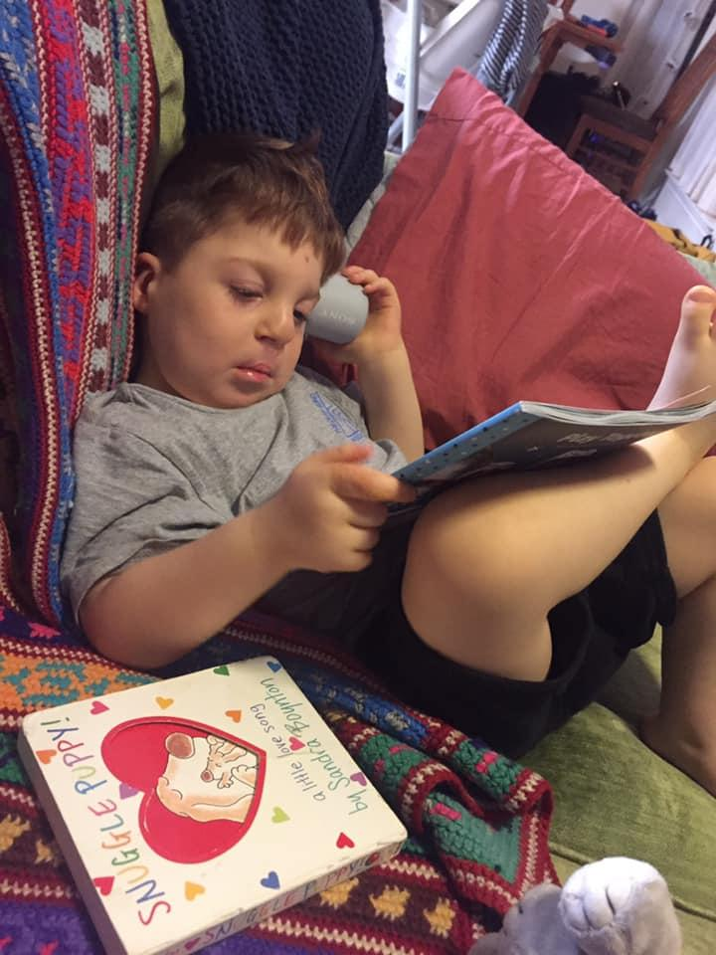
Something began to change…...
We began to get a number of contacts regarding a different type of child.
They were congenitally deafblind with formal language.

Slide 9
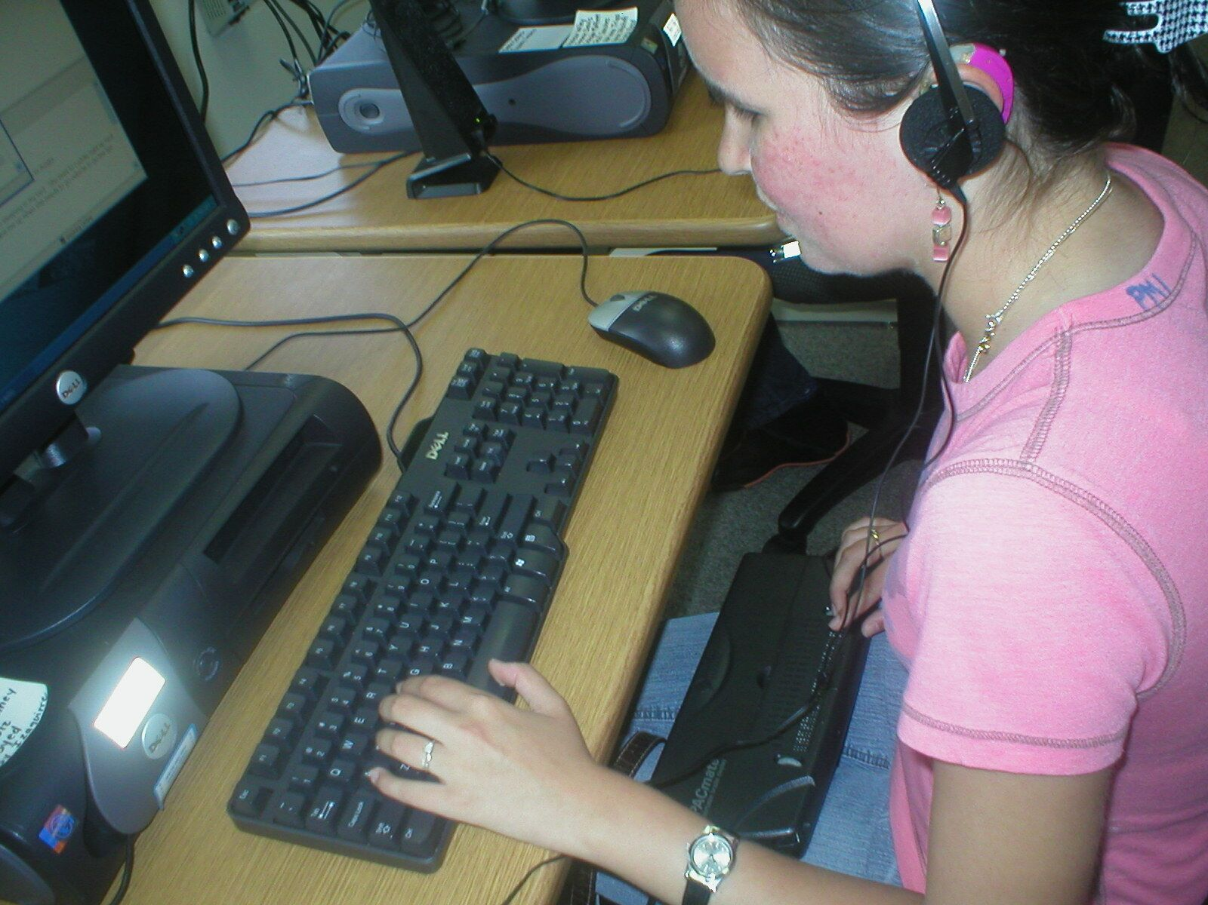
Proficient Communicators (2 of 7)
On state’s general education curriculum and not an alternative curriculum.
Most did not have an intellectual disability.
Accomplished in the use of a large array of technology.
pictue
Notes:
As we began to gather information there seemed to be some common elements….
The video is a project created by our colleague Matt Schultz and Nathan Widener on the Role of the Intervener for students who are Deafblind in a General Education setting.
Language/communication
Diploma track/grade level/transition trajectory
Social

Slide 10
Video 1

Slide 11
Proficient Communicators (3 of 7)
Although some similarities with students with Usher syndrome, there were distinct differences with this congenital population and we didn’t have a bank of resources to help.
And there were so many!! What was up?
Time to look at our Child Count….

Slide 12
Texas Deafblind Child Count = 820
State Testing age = 3rd grade - 12th grade
455 students tested
Regular State Testing w/wo accommodations = 142
School for the Deaf/School for the Blind = 10
Served by Regional Day Programs for the Deaf = 59
In the regular education classroom 80% = 85
In the regular education classroom 40-79% = 25
Notes:
313 students are taking alternative tests-they are our emerging communicators

Slide 13
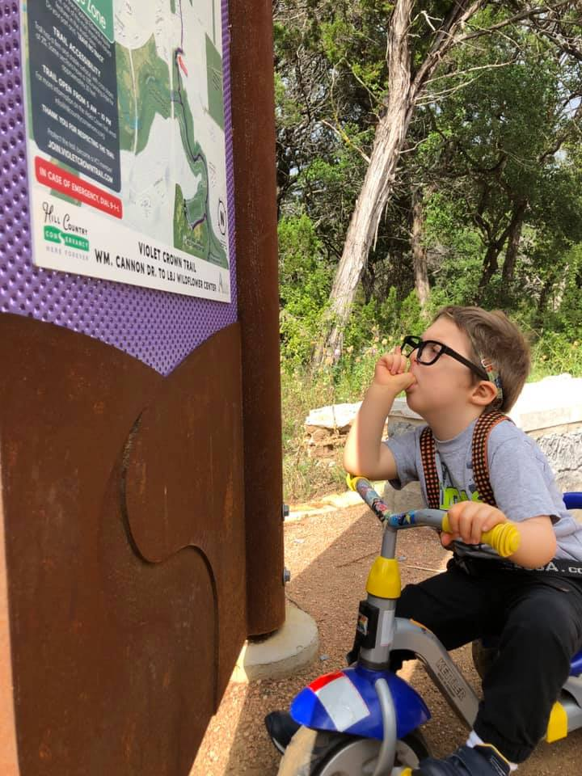
Texas Deafblind Childcount
Of the 142 students:
Cochlear Implants=30
Interveners= 18 (one certified)
CHARGE syndrome=13
Usher syndrome=18
Most of the PC are Congenital which is a real shift.

Slide 14
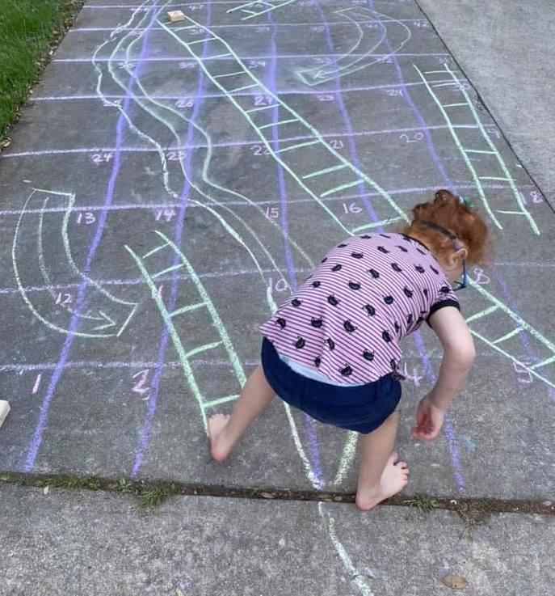
Proficient Communicators (4 of 7)
The majority of these students had different etiologies than Usher syndrome and were deafblind from birth.

Slide 15
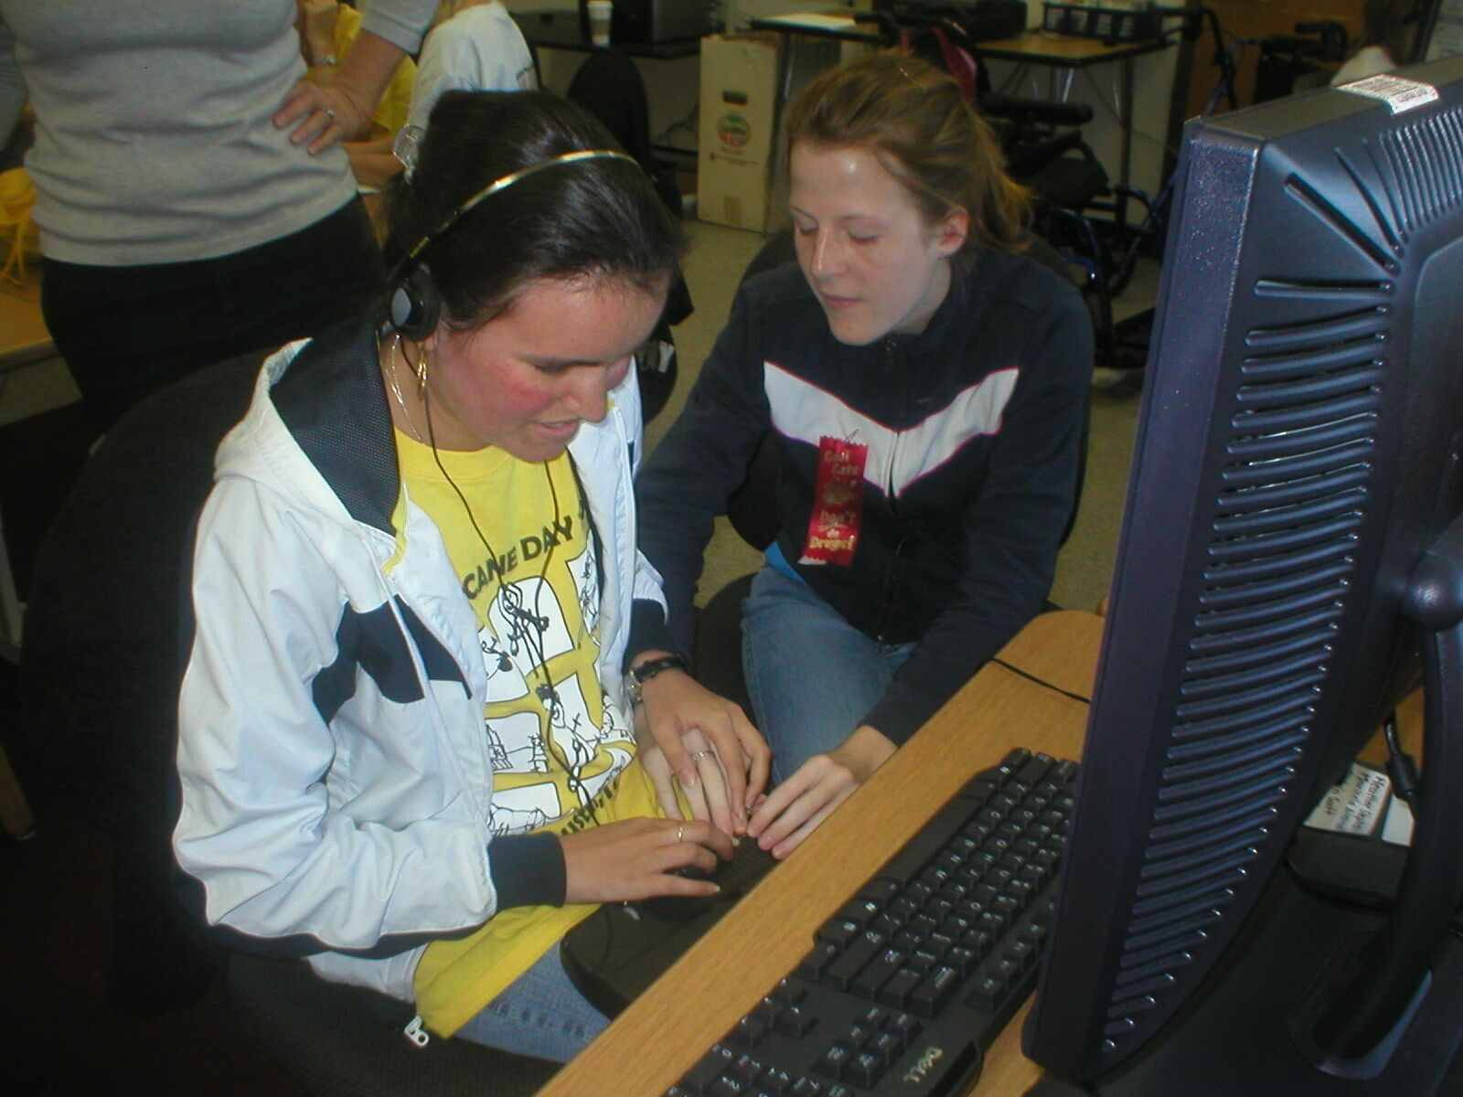
Proficient Communicators (5 of 7)
These students, especially in the number that they were occurring, were a real challenge for our Project.

Slide 16
Poll Question 3
Are you noticing more students who are congenitally deafblind (proficient communicators) in general education classrooms in your state, region, or district?

Slide 17
Proficient Communicators (6 of 7)
We began to collect information on this group we call Proficient Communicators and today, we
are sharing a snapshot of what our Project has learned about P.C. who are congenitally deafblind.
Our next speaker, Nancy O’Donnell will address P.C. who have Usher syndrome.

Slide 18
Proficient Communicators (7 of 7)
Are faced with some of the same underlying problems as Emerging Communicators.
Problems with gathering important incidental information that can lead to missing or incorrect key concepts as they grow up.
Additional time is required to gather information, process and respond.
Notes:
Deafblind time

Slide 19
PC: Gathering Common Needs
In general, they can look like they are “just fine” but they are not. It really hits in middle school.
Over time and across multiple on sites, our Project compiled a list of 12 specific recurring needs.
Information about each of these is included in your handouts.
Notes:
When the pace gets faster and the scope becomes wider, they start to stand out more and more….
In addition, they are really hard workers and motivated to keep, when they nod “yes I understand”, people often take that at face value and move on.
We selected only 5 to address today due to time constraints.
(modify curriculum, electives, homework, technology,stress

Slide 20
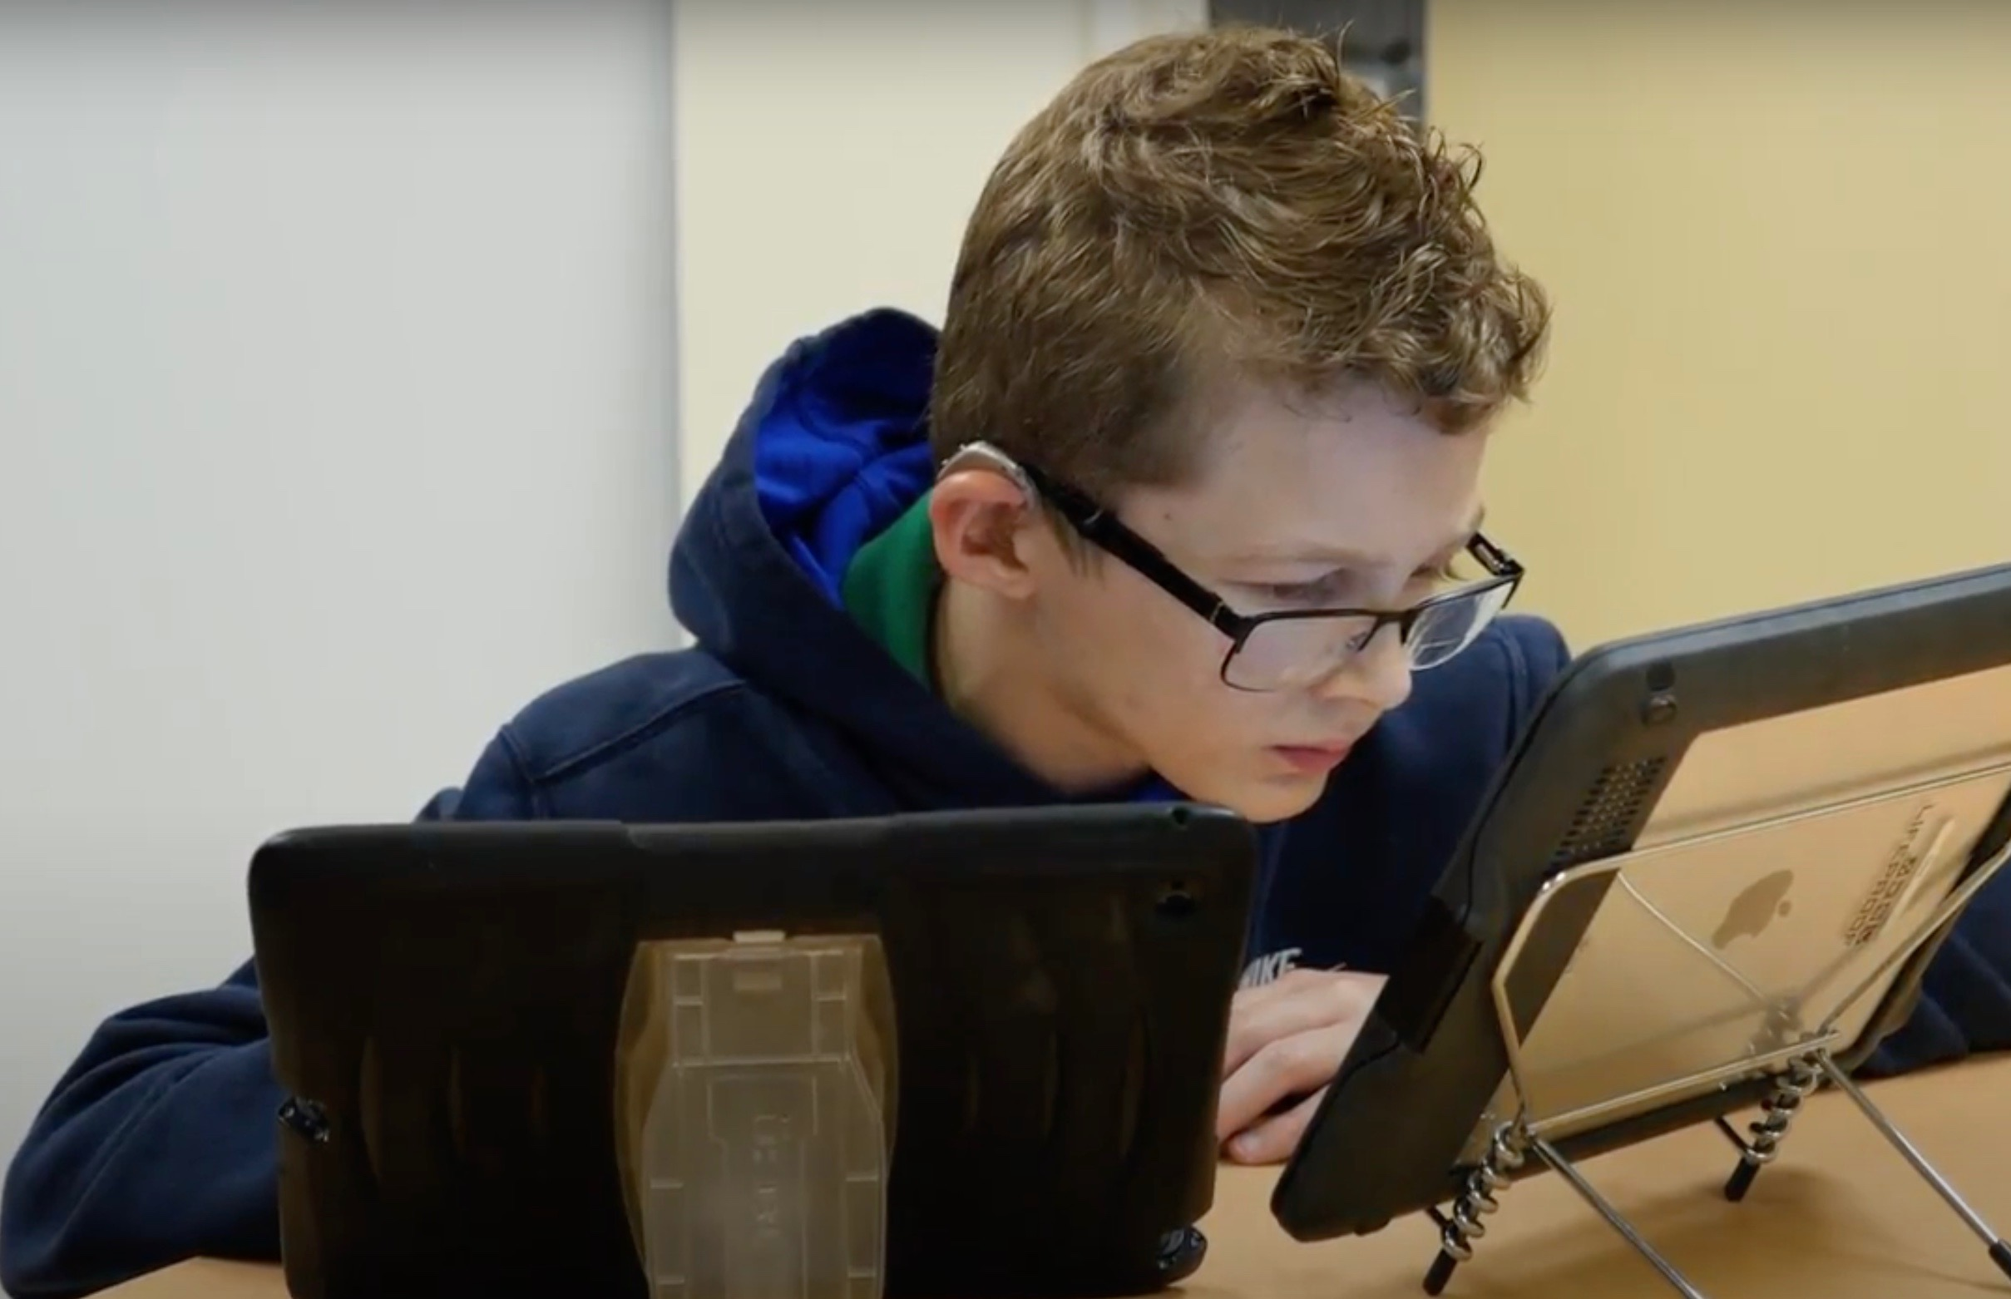
Modify Curriculum
Gathering information takes much longer than typical learners.
The pace of instruction
should be slower.
The scope of the information in a general education classroom can be overwhelming.
The curriculum should be prioritized so it is both manageable and instructive.
Notes:
One of those reoccurring needs was related to a need to modify the curriculum
These students are not able to learn the same amount of information at the same rate as their peers with typical vision and hearing…it’s just not possible.

Slide 21
Video 2
Henry and Deanna Youtube Video

Slide 22
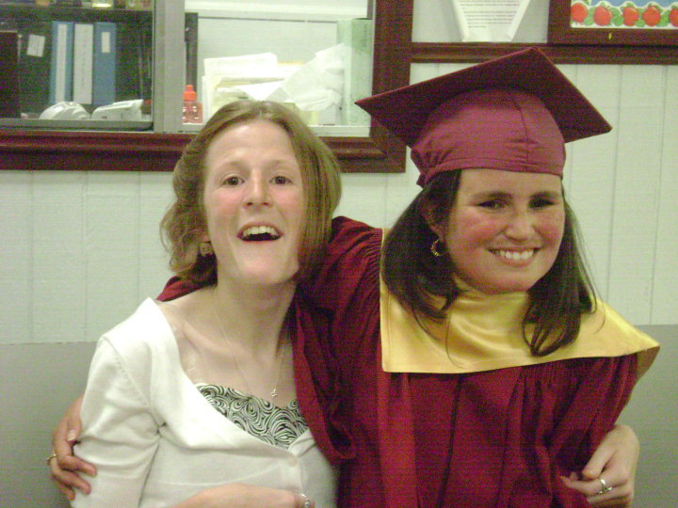
Comprehension
Define checks and include specific information in the student’s accommodations
Be on the alert
Go back and explain
Notes:
Another reoccurring need was related to Comprehension and the need to define comprehension checks.
Because they don’t know what they don’t know…and they don’t want to stand out. There are signals….
We need to have regular insight into our student’s existing level of understanding on a particular topic. Without it we are unable to assist with conceptual development
understand that next, more complex piece.
We can gain that insight into their understanding through effective comprehension checks.
should be open-ended questions that allow for the student to explain what the information means to them or how it relates to other information that they know. Instead of asking a Yes/No question such as “Do you understand?”, a more effective comprehension check may be “Can you explain that word or concept to me?” or “What does that mean to you?”

Slide 23
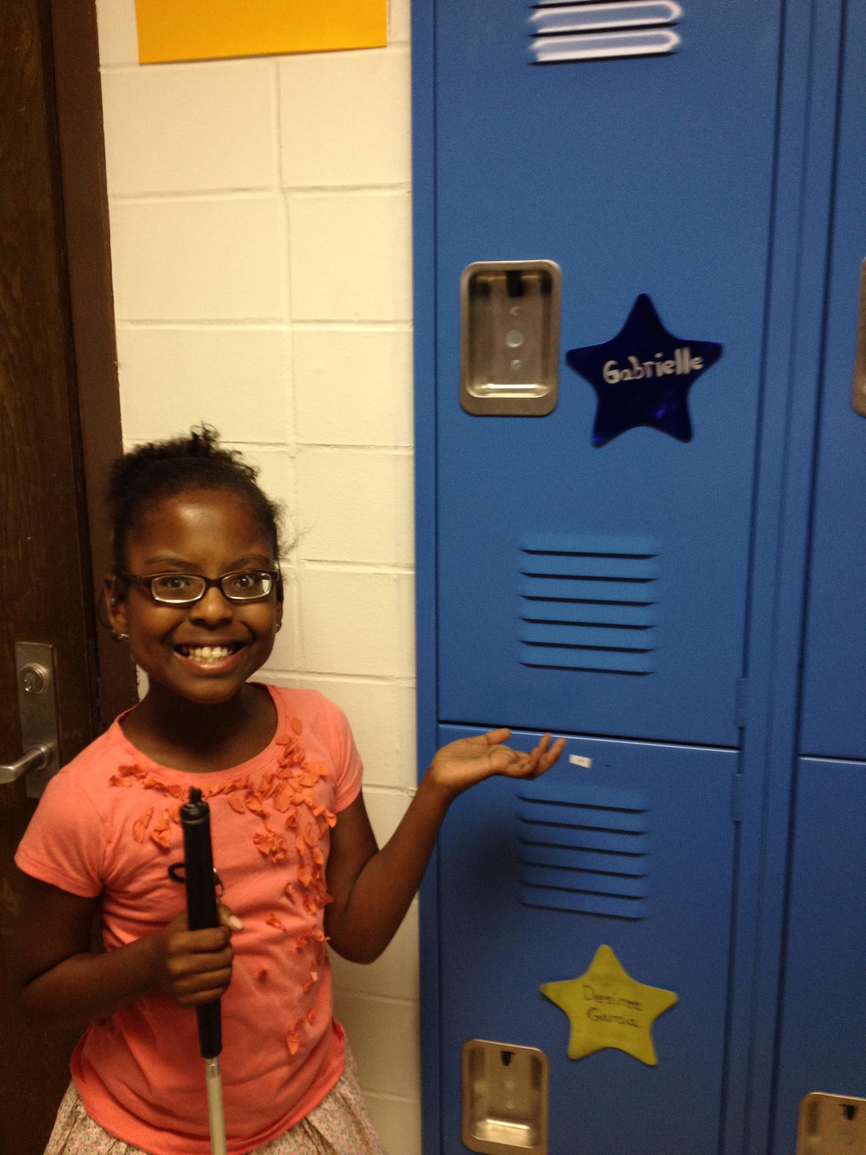
Create At Least One Elective
Pre-teaching
Re-teaching
Comprehension checks
Time for Inquiry and Investigation
Notes:
Electives can be created at the district level
Some state boards of education have created “Innovative courses that allow districts to offer state-approved innovative courses to enable students to master knowledge, skills, and competencies not included in the essential knowledge and skills of the required curriculum”
Pre-teaching core subject will help students become familiar with general topics, concepts and vocabulary before entering the real-time instructional environment. This will allow for more efficient and effective information gathering and processing in the larger setting.
While Cole works hard for visual and auditory access in the regular ed. setting, his ability to process the information is limited. Re-teaching the main components of the material will allow him the make the conceptual connections needed to store and retrieve the information from his memory.
A back and forth discussion is required for effective processing. Time for discussion, inquiry and investigation will help students develop a complete understanding of the course content. The comprehension checks will provide insight into areas that need to be further explored.

Slide 24
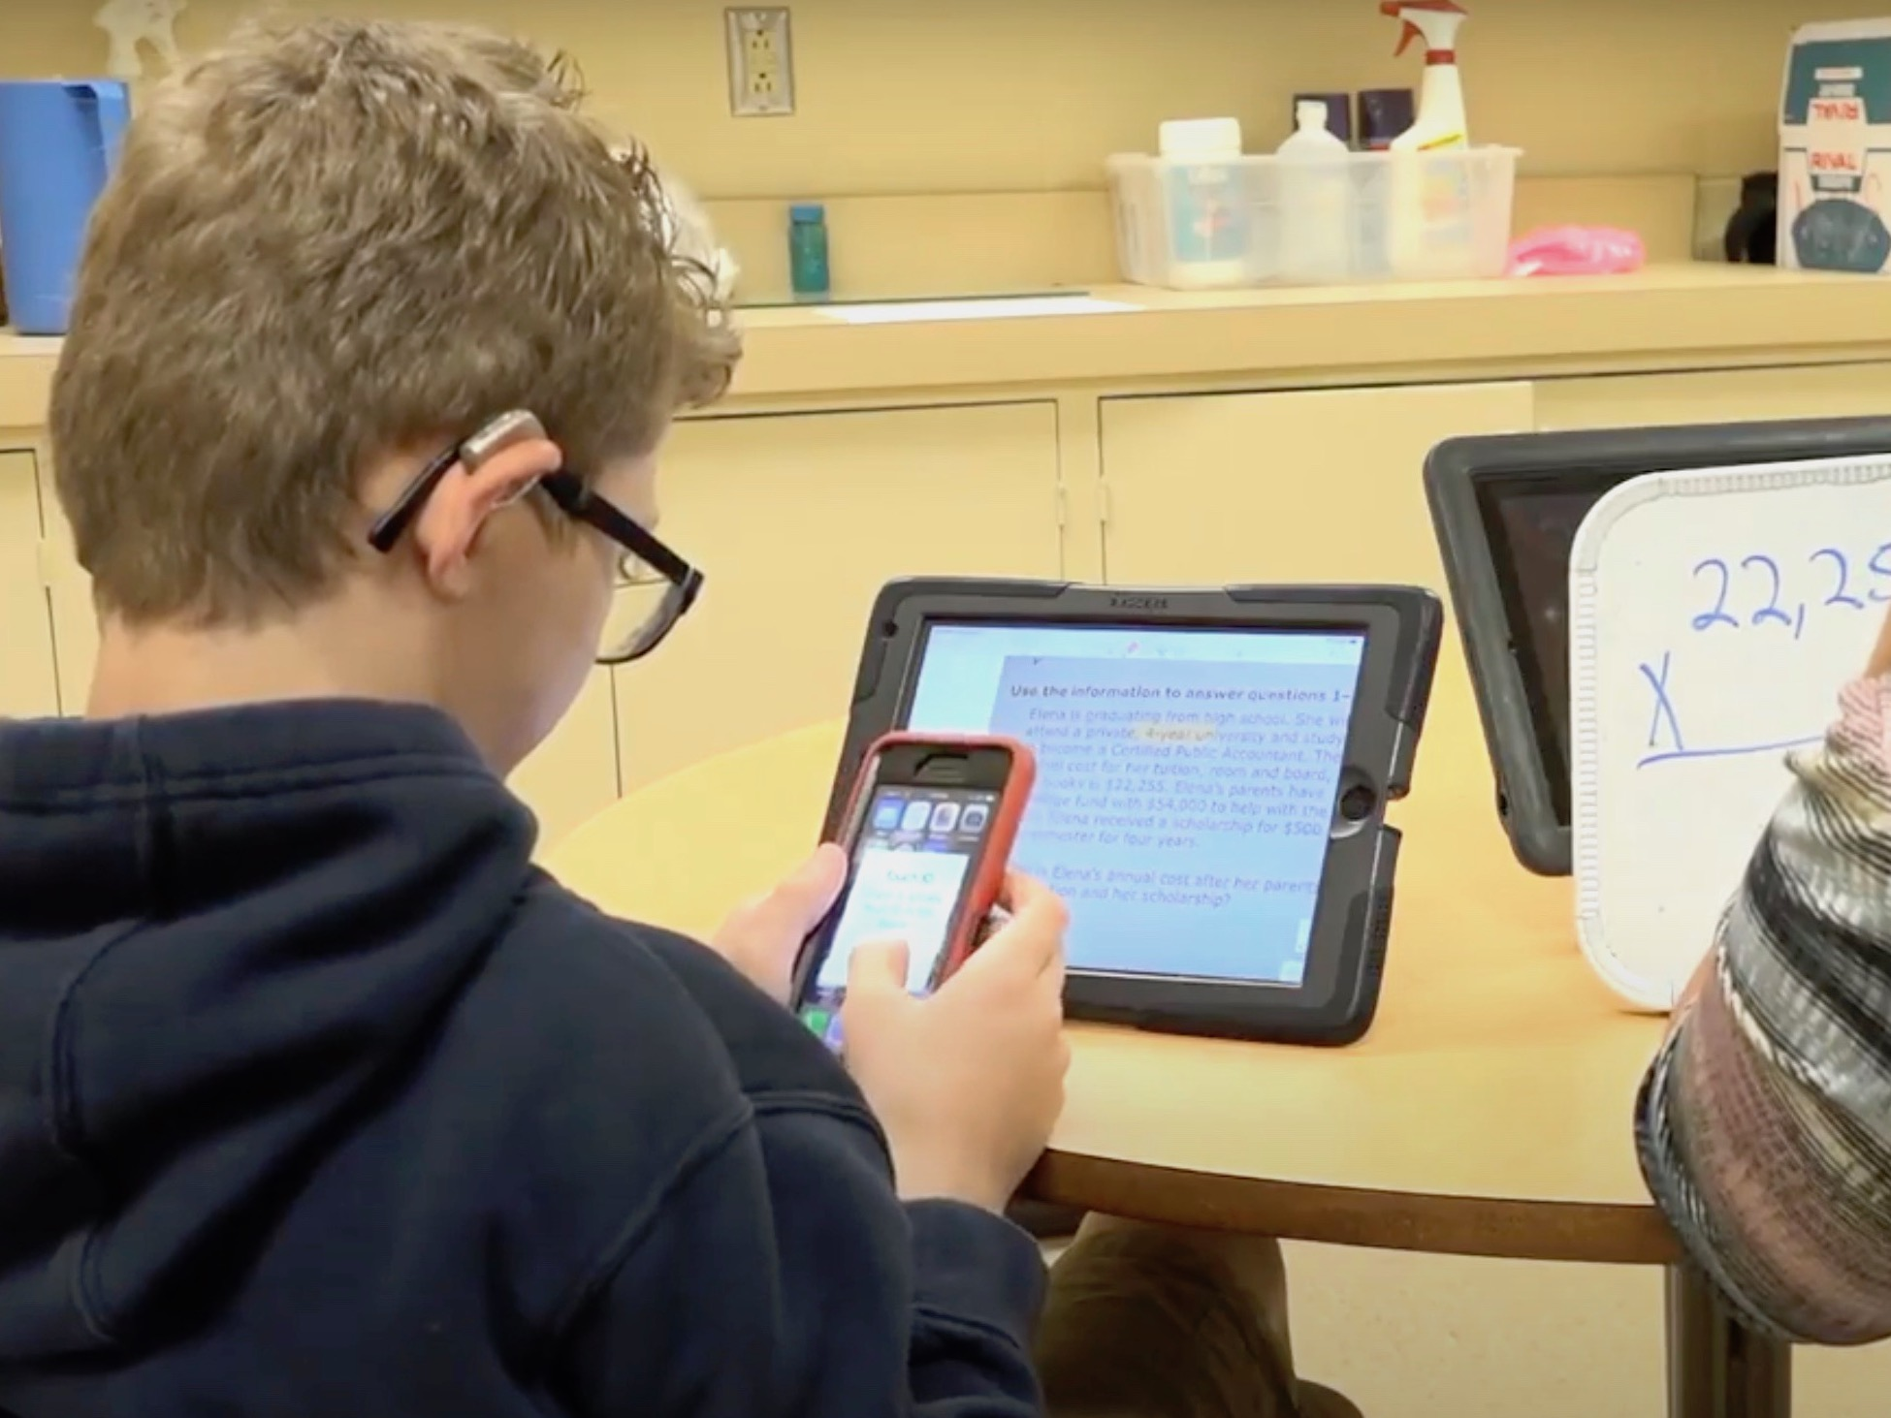
Manage Technology
How will these students not only use their technology, but manage it?
A plan must be made.
Notes:
Students who are deafblind often require technology to compensate for the combined vision and hearing loss. They are savvy with technology and may be responsible for many more devices than other students.
Who will repair it? When and where will it be charged? Does the student need help moving it from one location to another?
What role does the student play in managing their technology and what part do they need help with because it may not be reasonable for the student to do it all?

Slide 25
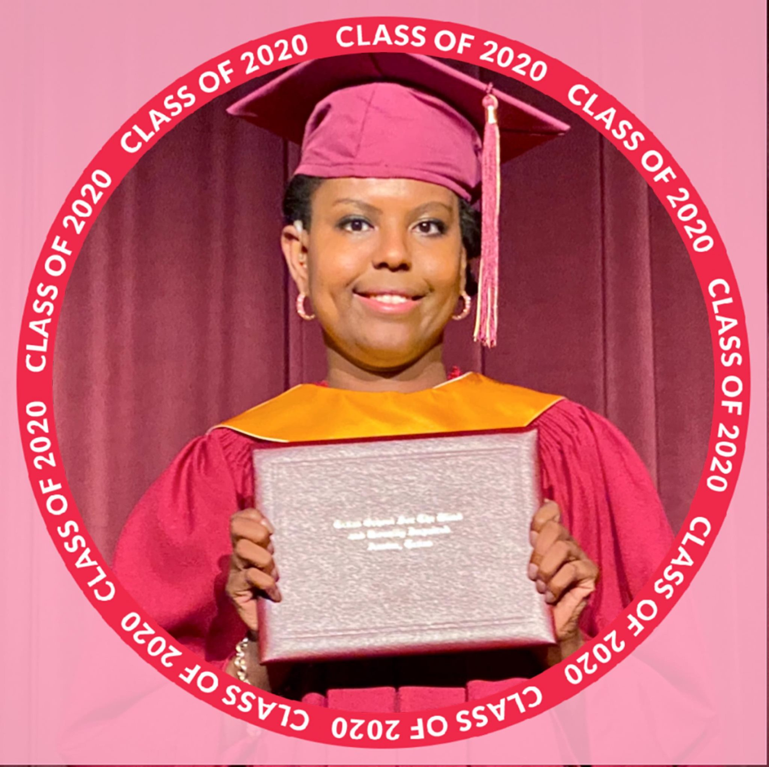
Homework!
These students are working much harder than their peers to gather information and often experience fatigue.
Strategies to reduce or eliminate homework may be necessary for some students.
Notes:
We’ve already mentioned these students can’t learn the same amount of information at the same rate as their peers with typical vision and hearing…..how can we help them most efficiently demonstrate their understanding of the material?
Alternative assignments
Shortened assignments
Natalie’s TDB followed up each unit with a project

Slide 26
Address Stress
Students who are Deafblind put forth a great deal of energy and effort over the course of a school day.
They have to work hard than their peers to keep up with real time instruction.
This can result in extremely high levels of stress as well as feelings of inadequacy and failure.
Notes:
These students with combined sensory losses are working so hard during the daylight hours and also at night.
They are trying to keep up academically and socially
They may be staying up late to complete their homework and not getting enough rest….
If stress addressed, these students can be at risk for toxic stress-which can reak havok on healthy development (both physical and emotional).

Slide 27
Poll Question 4
What are some of the needs you are noticing for congenitally deafblind proficient communicators?

Slide 28
Building Strategies and Resources
Texas Grant Activities for this year:
Identifying children younger than “testing age”
Child Count Email List of Professionals & Parents – Webinars
Literacy Initiative for young PC
Compiling Reports from On-sites
Requisite Concept Evaluation (RCE) - final pilot
Nationally, we are receiving help from:
NCDB workgroup - Kristi Probst
NFADB Family-To-Family Communities
Notes:
RCE
Evaluates foundational concepts necessary for students to benefit from the gen ed setting, identifies gaps and ceilings, modifications to
Identification Tool
Supporting Academic Rigor
Runs Sept-May

Slide 29
Meeting the Needs of Proficient Communicators with Usher Syndrome
Nancy O’Donnell, Director of Outreach
Usher Syndrome Coalition

Slide 30
American Annals of the Deaf - 1886
“The best elements of the home, of the school, of every department of human life, should be so gathered, combined, and administered as to promote, in the period of his youth, his highest educational well-being, and so to qualify him, the peer of the hearing, to discharge with pleasure and honor the full functions of an American citizen.”
- Peet, Harvey Prindle, Ph.D., LL.D. The Family Instruction of the Deaf in Early Childhood. American Annals of the Deaf for October 1886, WA, D.C.:Gibson Bros. 1886 8 vo. Pp 12
Notes:
Goals are still the same, all these years later

Slide 31
Usher Syndrome
Identified in 1914
Congenital bilateral sensorineural hearing loss (SNL)
“Adventitious” vision loss (RP)
Vestibular issues
No associated intellectual disability
Notes:
Affects males, females, all ages, all races, all ethnicities

Slide 32
Learners with Usher Syndrome
Have historically been proficient communicators
Attended schools/programs for the deaf/HOH (type 1)
Have had native language models
Attended local schools following general curriculum (Usher 2 &3)
Received support services - speech therapy, teacher of the Deaf, TVI

Slide 33
Usher Population estimates: 0-21
Early Hearing Detection and Intervention: 3200 - 11,000
USA Prevalence: 17/1000 births = 4600 - 15,000
Some subtypes more common in certain geographic areas or cultures – Ashkenazi Jewish, Cajun, Amish, Finnish heritage

Slide 34
Actual Numbers - Coalition
USH Trust # as of 8.2020
255 children, birth to 21
Youngest born in October 2019; registered in May
Several genetically dx under the age of 1
209 reported genetic testing to confirm dx

Slide 35
Actual Numbers – State DB Projects
2018 - 345 children, birth to 21
2015, over 51% had a cochlear implant, nearly five times the rate in the overall population of children who have dual sensory loss (11.3%)

Slide 36
Diagnosing Usher Syndrome - 2020
Newborn Hearing Screening - early identification of hearing loss
Dr. Google – parents diagnose Usher syndrome
Genetic testing
Prenatal genetic testing

Slide 37
Why are the Numbers so Low?
Dx missed because health care providers, teachers, not familiar with Usher
CIs mitigate hearing loss; Usher becomes invisible
Parents may not want to reveal dx to child or school
Students attend local schools across the country; not centralized
Vision loss doesn’t become a serious issue until latter part of education
Statewide screenings not routinely taking place

Slide 38
Proficient Communicators with Usher
How are Proficient Communicators with Usher different from the group Deanna described?

Slide 39
Usher = Constant Change
Students with Usher experience unpredictable, progressive vision loss which impacts visual fields, vision in dimly lit areas, adaptation to different lighting:
Strategies that worked yesterday may not work tomorrow, i.e.
interpreter sitting at a distance may need to move closer in darkened environments so student can visually “track” their signs
Regular print may be fine…until larger font is necessary, or braille is needed
As vision loss progresses, speech reading may be affected. This can be misdiagnosed as additional hearing loss

Slide 40
Usher Students Can Be Invisible
As vision changes, child may be labeled “clumsy,” “anti-social,” “inattentive” instead of “blind.”
Students cleverly and seamlessly adapt to waning vision – i.e., intuitively stop outside a classroom, scan, then enter
Students function very differently during daylight (school) hours than at home or at after school events
Students may be more attentive in the a.m., exhausted by afternoon. Exhaustion may look like disinterest, poor grades, defiance. Schedule smart!

Slide 41
Students with Usher May Need:
Time to visually scan/gather information due to restricted fields
Support to set up/manage technology in the classroom
Plans for troubleshooting when technology fails (batteries, Bluetooth connections, access to WiFi)
Sensory breaks
Emergency evacuation plans – “X” on the back; assign a travel buddy; human guide techniques
Lockdown training – how to communicate in the dark, silence cell phone, wait for help.

Slide 42
Accommodations not Modifications
Accommodations alter how a student learns. They do not change what the student is expected to learn. Excellent webinar highlighting 2 proficient communicators with Usher syndrome
​Educational Considerations for Students with Usher Syndrome

Slide 43
Let’s Ask the Experts!
We can learn a lot from Experts living with Usher.

Slide 44
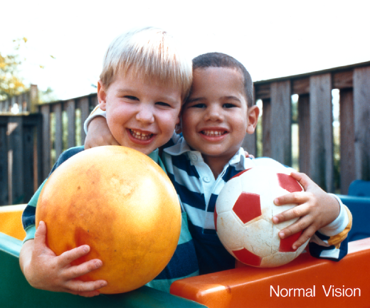
Retinitis Pigmentosa
Photo on the right shows a typical representation of an RP “view” of same photo of the boys on the left. The RP view shows all black with a small window with the boys’ faces.

Slide 45
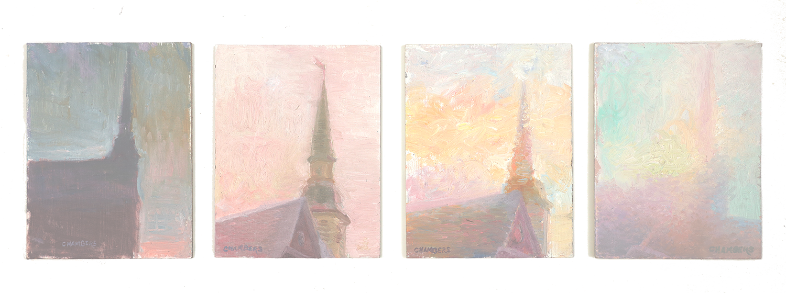
The USH View
Tim Chambers, master painter with USH2A recently painted a series showing how RP impacts vision and color perception. You can learn more on his website in the USH View. How might this influence your work with students?

Slide 46
Ask the Experts – Young Adults tell us:
“Not everything is about Usher. We can also have learning disabilities, mental health issues, dyslexia, etc.”
“Please ask us what we need!”
“We want to learn how to advocate for ourselves!”
“We are eager to meet others with Usher.”

Slide 47
Impact of Usher
How do we support Proficient Communicators with Usher syndrome, their parents, and the professionals who serve them?

Slide 48
Provide Universal Accessibility
Emerging/Best Practices
CART/captions that are customizable as vision changes
Image descriptions (ID)
Text transcripts – dialogue, narration, ID
ASL translations
Print, LP, electronic, braille materials
Accessible learning platforms
Accessible websites, social media, apps
Provide environmental info with Haptics

Slide 49
Support Parents
Seeking guidance on decisions:
To tell or not to tell, when, and how
The child
The school
To implant or not
Communication - ASL, speech, haptics, PT?
O&M instruction
Braille instruction
High Level advocacy

Slide 50
Support Practitioners
Seeking:
Guidance on effective instructional practices
Accessible distance learning platforms
Information to share with parents
A way to connect parents
Successful role models and mentors with Usher

Slide 51
Conduct Research
Emerging/Best Practices
Instruction
Distance education platforms
O&M – if/when to introduce
Braille instruction – if/when to introduce
Learner Fatigue – impact and strategies to mitigate
Haptics in education

Slide 52
Resources
What’s already out there that we can use?

Slide 53
A Review of the Literature
Of more than 100 articles, books, fact sheets, most are more than 20 years old
Some are timeless and informative
An Open Letter to Our Parents: What We Wish You Had Known, 1994, Nat-Cent News, HKNC
A Group for Students with Usher Syndrome in Louisiana, DB Perspectives Fall 2000-spring 2001
Usher Syndrome in the School Setting, 1997, HKNC, Miner and Cioffi

Slide 54
A Review of the Literature, cont’d
Some could be updated
Understanding Usher Syndrome: An Introduction for School Counselors, HKNC 2001
Counseling Students Who Have Usher Syndrome Fact Sheet Fact Sheet, Patricia Lago-Avery
Usher Syndrome: An Overview, Texas School for the Deaf, 2008
Usher Screening Guides

Slide 55
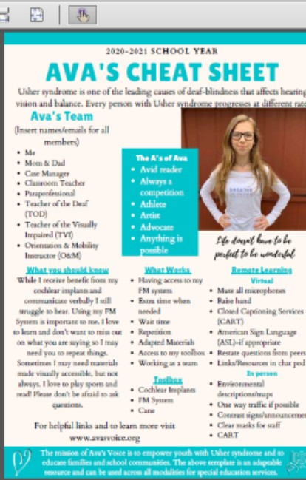
New Resources: IEPs
Ava’s Cheat Sheet Template and Sample
Ava’s Team
What you should know
What Works
Toolbox
Remote Learning
Collaboration Tips
Accommodations – In Person and Remote
Student Led IEPs

Slide 56
Resources for Youth
FB group – Young Adults Living with Usher Syndrome, 18-28
USC - Just for Young Adults blog by Megan Lengel “Seeing is Believing: My College Experience with Usher 1B”
Video: Advocacy in the DeafBlind World– Ryan Odland, HKNC
USHthis Summer Camp for Youth with Usher Syndrome, ages 11-17
USHthis Summer Camp Counselor opportunities, ages 18-24
USHangouts – 1 day camp for all kids attending the USC conference

Slide 57
Parent/Family Resources
Ava’s Voice:
The Diagnosis – Ava’s Voice interviews kids with Usher and their parents
discUSH Family Weekend
Usher Syndrome Coalition
Annual USH Connections Conference
USH Trust international registry – register and connect families
Global Usher Syndrome Awareness Day – 3rd Saturday of September
USH Ambassadors – building the Usher community, one state at a time
Blog on parenting – Mark Dunning
Info about Usher syndrome in ASL

Slide 58
Parent/Family Resources, cont’d
Webinar – Educational Considerations for Students with Usher Syndrome NCDB/Usher Syndrome Coalition/ Patti McGowan/Carly Fredericks
F2FC – monthly calls for families of kids with Usher syndrome
Facebook groups – Usher Moms, Moms of Adult Children with Usher Syndrome, Usher Syndrome Parents
National Family Association for Deaf-Blind: empowering the voices of families with individuals who are deaf-blind and advocating for their unique needs
Article - Denied an IEP or 504 Because Grades are Good
iCanConnect – National Deaf-Blind Equipment Distribution Program

Slide 59
Practitioner Resources
Webinar - Starting a National Dialogue on Finding Children with Usher Syndrome NCDB/Usher Syndrome Coalition
HKNC - lots of info, online offerings
Information about topics such as Haptics and ProTactile
free online courses through December 31st

Slide 60
Practitioner Resources, cont’d
Guidance from the Usher community
Artist Tim Chambers, The USH View – what do I really see?
Professionals Serving DeafBlind Consumers (PSDBC forum)
Information on the evolving culture, values
Blind but Not Blind – JennyLynn Dietrich, DeafBlind adult on autonomy
Protactile ASL – A New Language for the DeafBlind
Not Usher specific but relates to PCs:
Fostering proficient communication from birth: Clarissa Vollmer

Slide 61
Poll Questions 5
Poll #1 – What updated material about Usher syndrome does your project have to share?
Poll #2 – Who does your project have for consulting about meeting the needs of learners who are proficient communicators?

Slide 62
Moving Forward
Continue collaboration among service providers, students and families
Increase child find efforts
Forge relationships with the adult DB community
Encourage research
Establish best practices
Create central repository for materials and resources
Create trainings for professionals working with PCs

Slide 63
Poll Questions 6
What main issues would you want to address in the months to come – related to proficient communicators?

Slide 64
Please take the Meeting the Needs for Proficient Communicators Evaluation Survey

Slide 65
Final Slide
The contents of this presentation were developed under a grant from the U.S. Department of Education, #H326T180026. However, those contents do not necessarily represent the policy of the U.S. Department of Education, and you should not assume endorsement by the Federal Government. Project Officer, Susan Weigert.

