Slide 1

NC Deaf-Blind Project
Partnering to improve outcomes

Slide 2



Partners

Slide 3

Activities & Services
Inside of jointly developed brochure

Slide 4

INFO & RESOURCES

Slide 5
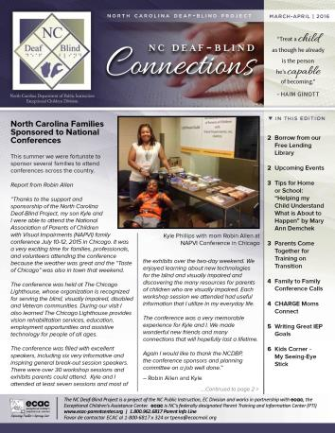
And there’s more…..
Family Newsletter –
      USPS & Electronically
Monthly Parent Calls
Workshops, Webinars and Institutes
      Including coordination with ECU
PEERs
Family Leadership Training
Section on ECAC’s Website dedicated to NCDBP
Facebook Page (public and private)
Lending Library

Slide 6
Yes…we Dare to dream…
Educators will…
Know about AND access services and supports…EARLY!
Have HIGH expectations for their students
Have the resources, skills and supports they need to effective teach learners with DB
Know about the importance of the Census and
Families & Youth will…
Know about AND access services and supports…EARLY!
Have HIGH expectations for their son or daughter or themselves
Know about their resources
Effectively advocate and participate in their child’s or their own educational planning… and their LIFE!

