Slide 1
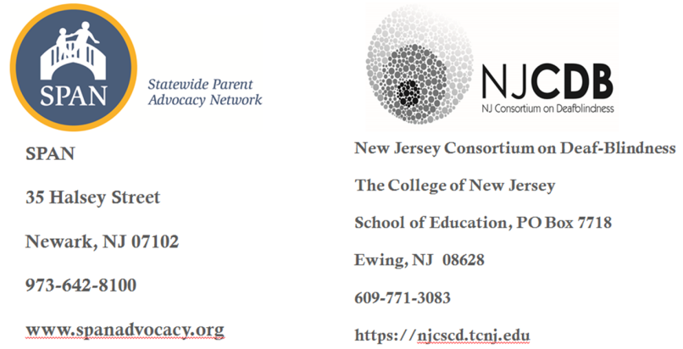
NJCDB & SPAN:
New Jersey
PTI Partners & Allies in Advocacy

Slide 2
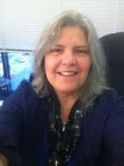


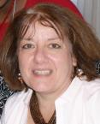
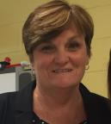
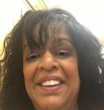
Who We Are
Diana Autin, Executive Co-Director & PTI Co-Director, SPAN
Carolyn Hayer, Director of Parent & Professional Development & PTI Co-Director, SPAN
Maria Docherty, Director of Technical Assistance, SPAN
Peggy Lashbrook, Acting Director and Transition Specialist, NJCDB
Michelle Ragunan, Program Coordinator, NJCDB
Carly Fredericks, Family Specialist, NJCDB

Slide 3
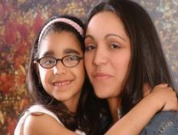
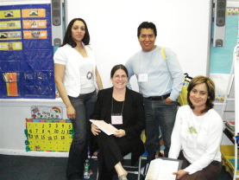
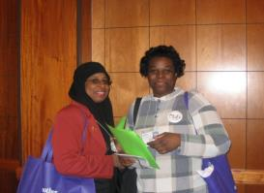
SPAN’S Mission
To empower families & inform & involve professionals & others interested in the healthy development & education of children, to enable them to become fully participating & contributing members of our communities & society.
Empowered Parents: Educated, Engaged, Effective!
Notes:
Diana

Slide 4
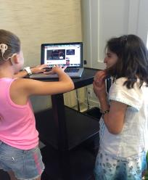

NJCDB’S Mission
NJCDB’s goal is to assure the provision of high quality education programs within natural environments/supported inclusive settings and appropriate services for infants, toddlers, children and youth who are Deaf-blind. NJCDB’S goal will be accomplished through a menu of discrete initiatives within a responsive statewide approach for families, educators and community service providers.
Notes:
Mary

Slide 5


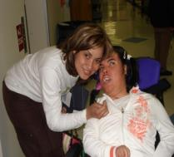
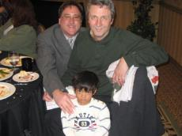
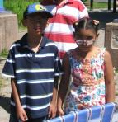
SPAN’S Priority
SPAN’s foremost commitment is to children with the greatest need due to disability; poverty; discrimination based on race, sex, language, or immigrant status; involvement in the child welfare or juvenile justice system; geographic location; or family or other special circumstances
Notes:
Carolyn

Slide 6
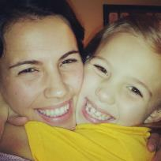
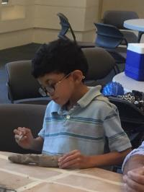
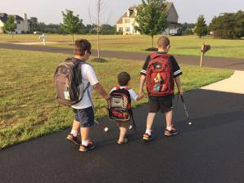
NJCDB’S Priority Areas
To facilitate the development and ongoing implementation of a Statewide Community of Practice on the Education of Students with Deaf-blindness focusing on evidence-based educational practices and includes family members; Deaf-blind adult consumers; early intervention, special and general education personnel; and State and Local Educational Agencies.
To develop and implement a well coordinated and responsive centralized system for professional development (including on-site coaching support) specific to the needs of students who are Deaf-blind.
To develop a statewide initiative for the early and ongoing identification of infants, students and youth with Deaf-blindness.
Notes:
Mary

Slide 7
Funding Sources
SPAN
  As the PTI for NJ, SPAN receives a US DOE grant of $454,835/year for 5 years to provide statewide information, training, TA, & support for families of infants, toddlers, children, youth, and young adults with disabilities including DB ages birth to 26 with a special focus on underserved families
  As the Family to Family Health Information Center, SPAN receives US DHHS MCHB funding of $95,700/year to provide services to families of children with special healthcare needs including deaf-blindness
NJCDB
  The Center for Sensory and Complex Disabilities (CSCD) within our School of Education at The College of New Jersey was awarded a five-year $1.3 million grant to continue and expand activities to support the education of infants, children and youth who are deaf-blind.
  NJCDB is funded by the U.S. Department of Education via a cooperative agreement awarded to states for purposes of improving educational outcomes for children and youth who have been identified as deaf-blind.

Slide 8
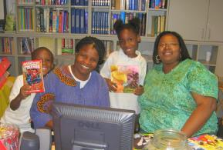
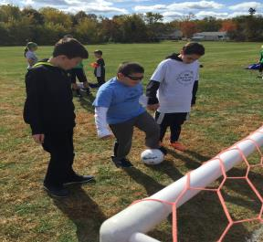
SPAN & NJCDB’S
Shared Issue Areas
Identification
Resources
Trainings
Family to family support
Technical Assistance
Notes:
Mary

Slide 9

Conferences & Collaboration
Collaborate on the implementation of an annual statewide mini-conference for families
Annual Family Learning Day
One teleconference/webinar each year focused on the issues of interest to families
Notes:
Mary

Slide 10
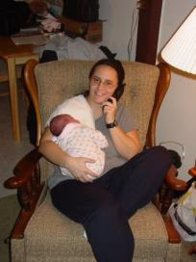
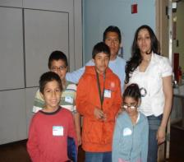
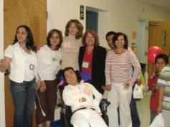
Individual Assistance
SPAN & NJCDB each provide technical assistance to identified families.
SPAN & NJCDB collaborate on TA to individual families when appropriate.
Notes:
Diana

Slide 11
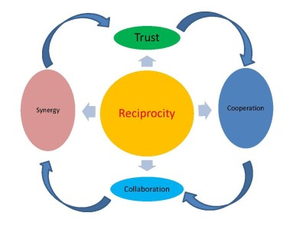
Reciprocal Collaboration
NJCDB provides guidance and information to increase the readiness of SPAN staff to guide families including through NJCDB’s participation on SPAN’s PTI Leadership Council.
SPAN advises NJCDB on avenues to foster the involvement of eligible families including those that have traditionally been underrepresented through SPAN’s participation on the NJCDB Advisory Committee.

Slide 12

Sharing Information
Link to each other’s websites
  www.spanadvocacy.org
  https://njcscd.tcnj.edu
Co-developing informational resources
Disseminating each others tools
Co-presenting information at
workshops & conferences
Individual assistance
Helping to set priorities
Notes:
Diana

Slide 13

Why does it work?
Shared values
Mutual respect formed over many years
Intentional proactive efforts to maintain relationship after changes in leadership
Deep understanding of mandates, strengths & limitations of each partner
Commitment to avoid duplication of effort & maximize scarce resources
Clarification of commitments & responsibilities via written formal MOU
Collaborative work
Notes:
Diana

Slide 14


Challenges & Solutions
Challenges
Solutions
Identifying families in underserved areas throughout the entire state
Disseminating resources available for deaf-blind children and their families
NJCDB established a Parent Advisory Committee (PAC) that includes three parents throughout the state to service north, central and southern areas
PAC parents will work closely with SPAN Resource Parents (SRP’s) to support identification and TA for at risk families
Notes:
Mary

Slide 15

Achieving Success
Annual mini-professional development activity to SPAN TA staff by NJCDB staff on new developments and emerging issues affecting the education of children who are deaf-blind.
Notes:
Diana

Slide 16

Thank you
Notes:
Diana

