Slide 1
PARENT LEADERSHIP
TRAINING
Collaborating Partners:
New York Deaf-Blind Collaborative – Clara Berg
Sinergia Metropolitan Center – Godfrey Rivera
Notes:
Feds are encouraging collaboration!! We need to all play in the sandbox.
Competition is part of the institutionalized mindset; we are wary of each other; slice of pie is getting slimmer;
Introduction of Partners/name tent 2”
Overview of the model/template 15”
Key elements of the partnership:
Relationships across the projects
Training curriculum of combined projects
Adapted curriculum for underserved
Leveraging of resources
Sharing expertise & capacity building
Success stories 10”
Q&A

Slide 2
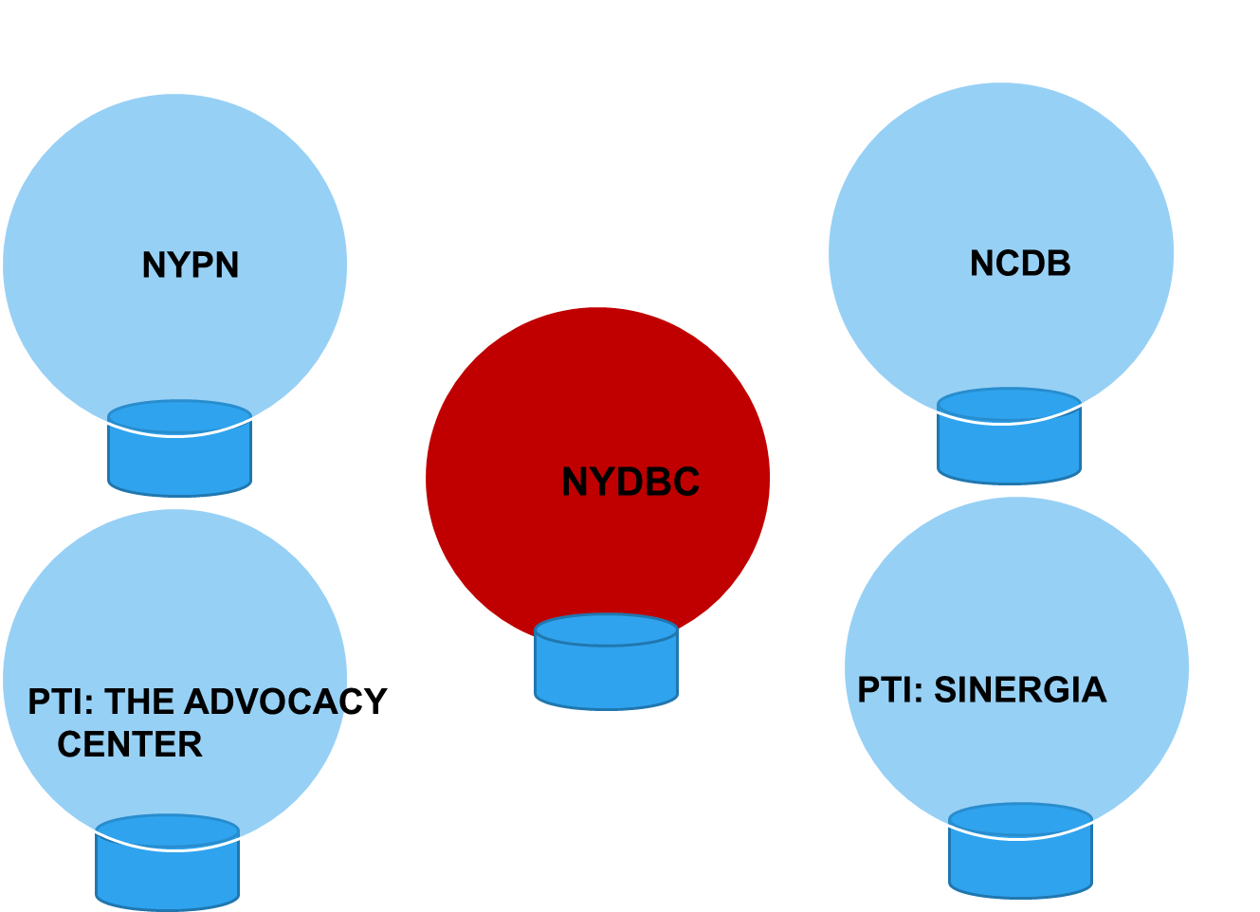
Collaborating Agencies
Notes:
Connection was created among projects and agencies and among ourselves

Slide 3
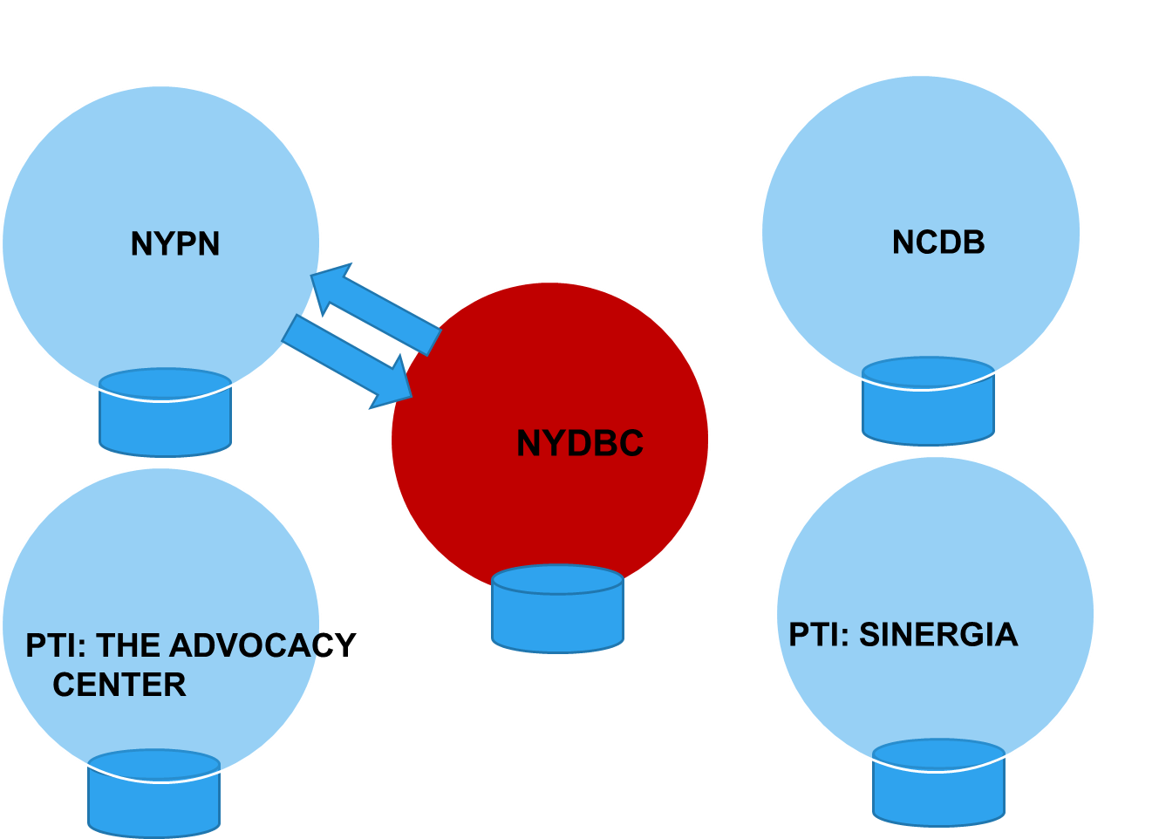
Collaborating Agencies
Notes:
Connection was created among projects and agencies and among ourselves

Slide 4
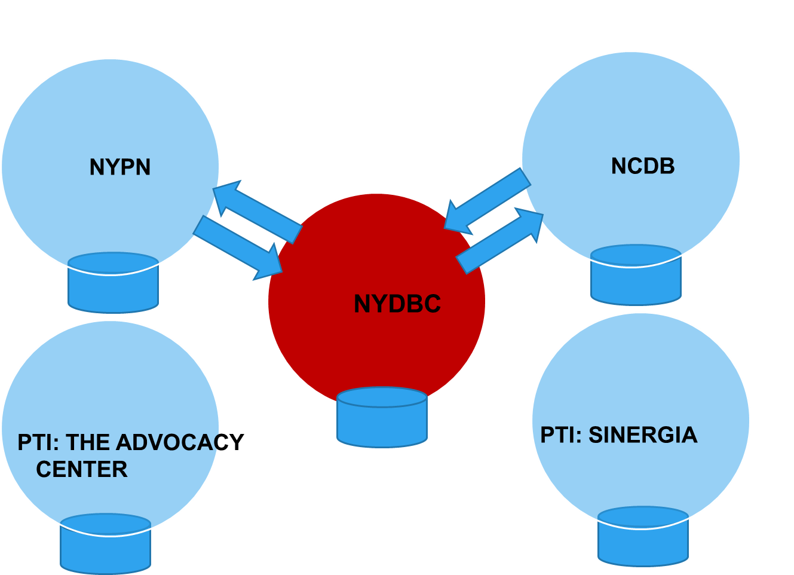
Collaborating Agencies
Notes:
Connection was created among projects and agencies and among ourselves

Slide 5
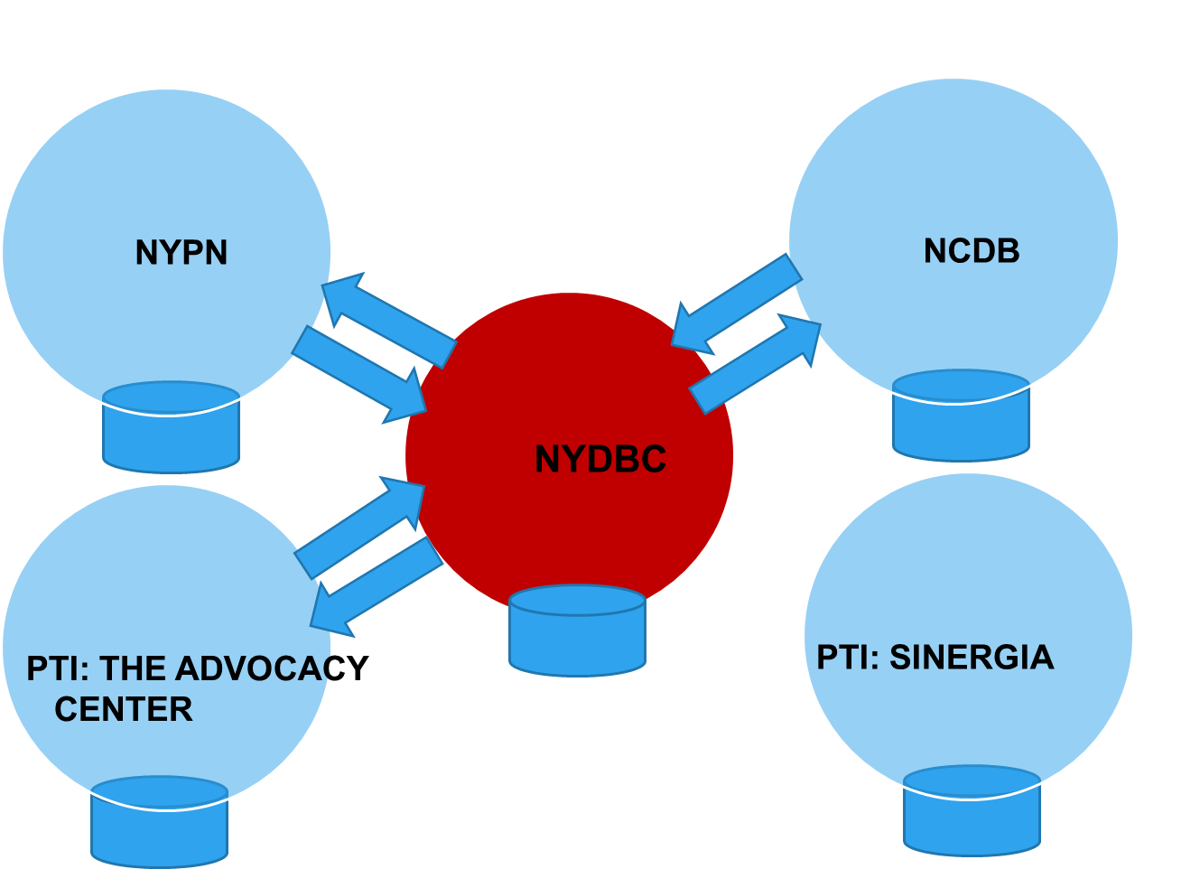
Collaborating Agencies
Notes:
Connection was created among projects and agencies and among ourselves

Slide 6
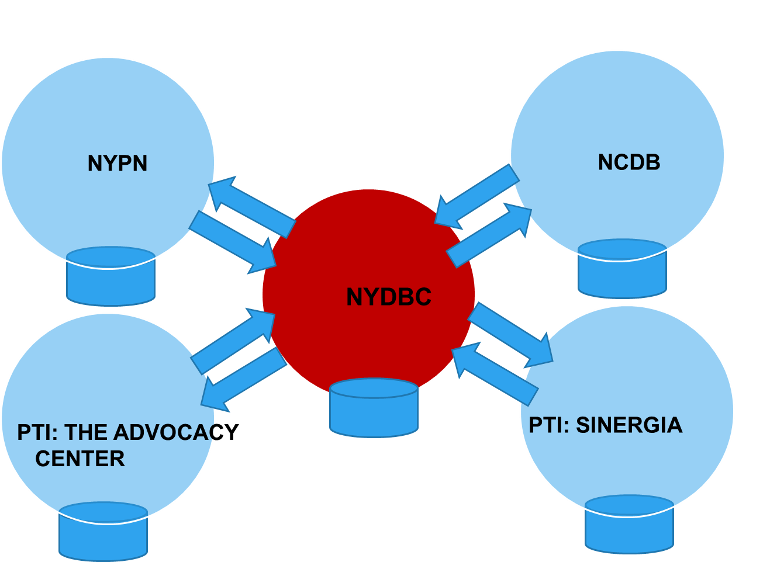
Collaborating Agencies
Notes:
Connection was created among projects and agencies and among ourselves

Slide 7
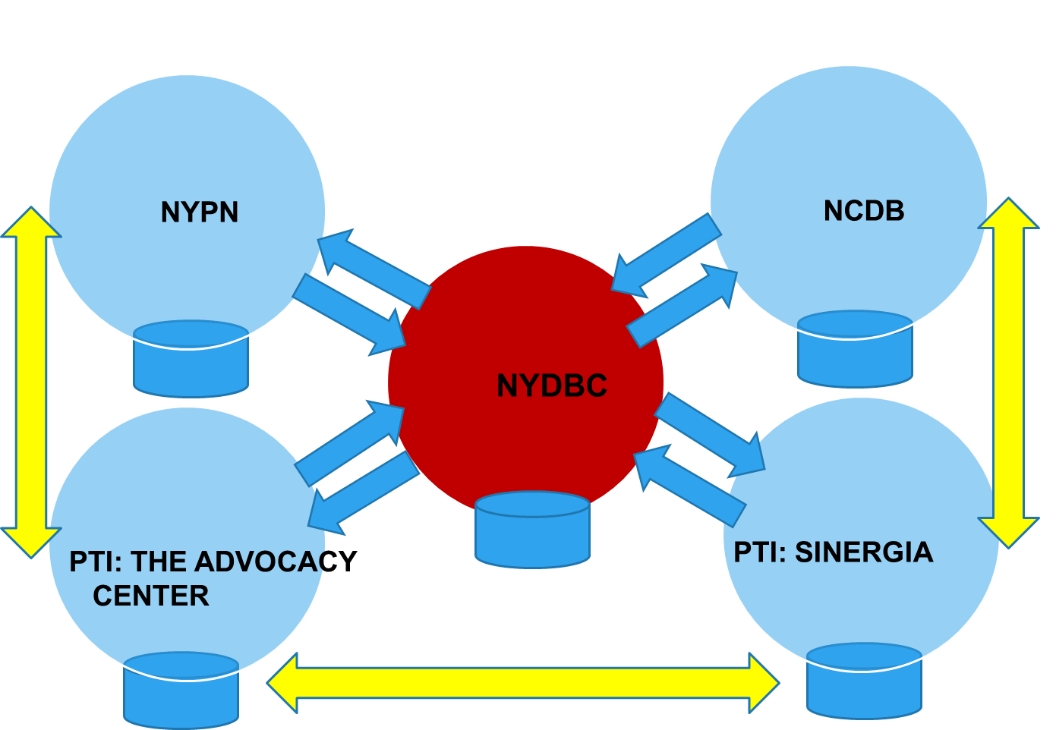
Collaborating Agencies
Notes:
Connection was created among projects and agencies and among ourselves

Slide 8
OVERVIEW OF THE MODEL / CONTENT | CHANGE / PARTNERS & COLLABORATORS | STRATEGIES
PLT in different areas of the state | NYDBC/NCDB | Gather information of other states
Series I – Rochester | The Advocacy Center Local resources | Creating new relationships
Series II – White Plains & Long Island | White Plains Independent Living Center Local resources | Resource leverage/teaming & collaboration
Series III – Metropolitan Area | Metropolitan Parent Center – Sinergia Local resources | Research based perspectives
Series IV – Metropolitan Area in Spanish Adapted curriculum & schedule | Parent to Parent of New York City Local resources | Shared experiences, new capacities
Series V – Virtual Meetings 6 + 1 In person (central location) | NCDB – The Advocacy Center – P to P of Western NY – | Adapted curriculum and created self evaluation

Slide 9
Model Description
  Pilot Program in Rochester:
    3 weekends (Friday evening until Sunday afternoon) in a total period of 6 months with conference calls and support between meetings:
      1st weekend – Learning about DB 101, self, family & child – PATH – Leadership Skills
      2nd weekend – Telling Your Story; state/local resources - Advocacy
      3rd weekend – Conflict resolution – Action Plan for the Future: self, family & child
Notes:
Telling Your Story was something to try; This became a key piece of the training
State Specific Resources – created different ways to identify resources; we wanted the families to have the benefit of local resources . E.g. Medicaid, in three regions

Slide 10
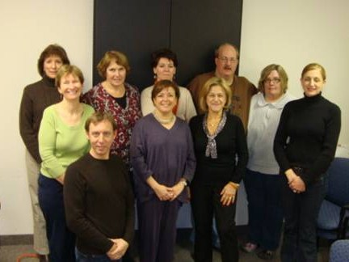
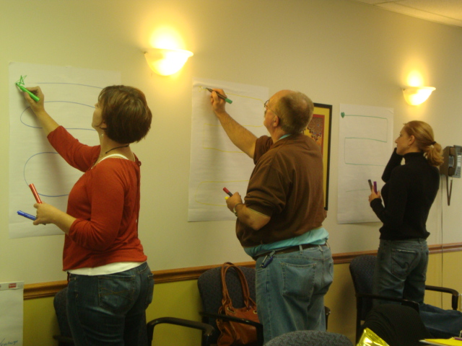
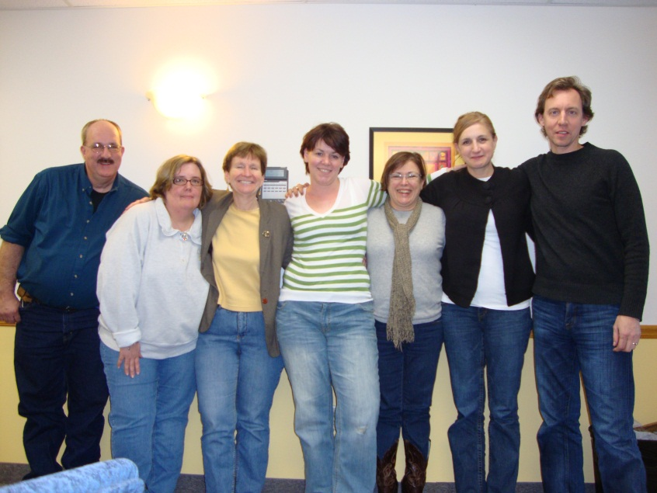
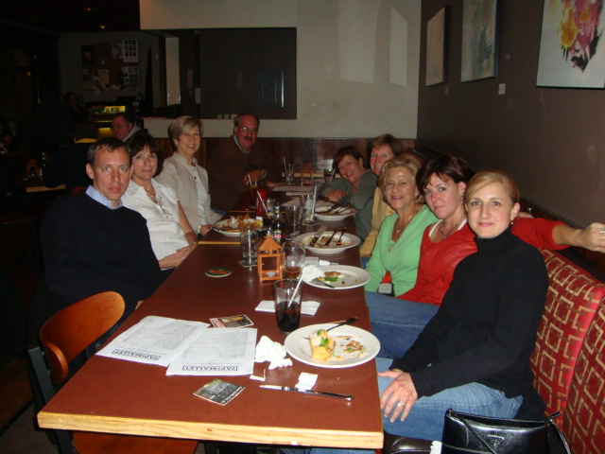
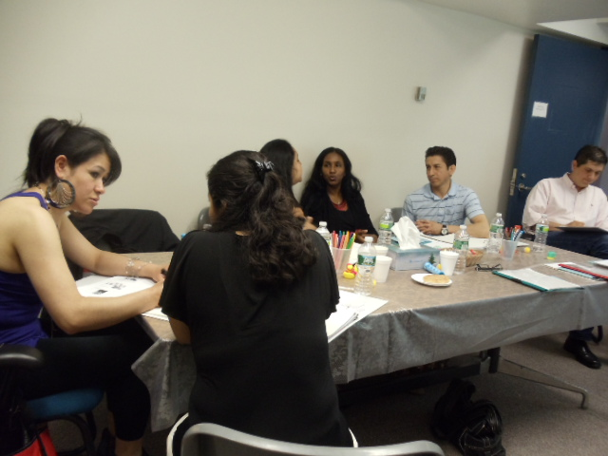
At work
Having
fun
Friendships

Slide 11

So…Why did it work?
WE :
Established strong relationships across the different projects
Developed a training curriculum that combined practices used by both the DB & PTI projects
Adapted the curriculum to train Spanish-speaking parents who have a child who is deaf-blind
Effectively leveraged technical assistance resources; Reduced duplication of services
Shared different types of expertise
and built new capacities among the participating projects

Slide 12

Key Element to the Partnership:
Shared values & passion
Quick buy in! Belief in collaboration
Diversity was embraced and celebrated
Generosity of spirit
Everyone is equal & valued
All bring expertise & gifts
Good at problem solving; adaptability
Friendships - developed individually and as a group
We “heard” each other
Notes:
We all embrace diversity
to the idea of parent leadership
Mutual understanding on the need to provide parent leadership training
sharing ideas, materials, etc
Enjoyment of each others company; chemistry; energy; trust; comfortable with one another; have fun together
Clara good communicator – a lot in writing; true willingness to share everything
Not set up for failure; all in it together attitude
No one was afraid about losing one’s own material
Highly interactive; all responses valued
Training must be delivered/created in an atmosphere where there is trust & parents feel safe
Setting a tone of respect
When delivered in Spanish, participation and interaction is higher

Slide 13
Key Element to the Partnership:
Leveraging Resources
Meeting space
  AV, media/internet access, copier
  Convenient location
Project staff conducted all presentations
Shared training materials

Slide 14
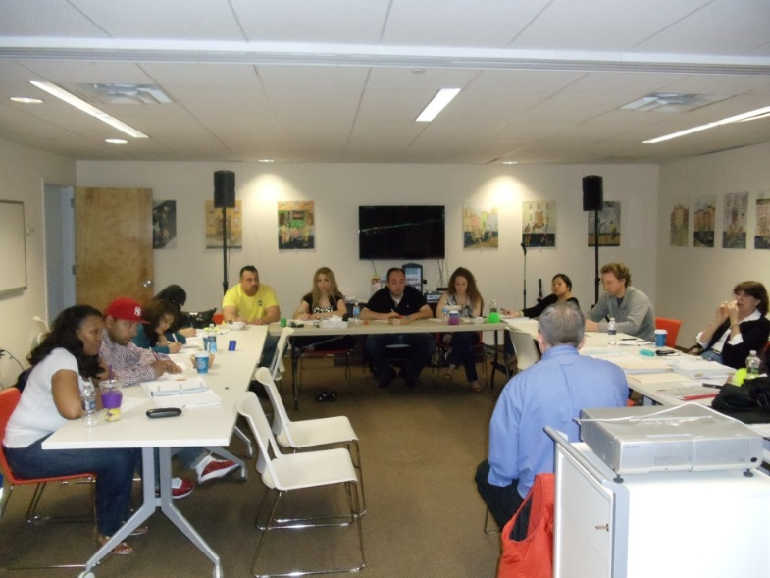
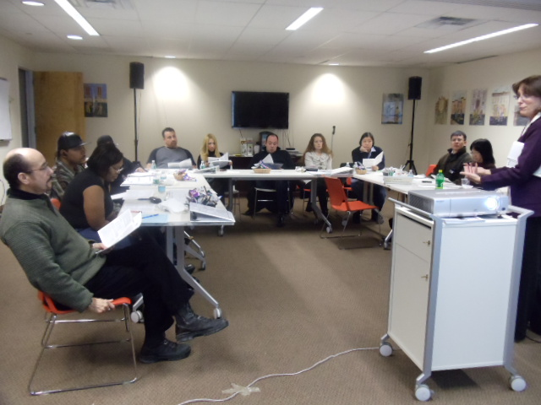
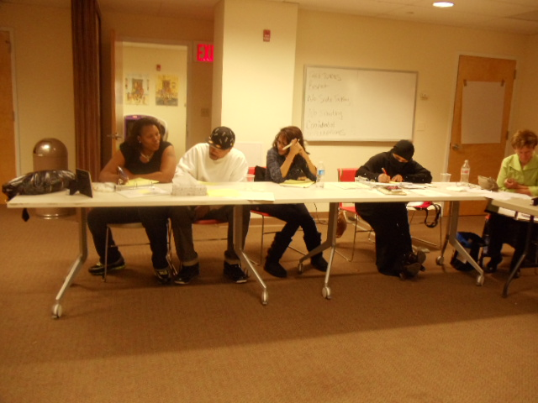
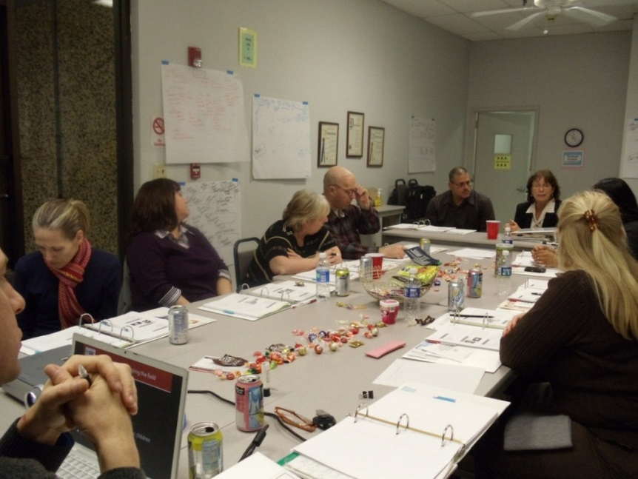
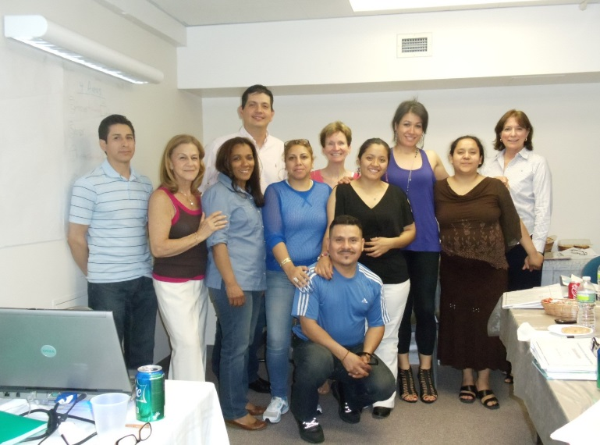
LEARNING
LISTENING
TEAM WORK
PRACTICING

Slide 15
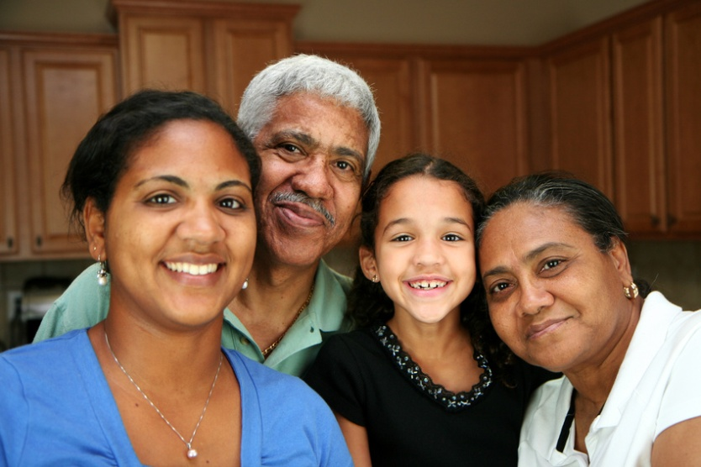
Key Elements to the Partnership:
Adapted curriculum for underserved
Spanish population
Adaptations in:
  Scheduling time
  Transportation
  Interpreting issues
  Financial support
  Training materials
Notes:
Previous model presented a Challenge; failed twice because this group has different needs and turned it into success when we were sensitive to their requests
Not 3 weekends; went to 8 Saturday (10:30 till 4 PM sessions) which included an Introductory session to have their commitment plus 7 sessions
Translation by someone who really understands the content
For English presentation, lots of preparation & thoughtful reflection on how to present; time factor
Clara good communicator – a lot in writing; true willingness to share everything
Not set up for failure; all in it together attitude
No one was afraid about losing one’s own material
Highly interactive; all responses valued
Training must be delivered/created in an atmosphere where there is trust & parents feel safe
Setting a tone of respect
When delivered in Spanish, participation and interaction is higher

Slide 16
Conclusions
There is an abundance of materials available. There is no need to reinvent the wheel!
Make trainings cost efficient by exchanging expertise, presenters & local agencies/centers.
Trust is an important component in every partnership.
Adapt the training curriculum to meet the needs of the families.
No one particular model fits all of the families.
Have fun!!

Slide 17
Success Stories
Individual success story
Collective success story
Notes:
Placeholder

Slide 18
THANK YOU!
Clara Berg, President
National Family Association for Deaf-Blind
nfadb.clara@gmail.com
Godfrey Rivera, …..
SINERGIA, Metropolitan Parent Center
grivera@sinergianyc.com

