Slide 1
Laying the Foundation for
Communication Exchange:
Practical Strategies
Presented for the National Center on Deaf-Blindness
March 21, 2018
Presented by: Susan M. Bashinski
Missouri Western State University

Slide 2
OBJECTIVES
Following this webinar, participants will be able to:
Generate at least one example, regarding a familiar learner, of how development of different communication modes for receptive communication and expressive communication might be very helpful.
Develop a pair of receptive and expressive nonsymbolic communication dictionaries for a particular learner.
Describe the aspects of a routine, which can make a critical contribution to a learner’s feeling sufficiently safe and secure to reach out to those around her in a communicative manner.

Slide 3
ASSUMPTIONS
There is absolutely NO learner who does not communicate.
Learners who are NONsymbolic communicators DO primarily communicate using idiosyncratic, nonconventional forms.

Slide 4
COMMUNICATION REMINDERS (1 of 2)
Early expression of “memories” will likely incorporate the movement and tactile aspects of the experience the learner is recalling.

Slide 5
COMMUNICATION REMINDERS (2 of 2)
For a learner who experiences deaf-blindness, the way in which she receives info. might be different from the way she expresses information

Slide 6
LEARNER NEEDS
Deaf-blindness requires a learner’s partners to take time to…
plan how a learner will RECEIVE information in every activity
plan what a learner will DO in every activity
consider the IMMEDIATE physical, visual, and auditory ENVIRONMENTAL CONTEXTS of every activity

Slide 7
PARTNER’S ROLE / REPERTOIRE
TA needs to provide potential communication partners with:
specific strategies they might implement, to facilitate a learner’s growth,
in the direction of conventional, intentional communication.
Partners’ repeated interpretations of a learner’s behaviors, over time, will shape intentionality & conventionality.

Slide 8
STRATEGIES FOR FACILITATING NONSYMBOLIC /
CONCRETE SYMBOLIC COMMUNICATION DEVELOPMENT

Slide 9
COMMUNICATION BEGINS WITH NONSYMBOLIC BEHAVIOR
Observe a learner during unstructured time
Follow the learner’s lead
Embellish potential communicative signals
OFTEN…..
Nonsymbolic skills must be directly taught

Slide 10
COMMUNICATIVE INTERVENTION: FACILITATION OF SYMBOLIZATION ABILITY
Experiences that involve movement and action
Multi-sensory exploration, including touch
Interaction with objects / activities that are highly preferred by the learner
Interactions that occur during play
Implementation of regular routines
Highly responsive adults!!!
Notes:
30 minutes TOTAL
T / F #3

Slide 11
Primary Goal:
ACHIEVING EQUAL COMMUNICATION PARTNERSHIP

Slide 12
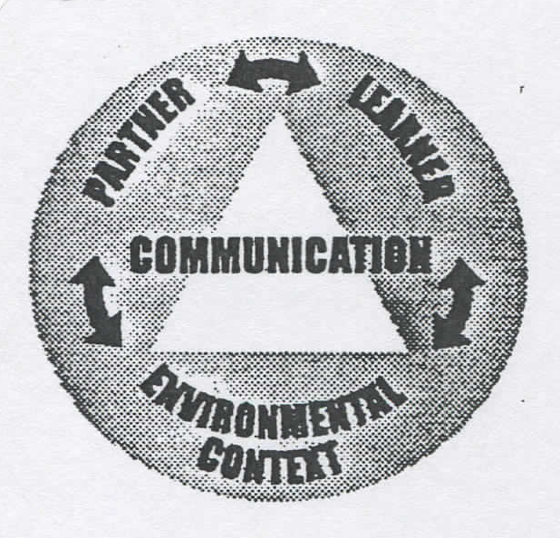
TRI-FOCUS MODEL
(for Teaching Nonsymbolic Communication)
Siegel-Causey & Bashinski, 1997

Slide 13
PARTNER’S ROLE / REPERTOIRE (1 of 2)
Typically, familiar people and environments (i.e., places, activities, settings) facilitate more and more effective communication from a learner with DB because he will likely:
be less anxious / nervous
feel less stress, due to unfamiliarity
be more comfortable asking to “take a break” (i.e, fatigue, stamina)

Slide 14
PARTNER’S ROLE / REPERTOIRE (2 of 2)
Positive ATTITUDE
EXPECTATION that learner is communicating
Key response behaviors
(i.e., RESPONSIVITY to subtle cues from a learner)
ATTUNEMENT to the learner

Slide 15
TRI-FOCUS MODEL
(for Teaching Non-symbolic Communication)
Enhancing (Partner’s) Sensitivity
Augmenting Input
Structuring Routines
Increasing Communication Opportunities
Modifying the Communication Environment
Notes:
Give example!!! Critical to include signal for PROTEST / REJECT T / F #5

Slide 16
TRI-FOCUS STRATEGIES
ENHANCING SENSITIVITY
Being aware of, and receptive to, the subtle cues of others
Strategies associated with this guideline target PARTNER skills!
Notes:
30 minutes TOTAL
T / F #3

Slide 17
ENHANCING SENSITIVITY (1 of 5)
Attention shift
Reluctance to initiate behavior
Persistence
Change in form or quality of behavior (i.e., “recasting”)
Termination of behavior(i.e., once a change is made & goal is achieved)
Display of dissatisfaction

Slide 18
ENHANCING SENSITIVITY: (2 of 5) Nonsymbolic Signal Dictionary
Each time _______ DOES this…. | It will be interpreted to MEAN this…. | ______’s partner will DO this… | ______’s partner will SAY this… | How ______’s partner will shape behave. to more CONVEN-TIONAL form

Slide 19
ENHANCING SENSITIVITY: (3 of 5) Nonsymbolic Signal Dictionary
Each time _______ DOES this…. | It will be interpreted to MEAN this…. | ______’s partner will DO this… | ______’s partner will SAY this… | How ______’s partner will shape more CONVEN-TIONAL form
When Jennifer gets up from her seat, Susan follows her (around the room) with her eyes Christopher kicks his feet when his wheelchair tray is removed

Slide 20
ENHANCING SENSITIVITY: (4 of 5)
Nonsymbolic Signal Dictionary
Process steps for building a signal dictionary for a learner:
Observe the learner in a variety of activities and with a variety of partners
Generate a listing of potential signals by identifying any volitional movements and responses the learner has
Analyze this listing to identify any patterns that exist

Slide 21
ENHANCING SENSITIVITY: (5 of 5)
Nonsymbolic Signal Dictionary
Process steps for building a signal dictionary for a learner (CON’T.):
Select a few of these as core signals
Assign meaning to each of these
Determine corresponding partner behavior (DO, SAY, & SCAFFOLD)
Stress to all partners the importance of consistent, immediate responding

Slide 22
TRI-FOCUS STRATEGIES (1 of 2)
ENHANCING SENSITIVITY
KEY: Accept the learner’s message!
Listen with your eyes,
and hands,
and heart….

Slide 23
TRI-FOCUS STRATEGIES (2 of 2)
AUGMENTING INPUT:
Enhancing meaning and facilitating retention by pairing verbal input and alternative modes (forms)
ALL COMMUNICATION SHOULD BE MULTI-MODAL!
Notes:
30 minutes TOTAL
T / F #3

Slide 24
TOUCH CUES

Slide 25
WHAT IS A TOUCH CUE?
A TOUCH CUE consists of
tactile contact,
made in a consistent manner,
directly on the learner’s body,
to communicate with him.

Slide 26
WHY USE TOUCH CUES?
The PURPOSE of a touch cue is to communicate a variety of a partner’s intents.
The use of touch cues may reduce a learner’s startle, or challenging behaviors, by helping him anticipate what is going to occur.
Touch cues are intended to support comprehension.
Notes:
Snell et al. (2010) reported that few intervention studies addressed comprehension or reported on participants’ receptive communication.

Slide 27
GUIDELINES FOR USING TOUCH CUES (1 of 2)
Does the learner have any severe neurological disability? (This might affect his ability to perceive the touch cue OR he might have significant tactile defensiveness.)
Solicit input from the learner’s family
Collaborate with all professionals on the learner’s team
Talk with the learner’s physical therapist and / or occupational therapist!

Slide 28
GUIDELINES FOR USING TOUCH CUES (2 of 2)
Consider the learner’s preferences when selecting both the type of, and placement for, a touch cue.
NEVER force a learner to accept a touch cue, or to engage in mutual touch “conversations.”
Touch cues should be easy for the learner to differentiate from routine physical contact

Slide 29
EXAMPLES OF TOUCH CUES
Tapping the child’s bottom (in supine)- “I’m going to lift your hips (for diaper)
Gently pulling up on the child’s upper arms - “Get ready to stand up.”
Touching the preschooler’s left elbow - “This is the way I say ‘HI,’ so you know who I am.”
Rubbing the middle of the toddler’s back - “I like that.”

Slide 30
TOUCH CUES
See Project SALUTE: Successful Adaptations for Learning to Use Touch Effectively
http://www.projectsalute.net/Learned/Learnedhtml/TouchCue.html
“What We’ve Learned-Information Sheets”

Slide 31
OBJECT CUES

Slide 32
WHAT IS AN OBJECT CUE?
An OBJECT CUE is an object,
or a part of an object,
that is used to REFER to
a person, place, thing, or activity.

Slide 33
WHY USE OBJECT CUES?
The PURPOSE of an object cue
is to provide a concrete means of supporting conversational interactions
AND
facilitating communication development.

Slide 34
GUIDELINES FOR USING OBJECT CUES (1 of 2)
Does the learner have sufficient motor ability to actively explore / manipulate the object?
Does the learner have sufficient sensory ability to process the object’s features?
AVOID the use of miniatures
with a learner who has
a significant vision loss!

Slide 35
GUIDELINES FOR USING OBJECT CUES (2 of 2)
NEVER force the learner to accept an object cue, or to engage in exploring one!
Demonstrate how to explore the object cue’s surface, guiding the learner to do the same
(i.e., use “tactile modeling”)
Offer object cues to the learner, gently--especially initially

Slide 36
EXAMPLES OF OBJECT CUES
WHOLE objects
bag - to mean, “Get your things to go home.”
bubble wrapping - to mean, “Take a break.”
PARTS of objects
top of plastic bottle – to mean, “Lunch! Go to the table.”
partial zipper – to mean, “Time to get dressed.”

Slide 37
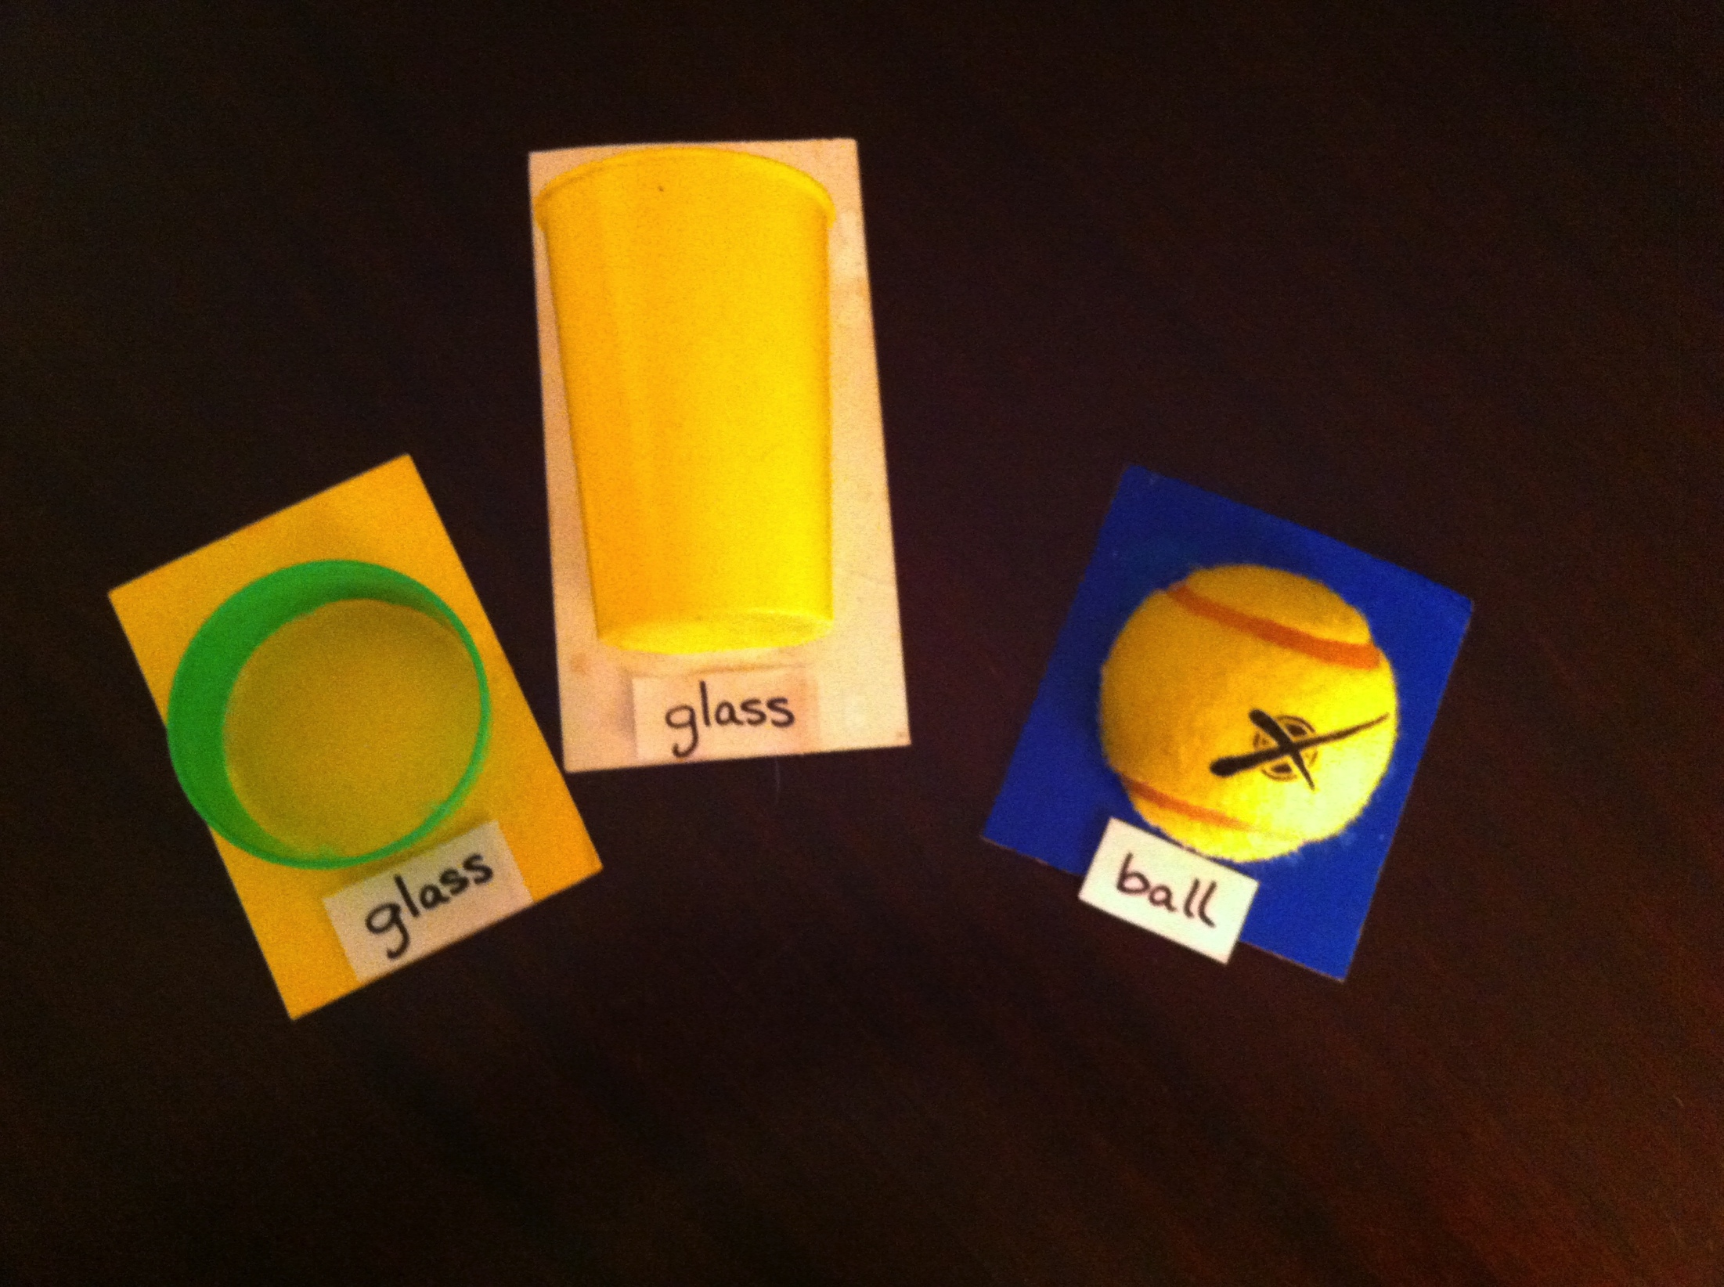
OBJECT CUES: Whole & Partial Objects
Notes:
Piece of actual component part
One component of multi-component object (cake, icing, candles, presents, etc.)—IDENTIFYING (candles not on other cakes, etc.)
Actual element of object

Slide 38
PREPARATION OF OBJECT CUES
Mount the objects used in these supports for the development of symbolization to help the learner distinguish:
when the object is an object and
when it is a representation (of the object)

Slide 39
OBJECT CUES
See Project SALUTE: Successful Adaptations for Learning to Use Touch Effectively
http://www.projectsalute.net/Learned/Learnedhtml/ObjectCue.html
“What We’ve Learned-Information Sheets”

Slide 40
AUGMENTING INPUT:
Dictionary Elements (1 of 4)
TOUCH or OBJECT cue | It is used to commu- nicate this MEANING | ______’s partner will DO this… | What is expected from the LEARNER

Slide 41
AUGMENTING INPUT:
Dictionary Elements (2 of 4)
TOUCH or OBJECT cue | It is used to commu- nicate this MEANING | ______’s partner will DO this… | What is expected from the LEARNER
Tap two times on Susan’s ankle Place bicycle handle grip on Christopher’s tray

Slide 42
AUGMENTING INPUT:
Dictionary Elements (3 of 4)
Process steps for building an input dictionary for a learner:
Select tangible symbol identifiers (OBJECT CUES) for key persons / activities
Match features of these to the learner’s sensory skills and preferences
Choose TOUCH CUES for each of the requests routinely made of the learner

Slide 43
AUGMENTING INPUT:
Dictionary Elements (4 of 4)
Process steps for building an input dictionary for a learner:
Target touch cues to body parts learner can volitionally move
Assign a unique meaning to each TOUCH and OBJECT cue
Determine corresponding partner behavior and what is expected of learner
Stress to all partners the importance of providing consistent cues to the learner

Slide 44
TRI-FOCUS STRATEGIES
AUGMENTING INPUT
KEY: Support the learner’s comprehension!
Talk with more than your mouth….
Notes:
30 minutes TOTAL
T / F #3

Slide 45
STRUCTURING ROUTINES

Slide 46
INTRODUCTION
Partnering with a learner with deaf-blindness involves…
INVITING THE CHILD“OUT (of her body)…”
to join you in the world, and to build levels of connections with her

Slide 47
STRUCTURING ROUTINES (1 of 3)
Definition of “routine”:
A related series of activities, organized into a predictable format
Consistent implementation of routines serve to organize a learner’s activities—and world!
A LEARNER NEEDS TO LEARN
TO ANTICIPATE

Slide 48
STRUCTURING ROUTINES: (2 of 3)
What are the primary components of any routine?
Initiate – How know it is time to begin?
Prepare – What need to do to be ready?
Perform Core – What do to participate, at least partially?
Terminate – How know when over?

Slide 49
STRUCTURING ROUTINES: (3 of 3)
What components should be integrated within every routine?
Communication skills
Choice making
Social skills
Optimal positioning (& movement)

Slide 50
STRUCTURING ROUTINES:
Dictionary Elements (1 of 2)
Process steps for building a structured routine for a learner:
Identify the times of day a partner predictably completes with learner daily (or several times each day)
Select one of these activities
Write each step of the activity, in sequence
Incorporate OBJECT / TOUCH cues from the learner’s augmented input dictionary

Slide 51
STRUCTURING ROUTINES:
Dictionary Elements (2 of 2)
Process steps for building a structured routine for a learner:
Identify the response the learner will be expected to make at each step, to participate at least partially
Anticipate the amount of time the learner will need for response (i.e., TIME DELAY)
Determine corresponding partner behavior (SAY, DO)
Notes:
#6 – in consideration of her stage of learning for each skill

Slide 52
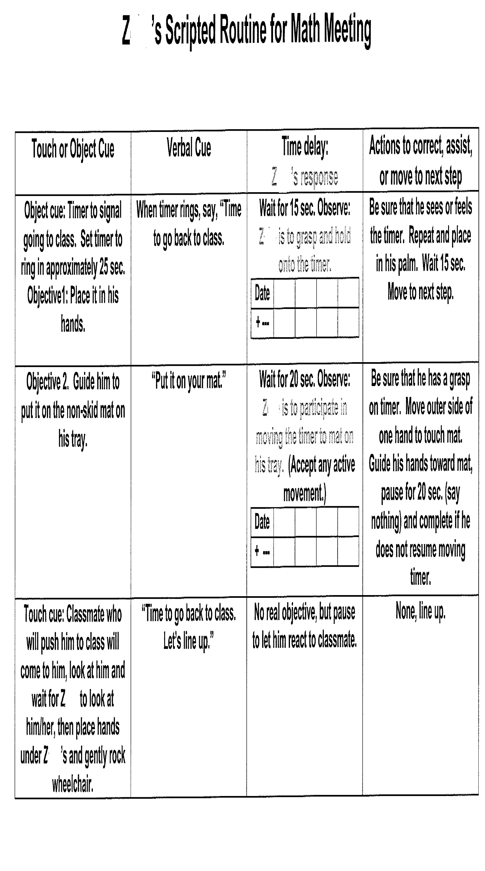
UTILIZING ROUTINES (1of 2)

Slide 53
UTILIZING ROUTINES (2 of 2)
KEY: Create predictability for the learner!
MUST have a clear: beginning,
middle, &
end!
Notes:
30 minutes TOTAL
T / F #3

Slide 54
ESSENTIAL TAKE-AWAYS:
COMMUNICATIVE INTERVENTION (with learners who are NON-symbolic or use CONCRETE representations)
Listen with your eyes,
and hands,
and heart….
(to develop learner’s expressive skills)
&
Talk with more than your mouth….
(to develop learner’s receptive skills)
Notes:
30 minutes TOTAL
T / F #3

Slide 55
THANK YOU!
Susan M. Bashinski
816.271.5629
sbashinski@missouriwestern.edu

