Slide 1
Collaboration:
Pennsylvania Deaf-Blind Project
Parent Education and Advocacy Leadership
April 13, 2016
Sue Ann Houser and Lori Brew

Slide 2
PaTTAN’s Mission
The mission of the Pennsylvania Training and Technical Assistance Network (PaTTAN) is to support the efforts and initiatives of the Bureau of Special Education, and to build the capacity of local educational agencies to serve students who receive special education services.

Slide 3
PDE’s Commitment to Least Restrictive Environment (LRE)
Our goal for each child is to ensure Individualized Education Program (IEP) teams begin with the general education setting with the use of Supplementary Aids and Services before considering a more restrictive environment.

Slide 4



Benefits of Collaboration
The DB Project focuses on educators and families.
PEAL focuses on families and educators.
Notes:
PaTTAN focuses on educators and families.
PEAL focuses on families and educators.
Commonality with expertise which is a tremendous compliment connecting the organizations
Animation to show families & educators
Educators and families
Joining together for the same cause -

Slide 5
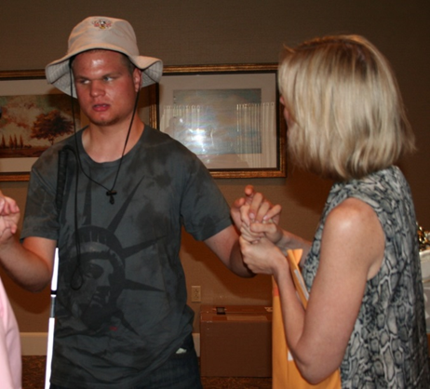
Collaboration Success
The PEAL Center and the DB Project collaboration has been successful due to the mutual respect and value of specific information in deaf-blindness.
Notes:
Both organizations or robust and thriving with expertise and energy. Giving deaf-blindness individual attention in the multiple disability categories has been essential and tremendously beneficial.

Slide 6
The mission of the Pennsylvania Training and Technical Assistance Network (PaTTAN) is to support the efforts and initiatives of the Bureau of Special Education, and to build the capacity of local educational agencies to serve students who receive special education services.
Notes:
Sue Ann

Slide 7
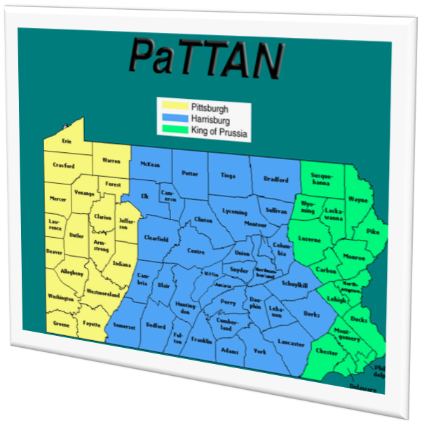
PaTTAN Deaf-Blind Initiative
Regional Teams
  Family Consultants: Molly Black and Patti McGowan
  Early Intervention Family Consultant: Anne Gaspich
  Early Intervention: Mary Anketell
  School Age Lead: Sue Ann Houser
  West: Lynn Fox, Scott Dougherty, Michelle Bilinsky
  Central: Jane Freeman, Doug Williams
  East: Jennifer Edgar, Susan Gill
Notes:
Sue Ann

Slide 8
Pennsylvania Deaf-Blind Conceptual Framework
Engaged and Supported Families
High Quality Early Intervention
- Assess early identification
- Provide universal and targeted professional development
- Provide universal and targeted support to parents including connection with PTI
Engaged and Supported Families
Effective School-Age Services and Access to General Education Curriculum
- Implement OHOA modules
- Provide universal professional development to paraprofessionals and others
- Provide universal and targeted support to parents including connection with PTI
Engaged and Supported Families
Meaningful Secondary Transition
- Implement ITTI modules and process
- Develop targeted resources on secondary transition
-Provide universal and targeted support to parents including connection with PTI
Students who are Deaf-Blind are College, Career, and Community Ready
Notes:
Sue Ann

Slide 9
Pennsylvania Deaf-Blind Project
OSEP funded specific objectives to address over the 5 years of the Project
  Improve early identification and intervention
  Improve secondary transition
  Support families who have children with deaf-blindness (Including collaboration with our PTI)
  Provide awareness level training to paraprofessionals
  Increase number of individuals who can provide intervener support to children who are deaf-blind
  Build a regional network of local liaisons
Notes:
Double check order of goals .*Add PTI to appropriate goal

Slide 10
Pennsylvania Deaf-Blind Project Evaluation
Pennsylvania must report annually on progress toward on activities and outcomes
External evaluator assisting the Project
Pennsylvania Deaf-Blind Advisory Committee
  PTI representation on the DB Advisory committee
Notes:
Sue Ann
Advisory Committee made up of Stakeholders
Parents
Providers
Educators
Administrators
PaTTAN

Slide 11

PTI In Pennsylvania
One PTI
The PEAL Center: serving the entire state of PA
  Elizabeth Healey, Executive Director
Two Community Parent Resource Centers (CPRCs)
  Mission Empower: serving primarily Erie
  Jill Hrinda-Patten, Executive Director (814) 825-0788
  Hispanos Unidos Para Ninos Excepcionales or HUNE:
  serving Spanish speaking parents in Philadelphia
  Luz A. Hernández, Executive Director 215-425-6203
Notes:
Will have this slide fixed

Slide 12

The PEAL Center serves…
Parents of infants through age 26
Parents of children with all disabilities
Youth
Professionals
Throughout the state
Notes:
Lori

Slide 13
The PEAL Center
Assists parents to…
  Understand their children’s disabilities, educational and developmental needs
  Communicate effectively with special education program & EI personnel
  Be informed decision makers
  Participate in school reform activities
Assists youth to…
  Become informed self-advocates
Notes:
Lori

Slide 14
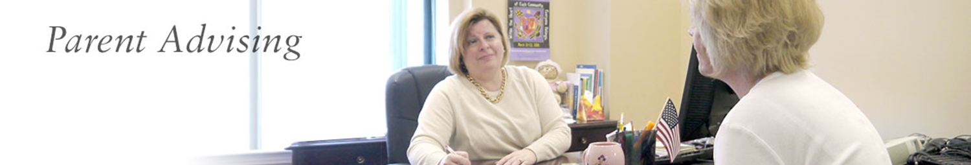
PEAL Center Offers
Free consultation with qualified parent advocates to help parents resolve disputes with Early Intervention & School age providers of education
  Strategize and plan for IEP meetings
  Consultation
Notes:
Lori

Slide 15

PEAL Center Informs
By offering training & information for…
  Parents
  Underserved parents
  Parents of children who may be
  inappropriately identified
  Youth
  Professionals
Notes:
Lori

Slide 16



PEAL Center Trainings
Face-to-Face
  IEP Mini-Series: Beginning with the End In Mind
  Transition to Adult Life
  Positive Behavior Support Plan
On-line
  Part One of IEP Mini-Series
  Archived webinars
Annual Inclusion Conference
  In Spring, nationally known specialists and advocates
Notes:
Lori

Slide 17


Pennsylvania Deaf-Blind Project
&
Parent Education and Advocacy Leadership
(PEAL)

Slide 18
Benefits of Collaboration
The DB Project and PEAL are sharing information with families AND educators:
Current needs families are experiencing
Services and resources of each other’s organizations
  Awareness level information
  Captioning of videos & trainings on PEAL’s website
Notes:
PaTTAN focuses on educators and families.
PEAL focuses on families and educators.
Lori – getting the pulse of current experiences of families – hot topics
Sue Ann – Awareness level info and services & resources examples from collaboration meetings –
------- In addition to materials, website information, resources and training opportunities are actively shared.
Lori - created a referral form from DB Project - form given to parent advisers to share with families. Shared with HUNE websites,

Slide 19
Collaboration Successes
Referral forms for PEAL parents advisers to give to families
Special projects focused on children and youth who are deaf-blind
Notes:
Lori – referral to prevent families from falling through the cracks.

Slide 20

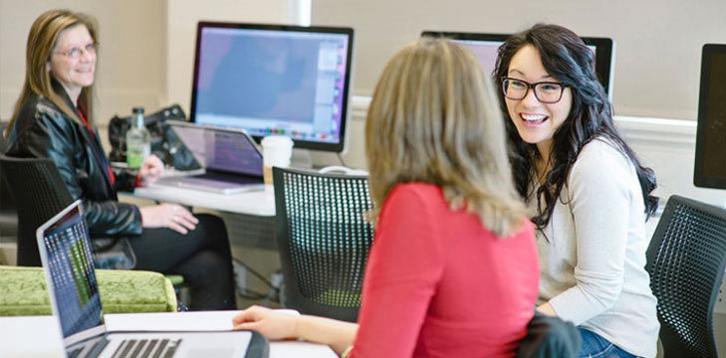
Challenges
Slow down enough to collaborate
Collaboration format – distance
Nuances of each other’s funding sources
Notes:
Sue Ann – both are “producers” of a high quality and quantity of “products”. Stopping to collaborate can be a challenge.
Lexicon of each other’s practices. Advocate for example. DB focused in family advocating for themselves. PEAL uses the word more freely.
Conflicting visions of

Slide 21

Collaboration at Its Best
Identify what we each do well and how this can benefit the collaboration
  Family engagement
  Teams for interveners
  Parent advising
  Transition across the educational system
Notes:
What do we each do well and honoring it in the collaboration.
Familiy engagement
Teams for interveners
PartenT advising
Transition from ei to school age, and secondary transition
8.Changes in personnel, funding, and other situations can challenge collaboration initiatives. Have you facedthese or other challenges? If yes, how have you handled them?
DBP: Upon the awarding of the current grant, October 2013, the DB Project was shifted to a new branch of the PA Bureau of Special Education. Also, until 2014, there were two Parent Training Information centers in Pennsylvania. There is now just one, PEAL. As a result, the Project and PEAL are revisiting the collaboration opportunities and making a deliberate action plan for future collaboration.
PC:Several years ago there was a change in the DB Project Coordinator. As a result of the survey we are now working to develop a relationship and build stronger collaboration.

Slide 22

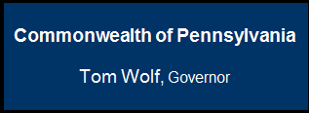

Contact Information
Sue Ann Houser
shouser@pattankop.net
www.pattan.net
Lori Brew
lbrew@pealcenter.org
http://pealcenter.org

