Slide 1
National Intervener Certification E-Portfolio (NICE)
Mentor Webinar Series
Webinar #3
Ensuring Intervener Success in NICE Part 2: Portfolio Scoring
The NICE Team
Ritu V. Chopra
Leanne Cook
Willie Hepworth

Slide 2
Welcome and Introductions
The NICE Team
  Ritu, Leanne, Willie
Share the following information by unmuting (#6) yourself or type in the chat box:
  Your name
  Your affiliation
  Whether you have served or are currently serving as a NICE mentor

Slide 3
Recap of Webinar 1 and 2
  NICE mentor role and expectations
  Self-examination of own mentoring skills
  Cyclical process of mentoring
    Tools to use for different steps/stages of the process
  Strengthening two components of NICE artifacts – documentation and explanations; importance of strong narratives in artifact explanations
  Enhancing Intervener's self-reflection and self-assessment skills for success in the NICE process and their everyday practice

Slide 4
Overview of Webinar 3
Focus: This final webinar in the 3-part series expands on the information provided in the previous webinars. We will review scoring of artifact examples (effective and ineffective) from the perspective of reviewers to help mentors understand how to support intervener candidates as they create artifacts for their portfolios.
Learning Outcomes:
  Recognize the Council for Exceptional Childrens’ intervener competencies that are hard to demonstrate and assess
  Learn how an understanding of the scoring process helps intervener candidates develop effective artifacts
  Learn about the unique perspective of mentors who are reviewers
  Become familiar with a checklist for ensuring the timely completion and submission of portfolios

Slide 5
Top 6 Competencies Receiving Lowest Scores
1.K07: Effect of deafblindness on psychological development and on the development of self-identity
2.K01: Differences between concept development and skill development, and the effect of deafblindness on each
3.S01: Facilitation of the individual's understanding and development of concepts
7.S02: Share observations of the individual's communication skills with other
2.K03: Strategies that promote visual and auditory development
5.S06: Vary the level and intensity of input and the pacing of activities

Slide 6
Types of Documentation Used by
Successful Candidates
1.K07: Effect of deafblindness on psychological development and on the development of self-identity
      Photo series of work with student, written work (reflection)
2.K01: Differences between concept development and skill development, and the effect of deafblindness on each
      Photo series of student using skill related to concept, written work sample (reflection)
3.S01: Facilitation of the individual's understanding and development of concepts
      Video

Slide 7
Types of Documentation Used by
Successful Candidates Cont.
7.S02: Share observations of the individual's communication skills with other
      Data sheets, IEP notes, communication book, home talk, emails
2.K03: Strategies that promote visual and auditory development
      Professional Development Products
5.S06: Vary the level and intensity of input and the pacing of activities
      Video

Slide 8
  How Else Interveners Can Score Higher on
  These Competencies
Strong narratives in the explanation section – we discussed this at lengthy in the previous webinar
  Addressing the link between the documentation and how it addresses each competency
  Reflecting carefully and thoughtfully and writing detailed explanations
Deeper understanding of the scoring process on mentor’s part helps intervener candidates develop effective artifacts

Slide 9
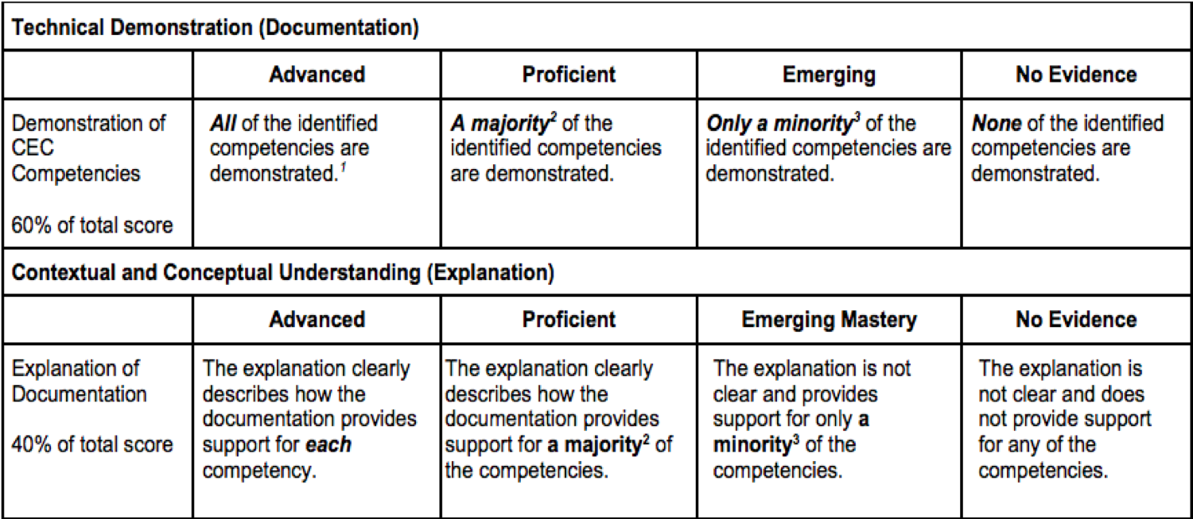
Recap: Scoring Rubric

Slide 10
Recap: Rubric - Defining Majority and Minority
Number of competencies in artifact | Majority means . . . | Minority means . . .
1 | The single competency is demonstrated/explained | No competencies are demonstrated/explained
2 | Both competencies are demonstrated/explained | No competencies are demonstrated/explained
3 | 2 of the 3 competencies are demonstrated/explained | Only 1 competency is demonstrated/explained
4 | 3 of the 4 competencies are demonstrated/explained | Only 1 competency is demonstrated/explained
5 | 3 to 5 of the competencies are demonstrated/explained | Only 1 or 2 competency is demonstrated/explained

Slide 11
Scoring Exercise
You will look at the three parts of artifacts:
    Checkboxes
    Documentation
    Explanation
  You will score the artifact using the rubric via a poll
  We will discuss the results

Slide 12
Artifact 1: Box of DeafBlindness
Check boxes:
  Photo work sample
  Self study
  In school
  District training
  Self directed/team effort

Slide 13
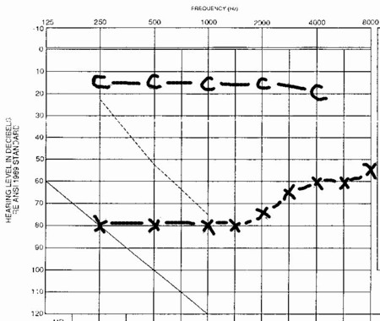
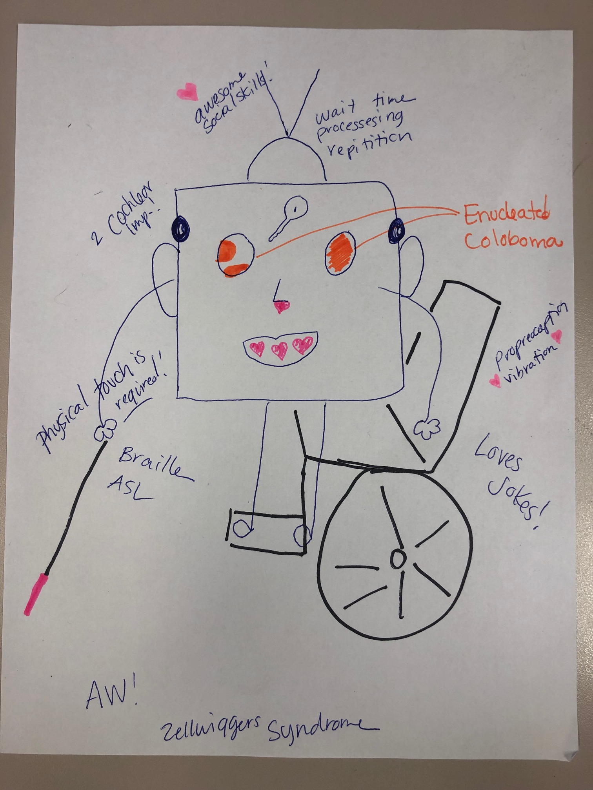
Documentation: Box of Deafblindness
1. K5 Effect of combined vision and hearing loss on development and learning
1.K15 Learning style and communication of the individual
1.K16 Audiological and ophthalmological conditions and functioning of the individual
Notes:
https://www.whydomath.org/node/hearing/hearingLoss.html

Slide 14
Box of DeafBlindness: Explanation
How does the documentation provided for this artifact support each associated competency?
The documentation illustrates 1.K5 and 1.K16 demonstrating the ways that his vision functions (Coloboma and Enuclation) resulting in no vision in one eye and patchy vision (unable to determine acuity) in the other. It also clarifies hearing with two CIs that yield great auditory attention in quiet environments. It exemplifies that how he accesses things in the classroom change based on the environment as well as how he is processing such as was he tired or hungry.
The ways that he accesses braille, touch, and need for reduced environmental sounds is also noted. 1.K15 is also addressed inasmuch as what his needs are. Also documented is his use of ASL and other tactile methods of getting information throughout the day if he becomes too fatigued.

Slide 15
Box of DeafBlindness: Explanation cont.
1. Describe the activity (or activities) depicted by the documentation and explain what the student/client is doing. How is it related to his or her goals or needs?
This relates to the students needs because when doing instruction or supporting teaching I need to be aware of how to best use his hearing, such as going to a different room or away from a fan, and vision, by presenting things on the left side towards the top of his vision (1.K5). Knowing his syndrome is progressive is also important because I can be sure that over the years we’ve worked together I am modifying things as needed and being aware of the changes.
2. In what ways are the knowledge and/or skills highlighted in the documentation important to your work with the student/client?
His conditions and their impact change how things are presented everyday. When he is in a loud environment I use more touch and real objects to facilitate his learning and knowledge of the content delivered by his teacher. Also, knowing that the combined approaches such as using touch and speech together in specific environments to support him makes a big difference.

Slide 16
Artifact 1 Recommended Score NICE Team
Documentation: Proficient
  Justification: A majority of the identified competencies are demonstrated.
  Suggestions for improvement: further demonstrate the impact of the audiological and ophthalmological conditions, and impact of combined loss on development.
Explanation: Advanced
  Justification: explanation clearly describes how the documentation provides support the majority of competencies.

Slide 17
Artifact 2: Transition Bear
Check boxes:
  Photo work sample
  Classroom
  Team effort

Slide 18
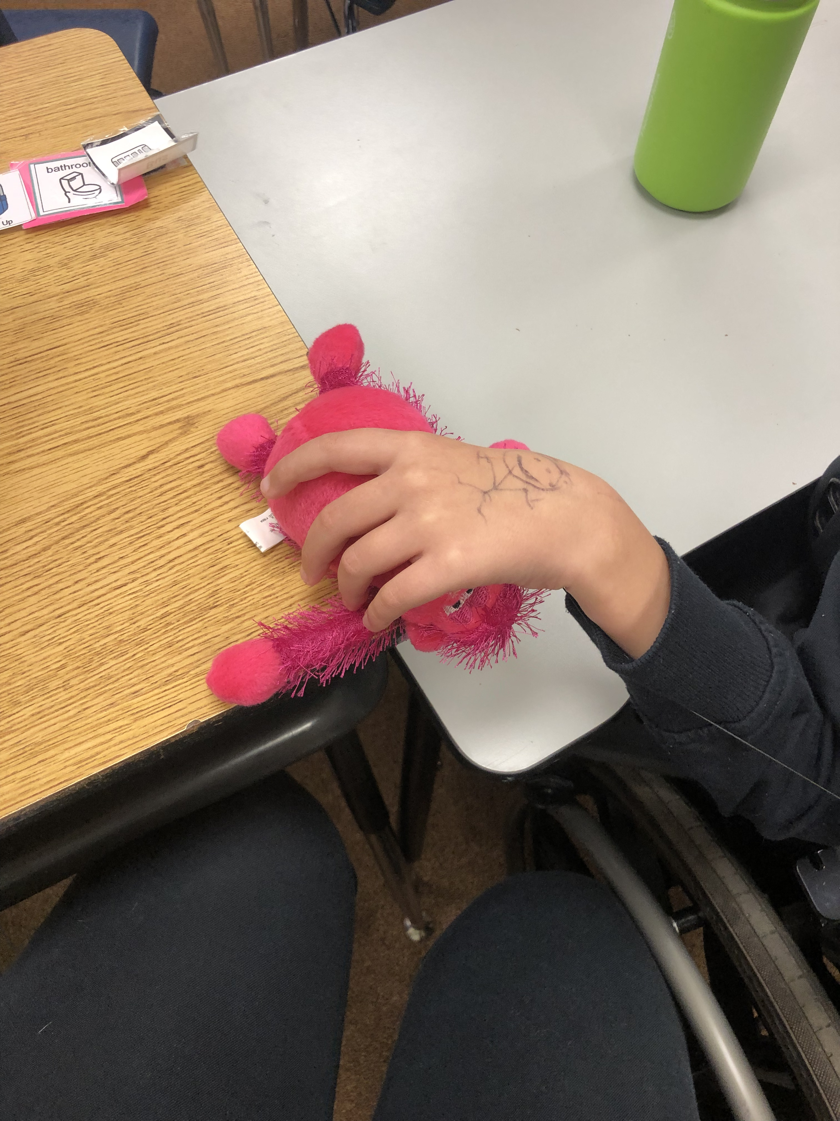
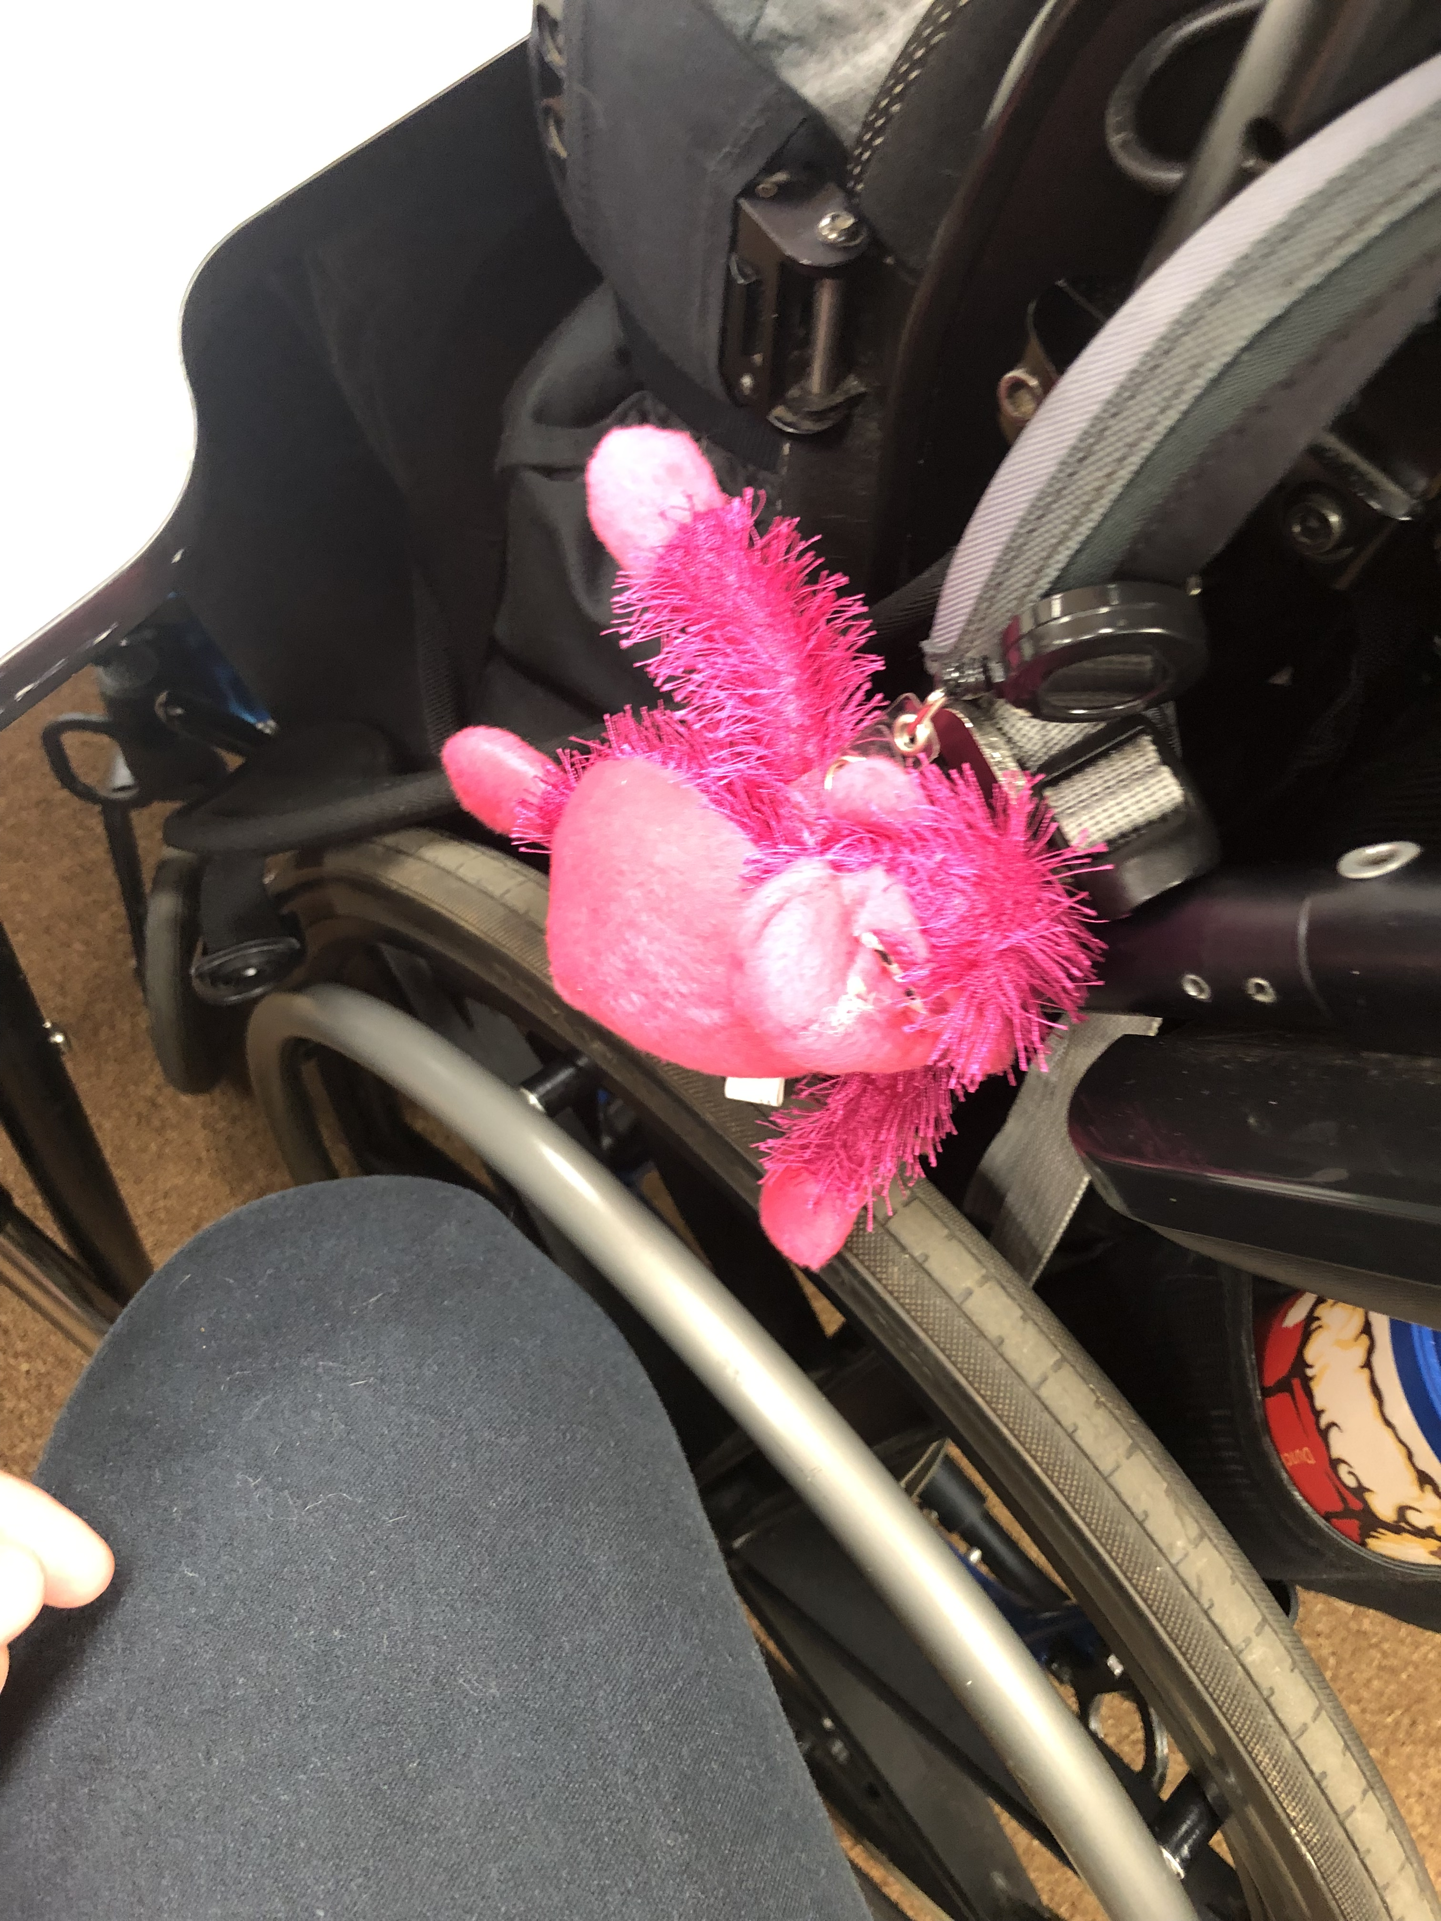
Documentation: Transition Bear
5.S12 – Use touch to supplement auditory and visual input and to convey information
5.S27 – Observe and identify communicative behavior and intent

Slide 19
Explanation
How does the documentation provided for this artifact support each associated competency?
For 5.S12, the bear signifies that we are transitioning. Often it gets loud and it is hard to focus. Sometimes when it is loud AD will reach for the ducks location on the chair.
1. Describe the activity (or activities) depicted by the documentation and explain what the student/client is doing. How is it related to his or her goals or needs?
The student is holding the symbol that means we are transitioning. When they grab it they are communicating that the volume is loud and they think that it is time to transition from one activity to the next.
3. In what ways are the knowledge and/or skills highlighted in the documentation important to your work as a member of the student/client's team?
The idea for the transition bear was from the TOD, TVI, and PT. Together they thought it would be good and I worked with the teacher to attach it to his chair and use it regularly so he would learn the association.

Slide 20
Artifact 2 Recommended Score Per NICE Team
Documentation: Emergent
  Justification: Only a minority of the identified competencies are demonstrated.
  Suggestions for improvement: Add additional pieces of documentation to show use throughout the day or in multiple settings. Consider using different documentation in conjunction with the images to further strengthen.
Explanation: Emergent
  Justification: The explanation is not clear and provides support for only a minority of the competencies.
  Suggestions for improvement: Show more connection/evidence for the bear as a communication tool on behalf of the student.

Slide 21
Artifact 3: Calendar
Check boxes:
  Photo work sample
  In school
  District training
  Self directed/team effort

Slide 22
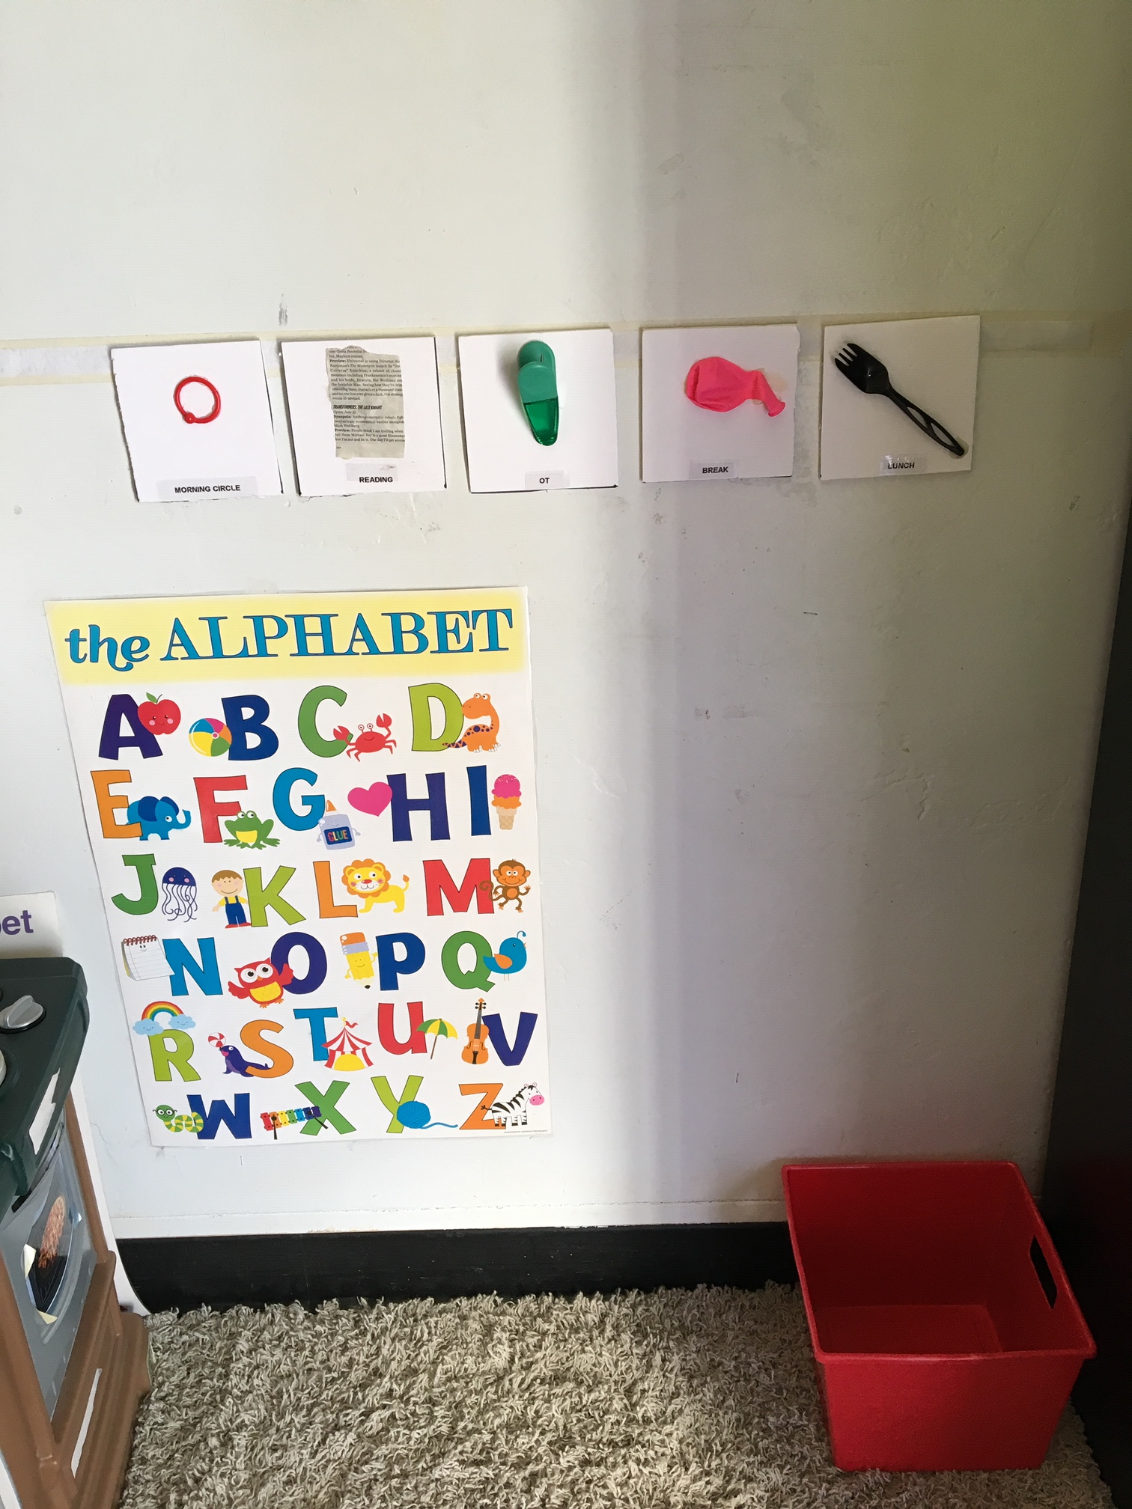
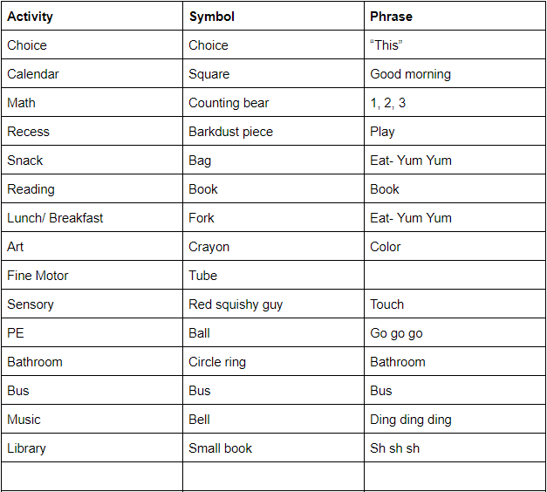
Documentation: Calendar
3.K1 The use of calendar system

Slide 23
Explanation for Calendar
How does the documentation provided for this artifact support each associated competency?
The pictures show the students calendar where an object matches up with an activity or person throughout the day. The calendar matches the calendar the classroom teacher has at the front of the room, but at our own pace. Everyday we use the calendar. In the morning when the teacher is going over the calendar we go over the first half of the day and then the second half. Only half of the calendar fits on the wall so we divided it by lunch. When we come back from lunch we go over the second half again. He uses the calendar by going over to it, feeling the item, “reading” the braille and then doing the activity. After the activity is done he comes back and removes it.

Slide 24
Explanation for Calendar Cont.
3. In what ways are the knowledge and/or skills highlighted in the documentation important to your work as a member of the student/client's team?
His calendar has items that he has used for multiple years which helps him remember the items. Then the vision teacher added braille and the teacher of the deaf specified what words she wants us to say we when read each item. The teacher, the TVI, and the teacher of the deaf came together to make something that worked. I made the document so I could be consistent.
4. What did you learn about yourself as an intervener as you gathered the documentation for this artifact?
I learned that without the document that says what each symbol is and the language I am not as consistent with saying the right thing. Writing down what I needed to do helps me stay consistent for him.

Slide 25
Artifact 3 Recommended Score Per NICE Team
Documentation: Emergent
  Justification: It did not demonstrate use of a calendar.
  Suggestions for improvement: Include an image of the student using the calendar with the candidate.
Explanation: Advanced
  Justification: explanation clearly describes how the documentation provided support the competency.

Slide 26
Perspective of a Mentor who is also a Reviewer
In your role as a NICE reviewer, what did you learn that has helped you with your role as a NICE mentor?
What advice would you give to the other mentors to help their interveners be successful in the NICE process in terms of :
  Obtaining high score in NICE portfolios (e.g. effective documentation aligned with competencies, writing effective explanation)
  Your feedback practices
  Timely completion
  Other advice/thoughts you would like to share

Slide 27
Revisiting Mentor Tools:
Ensuring Strong Portfolio and Timely
Completion & Submission
Action Plan Form (Form D)
Mentor Feedback Form (Form F)
Mentor Checklist (Form E)

Slide 28

Data collected from open-ended questions from interveners who successfully completed NICE indicate that mentoring participants received was the most important factor in helping participants complete their e-portfolio.
NICE Mentors Play a Crucial Role!
Notes:
I like this slide as a transistion

Slide 29

Questions?
Please help us improve our services by completing the webinar evaluation: https://tinyurl.com/re6uede

Slide 30
Resources: NICE Webinar Series
Materials (slides, recordings, transcripts and mentoring forms) for all three webinars are available at:
https://nationaldb.org/library/page/2748

