Slide 1
National Intervener Certification E-Portfolio(NICE) Mentor Webinar Series
Webinar #2
Ensuring Intervener Success in NICE Part 1: Strong Narratives and Reflective Practice
The NICE Team
Ritu V. Chopra
Leanne Cook
William Hepworth

Slide 2
Welcome and Introductions
The NICE Team
Ritu, Leanne, Willie
Share the following information by unmuting (#6) yourself or type in the chat box:
Your name
Your affiliation
Whether you have served or are currently serving as a NICE mentor

Slide 3
Overview of Webinar 2
Focus: This interactive training webinar will aid participants in understanding the expectations within the NICE portfolio creation process. Presenters will review the scoring rubric and highlight the importance of reflective practice and strong narratives in the explanation sections of the artifacts.
Learning Outcomes:
Increase knowledge of two components of NICE artifacts – documentation and explanations
Increase knowledge of importance of strong narratives in artifact explanations
Develop an understanding of the importance of enhancing interveners’ self-reflection and self-assessment skills regarding their own practice

Slide 4
A Quick Recap: Two Scored Sections of the Artifact
Section 1: Documentation
Section 2: Explanation

Slide 5
Section 1: Documentation (Technical Demonstration of Competence)
Candidates:
Identify/select competencies within a Standard
Create and upload a corresponding piece of documentation to show how these competencies are implemented or demonstrated within their work.

Slide 6
Section 2: Explanation (Contextual and Conceptual Understanding)
Candidates:
Describe the link between their documentation and the selected CEC competencies
Explain what is being demonstrated within the documentation using writing prompts :
one mandatory question; and
choice of four additional questions from which the candidate selects two.

Slide 7
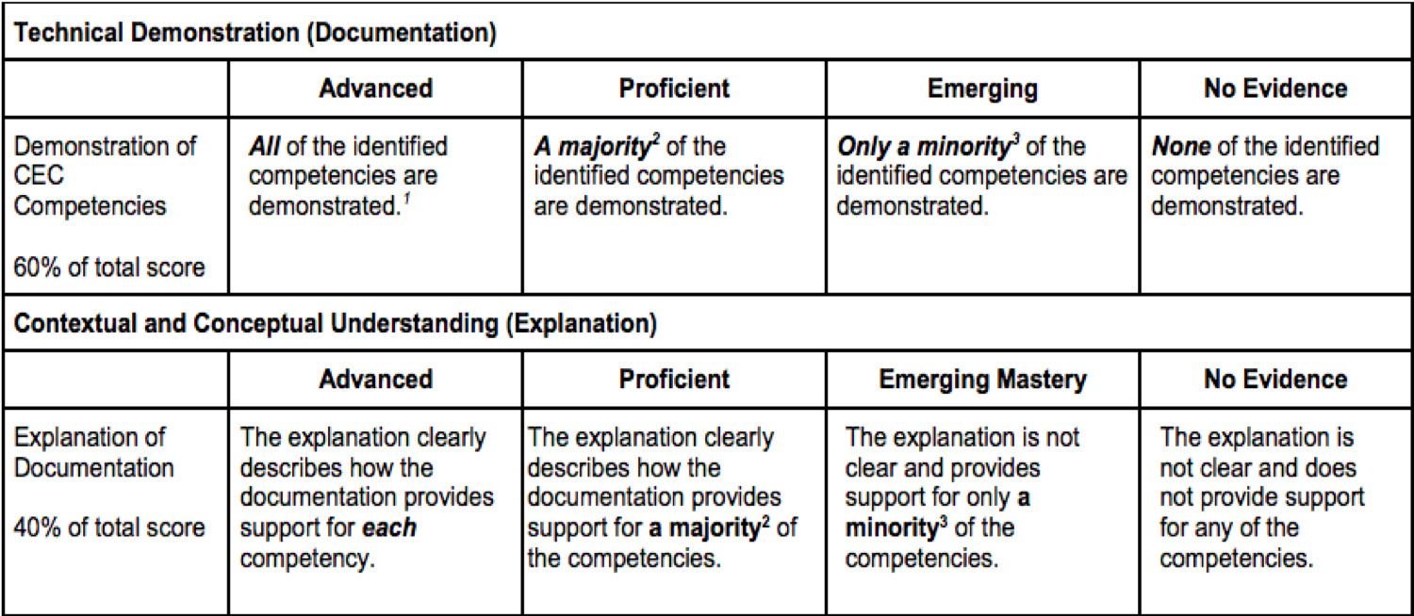
Recap: Scoring Rubric

Slide 8
Recap: Rubric - Defining Majority and Minority
Number of competencies in artifact | Majority means . . . | Minority means . . .
1 | The single competency is demonstrated/explained | No competencies are demonstrated/explained
2 | Both competencies are demonstrated/explained | No competencies are demonstrated/explained
3 | 2 of the 3 competencies are demonstrated/explained | Only 1 competency is demonstrated/explained
4 | 3 of the 4 competencies are demonstrated/explained | Only 1 competency is demonstrated/explained
5 | 3 to 5 of the competencies are demonstrated/explained | Only 1 or 2 competency is demonstrated/explained

Slide 9
Section 1: Documentation
The interveners’ selection and alignment of documentation to exemplify their knowledge and skills is the most important aspect of the E-Portfolio.
There are eight approved documentation types for candidates to us
Photo work samples Video work samples Written work samples Completed coursework assignments | Professional development products Self-study products Performance evaluations Reports of formal observations of the intervener
While the requirement is a minimum of 19 artifacts – however, we’ve noticed that portfolios with 22 or more obtain higher scores. Over use of the same documentation for multiple competencies is not favorable.

Slide 10
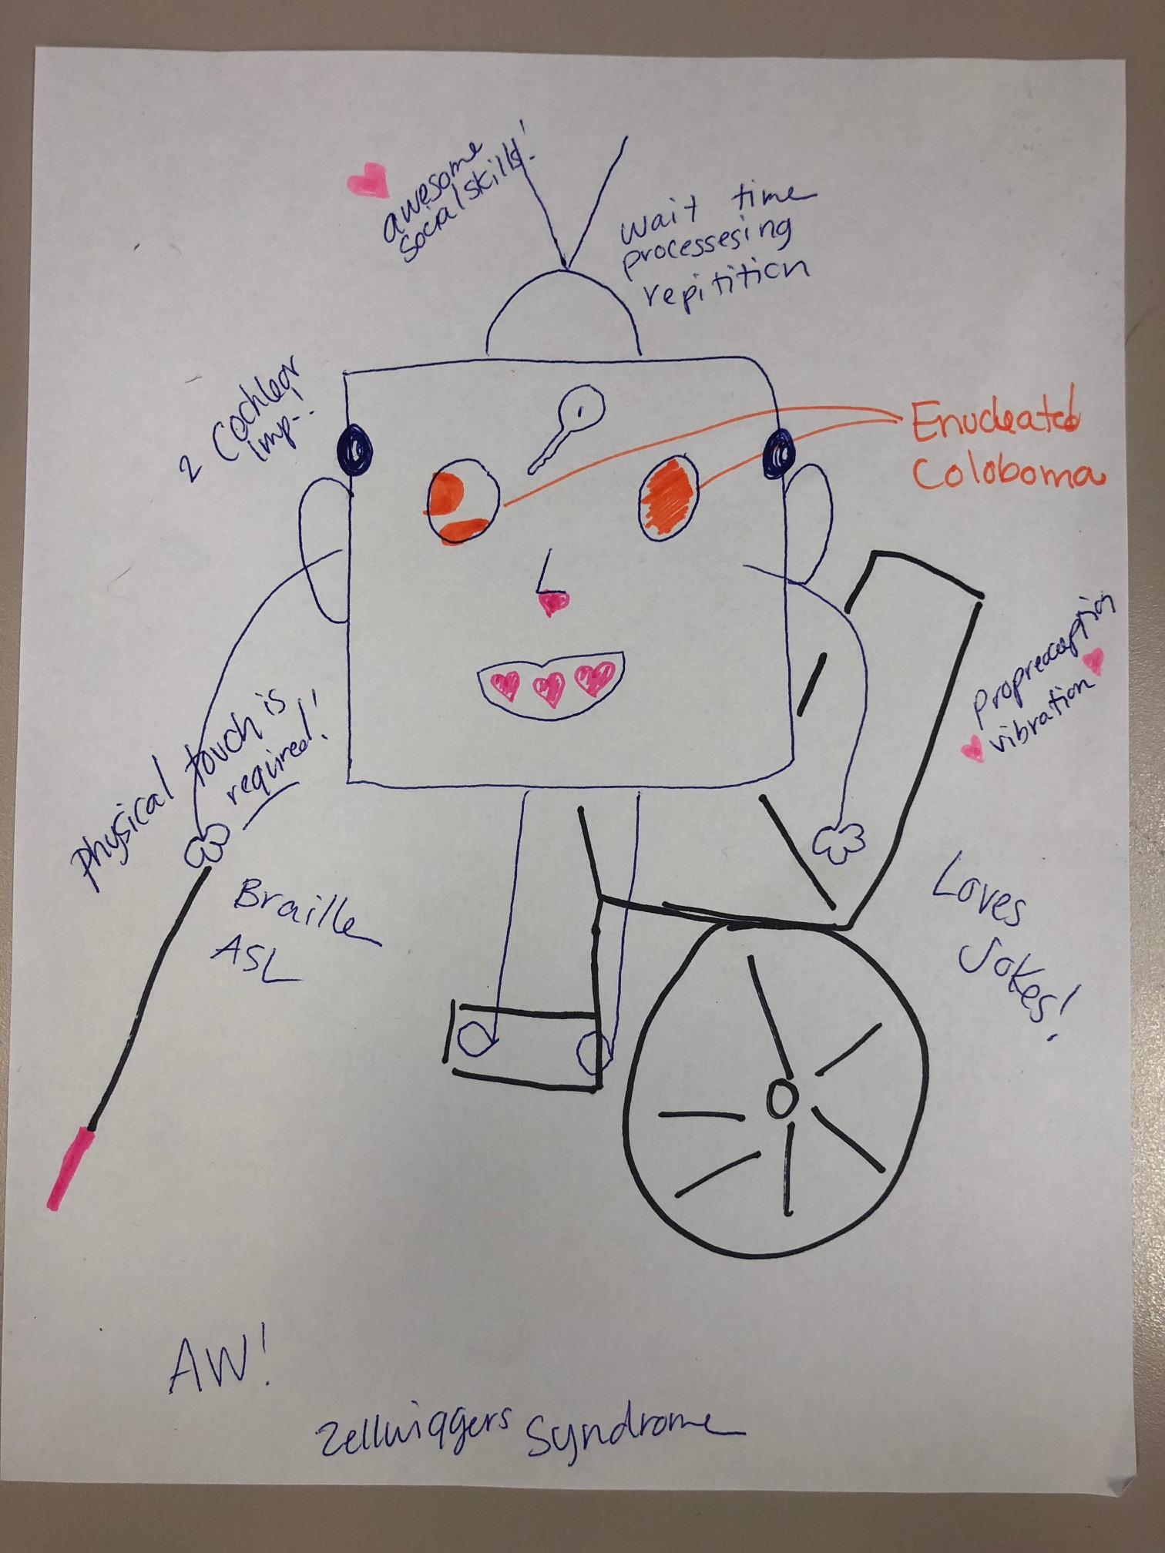
Example: Effective Documentation
1. K5 Effect of combined vision and hearing loss on development and learning
1.K15 Learning style and communication of the individual
1.K16 Audiological and ophthalmological conditions and functioning of the individual
Example Documentation Type: Self Study

Slide 11
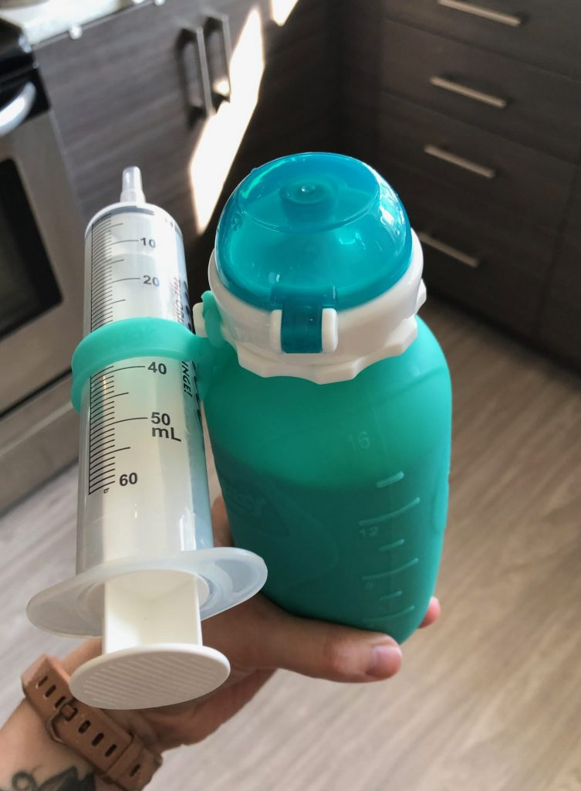
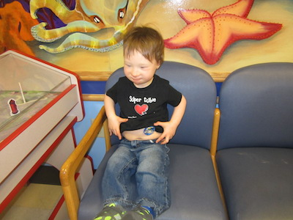
Example: Ineffective Documentation
1.K10 Effect of additional disabilities on individuals with deafblindness
1.K17 Additional disabilities of the individual, if present
1.K18 Effects of additional disabilities on individual, if present
Additional Information
Additional disabilities for students may include: CP, seizures, g tubes, syndromes, paralyzed, intellectual disabilities and mental illness.
Notes:
Images:
https://complexchild.org/articles/2015-articles/february/tube-removal/
https://thefightingirishmartins.com/g-tube-supplies-babies/

Slide 12
Selecting Appropriate Documentation
Multiple types of documentation that can be mixed and matched to address selected competencies - the focus is to address each competency fully.
Some documentation is more aligned with knowledge competencies (e.g. Coursework, Professional Development)
While videos are usually more effective for skill competencies, they are not always possible. Consider other options such as:
Use series of picture photos which usually provide more evidence than using just one photo
Observation reports

Slide 13
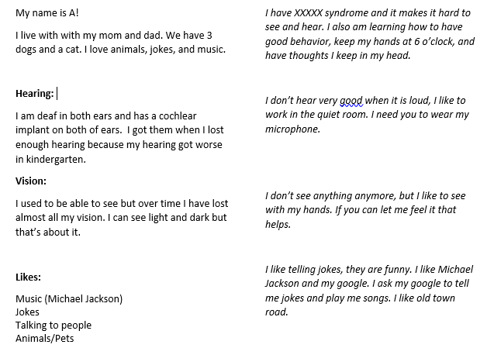
Strengethen the Documentation: Effective Use the Additional Information Box
1.K12 Specific causes of the deafblindness
1.K13 Strengths and needs of the individual
1.K14 Likes and dislikes of the individual

Slide 14
Strengethen the Documentation: Effective Use the Additional Information Box Additional Information for documentation on the previous slide
This document was written by AD and me. Together, we wrote this to share with the teachers for the next year. My writing is on the left, and AD’s actual words are on the right in italics. We had discussions about each item to be able to summarize it in terms of what "likes" meant. We created a book (uploaded here as a PowerPoint) with each item on a page and pictures to illustrate the idea and shared it with the teachers. AD helped pick the pictures himself.

Slide 15
Section 2: Explanation
The dcoumetation that doesn’t speak by itself strongly, can be strenghened with strong explanation as well.
Mandatory Question:
How does the documentation provided for this artifact support each associated competency?
Candidates Select Two of the Following Questions:
Describe the activity (or activities) depicted by the documentation and explain what the student or client is doing. How is it related to his or her goals or needs?
In what ways are the knowledge and/or skills highlighted in the documentation important to your work with the student/client?
In what ways are the knowledge and/or skills highlighted important to your role as a member of the student/client’s team?
What did you learn about yourself as an intervener as you gathered the documentation for this artifact?

Slide 16
Example Effective Explanation: Box of Deafblindness
1. K5 Effect of combined vision and hearing loss on development and learning
1.K15 Learning style and communication of the individual
1.K16 Audiological and ophthalmological conditions and functioning of the individual
How does the documentation provided for this artifact support each associated competency?
The documentation shows 1.K5 and 1.K16 by illustrating the ways that his vision causes him to see (Coloboma and Enuclation) resulting in no vision in one eye and patchy vision (unable to determine acuity) and hearing with two CIs. I also listed the ways that he accesses such as braille, touch, and need for reduced environmental sounds. This also addressed 1.K15 in what his needs are. Also documented is his use of ASL and other tactile.

Slide 17
Box of Deafblindness: Explanation (continued)
1. Describe the activity (or activities) depicted by the documentation and explain what the student/client is doing. How is it related to his or her goals or needs?
This relates to the students needs because when doing instruction or supporting teaching I need to be aware of how to best use his hearing, like going to a different room or away from a fan, and vision, by presenting things on the left side towards the top of his vision. Knowing his syndrome is also important because it is progressive. I can be sure that over the years we’ve worked together, I am modifying things as he needs and being aware of the changes.
2. In what ways are the knowledge and/or skills highlighted in the documentation important to your work with the student/client?
His conditions and their impact change how things are presented everyday. I know that when he is in a loud environment I can use more touch and real objects to get the content from the teacher to support his understanding and learning better. Also, knowing that combining approaches, like using touch and speech together in specific environments to support him, makes a big difference.

Slide 18
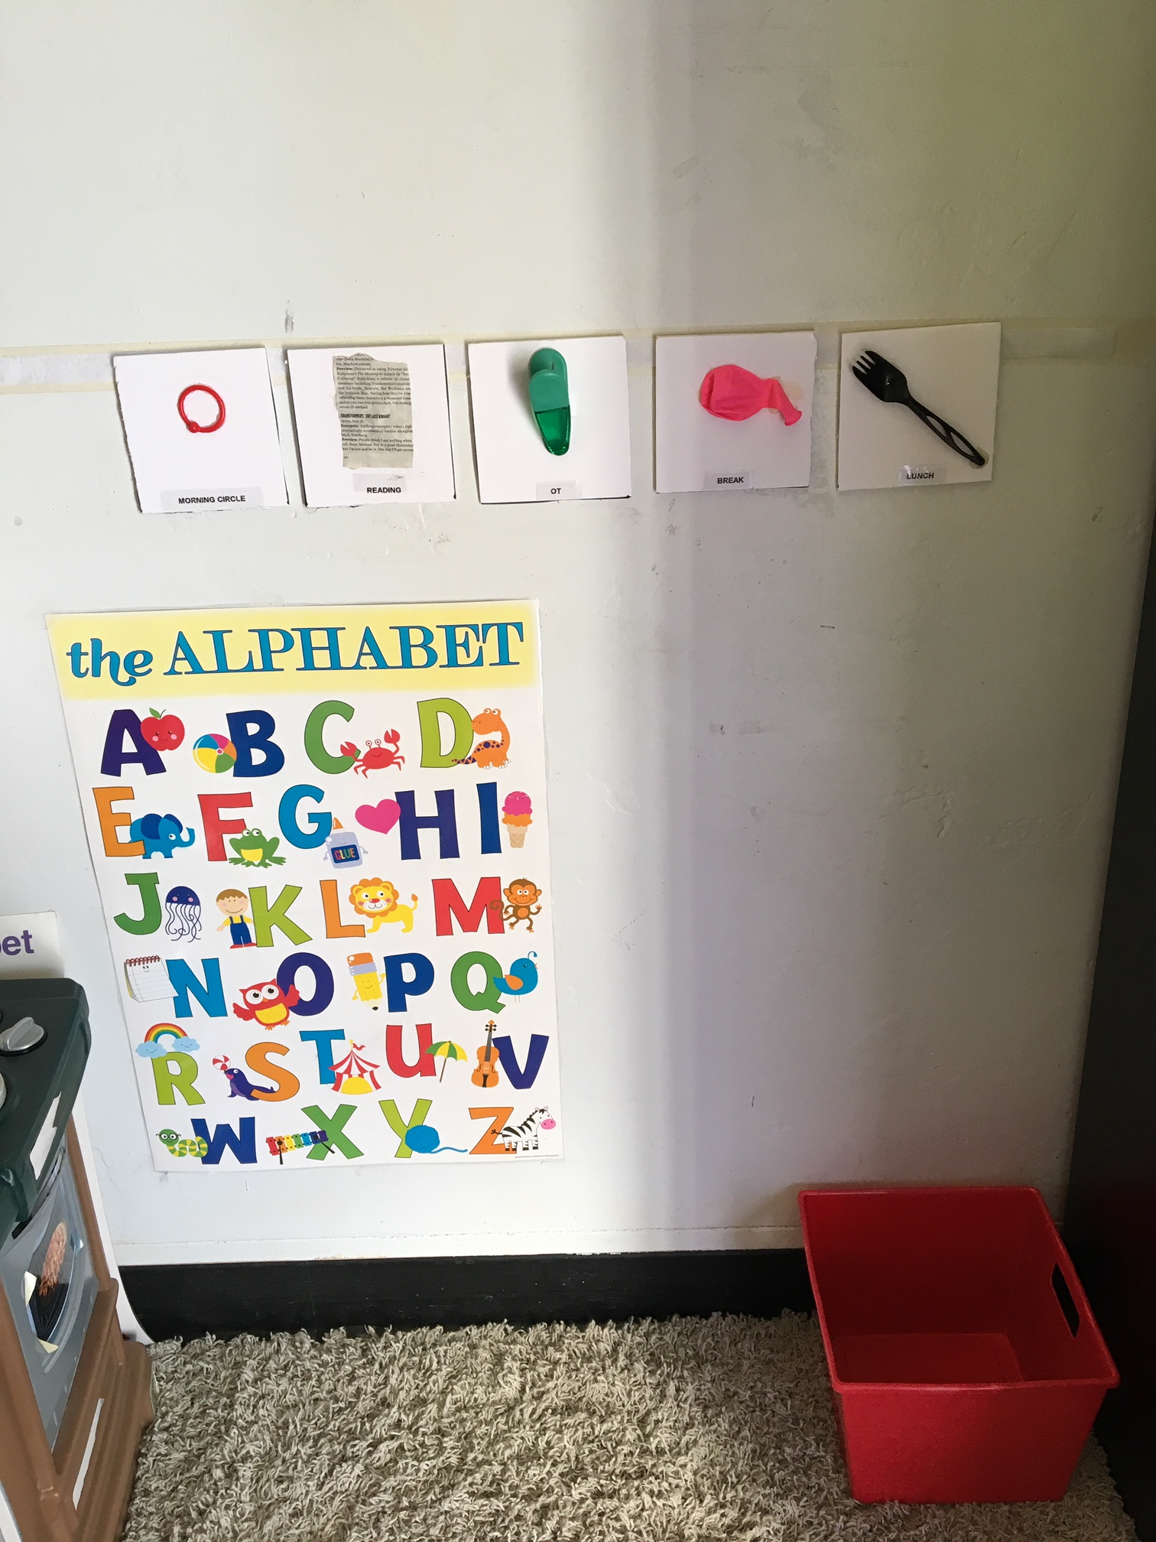
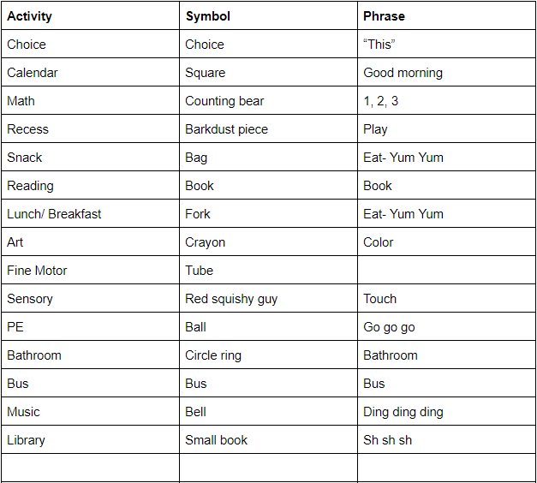
Documentation: Calendar
3.K1 The use of calendar system

Slide 19
Ineffective Explanation for Calendar
How does the documentation provided for this artifact support each associated competency?
The pictures show the students calendar and the list of symbols and what we say with each one.
3. In what ways are the knowledge and/or skills highlighted in the documentation important to your work as a member of the student/client's team?
The students calendar is shown here, it shows what his day looks like before lunch.
4. What did you learn about yourself as an intervener as you gathered the documentation for this artifact?
I think with this documentation I learned that consistency is more important, and I can sometimes forget how important it is to do and say the same thing every time we use the calendar.

Slide 20
Strong Narratives in the Explanation Section
Choosing questions that complement the documentation most effectively.
Explanations are meant to provide reviewers with sufficient information about what they will see demonstrated in the documentation - not one or two sentences as seen in calendar example.
If mutlitpe competenices are assocated with the artificat - describe the link between the docuemntation and each competency by naming the comptency.
General statememt encomppassing all competencies or about one competency only is not effective.
Once again, we emphasize - The dcoumetation that doesn’t speak by itself strongly, can be strenghened with strong explanation.

Slide 21
Strong Narratives in the Explanation Section Cont.
Reviewers do understand that English may not be the first language for an intervener.
however, poor punctuation and use of wrong words/terms make review harder or convey a totally different meaning
While written text explanation is required; supplemental video or audio explanations are permitted.
Most importantly, explanation is about intervener’s reflection on their own practice – not what the student is doing but what are you doing as the intervener, and what are you learning from it.
Encourage Reflective practice – not only for ePortfolio but in everyday practice.

Slide 22
Reflective Practice
What does reflective practice mean?

Slide 23
Reflective Practice Cont.
Reflective practice is the ability to reflect on an action so as to engage in a process of continuous self-examination and learning.
In a professional setting, reflection is:
deliberate;
purposeful;
structured;
about linking theory and practice;
to do with learning;
about change and development

Slide 24
More about benefits of reflective practice……
Self-Reflection is the key to improvement and lifelong professional development for all of us:
Self Reflection is helps us have better understanding of our students/clients and their needs and abilities and improve one’s practice with students.
When we self-reflect as mentors, were are more likely to develop reflective interveners who are active and independent learners.
Interveners with increased self-reflection skills, in turn, are more likely to have similar impact on the students that they work with.

Slide 25
Reflection: A Recommended Practice for Everyone!
A way of working that spans disciplines and encourages us to …
Consider the possible implications of our interventions while in the midst of our work
Slow down, filter our thoughts, and more wisely choose actions and words
Deepen our self awareness and understanding of the contextual forces that affect our work
Take time afterward to consider our work and the related experiences in a way that influences our next steps.

Slide 26
Enhancing Intervener’s skills in Self-reflection and Self-assessment
Tell them about use of self-reflection in your own practice
Use the NICE Intervener Self-reflection Tool as an assignment with the intervener to practice self-reflection
Using Mentor Feedback Form as a reflection tool to enhance the quality of NICE Artifacts.

Slide 27
Questions?
Please share your thoughts on how we can improve by completing our webinar evaluation: https://tinyurl.com/qw5eteu

Slide 28
What is coming next: Overview of Webinar #3
Webinar #3: Ensuring Intervener Success in NICE: Part 2 - Portfolio Scoring
Focus: This final webinar in the 3-part series expands on the information provided in current previous webinar. We will review scoring of artifact examples (effective and ineffective) from the perspective of reviewers to help mentors understand how to support intervener candidates as they create artifacts for their portfolios..
Learning Outcomes:
Recognize the Council for Exceptional Children intervener competencies that are hard to demonstrate and asses
Learn how an understanding of the scoring process helps intervener candidates develop effective artifacts
Learn about the unique perspective of mentors who are reviewers
Become familiar with a checklist for ensuring the timely completion and submission of portfolios

