Slide 1


Educational Considerations for Students with Usher Syndrome – Part 1
October 11, 2017
Presented by:
Carly Fredericks
Family Engagement Coordinator-New Jersey/Founder of Ava’s Voice/NFADB
Patti McGowan
Family Engagement Coordinator-Pennsylvania/NFADB
Nancy O’Donnell
Director, USH Trust Registry-Usher Syndrome Coalition
Facilitated by:
Megan Cote
NCDB Initiative Lead for Early Identification/ Referral & Family Engagement
nationaldb.org
info@nationaldb.org
The contents of this presentation were developed under a grant from the U.S. Department of Education #H326T130013. However, those contents do not necessarily represent the policy of the Teaching Research Institute, nor the US Department of Education, and you should not assume endorsement by the Federal Government. Project Officer, Jo Ann McCann.

Slide 2
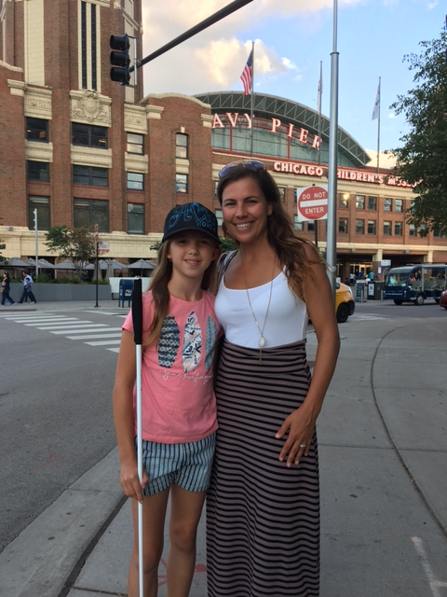
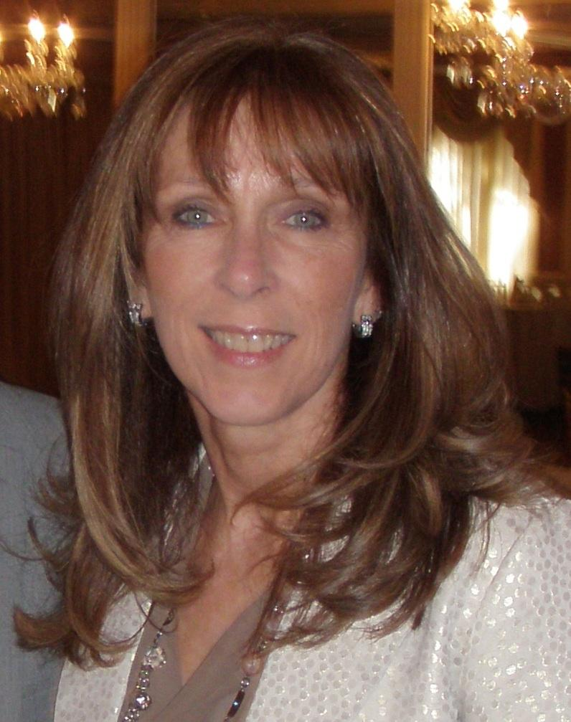
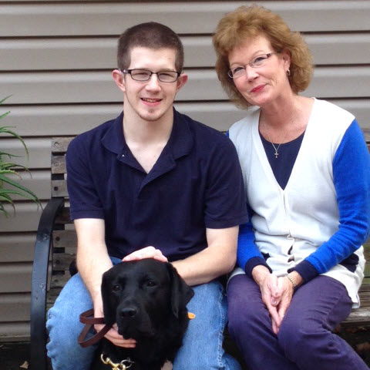
“This is US”
Notes:
Megan-Introductions

Slide 3
Part I Content
Overview of Usher syndrome
Your child with Usher syndrome
First steps in creating the educational program
Notes:
Carly-performance may “hh” staying competitive at their academic capability

Slide 4
Part II Content
The Individualized Education Plan
Accommodations and Modifications
Detailed example of Specially Designed Instruction
The educational team
Transition
Adult services
Notes:
Carly-performance may “hh” staying competitive at their academic capability

Slide 5
Webinar Outcomes
Participants will:
increase their knowledge about the impact that combined vision and hearing loss (due to Usher syndrome) has on their child’s learning
understand some of the educational considerations that may be needed now and in the future
Notes:
Patti: as parents we not only have to think of the NOW for our children with Usher syndrome- we have to always prepare for the FUTURE

Slide 6
History of USH
1914 - Charles Usher, Scottish ophthalmologist studied 69 individuals with RP, 19 of whom also had hearing loss.
What have we learned in 103 years?
Notes:
Nancy

Slide 7
What is Usher syndrome
Congenital bilateral sensorineural hearing loss (SNL)
Retinitis pigmentosa (RP) – night blindness and a loss of peripheral vision. This may become evident at different ages, depending on type of Usher
Vestibular/balance issues
Notes:
Nancy

Slide 8
Usher Syndrome FAQs
Most common genetic cause of combined vision and hearing loss
Recessive - both parents must carry the Usher gene
Affects males and females
3 main types and 16 subtypes
http://hereditaryhearingloss.org/main.aspx?c=.HHH&n=86573
Notes:
Nancy

Slide 9
Usher type 1
Profound hearing loss (deaf)
Early onset RP (first decade of life)
Vestibular (balance) problems affecting early milestones of crawling, walking, balance and coordination
1B, 1C, 1D, 1E, 1F, 1G, 1H, 1J, 1K
Notes:
Nancy

Slide 10
Usher type 2
Moderate to severe hearing loss (hard of hearing)
RP evident in teen years
No balance problems
2A, 2C, 2D
Notes:
Nancy

Slide 11
Usher type 3
Sighted and hearing at birth; progressive hearing and vision loss.
Progressive balance loss in 50% of those with USH3
Rare - more common in Finland and Ashkenazi Jews
3A and 3B
Notes:
Nancy

Slide 12
Atypical Usher
Doesn’t fit any of the first three categories OR
symptoms do not fully express OR
symptoms are absent
Notes:
Nancy

Slide 13
Population estimates
USA USH population estimated to be between 20-50,000.
# kids, ages birth to 21, could be between 7560 and 13,125.
Notes:
Nancy

Slide 14
What do we know - NCDB
NCDB’s 2016 child count showed just under 300 kids with Usher syndrome, birth to 21 out of nearly 10,000 children identified as deafblind. .
Notes:
Nancy

Slide 15
What do we know - USC
As of October, 2017, the Usher Syndrome Coalition registry had 278 kids with Usher syndrome registered in the USA, birth to 21
Notes:
Nancy

Slide 16
Where is everyone??
Not yet identified with Usher
Identified but still functioning visually with CI or H/A
Don’t want to “say anything” yet.
Notes:
Nancy

Slide 17
Those 5 words...
Your child has
Usher syndrome...
Notes:
Carly: We all have our own story…we can remember exactly where we were, who was with us, what we were wearing and that indescribable moment that took over our bodies. Little did we know what an amazing journey we would embark on with our child, our families and this community of remarkable resilient individuals living with Usher Syndrome. No matter the age or time of diagnosis we all know the feeling, it’s not the most pleasant, but we hope you are comforted knowing you are not alone!

Slide 18
Grieving and Believing
The initial shock of the diagnosis
The unknown is the worst
Unraveling the unknown
Embracing the journey
Notes:
patti: As parents we are heartbroken of the news- but our children will do and can do amazing things. There is the initial Shock, natural to grieve, - where to begin, diagnosis of the “unknown” when sight loss, more hearing loss? educate yourself and others,
Embrace the journey- I knew my son was capable of learning I just knew he was going to learn in a different way- began my network and support system, as I could not do this alone

Slide 19

Fill your toolbox
“Knowledge is POWER”
Notes:
Carly: This picture of a toolbox with “ “ is the tools we are talking about however, Early on there were moments I found myself fearful of introducing a new skill or support (cane) because it was like facing the reality or that now that I did now she was going to need it. I never wanted to rush it, but I found more and more that we learned together Ava received a little more of an understanding about her reality and had the opportunity to overcome the obstacle or challenges without fighting them.

Slide 20
What’s first?
Making connections...
Educate yourself!
Set a Goal for yourself!
Network with other families
Meet adults with Usher syndrome
Connect to your State Deaf-Blind Project and the National Center on Deaf-Blindness (NCDB)
Usher Syndrome Coalition- USH Trust registry
Parent Groups (NFADB,PTI,) local, state, national
HKNC- get your child on the registry
Notes:
Patti- it was all about gaining knowledge in the beginning- understanding the impact of the dual sensory loss- educating myself to be able to explain to others- process, will take years
-Set a goal for myself: Advocate FOR my son, Advocate BESIDE my son, Advocate BEHIND my son
-Got connected, ongoing developing a network, take advantage of trainings, forums,
-other families, meeting adults w/Usher, getting connected and networking,

Slide 21

One size does NOT fit all!
Learn
Consider
Make educated decisions
Follow your child’s lead
ADVOCATE
Notes:
Carly
photo description:

Slide 22
Exploring Modes of Communication
Total Communication
Auditory/Oral spoken Language
American Sign Language
Tactile Sign Language
Follow your child’s lead...
Notes:
Patti-definition(s)- options- no right or wrong- personal decision as a family and then watch for the lead of your child
Total Communication (TC) is an approach to Deaf education that aims to make use of a number of modes of communication such as signed, oral, auditory, written and visual aids, depending on the particular needs and abilities of the child.
The Auditory/Oral (A/O) approach teaches infants and young children to use hearing and speech to develop spoken language for communication and learning.
ASL:is a language which chiefly uses manual communication to convey meaning, as opposed to spoken language.
Tactile signing is a common means of communication used by people with both a sight and hearing impairment which is based on a sign language or other system of manual communication.
Carly- What does it look like using multiple modes of communication

Slide 23
PART WHAT?
Early Intervention Program - Part C – serves children birth-3
Lead Agency designated by the state
Services must be provided to children experiencing developmental delay or a condition that is highly likely to result in a developmental delay and therefore needs early intervention
Individualized Family Service Plan (IFSP)
Family Involvement – Participation on all teams making decisions about the child’s individualized plan for services
Receive services to improve the family’s ability to meet the needs of their child with a disability
Location of Services - Natural Environment—to the maximum extent appropriate, the child is served in environments that are normal or natural for a child of that age (including the home and integrated child care settings).
Costs for Services - States may charge for services (e.g. sliding scale), but must ensure no one does not receive services because of inability to pay.
Notes:
Carly

Slide 24
PART WHAT? (cont.)
Special Education Program – Part B – children ages 3-21
Lead Agency is the State Department of Education
Special education must be provided to children who fit 1 or more of the following categories of disability: Mental retardation, a hearing impairment (including deafness), a speech or language impairment, a visual impairment (including blindness), a serious emotional disturbance (referred to in this part as emotional disturbance), an orthopedic impairment, Autism, Traumatic brain injury, other health impairment, a specific learning disability, Deaf-blindness, or multiple disabilities
Individualized Education Plans (IEP)
Family Involvement - Participation on all teams making decisions about the child’s individualized plan for services
Location of Services - Least Restrictive Environment—to the maximum extent appropriate, the child receives services and participates in the general curriculum, non-academic, and extra-curricular activities alongside peers without disabilities.
Costs for Services - All services must be provided for free.

Slide 25
Early Intervention (birth-3yrs)
Early intervention refers to educational services for young children (birth to age 3) who have disabilities. Part C
Early intervention focuses on helping eligible babies and toddlers learn the basic and brand-new skills that typically develop during the first three years of life, such as:
physical (reaching, rolling, crawling, and walking);
cognitive (thinking, learning, solving problems);
communication (talking, listening, understanding);
social/emotional (playing, feeling secure and happy); and
self-help (eating, dressing).
Notes:
Carly- Falls under Part C

Slide 26
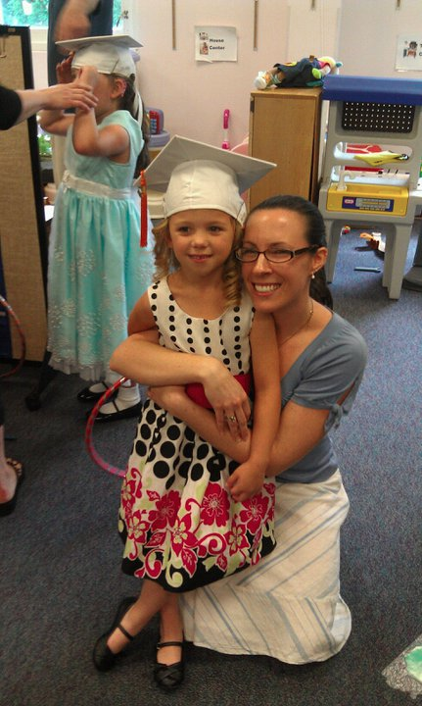
Preschool (age 3-5yrs)
Services for preschool children (ages 3 through 5) are provided free of charge through the public school system. These services are available through the same law—the Individuals with Disabilities Education Act—
Notes:
Carly
Inclusion:
Most restrictive setting:

Slide 27
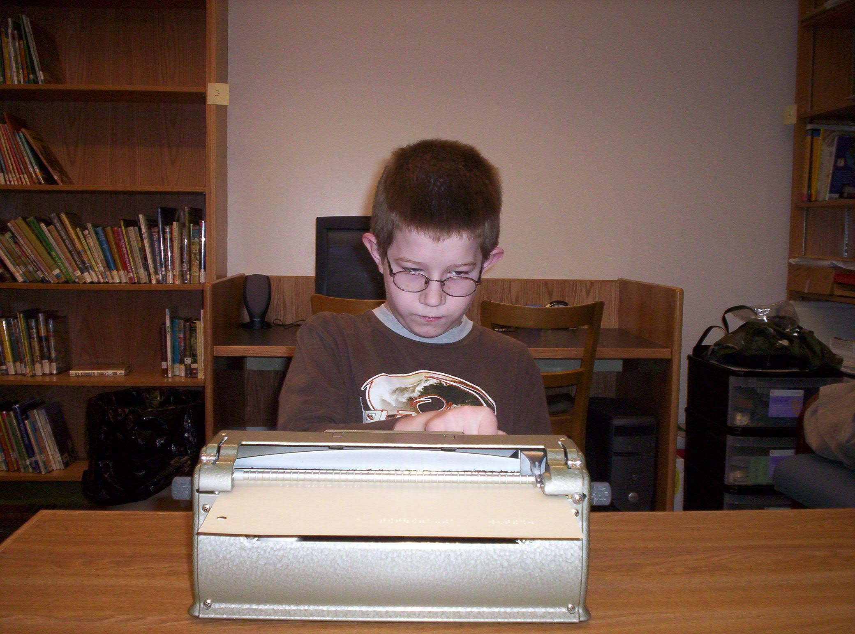
School Age (age 6 - 21yrs)
For school-aged children and youth (aged 3 through 21), special education and related services are provided through the school system. Part B
The student must both be eligible for and in need of special education in order to be entitled to special education services.
Notes:
Patti: Students with disabilities have the right under the IDEA law to attend school through their 21st year.
Entitlement vs Eligibility . Check in with your state DB Project for state specific information-
You have an option to take advantage of the extended school years, and this may be important for all the “extras” that our children need to learn on top of the general ed curriculum. ex: braille, O&M,

Slide 28
Who’s on my team?
Parent, Student
Family member, guardian
Special Ed Director, LEA/Case Manager
General Education Teachers
Special Education Teachers
Teacher of Visual Impairment (TVI)
Teacher of the Deaf (TOD)
Educational Interpreter
Intervener, Para-professional
Audiologist
AT Consultant
Deaf-Blind Consultant
Speech Pathologist
OT, PT
Notes:
Carly
Open lines of communication between team members.
“Core team” of the sensory team members should be discussed

Slide 29
Classification
Federal Definition:
Deaf-blindness means concomitant hearing and visual impairments, the combination of which causes such severe communication and other developmental and educational needs that they cannot be accommodated in special education programs solely for children with deafness or children with blindness. 34 CFR 300.8 (c) (2)
Notes:
Patti- heavy word- (3 yrs to say it)- thinking only of Helen Keller-understanding not total deafness nor blindness but understanding the impact of the dual loss especially in the educational system. Our kids w/Usher will miss information and they have a right to not miss information. They do not know what they have not seen or heard- we owe to our kids not to allow this to happen. This is why supports are so important- Our children with Usher may need supports to be independent- break the myth!

Slide 30
Assessments
The evaluation must use a variety of assessment tools and strategies to gather relevant functional, developmental, and academic information about the child, including information provided by the parent. When conducting an initial evaluation, it’s important to examine all areas of a child’s functioning to determine not only if the child is a child with a disability, but also determine the child’s educational needs. This full and individual evaluation includes evaluating the child’s:
Health,
Vision and hearing
Social and emotional status
General inteliligence
Academic performances
Communicative status and
Motor abilities
Notes:
Carly: As IDEA states, the school system must ensure that—
…the evaluation is sufficiently comprehensive to identify all of the child’s special education and related services needs, whether or not commonly linked to the disability category in which the child has been classified.
Initial assessment: SPAN doc. ADD NOTES HERE
Functional Vision Assessment (FVA)
Learning Media Assessments (LMA)
*Classification comes in
Patti- Suggestions: You know your child that also plays as a factor. Usher changes over periods of times so good idea to keep up with assessments and evaluations regularly -both educationally and medically - good idea to share medical assessments with the educational team- Suggest to always have a deafblind consultant with these assessments.
EA: Key components include: Parent and/or caregiver interview-Teacher and/or service provider interview-Review of records-Child Observations-Child or Student Interview-Current Learning and Literacy Functioning-Functional Reading and Writing
FVA: It is an assessment of how a child uses the vision he or she has in everyday life, so it is usually not done with children who are totally blind or have light perception only.
LMA: conducted by the Teacher of Students with Visual Impairments (TVI), is required to determine what kinds of literacy and functional learning materials are appropriate.

Slide 31
Develop IEP
Based on the results of the Assessment, the team develops educational goals for the school year.
The IEP tells his story and designs a path for him to achieve his educational outcomes. This includes adaptations, accommodations or modifications for him/her to access the general ed curriculum.
Notes:
Carly-performance may “hh” staying competitive at their academic capability

Slide 32
Contacts
Megan Cote
megan.cote@hknc.org
Carly Fredericks
frederc5@tcnj.edu
Patti McGowan
pmcgowan@pattan.net
Nancy O'Donnell
nancy.odonnell0813@gmail.com

