Slide 1


Educational Considerations for Students with Usher Syndrome – Part 2
October 11, 2017
Presented by:
Carly Fredericks
Family Engagement Coordinator-New Jersey/Founder of Ava’s Voice/NFADB
Patti McGowan
Family Engagement Coordinator-Pennsylvania/NFADB
Nancy O’Donnell
Director, USH Trust Registry-Usher Syndrome Coalition
Facilitated by:
Megan Cote
NCDB Initiative Lead for Early Identification/ Referral & Family Engagement
nationaldb.org
info@nationaldb.org
The contents of this presentation were developed under a grant from the U.S. Department of Education #H326T130013. However, those contents do not necessarily represent the policy of the Teaching Research Institute, nor the US Department of Education, and you should not assume endorsement by the Federal Government. Project Officer, Jo Ann McCann.

Slide 2
Part I Content
Overview of Usher syndrome
Your child with Usher syndrome
First steps in creating the educational program
Notes:
Carly-performance may “hh” staying competitive at their academic capability

Slide 3
Part II Content
The Individualized Education Plan
Accommodations and Modifications
Detailed example of Specially Designed Instruction
The educational team
Transition
Adult services
Notes:
Carly-performance may “hh” staying competitive at their academic capability

Slide 4
Accomodations vs. Modifications
Accommodations alter how a student learns. They do not change what the student is expected to learn. Accommodations describe an alteration of the environment, curriculum format, or equipment that allows an individual with a disability to pursue a regular course of study and/or complete assigned tasks.
VS-
Modifications describe very fundamental changes in the curriculum. They may include altering the standard expectations for a course or assessment, as the student may be unable to learn all of the material, or particular portions of the material presented
Notes:
Patti-Examples- accommodations> same work as peers, extended test time, test questions read orally,
Modifications> might be only 10 of the 30 questions on a test, instead of writing an essay you may have multiple choice questions
Carly-examples:

Slide 5
Examples of Specially Designed Instruction (1 of 4)
Intervener
CCTV for distant and near viewing
Written or verbal descriptions for materials that are color coded for identification
Digital book player
Hand­held magnifier
Braille Notetaker
Long Cane
OCR­ Scan and read program
Notes:
Patti-Sharing of my son Hunter and his IEP- Special design instruction and related services or direct services for a student with adaptations, accommodations - So what does this mean? Look at IEP - Related Services- Special Design Instruction.
Bring up Carly’s tool box- Hunter knew when and where some of the SDI’s were needed

Slide 6
Examples of Specially Designed Instruction (2 of 4)
Preferential seating (as determined by Hunter and his teachers)
Use of hat indoors when needed to reduce glare
Desk copy of notes or note taker (hard copy or electronic copy of notes prior
Large print (129% on 17x11 size paper) or scanned materials
Digital Textbooks
Notes:
Patti-Special design instruction and related services for a student - So what does this mean? Look at IEP - Related Services- Special Design Instruction

Slide 7
Examples of Specially Designed Instruction (3 of 4)
High contrast marker on whiteboard
2 Personal FM transmitters
Gain student's attention before speaking to him
Repeated directions
Multi­sensory instruction (auditory/visual/hands­ on)
Frequent opportunities for review and checks for understanding
Word prediction software
Notes:
Patti- Talk a little about PRE-Teaching and RE-Teaching- best practice of what to expect and then to make sure all was heard after the fact. There also needs to be that additional time of processing. We call this WAIT TIME.
With my son it always takes twice as long to do half the work- not an excuse but a fact. Now he has to prove it is a fact by getting all required work done.

Slide 8
Examples of Specially Designed Instruction (4 of 4)
Oral testing
Opportunities for sensory breaks (one-on-one quiet time)
Teachers need to identify self when speaking and identify name of the student who is about to provide answers and/or comments
Teacher restates student comments
Digital recorder
Tablet with Scientific/Graphing calculator
Notes:
Patti- share the importance of identifying oneself- parents may need to model this for others including educators

Slide 9
Related Services
Speech - Language Therapy - at least 50 sessions of 20 minutes
Intervener - 180 days during the school year
Hearing Support - 56 sessions for 42 minutes per IEP year, barring absences, inclement weather or special classroom activities
Audiological Services - at least 2 hours per IEP year
Assistive Technology Support - at least 2 hours/per IEP year
Orientation & Mobility - at least 16 hours per IEP year
Vision Support - 300 sessions for 42 minutes barring absences, inclement weather or special classroom activities
Occupational Therapy - at least 1 session for 42 minutes per IEP year
Notes:
Patti-Special design instruction and related services for a student - So what does this mean? Look at IEP - Related Services- Special Design Instruction

Slide 10
Support for School Personnel General Ed
General Education Teachers
In­ service with classroom teachers about deaf­ blindness, assistive technology, and accommodations
Consultation from the Intervener
Academic collaborative meetings
FM system in­service training
Consultations regarding hearing loss as needed
Notes:
Patti- Support will be needed for the General Education Staff- chances are they have not worked with a student with a dual loss (Usher) - and again this would be individualized and unique- Indirect Services

Slide 11
Support for School Personnel Other
Example of staff who will receive support:
Teacher of the Visually Impaired, Teacher of the Deaf/HOH, Intervener, Audiologist, AT Consultant
In­ service with classroom teachers about deaf­blindness, assistive technology, and accommodations
Transitional collaborative meetings
Consultation from Occupational Therapist
Notes:
Patti- This would be an example of indirect services to the educational team members working with a student with dual loss, and they do would do indirect service as colleagues.

Slide 12
Collaboration
“You don’t know what you don’t know”
break barriers
communicate
overcome challenges
be open minded
Notes:
Carly: Model of collaborative trainings

Slide 13
Teacher of the Deaf (TOD)
May work with children from preschool to college age
Works in a variety of environments
Understanding of complexity of language and its development
Deep understanding in which hearing loss may affect language
Notes:
Carly
pre-teach,
Provided by district
Through Itinerant program
School for the Deaf
*They become your go to

Slide 14
Teacher of the Visually Impaired (TVI)
Typically - licensed special education teacher with certification and specialized training in meeting the educational needs of students who are blind or have visual impairments ages birth through 21 (states vary on the criteria for certification as a Teacher of Students with Visual Impairments).
This is an instructional position, as opposed to a related service or vision therapy.
Notes:
Patti -Key player on Hunter’s team: in tandem w/Hunter did accommodations/Braille instruction/ key player on core team and team at large.
Worked well with TOD-Intervener-Speech-O&M-

Slide 15
Occupational Therapy (OT)
Occupational therapy (OT): combines the art and science of providing and directing activities that serve to restore and enhance performance of skills needed for functional daily living.
Notes:
Patti- OT aspect/tactile defensiveness/ writing/

Slide 16
Physical Therapy (PT)
Uses a variety of treatments to help build strength, improve movement, and strengthen skills needed for daily activities: crawling, walking, balance and coordination activities.
OTs and PTs - part of IEP; do assessment and establish clearly defined goals for everyone to follow
Notes:
Nancy- “reiterate balance with different types
Carly- balance issues early on with type/sitting up/walking/core training
OT PT team - including school officials, educators and the therapists assigned as part of the school-based services program.

Slide 17
Speech
The purpose is to promote communicative and linguistic as well as to optimize outcomes for deaf and hard of hearing children.
Notes:
Carly
qualifications
importance when newly implanted or aided
“it has to go in to come out”

Slide 18
What is an Educational Interpreter?
Very different scope of practice than interpreter for adult community:
part of the educational team
specially trained – not an aide who knows some sign language
is a related service provider
legal responsibility to support child’s education/access to the general curriculum.
Notes:
Nancy-RID National Association of Interpreters in Education
Interpreters vs. aides who sign; The NAIE believes students who are deaf/hard of hearing have the right to access the educational environment using professional interpreting services which provide communication in the modality determined by the Individual Education Plan or 504 plan and as required by IDEA and state education agencies.
Therefore, The NAIE believes this organization is critical in order to support, collaborate and advocate for interpreters in education by acknowledging and addressing the complex challenges of the work, and advancing the field through research, professional development, and partnerships with educational stakeholders.
The NAIE also believes a professional interpreter working in an educational setting is an individual who holds specialized academic and professional credentials that include knowledge and skill sets for the educational environment, adheres to a high standard of ethical practices and professional integrity, pursues excellence through professional development opportunities that continually enhance the quality of the services provided, values, respects and advocates for the advancement of the profession, and, engages in collegial relationships with interpreting peers and other members of the educational team.

Slide 19
Professional training for EIs
Certification through Boys Town - Educational Interpreter Performance Test classroominterpreting.org/eipa
National Association of Interpreters in Education – for interpreter support
Notes:
Nancy-RID/EI
Interpreters vs. Aides who signs

Slide 20
Interveners
Provide consistent one-to-one support to a student who is deaf-blind (age 3 through 21) throughout the instructional day;
Provide access to information and communication;
Facilitate the development of social and emotional well-being for children who are deaf-blind;
Specially trained in understanding deaf-blindness and the process of intervention.
Notes:
Patti
May require interpreter and an intervener - Intervener 1:1 w/specific training in the dual loss/deafblindness. Should be as unique and individualized as the students IEP. Do WITH not FOR the student. Simply the EYES and EARS of the student. The student does not know what he/she may miss and they have the right to know everything in their environment and going on around them. Bridge of Access
Para-professionals:
Para (in role of an Intervener):
Para- in classroom setting:

Slide 21
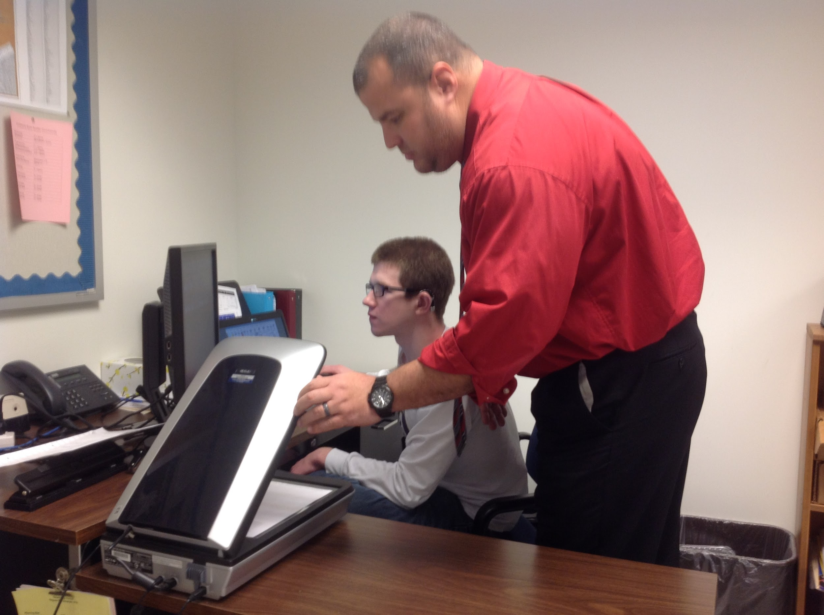
Interveners in action!
Notes:
Patti
May require interpreter and an intervener - Intervener 1:1 w/specific training in the dual loss/deafblindness. Should be as unique and individualized as the students IEP. Do WITH not FOR the student. Simply the EYES and EARS of the student. The student does not know what he/she may miss and they have the right to know everything in their environment and going on around them. Bridge of Access
Para-professionals:
Para (in role of an Intervener):
Para- in classroom setting:

Slide 22
O&M
Orientation and mobility (O&M) specialists teach individuals with low vision or no usable vision to travel safely, confidently and independently in their environment. They work with infants, children and adults usually on a one-to-one basis in a home, school, hospital or in the community.
Notes:
Carly- trailing for safety in home, cane, transitioning day/night
Low Vision or No usable Vision- talk about the word “impairment”
Patti-orientation ( new school/different classrooms/ offices in the school building/ football stadium/ Pool area) High School years: learning public transit, subways, guide dogs ( research/applying/ follow up after teamed with a guide dog for the blind)

Slide 23
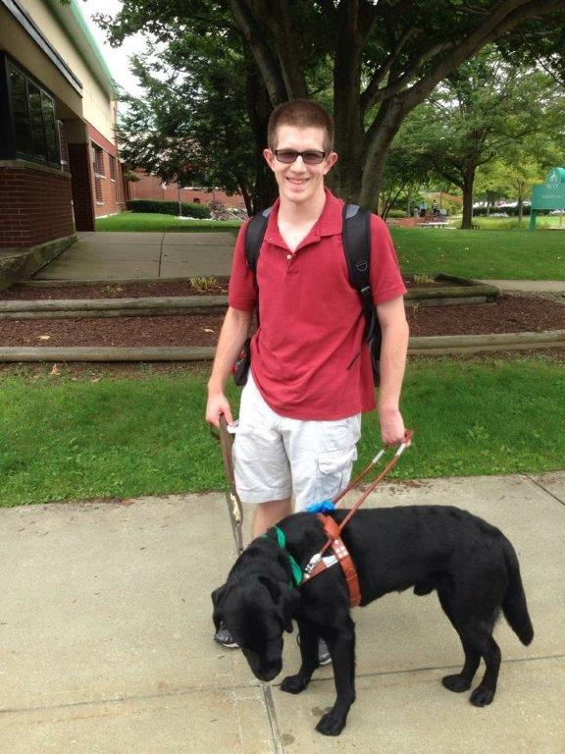
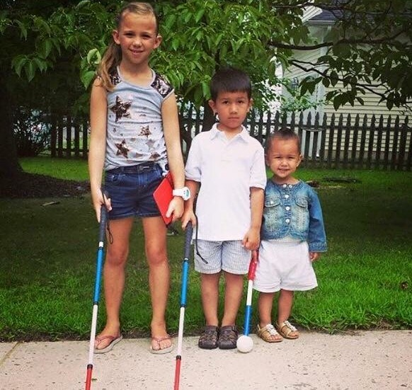
Independence

Slide 24
Extra Curricular Activities
The Rehab Act requires that students with disabilities be provided equal opportunity for participation in interscholastic, club, and intramural athletics programs offered or sponsored by a school.
Notes:
Carly
Patti- In community: Agua Club- Boy Scouts (Eagle)- Church-Volunteered at our Local Food Bank Monthly- School: High School Varsity Swim Team
*Accomodations

Slide 25
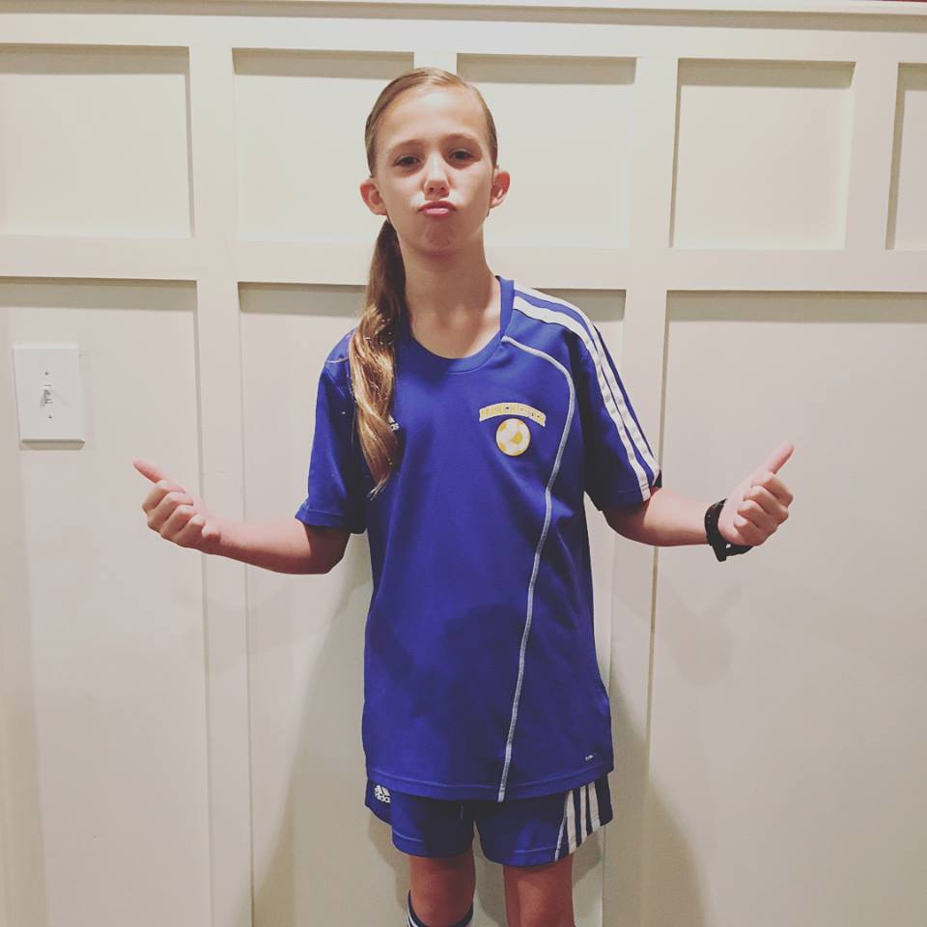

Keep your eye on the prize!

Slide 26
Not already!
Identify new team members
Share student profile
  Focus on strengths
Introduce team “mates”
Begin forming a relationship
Thank you goes a long way
Notes:
Carly- importance of meeting prior to end of school, identifying staff and attend last team meeting “Passing of the torch” Just as important to the teacher
*Most important person on the team, consistency, know your child the best
Patti: Important to have team meetings outside of the IEP meeting ( we met quarterly) Hunter did “All about Me” PPT for new teachers- passing the “torch” at the end of the school year-encouraging teachers to talk about Hunter- Supplementary Aids and Services Toolkit-

Slide 27

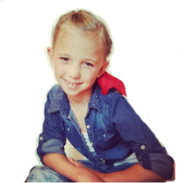
“Ava is a nutshell”
A’s of AVA
Avid reader
Always a competition
Athlete
Artist
Advocate
Anything is possible
Notes:
Carly- importance of meeting prior to end of school, identifying staff and attend last team meeting “Passing of the torch” Just as important to the teacher
*Most important person on the team, consistency, know your child the best
Patti: Important to have team meetings outside of the IEP meeting ( we met quarterly) Hunter did “All about Me” PPT for new teachers- passing the “torch” at the end of the school year-encouraging teachers to talk about Hunter- Supplementary Aids and Services Toolkit-

Slide 28
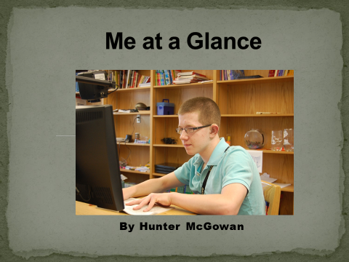
Me at a Glance
Hunter prepares and presents a power point presentation to share with his educational team and peers.
Notes:
Hunter prepared and presented a ppt about himself to teachers and peers , including overview of usher syndrome, technology that he used this was the beginning of his self determination and self advocay

Slide 29
Identity
Self-determination involves many attitudes and abilities including: self-awareness, assertiveness, creativity, and pride, and problem solving and self-advocacy skills. To take charge of your own life, you must be able to set goals, evaluate options, make choices and then work to achieve your goals.
Students who have self-determination skills have a stronger chance of being successful in making the transition to adulthood, including employment and independence (Wehmeyer & Schwartz, 1997).
Notes:
Patti - will describe slide as is, Your child will decide his or her identity - make sure you support - Nancy will add in DB vs. Db
Usher can be misleading, invisible...resourceful & clever. They will fill in information. So, who is this person with Usher? They decide, not us.

Slide 30
Secondary Transition Planning
Generally begins at age 14
Transition plan is part of IEP
Establishes goals for post graduation through career awareness exploration activities.
Based on student's needs, strengths, skills, and interests.
Involves student and individuals directly involved in helping them prepare to enter a post-school environment.
Notes:
Patti Three areas to cover and have good goals
• Postsecondary Education/Training (higher ed or vocational)
• Employment
• Independent Living/Community Participation

Slide 31
Transition to Adulthood (18+)
Postsecondary Education: Many high school students with disabilities, including those with deaf-blindness, continue their education in post-secondary schools including vocational and career schools, 2 and 4 year colleges, and universities. While a free and appropriate public education (FAPE) is guaranteed through the Individuals with Disabilities Education Act (IDEA), once a student graduates from high school public funding is not guaranteed. Some students may be eligible for support from vocational rehabilitation agencies.
Notes:
Patti- beginning this new piece of the journey

Slide 32
Adult Services
Eligibility not Entitlement
Commission for the Blind
  http://ncsab.org/List/StateDirectors
Department of Vocational Rehabilitation
  https://www.csavr.org/state-vr-directors
HKNC Reps, Registry, Trainings
Support Service Providers
Gallaudet, National Technical Institute for the Deaf, CSU Northridge or any college with supports for individual

Slide 33
It’s the climb
“Alone we can do so little, together we can do so much”- Helen Keller
Notes:
Carly

Slide 34
Links & Resources Usher Syndrome Coalition
Website: www.usher-syndrome.org
USH Trust Registry:
http://www.usher-registry.org
USH Blue Book:
https://www.usher-syndrome.org/our-story/join-the-ush-blue-book.html
USH Blog:
https://www.usher-syndrome.org/our-story/ush-blog.html
USH Talks:
https://www.usher-syndrome.org/what-is-usher-syndrome/presentations/ush-talks-library.html
USH Connections Conference:
https://www.usher-syndrome.org/our-story/ush-connections-conference-summaries.html

Slide 35
Links & Resources
NCDB
Website: www.nationaldb.org
State DB Projects: https://nationaldb.org/members/list?type=State+Project
Family Matters Stories:
http://nfadb.org/stories/
Resources:
https://nationaldb.org/families
Training Opportunities:
https://nationaldb.org/events

Slide 36
Links & Resources
National Family Association
for Deaf-Blind (NFADB)
www.nfadb.org
Helen Keller National Center for Deaf-Blind Youths and Adults (HKNC)
www.helenkeller.org/hknc

Slide 37
Contacts
Megan Cote
megan.cote@hknc.org
Carly Fredericks
frederc5@tcnj.edu
Patti McGowan
pmcgowan@pattan.net
Nancy O'Donnell
nancy.odonnell0813@gmail.com

