Slide 1
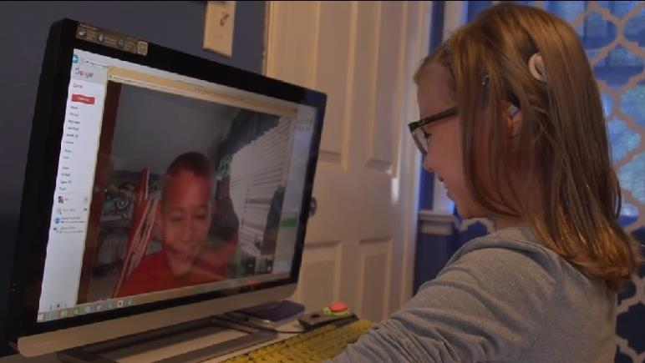
iCanConnect: The National Deaf-Blind Equipment Distribution Program

Slide 2
Program Overview
Presented by:
Marcia Brooks
Director, Perkins National Deaf-Blind Equipment Distribution Program (iCanConnect) Perkins School for the Blind
Carly Fredericks
iCanConnect Program Coordinator, New Jersey

Slide 3
Background
iCanConnect is the National Deaf-Blind Equipment Distribution Program, part of the 21st Century Communications and Video Accessibility Act, signed into federal law in 2010.
iCanConnect is administered by the Federal Communications Commission (FCC).
After a 5-year pilot, iCanConnect became permanent on July 1, 2017.

Slide 4
History
The Twenty-First Century Communications and Video Accessibility Act (CVAA) is sometimes referenced as digital equivalent of Americans With Disabilities Act (ADA)
The CVAA updates federal communication laws to increase access of people with disabilities to modern communications
Requires an FCC clearinghouse on accessible communications services & equipment (NDBEDP)

Slide 5
Where is iCanConnect available?
Any resident of the U.S. including the District of Columbia, Guam, American Samoa, Puerto Rico, the U.S. Virgin Islands, and the Northern Mariana Islands, who meets federal income and disability guidelines and has significant combined hearing and vision loss is eligible for iCanConnect.

Slide 6
Overview
iCanConnect provides free equipment and training to income-eligible people with significant combined hearing and vision loss.
The goal of the program is to help people who are deaf-blind connect with others to:
Enhance social interaction
Reduce isolation
Promote increased independence

Slide 7
Program purpose and parameters
Program is for distance communications, not face-to-face:
e.g., hearing aids or brand-specific
accessories are not permitted
Program cannot take the place of schools’ and employers’ obligations in classroom & workplace
Program can provide a student with device(s) for home or mobile use outside the classroom

Slide 8
Program structure
FCC certifies one entity per state/territory to lead the program
Certifications were granted for the first 5 years of the permanent program (July 1, 2017 - June 30, 2022)
Each state receives an annual allocation based on population
iCanConnect is a reimbursement program, the allocation is not distributed in advance

Slide 9
Who is eligible?
To qualify, individuals must have:
Significant combined vision and hearing loss that causes difficulty in attaining independence in daily life activities.
Household/family income less than 400% of the annual federal poverty rate, or qualify for a federal low-income assistance program.

Slide 10
Disability eligibility
To qualify, individuals must have:
Significant combined vision and hearing loss that causes difficulty in attaining independence in daily life activities.
Program rules require the term “deaf-blind” to have same meaning given by Helen Keller National Center Act.
The ability to use or learn to use equipment to engage in 2-way distance communication.

Slide 11
Proof of disability eligibility
The FCC requires each applicant to submit a signed disability attestation from a professional familiar with consumer’s hearing & vision loss.
Doesn’t have to be medical professional
Certifies applicant meets program’s definition of deaf- blindness (based on HKNC Act)
New in permanent program: must include basis of attestation that addresses combined hearing & vision loss

Slide 12
Disability attestation examples
“I reviewed the applicant’s medical records or vision and hearing evaluation records”
“I have known/observed/provided services to <applicant name> for x years”
“Based on my testings/assessment of <applicant name>’s hearing and observation of his/her ability to see…”
Vice versa: tested vision, observed ability to hear

Slide 13
Proof of income eligibility
To qualify, must provide proof of household/family income less than 400% of the federal poverty guidelines (FPG), or qualify for a low-income assistance program.
400% of FPG to accommodate this population’s higher incidence of unemployment and medical costs
Eligible federal programs include SSI, Medicaid,public housing assistance, food stamps or SNAP, etc.
Household income includes all people in household contributing to household expenses, e.g. spouse.
Eligibility based on pre-tax income

Slide 14
2018 Federal Poverty Guidelines
Number of persons in family/household | 400% for everywhere, except Alaska and Hawaii | 400% for Alaska | 400% for Hawaii
1 | $48,560 | $60,720 | $55,840
2 | $65,840 | $82,320 | $75,720
3 | $83,120 | $103,920 | $95,600
4 | $100,400 | $125,520 | $115,480
5 | $117,680 | $147,120 | $135,360
6 | $134,960 | $168,720 | $155,240
7 | $152,240 | $190,320 | $175,120
8 | $169,520 | $211,920 | $195,000
For each additional person, add | $17,280 | $21,600 | $19,880
Source: U.S. Department of Health and Human Services

Slide 15
Consumer application
Required common elements across states
Signed consumer attestation
Signed disability attestation
Applicant’s previous participation in other states
Consumer must be given program’s Privacy Notice, can be included in application
Eligibility cannot be determined until applicant’s signed application and disability and financial documentation are provided

Slide 16
How does iCanConnect work?
Outreach
Intake
Eligibility determination
Assessment
Equipment procurement
Installation
Training
Technical support

Slide 17
Who can benefit?
Many people can benefit from iCanConnect, including:
A college student who needs to communicate remotely with professors, students and family back home.
A grandparent who wants to stay in touch with out-of- state grandchildren.
A person with Usher syndrome who wants to remain independent, engaged in the world and connected with others.
A child wanted to communicate in their primary language outside of school???
A person seeking employment

Slide 18
Chuck Ferrara reconnects to community
For someone as outgoing as Chuck Ferrara, social separation is difficult to face.
The equipment he received through iCanConnect has helped him regain his human connections.
“My new equipment helped me get out of the isolation that I’ve faced as a deafblind man,” says Chuck.
“iCanConnect has had a wonderful impact on me and my life and I’m grateful for it,” he says.

Slide 19
Annette Rogers connects to family
Annette Rogers needed better tech communication skills and technology to keep in touch with her family.
“I was having challenges. I wouldn’t get my email and I wouldn’t find out what was going on,” she says.
Today, Rogers uses the equipment she received through iCanConnect to keep in touch with her family in Trinidad and across the country.

Slide 20
What equipment is available?
Equipment that enables 2-way distance communication, such as:
Computers (Windows and Apple)
Desktops and laptops
Large monitors if needed
Mobile devices (with accessories such as keyboards and protective cases)
Cell phones
Smart phones
Tablets

Slide 21
What additional equipment is available?
Landline phones
Amplified speaker
Cordless
Related devices
Signalers to alert user of a phone call or incoming email
Audible, visual and vibrating
Software
Screen readers and screen magnifier programs

Slide 22
Even more equipment is available
Braille devices
Braille displays
Multipurpose stand-alone braille devices - connected via Wi-Fi or paired with a mobile device for tactile access to email, text messages, etc.
Consumers must have, for devices that require them:
Braille and/or American Sign Language (ASL) skills
Internet service or access to Wi-Fi
Landline phone or mobile service
Check out www.icanconnect.org/equipment for examples of equipment iCanConnect provides.

Slide 23
Parameters for equipment distribution
Braille displays and notetakers
Consumer must be proficient enough in braille to make practical use of braille equipment
Internet and phone service
Consumer must have access to internet and phone service for equipment that requires it
FCC guidelines for AAC equipment
Not permitted to promote language development
Permitted to give voice to literate people who cannot speak
Check out www.icanconnect.org/equipment for examples of equipment iCanConnect provides.

Slide 24
Let’s take a tour of iCanConnect.org
Find your local program contact
Income and disability eligibility guidelines
Browse examples of equipment
Informational videos in English and Spanish
Consumer success stories

Slide 25
Meet Molly
5 years old
CHARGE etiology
14 surgeries
Colobomas
Severe balance issues
Has bilateral cochlear implants
Primary mode of communication is ASL
Attends the state school for the deaf
Emerging expressive verbal language
Uses about 500+ signs both expressive and receptive
Loves to play with her friends
Future Instagram fashion diva

Slide 26
Molly’s Team
Who’s listening?
Molly
Mom and Dad
iCC Program Coordinator
iCC Technology Specialist
State Deaf-Blind Project

Slide 27
Assessment
Evaluation Purpose: Molly's primary mode of communication is ASL. She has attended Katzenbach School for the past three years. Molly has learned to use an iPad at school and this evaluation is to determine whether an iPad would be appropriate for Molly receive for use at home.
Observations: This evaluation took place at home. Molly was in her living room. Her mother has an iPad, and Molly uses the iPad to FaceTime with her classmates so that they can communicate with ASL. Molly demonstrated that she can use the iPad independently, she understands how to swipe and select an app, and her parents stated on the referral form that Molly knows how to answer and how to reject FaceTime calls.

Slide 28
Assessment, cont.
Equipment Recommendations:
An iPad Pro would provide a larger screen area for Molly so that she can see her friends when they talk to her on FaceTime.
An Otterbox case for the iPad, to protect the device from breaking.
Training Recommendations:
Molly would benefit from some training to use the iPad accessibility features. She is very young, however, and her parents should be present during the training so that they can assist her as she begins to use more advanced features of the iPad. Total Training Hours Requested: 5

Slide 29
Success
Understanding needs of consumer
Collaboration
Setting expectations

Slide 30
Contact your state’s iCanConnect program
Explore consumer referral opportunities
Partner on outreach opportunities
Identify appropriate materials for dissemination
Discuss if/how you can provide or facilitate disability attestations, in accordance with HKNC Act/program’s definition of deaf- blindness

Slide 31
Resources
www.iCanConnect.org
Find your local program contact:
http://icanconnect.org/states
FCC NDBEDP page: fcc.gov/ndbedp (includes rules)
HKNC Act definition of deaf-blind:
https://nationaldb.org/library/page/90
21st Century Act (CVAA):
fcc.gov/consumers/guides/21st-century- communications-and-video-accessibility-act-cvaa

Slide 32
QUESTIONS

Slide 33
Connect
To learn more about iCanConnect and to find your local iCanConnect contact, visit:
www.iCanConnect.org
Or call:
800-825-4595

