Slide 1
Indiana Deaf-Blind Services: Indiana State University
Supporting Infants & Toddlers with Multiple Disabilities, Including Combined Vision & Hearing Loss (Part 1)
Lisa Poff, Program Coordinator
Barbara Purvis, M.Ed., Presenter
May 17, 2016

Slide 2
Outcomes
Increased knowledge of
Risk factors associated with combined vision and hearing loss
Impact of combined vision and hearing loss on early development
Key evidence-based practices to improve developmental outcomes
Accommodations & adaptations that promote access to & participation in learning experiences
Strategies to promote movement, exploration, communication, concept development & social interaction

Slide 3
DEC Recommended Practices
Assessment
A2. Practitioners work as a team with the family and other professionals to gather assessment information
Environment
E3. Practitioners work with the family and other adults to modify and adapt the physical, social and temporal environments to promote each child’s access to and participation in learning experiences.
Family
F5. Practitioners support family functioning, promote family confidence and competence, and strengthen family-child relationships by acting in ways that recognize and build on family strengths and capacities.
Teaming and Collaboration
TC1. Practitioners representing multiple disciplines and families work together as a team to plan and implement supports and services to meet the unique needs of each child and family.

Slide 4
Overview of Deaf-Blindness
Describes a variety of combinations of vision and hearing loss
Approximately 10,000 children in the U.S. (birth to 21 years old)
Most have some residual vision & hearing
Approximately 90% have additional disabilities
Greatly impacts relationships, movement, communication and learning
Notes:
As many as 90-95% of children with hearing and vision loss also have other disabilities
About 200 different conditions are associated with vision and hearing losses- over half are genetic.
Estimates indicate that there are approximately 40,000 people in the United States who are Deafblind. A study by the National Census has identified nearly 10,000 children and youth.
Lowest of low incidence disabilities

Slide 5
Talking about Deaf-Blindness
Always put the child first!
Child with combined vision and hearing loss
Child with deaf-blindness
Child who is deaf-blind
Child with dual sensory loss/losses
Child with dual sensory impairments
Child with functional vision & hearing challenges
Child with deaf-blind intervention needs
Notes:
Let the audience know that they may hear more than one term used to describe eligible children
Encourage use of people-first language
Acknowledge that the term “deaf-blind” may be frightening to some parents/family members
In the author’s opinion, the last two phrases best describe the young children seeking to be identified; discussions about the additional services and resources available when the terms “deaf-blind” or “deaf-blindness” are used can be discussed later

Slide 6
Identifying Young Children with
Combined Vision and Hearing Loss
Who are these little ones?
How do we find them?
  Know the risk factors
  Review of medical records
  Information from parents and caregivers
  Observation & Screening
  Follow-up evaluations
Whose role is it?
Notes:
Who
Diversity of population
No one profile
Handout: Children who are DB (Practice Perspectives) and/or Vermont piece
How
Will be talking more about risk factors
Medical records give clues – always review birth history (prematurity, red flag terms) and recent healthy history (illness, accidents, abuse)
Formal interviews – intake, evaluation, initial home visit, IFSP development & review, probe any time “red flag” is present
Informal interviews – while providing direct services, preparing for IFSP, progress monitoring/assessment prior to IFSP review, Probe any time “red flag” is present
Observation – any time you’re with the child, especially during home visits
Screening – by referral or by member of team
Role
In some states roles are very specific (e.g. designated service coordinators determine eligibility & develop IFSPs); in other states Ei providers have multiple roles (be sure to find out the structure of the Part C system in your state)

Slide 7
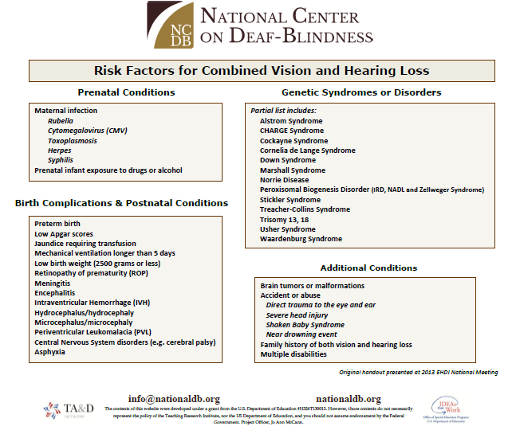
Risk Factors for Combined Vision and hearing Loss

Slide 8
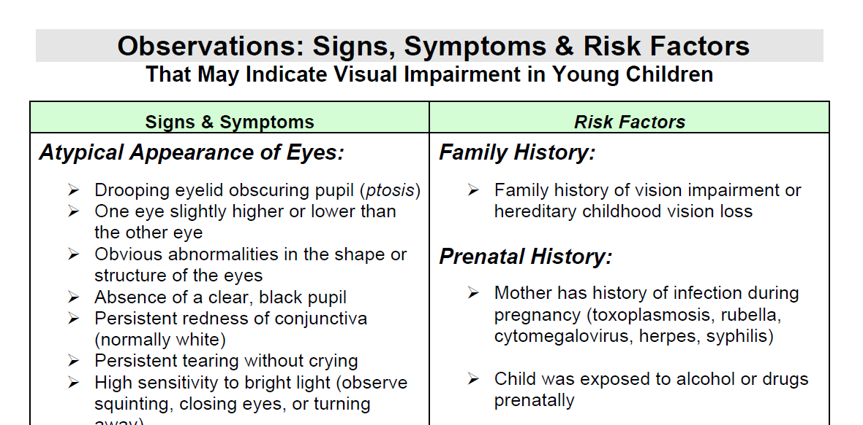
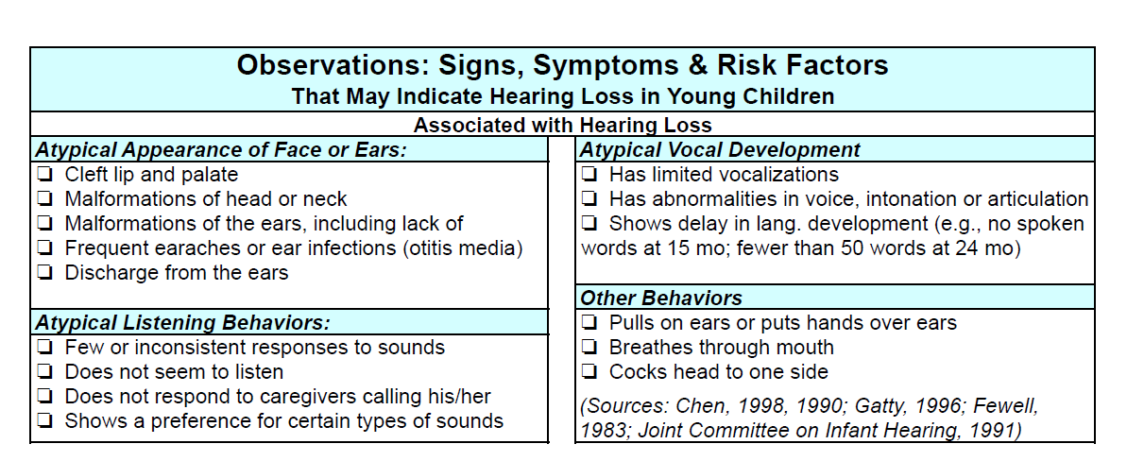
Observations
https://www.indbservices.org/images/Handouts/0203.WSDS.pdf#page=3

Slide 9
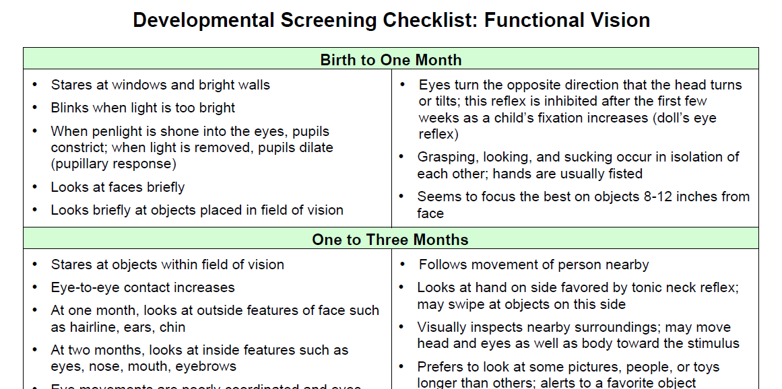
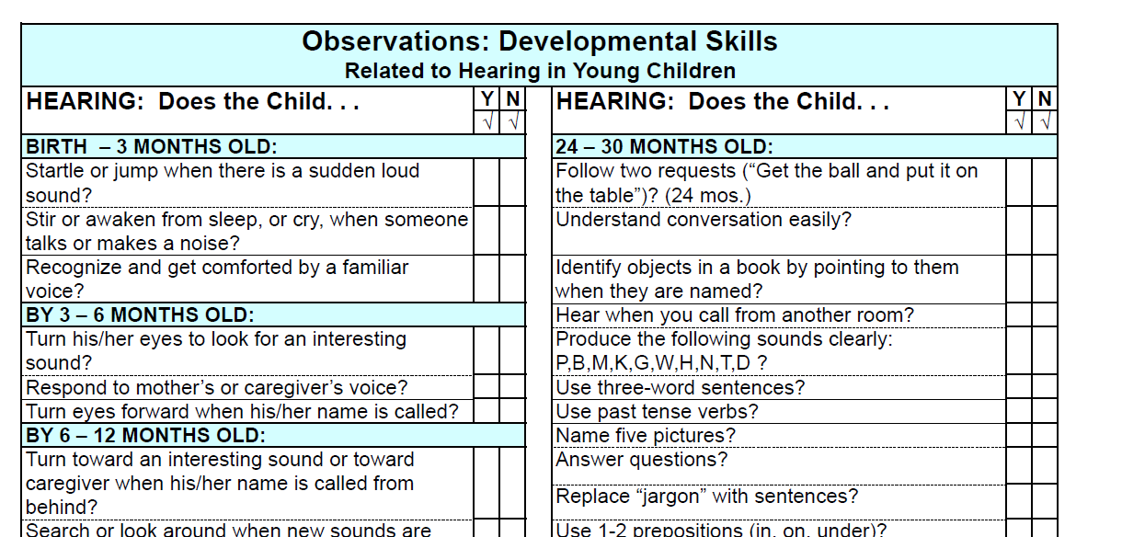
Developmental Checklist
https://www.indbservices.org/images/Handouts/0203.WSDS.pdf#page=4

Slide 10
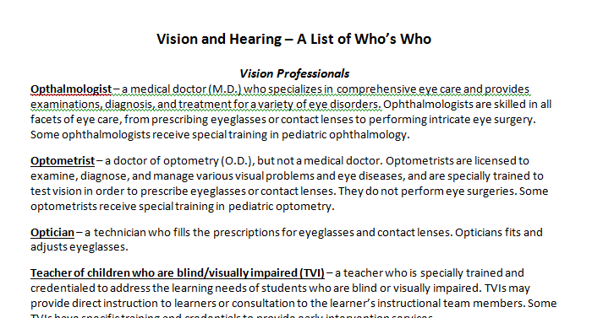
Vision and Hearing Professionals
Vision Professionals
Ophthalmologist- a medical doctor (M.D.) who specializes in comprehensive eye care and provides examinations, diagnoses, and treatment for a variety of eye disorders. Ophthalmologists are skilled in all facets of eye care, from prescribing eyeglasses or contact lenses to performing intricate eye surgery. Some ophthalmologists receive special training in pediatric ophthalmology.
Optometrist- a doctor of optometry (O.D.), but not a medical doctor. Optometrists are licensed to examine, diagnose and manage various visual problems and eye diseases, and are specially trained to test vision in order to prescribe eyeglasses or contact lenses. They do not perform eye surgeries. Some optometrists receive special training in pediatric optometry.
Optician- a technician who fills the prescriptions for eyeglasses and contact lenses. Optician fits and adjusts eyeglasses.
Teacher of children who are blind/visually impaired (TVI)- a teacher who is specially trained and credentialed to address the learning needs of students who are blind or visually impaired. TVIs may provide direct instruction to learners or consultation to the learner’s instructional team members.

Slide 11
Identifying Young Children with
Combined Vision and Hearing Loss Continued
Who can help?
  Indiana Deaf-Blind Services Project
  Lisa Poff, Project Coordinator
  www.indbservices.org
  www.facebook.com/INDBServices
  812.237.2830
  DB@indstate.edu

Slide 12
Risk Factors
Hereditary Syndrome or Disorder
Certain prenatal, perinatal and postnatal
conditions
Premature (preterm) birth
Severe head injury
Trauma to the eye and ear
Multiple disabilities
Family History of vision and/or hearing loss
Notes:
Point out that not all individuals with these conditions will qualify as deaf-blind, but when EI professionals read/hear these terms they should automatically think “I’d better be sure that we follow up on vision and hearing evaluations”

Slide 13
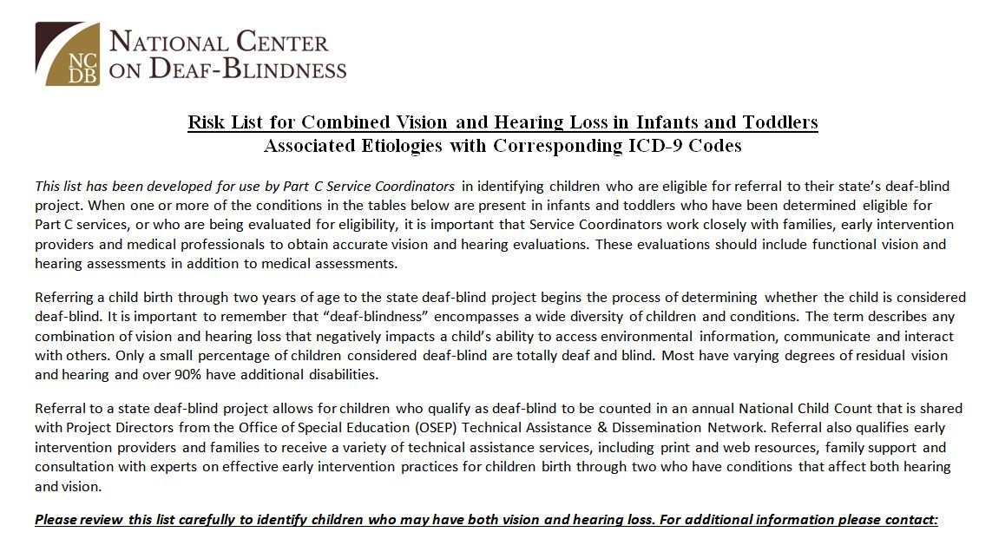
Risk List for Infants and Toddlers
Risk List for Combined Vision and Hearing Loss in Infants and Toddlers Associated Etiologies with Corresponding ICD-9 Codes (ICD-10 Codes replaced ICD-9 in October 2015)
This list has been developed for use by Part C Service Coordinators in identifying children who are eligible for referral to their state’s deaf-blind project. When one or more of the conditions in the tables below are present in infants and toddlers who have been determined eligible for Part C services, or who are being evaluated for eligibility, it is important that Service Coordinators work closely with families, early intervention providers and medical professionals to obtain accurate vision and hearing evaluations. These evaluations should include functional vision and hearing assessments in addition to medical assessments. Referring a child birth through two years of age to the state deaf-blind project begins the process of determining whether the child is considered deaf-blind. It is important to remember that deaf-blindness encompasses a wide diversity of children and conditions. The term describes any combination of vision and hearing loss that negatively impacts a child’s ability to access environmental information, communicate and interact with others. Only a small percentage of children considered deaf-blind are totally deaf and blind. Most have varying degrees of residual vision and hearing and over 90% have additional disabilities. Referral to a state deaf-blind project allows for children who qualify as deaf-blind to be counted in an annual National Child Count that is shared with Project Directors from the Office of Special Education (OSEP) Technical Assistance & Dissemination Network. Referral also qualifies early intervention providers and families to receive a variety of technical assistance services, including print and web resources, family support and consultation with experts on effective early intervention practices for children birth through two who have conditions that affect both hearing and vision.

Slide 14
Prenatal Conditions (1 of 2)
Maternal Infections
Rubella
Cytomegalovirus (CMV)
Toxoplasmosis
Herpes
Syphilis
Prenatal infant exposure to drugs
or alcohol

Slide 15
Perinatal Conditions (2 of 2)
Low Apgar scores
1-4 at 1 minute or 0-6 at 5 minutes
Hyperbilirubin (jaundice) requiring
transfusion
Mechanical ventilation for longer
than 5 days
Preterm Birth
Infection or illness shortly after birth
Notes:
Perinatal refers to the last stages of pregnancy through the first few weeks after birth.
It is defined differently in different sources (beginning from 22 or 24 weeks completed gestation to 7 or 28 days following birth).
Includes indicators or events resulting from complications during delivery or shortly after delivery.
Such information will be found by checking a child’s birth history.

Slide 16
Prematurity
Birthweight < than 1500 grams (3.3lbs)
Retinopathy of prematurity
Preterm birth, exposed to oxygen
On ventilator longer than 5 days
Elevated bilirubin requiring transfusion

Slide 17
Postnatal Conditions (1 of 2)
Syndrome associated with hearing
loss and/or visual impairment
Meningitis or encephalitis
Hydrocephalus/hydrocephaly
Cranio-facial abnormalities
Cerebral palsy or other neurological
disorders
Notes:
Point out that EI providers are often more likely than teachers to have birth history information readily available; it’s important to pay attention to it and know that these terms signal the need to be on the lookout for vision and/or hearing problems.
Point out that neurological disorders are more likely to result in characteristics or diagnoses of cortical vision or hearing difficulties than other eye conditions; it’s not uncommon for families to have been told that there’s nothing wrong with their child’s eyes and vision or ears and hearing
Check the child’s birth and health history

Slide 18
Postnatal Conditions (2 of 2)
Brain disorders, brain tumors or malformations of the brain
Loss of oxygen to the brain
Severe head trauma
Prolonged fever
Notes:
See comments from previous slide

Slide 19

Red Flag Terms
Anoxia, asphyxia, hypoxia
Atresia
Cerebral hemorrhage
Cerebral palsy
Ischemia
Meningitis
Periventricular damage
Fetal alcohol symdrome
Notes:
Again, these don’t mean for sure that deaf-blindness will be present but that close attention needs to be given to vision and hearing skills and development

Slide 20

Red Flag Comments (1 of 2)
“Sometimes he seems to see things,
other times, he doesn’t.”
“She has a syndrome called CHARGE,
but the eye doctor said her vision is fine.”
“This little guy spent two months
in the NICU and his records say that
he lost oxygen at birth.”
Notes:
Again, these don’t mean for sure that deaf-blindness will be present but that close attention needs to be given to vision and hearing skills and development

Slide 21

Red Flag Comments (2 of 2)
“This child has cortical visual impairment
as a result of head trauma when he was a
baby, but there’s nothing in his records
about a hearing problem.”
“This little girl has a syndrome
I’ve never heard of.”
Notes:
Again, these don’t mean for sure that deaf-blindness will be present but that close attention needs to be given to vision and hearing skills and development

Slide 22
Signs & Symptoms
Appearance
Abnormalities of shape or structure of
eyes or ears
Atypical formation of face, head or neck
Behaviors
Atypical listening or vocalizing
Unusual eye movements, gaze or head
position
Difficulty tracking, reaching, responding
Notes:
Again, these don’t mean for sure that deaf-blindness will be present but that close attention needs to be given to vision and hearing skills and development

Slide 23
Remember your A-B-Cs
A) Appearance
Behaviors
C) Conditions
Notes:
Recap by reminding participants about what they see, hear or read that indicate the need for attention to vision and hearing skills. Remind them that your DB Project is available for training and consultation and that your services are FREE!

Slide 24
Implications of prematurity
Survival rate of younger, lower birth weight and
medically fragile infants has increased steadily
Preterm infants are at risk for sensory loss
  Vision & hearing = most complex sensory systems
  Last to fully mature
Neurological complications can affect visual and
auditory processing
Let’s think about
Intensive Care Nursery vs. Womb
Notes:
Being Born Early handout

Slide 25

Born too Soon Article
Notes:
A visual
Encourage you to put your hands in front of you to give you a sense of the actual size
Jason probably weighed over two pounds in this picture, which was about twice his birthweight

Slide 26
Prenatal sensory development
Typical sensory development follows a sequential maturation process
Tactile ➔ Vestibular ➔ Gustatory ➔ Olfactory ➔ Auditory ➔Visual
Each system interacts with every other system
Each system impacts every other system
Compromise to one system affects all systems
Vulnerable sensory systems require supportive interventions
Individualized Developmental Care can improve outcomes (NIDCAP)

Slide 27
Implications of prematurity:
For Babies
Unnatural environment impacts development
Medical concerns often take priority over developmental and educational concerns
Developmental implications can include
  Challenges with state regulation and attention
  Feeding difficulties
  Tactile or sensory defensiveness
  Difficulty processing sensory input

Slide 28
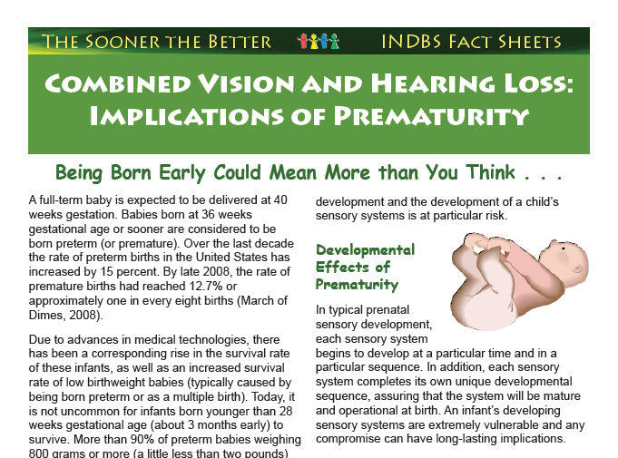
Implications of Prematurity fact Sheet
Combined Vision and Hearing Loss: Implications of Prematurity: Being born early could mean more than you think.
A full-term baby is expected to be delivered at 40 weeks gestation. Babies born at 36 weeks gestational age or sooner are considered to be born preterm (or premature). Over the last decade the rate of preterm births in the United States has increased by 15 percent. By late 2008, the rate of premature births had reached 12.7% or approximately one in every eight births (March of Dimes, 2008). Due to advances in medical technologies, there has been corresponding rise in the survival rate of these infants, as well as an increased survival rate of low birthweight babies (typically caused by being born preterm or as a multiple birth). Today, it is not uncommon for infants born younger than 28 weeks gestational age (about 3 months early) to survive. More than 90% of preterm babies weighing 800 grams or more (a little less than two pounds)…development and the development of a child’s sensory system is at particular risk.
Developmental Effects of Prematurity: In typical prenatal sensory development, each sensory system begins to develop at a particular time and in a particular sequence. In addition, each sensory system completes its own unique developmental sequence, assuring that the system will be mature and operational at birth. An infant’s developing sensory systems are completely vulnerable and any compromise can have long-lasting implications.

Slide 29
Implications of prematurity:
For Families
Emotional roller coater
Difficulty bonding
Strains on relationships
Information overload
Juggling time commitments
At-risk parents particularly vulnerable
Emotional effects can be long-lasting
Notes:
Feel overwhelmed
Feelings of guilt, anger, worry, resentment, nobody understands
often feel baby belongs more to nurses
Time in hospital and beyond (couples, family, friends)
Time with baby vs. time for job, siblings, other family responsibilities
Job, finances, juggling other family responsibilities
Higher rate of child abuse

Slide 30
Implications of prematurity:
For Service Providers
Prioritize sensory issues from start
Build customized, collaborative team
Find out about hospital experiences of children you work with
Give families space and time – they need and deserve it!
Realize that family behaviors viewed as barriers may have deep-rooted origins
Be careful how you “use your words”
Notes:
Include family, medical, school, community agencies
NICU and PICU

Slide 31
Implications of Ongoing Medical Issues
Frequent and/or prolonged hospital stays
Increased demands on time
Developmental & educational concerns may take lower priority
Similar family stressors likely
Gaps in learning opportunities add
challenges
Effects of medication
Notes:
Record keeping, appointments, case management
Disruption of family life, job, physical & emotional health (worry, lack of sleep, etc)
Takes lots of effort; must learn to maneuver multiple new systems
Just worried about keeping their baby/child alive
Less time for family activities, siblings get less attention
Support from friends & extended family lessens
Reluctance to ask for help
Strain on marital relationship
(time missed, skills lost or not practiced)

Slide 32
Implications of Multiple Disabilities
Loss of child imagined
Cultural considerations
Family stressors become ongoing
Numerous home visitors
May see increased emphasis on
protecting the child
May also see lower expectations
Reactions of family & friends
Delayed development
Notes:
Dealing with feelings of grief – often now thought of as a bundle of feelings that occur & re-occur, rather than “stages” to move through
Based on religious beliefs, personal experience (or lack of) with disability, personal values (“at least she’s not retarded”)
Disruption of family life continues, struggle with how to adapt to the “new normal”; employment/financial worries ; strains on marital relationship
EI providers, nurses, case workers
Acquaintances, people in community also

Slide 33
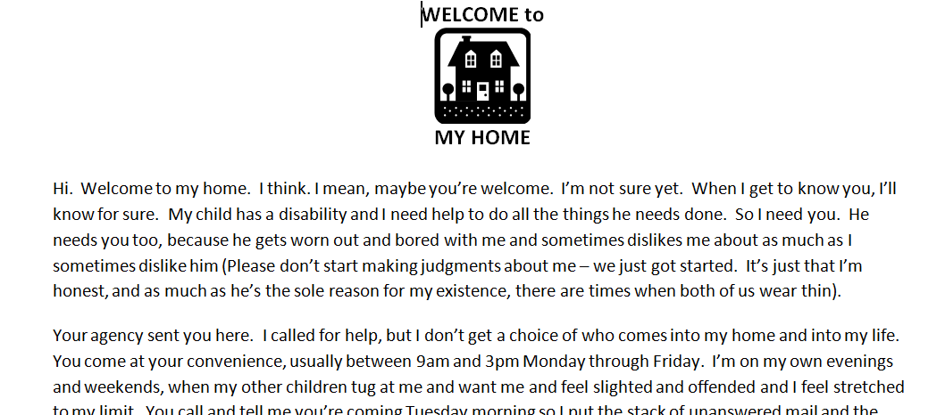
Welcome to My Home
Welcome to my Home
Hi Welcome to my home. I think. I mean, maybe you’re welcome. I’m not sure yet. When I get to know you, I’ll know for sure. My child has a disability and I need help to do all the things he needs done. SO I need you. He needs you too, because he gets worn out and bored with me and sometimes dislikes me about as much as I sometimes dislike him (Please don’t start making judgements about me, we just got started. It’s just that I’m honest, and as much as he’s the sole reason for my existence, there are times when both of us wear thin). Your agency sent you here. I called for help, but I don’t get a choice of who comes into my home and into my life. You come at your convenience, usually between 9 am and 3 pm Monday through Friday. I’m on my own evenings and weekends, when my other children tug at me and want me and feel slighted and offended and I feel stretched to my limit.

Slide 34
Impacts of Hearing Loss
Communication challenges
Hearing may be inconsistent
Missing or distorted information
Fatigue, ability to focus
Difference in how everyday
activities are experienced
Notes:
Even minor hearing loss can greatly impact language development and learning
Expressive language difficulties greater than comprehension
Delays in developing comprehension that may be made worse by hearing loss and other challenges
Child with conductive loss brought on by otitis media may be able to hear some days, not others
If otitis media persists, can have constant mild hearing loss forcing child to figure out what person is saying based on context of conversation
Misses information

Slide 35
Impacts of Vision Loss & Blindness
Bonding challenges
Apprehension
Missing, inconsistent or distorted
information
Fatigue, inability to focus
Body and space awareness
Difference in how everyday activities
are experienced
Notes:
Bonding: the work of Selma Fraiberg found mothers didn’t bond well with blind infants because they didn’t get the reinforcement of smile and eye contact. Fraiberg worked with moms to look for other signs of recognition in body language and especially in hands
Object permanence: sighted babies learn objects are “out there” when out of sight – blind babies need to be taught. Using sound to develop object permanence occurs later, and blind babies are delayed in concept development and language development
World can be a scary place
children are often very cautious (with good reason)
sometimes we are cautious about letting them try things as well
without visual feedback there’s little motivation to reach, explore their own body movements, try to move and explore the world
Mobility: (motor skills) with no object permanence, no incentive to move
Self concept: sighted babies learn about themselves and others by watching their hands and feet, seeing themselves in mirror, comparing their image, and other people. Blind babies have problems with language: pronoun confusion, echolalia (repeating, or echoing speech) because have trouble constructing self image
Abstract concepts: the big picture- how the world is put together; putting together the pieces you can touch into the whole ; Understanding things you can’t explore: clouds, sunset, colors. What it means to see

Slide 36
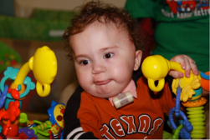
Impacts of Deaf-Blindness
Deaf-blindness is often described as a disability of ACCESS
Combined vision and hearing loss affects
Communication
Exploration > Mobility > Engagement > Participation
Relationships > Social interaction > Friendships
Visual & Mental Memory > Concept development
Independence
Incidental Learning
Notes:
Isolation: The 2 distance senses of vision and hearing connect people to the world beyond their own body space. It is said that blindness takes away things, and deafness takes away people. The world shrinks to what you can touch
Relationships/social skills: early bonding with parents, sense of self, discriminating who is who, picking up social cues, appropriate behaviors, communicating with others
Absence of incidental learning: must use touch or be in close proximity to learn about things. We gain information effortlessly through distance senses but if interpreter doesn’t tell db person with deafblindness, they don’t know
Even when not total loss in either sense, get incomplete, confusing, information that gives a distorted understanding of things
Visual & Mental imagery: concepts of space, time, color, - cloud, red, complexity of language,
Learned helplessness: good fairy syndrome, passivity learned – wait for prompting
Experiences: opportunities to experience in accessible way
Language-
Mobility: without stimulus to move for things because don’t see,or hear
Multiple disabilities affect ability to seek information

Slide 37
How do infants and toddlers learn?
Early Childhood Development Basics
  Sensory exploration
  Movement
  Watching & listening
  Trying new things
  Repeating favored activities
  Asking questions
  Security of safe, familiar environment

Slide 38
Incidental Learning . . .
is what happens as young children
watch, listen and put meaning to
what’s going on around them
Notes:
Literature estimates 75% of what we know, and >90% of what a child under 5 knows is learned by vision
Remember this term if you’re not already familiar with it

Slide 39
Distance Senses
Vision and Hearing are the primary senses for learning
They are also known as the distance senses

Slide 40
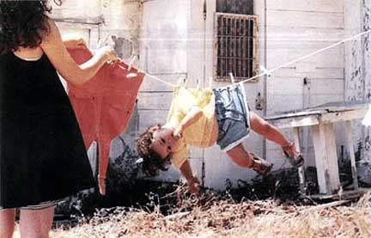
Sensory challenges
Sensory challenges turn our world
UPSIDE DOWN!

Slide 41
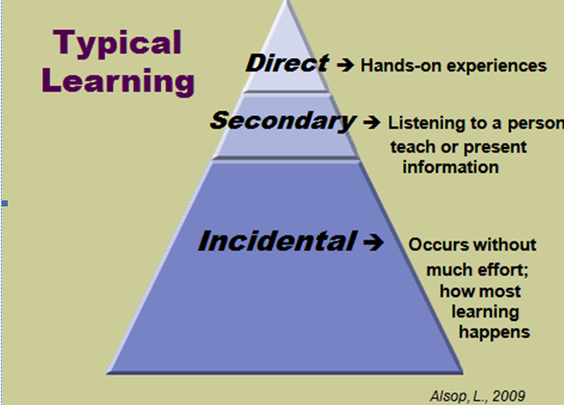
Typical Learning
Typical Learning
Direct: Hands-on experiences
Secondary: Listening to a person teach or present information
Incidental: Occurs without much effort: how must learning happens

Slide 42
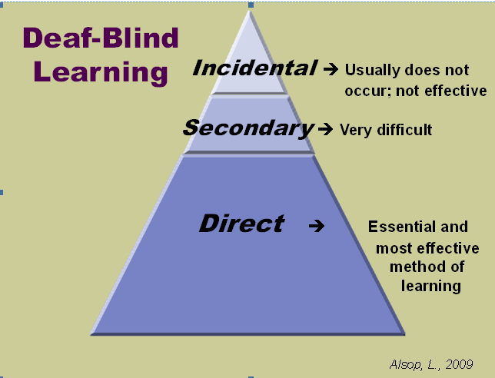
Deaf-Blind Learning Pyramid
Deaf-Blind Learning
Incidental: Usually does not occur; not effective
Secondary: Very difficult
Direct: Essential and most effective method of learning

Slide 43
So how do infants and toddlers with complex challenges learn?
By touching, tasting, smelling, reaching, moving
By trying things out
By repeating thing they like and avoiding things they don’t
By asking questions
By being surrounded by people who provide a safe place to learn
Notes:
Children with complex learning challenges need the same kinds of learning experiences as other children
But they will also need
more time to do them
to repeat them more often
activities that are designed just for them and their particular set of needs
a team who can provide the safe place needed to learn and grow
So how do we do that?

Slide 44

Building a Foundation for Learning
Team Approach
Access to People, Objects & Activities
Meaningful Learning Activities
Appropriate Assessment
Individualized Communication System
Trusted Relationships
A circle diagram with six boxes. Team Approach, Access to People, Objects & Activities, Meaningful Learning Activities, Trusted Relationships, Individualized Communication System, Appropriate Assessment.
Notes:
Will look at each one
Then some in more detail

Slide 45
Team Approach
Parents provide critical input
Collaboration is key
Finding what works requires willingness to move out of our typical roles and comfort zones

Slide 46

Assessment
The root of the word assessment is assidere, which means “to sit beside and get to know.”
Notes:
Authentic assessment refers to the systematic recording of developmental observations over time about the naturally occurring behaviors and functional competencies of young children in daily routines by familiar and knowledgeable caregivers in the child’s life.
What: real behaviors relevant to the child’s current daily functioning and to new situations (functional skills)
How: observation and record keeping of child’s behavior during work/play (real life) Professionals can “occasion” opportunities for a skills so that it is more readily observed.
Who: familiar and knowledgeable caregivers
Where: natural context NOT decontextualized settings Natural------------Analog-------------Simulated----------------Clinical
When: One-time observation are insufficient and often misleading.
Reference: Bagnato (KITS Summer Institute and book; Authentic Assessment)

Slide 47
Authentic Assessment
Familiar people….
In familiar settings…
With familiar objects/toys… Doing familiar things.
Adapted from: Sophie Hubbell, M.A.T
Kent State University
Notes:
Gathering information: who, what and how
Conducting interviews
Documenting authentic assessment practices: written descriptions (anecdotal/running records, ABC data); Permanent records (work samples, portfolios, photographs, video clips); Counts and Tallies (rating scales, rubrics)

Slide 48
Assessment for children with combined vision & hearing loss
Multi-faceted approach
Functional Vision Assessment (FVA)
Functional Hearing Assessment (FHA)
Identifying sensory preferences
Putting the pieces together
Notes:
Assessment
One size definitely does not fit all!
Standardized instruments yield very little information that’s useful – not normed for our kids
Hard to demonstrate what they know – often considered to have cognitive limitations but may not be so
Need input from a variety of sources – parent/caregiver/teacher report, observation
Materials that are meaningful, familiar work best
State DBP can help
Tanni’s Individual Sensory Learning Profile
Deb Gleason’s Sensory Functioning Assessment and Intervention Strategies
Practice Perspectives: Authentic Assessment

Slide 49
Access
Vision and hearing = Distance senses
Multiple disabilities affect ability to seek information
Information and responses are absent, limited or distorted
Impacts incidental learning
Notes:
Deaf-blindness is a disability of access

Slide 50
Providing Access (1 of 4)
Maximize residual vision and hearing
Functional Vision Assessment results
Functional Hearing Assessment results
Glasses, low vision devices
Hearing aids, personal FM system
Assistive technology devices
Notes:
Increase access and maximize learning
Investigate the medical diagnoses
Understand the implications of the diagnoses—what you might expect
Seek help from team members for functional assessments
Take time
Carefully observe
Record observations and circumstances
Recognize the importance of tactile information
Vision and hearing oriented culture
Identification, communication, pleasure
Use of hands as tools, voice, sensory organs
Utilize other senses
Recognize the importance of doing for learning
Limited use of models
Need to be directly involved
Repetition is practice
Involve in full routine
Allow added time for taking in information, processing it, & responding
Fatigue factor
Reading state and readiness

Slide 51
Providing Access (2 of 4)
Visual accommodations Include
Color
Size
Lighting
Contrast
Position
Spacing
Distance Arrangement
Auditory accommodations include
Position (child’s, yours)
Control of background noise
Tone
Volume
Notes:
Increase access and maximize learning
Investigate the medical diagnoses
Understand the implications of the diagnoses—what you might expect
Seek help from team members for functional assessments
Take time
Carefully observe
Record observations and circumstances
Recognize the importance of tactile information
Vision and hearing oriented culture
Identification, communication, pleasure
Use of hands as tools, voice, sensory organs
Utilize other senses
Recognize the importance of doing for learning
Limited use of models
Need to be directly involved
Repetition is practice
Involve in full routine
Allow added time for taking in information, processing it, & responding
Fatigue factor
Reading state and readiness

Slide 52
Providing Access (3 of 4)
Position and location of child
Position and location of materials
Adapted materials
Assistive technology
Time to prepare, process, respond, rest
Notes:
Increase access and maximize learning
Investigate the medical diagnoses
Understand the implications of the diagnoses—what you might expect
Seek help from team members for functional assessments
Take time
Carefully observe
Record observations and circumstances
Recognize the importance of tactile information
Vision and hearing oriented culture
Identification, communication, pleasure
Use of hands as tools, voice, sensory organs
Utilize other senses
Recognize the importance of doing for learning
Limited use of models
Need to be directly involved
Repetition is practice
Involve in full routine
Allow added time for taking in information, processing it, & responding
Fatigue factor
Reading state and readiness to learn

Slide 53
Providing Access (4 of 4)
Physical environment
Lighting, clutter, acoustics
Designated spaces
Organization of materials and equipment
Visual or tactile cues as labels
Adaptations and accommodations

Slide 54

Communication Systems
All children communicate!
Our role
  Expectation
  Opportunity
  Interpret and respond
  Shape
  Model & coach
Notes:
Understand the difference between “communication” and “language”
May not all use formal language, but all children communicate
Interpret, respond and shape communicative intent – and teach families to do the same
Elements of a good “conversation”
Sometimes we teach family; sometimes family teaches us

Slide 55
Reading Infant Signals
Communication begins at birth
May be atypical
Recognize subtle signs
Learn to read and respond to each child’s unique signals
Notes:
Let them know when you are not going to be predictable
Allow the child to direct conversations about their topic (follow their agenda, not yours)
Incorporate rhythm, music, finger plays and mime games into daily routines and activities
Non-traditional conversations
Have frequent conversations with the child (may or may not use spoken language)
Be responsive

Slide 56
Reading Infant Signals
Heart rate
Breathing
Skin color
Facial expressions
Muscle tone
Position
State
Hyperextension
Flailing
Splaying
Yawning, Sneezing
Hiccups
Gagging
Salute

Slide 57
Individualized Systems
Recognize behavior as communication
Know hierarchy of communication
Engage in non-traditional conversations
Assess receptive & expressive communication methods
Identify child preferences & interests
Notes:
Will cover this in more detail later

Slide 58
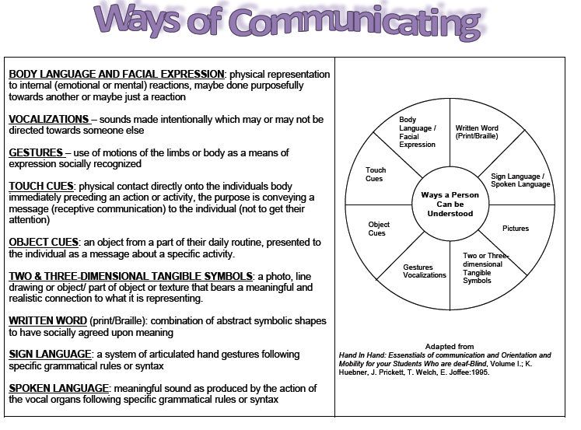
Ways of Communicating
BODY LANGUAGE AND FACIAL EXPRESSION: physical representation to internal (emotional or mental) reactions, maybe done purposefully towards another or maybe just a reaction
VOCALIZATIONS – sounds made intentionally which may or may not be directed towards someone else
GESTURES – use of motions of the limbs or body as a means of expression socially recognized
TOUCH CUES: physical contact directly onto the individuals body immediately preceding an action or activity, the purpose is conveying a message (receptive communication) to the individual (not to get their attention)
OBJECT CUES: an object from a part of their daily routine, presented to the individual as a message about a specific activity.
TWO & THREE-DIMENSIONAL TANGIBLE SYMBOLS: a photo, line drawing or object/ part of object or texture that bears a meaningful and realistic connection to what it is representing.
WRITTEN WORD (print/Braille): combination of abstract symbolic shapes to have socially agreed upon meaning
SIGN LANGUAGE: a system of articulated hand gestures following specific grammatical rules or syntax
SPOKEN LANGUAGE: meaningful sound as produced by the action of the vocal organs following specific grammatical rules or syntax
Circle showing Ways a Person Can be Understood in the middle. It is encircled by pieces of an outer circle containing: Body Language/Facial Expression; Written Word (Print/Braille); Sign Language/Spoken Language; Pictures; Two or Three-dimensional Tangible Symbols; Gestures Vocalization; Object Cues; Touch Cues. Noted that it is adapted from Hand In Hand: Essentials of communication and Orientation and Mobility for your Students Who are deaf-Blind, Volume I.; K. Huebner, J. Prickett, T. Welch, E. Joffee:1995.

Slide 59
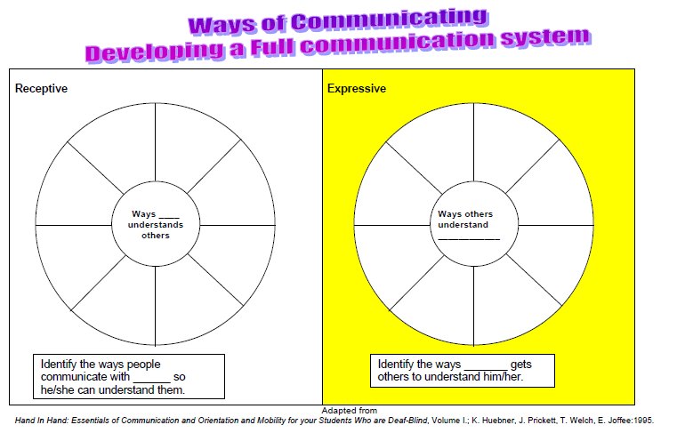
Ways of Communicating: Developing a Full communication System
Receptive
Ways ____ understands others
Identify the ways people communicate with ___ so he/she can understand them
Expressive
Ways others understand ____
Identify the ways ____ gets others to understand him/her.

Slide 60
Trusted Relationships
Facilitate access, communication, social interaction
Bonding
Respect
Enter child’s world
Provide consistency
Notes:
Successful learning begins here!
Primary caregiver relationship is first to be established; will talk about bonding in a minute
Everyone deserves to be treated with respect
Children pick up more than we think – treat them as you would want to be treated
Children sense our discomfort or apprehension so be careful
Must think of world from their perspective
Hands-on learning has to take place (remember the incidental learning pyramid); doing things over & over in the same way each time
Once you’ve built a trusting relationship you can play a key role in child’s learning; child trusts that you won’t do anything that would frighten or harm
You can “show” them the world; introduce new objects & experiences
You become a valued communication partner
You can facilitate other relationships & activities (help them “play”, be a part of things other children are involved in)

Slide 61
Bonding (1 of 3)
Challenges to caregiver
Intense emotions
Fear of death
Separation during early weeks
Absence of visual gaze
Difficulty reading cues
Lack of responsiveness & reciprocity
Notes:
Feelings of loss (of imagined child), guilt, inadequacy (Will I be able to handle this?)
Physical exhaustion, reduced emotional availability
Still not out of the woods; may have lost another baby if this was a multiple birth
Child may have spent weeks or months in NICU – or been rushed back to the hospital
Primary infant response of gazing at caregiver doesn’t happen; this can be devastating
Baby may seem disinterested or even rejecting of caregiver (e.g. arching/looking away/fussing may actually be response to sensory overload)
Those early, satisfying back & forth interactions aren’t there
Responses may be delayed or inconsistent; makes it hard to feel like you’re making progress

Slide 62
Bonding ( 2 of 3)
Challenges to infant
Separation during early weeks
Effort required to feed
Lack of typical visual feedback
Lack of typical auditory feedback
Self-regulation
Notes:
1) Atypical early start interfered with normal bonding process (even for sighted infants)
2) These babies are often working VERY HARD during feeding; might need to work on bonding at another time
3 & 4) Unable to experience looks & sounds that other babies do; are unaware of them; little or no perception of what’s happening so can’t interpret & internalize on their own
5) Again – the nature of their disabilities or medical conditions means they’re working very hard
May be uncomfortable or in pain
Difficult to arouse, or to calm
Medications may have side effects

Slide 63
Bonding ( 3 of 3)
Strategies that may help
Support for caregiver
Use of other sensory channels
Touch
Minimize distractions
Work to establish a routine
Notes:
Infants sense our discomfort or apprehension so it’s important to provide support for parents/caregivers
information/education – reading cues, recognizing subtle cues, feeding tips from OT/SLP
connect with another parent
point out little things (“look how she’s snuggling up to you”, “he seems to be calming down”, “you look more comfortable every time I come”)
encourage caregivers to act naturally (e.g. it’s OK to go ahead and talk “motherese”, sing even though baby can’t hear)
Other sensory channels
smell (point out that sense of smell is absent or compromised for children with CHARGE) – second sensory system to become fully functional, infants recognize smell of mother
vestibular, proprioceptive - movement, pressure, position
Touch – will talk a lot about this throughout the day
pressure, temperature, texture
center to extremities , head to toe
infant massage
Quiet room, quiet time
Beginning use of touch cues & object cues (will talk more about later)

Slide 64
Building Trusted Relationships (1 of 2)
Consider past experiences (positive and negative)
Providing security & earning trust
  Consistency
  Gaining attention
  Predictability
  Greeting and leaving
  Personal identifiers
Notes:
Think about past experiences and their impact on the child
Don’t assume the learner will automatically trust you – you need to establish the relationship and earn trust
Where and how you touch an individual is key in establishing a relationship
Can’t stress enough
Knowing what’s coming next builds security (for anybody – e.g. what if you lose your planner)
Also need to let them know when you are not going to be predictable
Interact and “be present” – it’s about the child, not you
Announce your presence
Where and how you touch an individual is key in establishing a relationship; ask caregiver (center to extremities, head to toe)
Be consistent (every time & every team member)
Pay attention to states of arousal
Always identify yourself – everyone needs to do it! Every time!
Say "Hello" and "Good-bye" and expect child to do the same
Expect, wait for and acknowledge child’s responses
Must be unique
Nice team activity
While working to establish communication system with little ones you should also use words and/or signs
Cautions: children will likely notice changes in jewelry, cologne, soap, haircut, beard, etc.

Slide 65
Building Trusted Relationships (2 of 2)
Know likes and dislikes
Follow child’s lead
Frequent conversations Conversations: Connecting and Learning with Persons who are Deafblind (http://support.perkins.org/site/PageServer?pagename=Webcasts_Conversations)
Role of hands & touch Reflections on Deafblindness: Hands and Touch (http://support.perkins.org/site/PageServer?pagename=Webcasts_Reflections_on_Deafblindness)
Notes:
Engagement and responsiveness increases when the activity or “conversation” is something child likes
Allow the child to direct conversations about their topic (follow their agenda, not yours)
Incorporate rhythm, music, finger plays and mime games into daily routines and activities
Read child’s signals
Non-traditional conversations
Have frequent conversations with the child (may or may not use spoken language) – opportunities for turn-taking
Be responsive

Slide 66
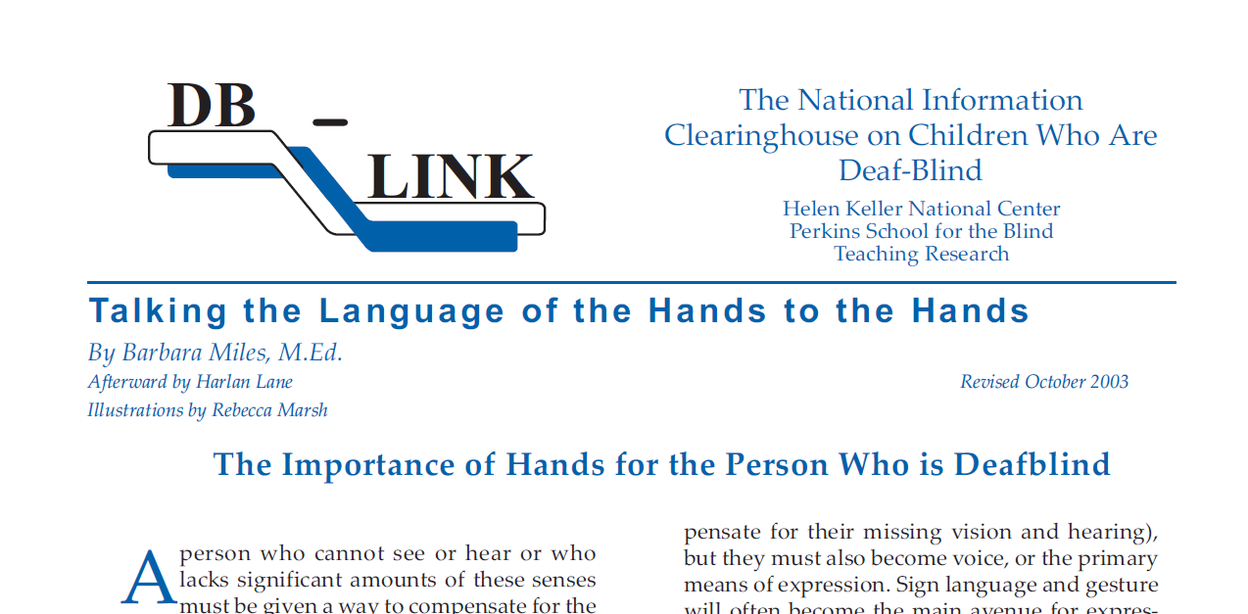
The Language of Hands

Slide 67
Thinking about Touch ( 1 of 2)
Hands convey information through
Temperature
Tone
Speed of movement
Degree of pressure
Children learn to read what is being conveyed when you touch them
Notes:
There are a range of emotions you can communicate through touch
Tenseness, relaxed

Slide 68
Thinking about Touch (2 of 2)
What can you learn about a child from his/her response to your touch? To other types of tactile input?
What do your hands convey when you touch a child?
Where and how will you touch a child to be most respectful?
Notes:
Keep in mind where you touch the student (palms, back of hands, arms, legs, chest)

Slide 69
Meaningful Activities
Limitations for children with disabilities
  Range and variety of experiences
  The ability to get about
  Interaction with the environment
Overcoming limitations
  . . . these are best intervened through the use of
  repeated, meaningful, hands on experiences through
  daily activities with family members.
Berthold Lowenfeld

Slide 70
Similar Terms
Meaningful, hands on experiences through daily activities with family members
Sound familiar?
Routine Based Early Intervention
Notes:
Two terms that mean similar things
RBEI is familiar term to early intervention providers
That’s what we’re talking about . . . with a few additional considerations to make those experiences “meaningful” for children with multiple disabilities & combined vision & hearing loss

Slide 71
Routine Based Early Intervention (1 of 3)
Builds on activity settings and learning opportunities vs. embedding therapy
Promotes child participation in activity settings that have development-enhancing qualities vs. focusing on skill development
Based on adult responsiveness to the child vs. teaching specific skills
Notes:
Given all that as background – here are some important terms you’re going to be hearing during the rest of our time together this morning. We’ll be spending some time talking about each one.
Let’s start with natural environments . . .

Slide 72
Things to Consider
Activity settings & Learning Opportunities
Not only about how many
It’s about consistency, relevance, perspective
Child participation
Not about participation for participation’s sake
It’s about relevance and quality of engagement, from child/family perspective
Adult responsiveness
Can’t always be about what we want
It’s about careful observation, slowing down, making it relevant, stepping outside our own comfort zones
Notes:
Relevant appears in each bullet – everything we do has to make sense to the child & family – they’re too complex/needs too great for us to waste their time – need to listen, set aside some of our own ideas about priorities – you’ve heard this before – but it CAN’T be ignored when you’re working with these kinds of kids

Slide 73
Sources of Children’s Learning Opportunities
Family
Community
Early Childhood Programs
Family
Community
Early Childhood Programs
Bruder & Dunst, 1999
Notes:
Virtually everything a child experiences takes place in one of these three contexts – Family, Community, Early Childhood Programs. Our emphasis in past has been on the bottom circle, the paradigm shift and current research base is calling on us to look just as carefully at the other two – and to strike a balance for families.
Let’s take a look at each one . . .

Slide 74
Routine Based Early Intervention (2 of 3)
Takes place in family context
“ includes a mix of people and places that support a variety of…learning opportunities …such as cooking, eating meals, splashing water during bathtime, looking at books, and learning how to greet people at family get-togethers”
(Bruder & Dunst, 1999)

Slide 75
Routine Based Early Intervention (3 of 3)
Takes place in community life
“includes a mix of people and places … including the people and things encountered on a walk in the neighborhood, a visit to the library, or a shopping trip”.
(Bruder & Dunst, 1999)

Slide 76
What is a “Routine”?
Beginning and ending
Outcome oriented
Meaningful
Predictable
Sequential or systematic
Repetitious
(FGRBI, Florida State University, 2014)
Notes:
More than just a beginning and ending for these children (will see in next slide)

Slide 77
Why are Routines Important?
Predictability
Provide security
Decrease stress
Anticipation
Sense of control
Notes:
Comes from EI literature but is exactly what we’ve been talking about as important for kids with multiple disabilities

Slide 78
What are the Steps in a Routine?
Initiation
Preparation
Core
Termination

Slide 79
How do You Design Meaningful Learning Experiences?
Consider the child’s perspective
Identify likes and dislikes
Determine preferred sensory learning channels and learning styles
Identify learning opportunities
Create routines within activities
Use age appropriate activities and materials
Notes:
Must be motivating
Everyone learns best when subject is of interest
Early childhood education accepts the practice of child-directed learning
Difficult for learners with deaf-blindness to be engaged/motivated in topics for which they have no frame of reference
IFSP/IEP/Transition Plans mandate consideration of preferences and interests
Provide a multi-sensory approach
Has to make sense to the child – think of what the experience will mean (or not) to the child

Slide 80
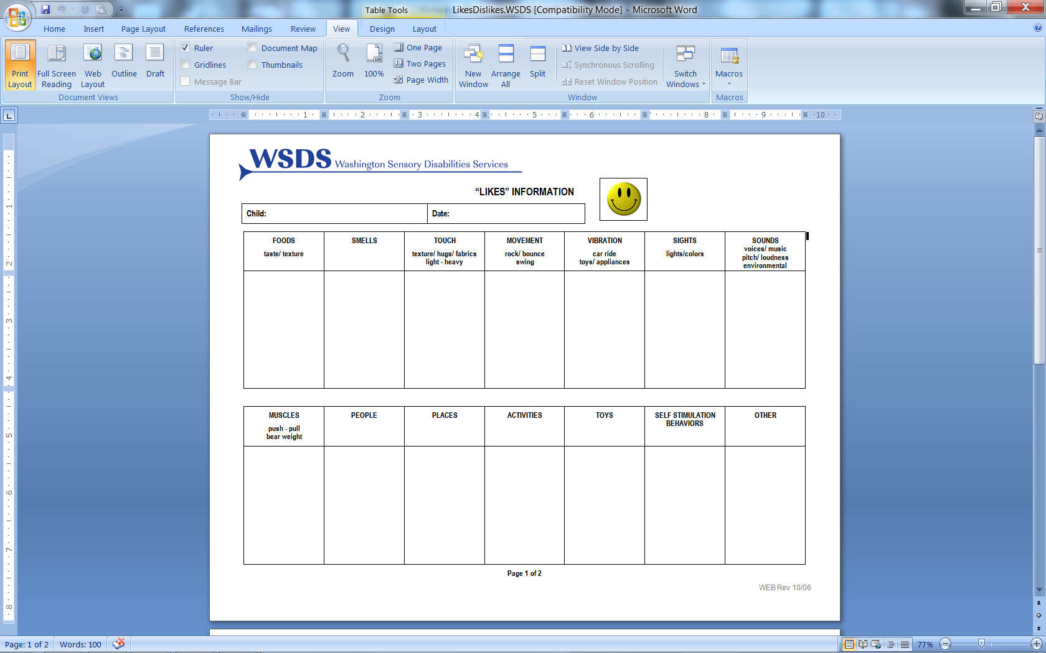
Preferences and Interests

Slide 81
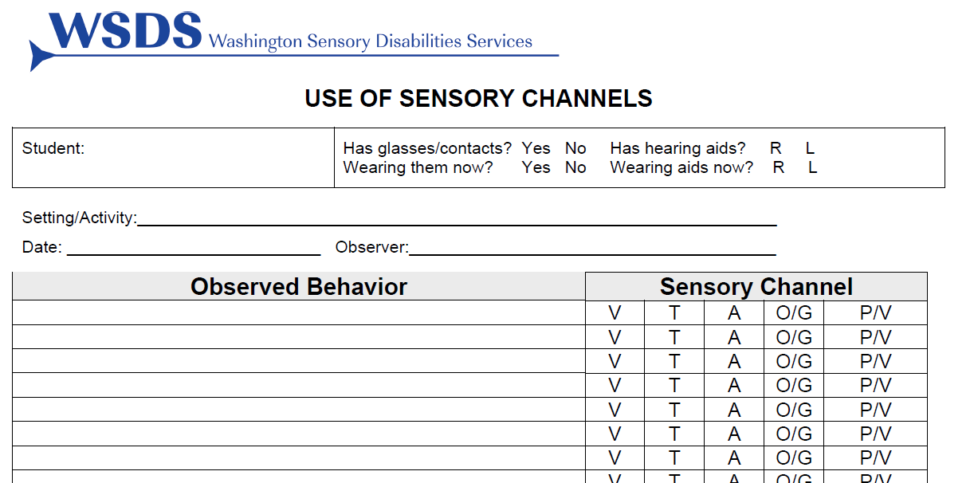
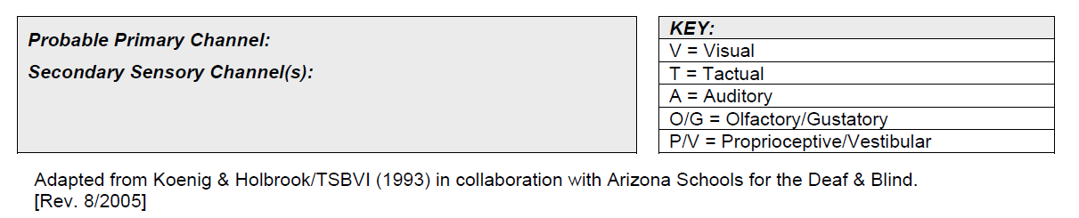
Identify Use of Sensory Channels

Slide 82
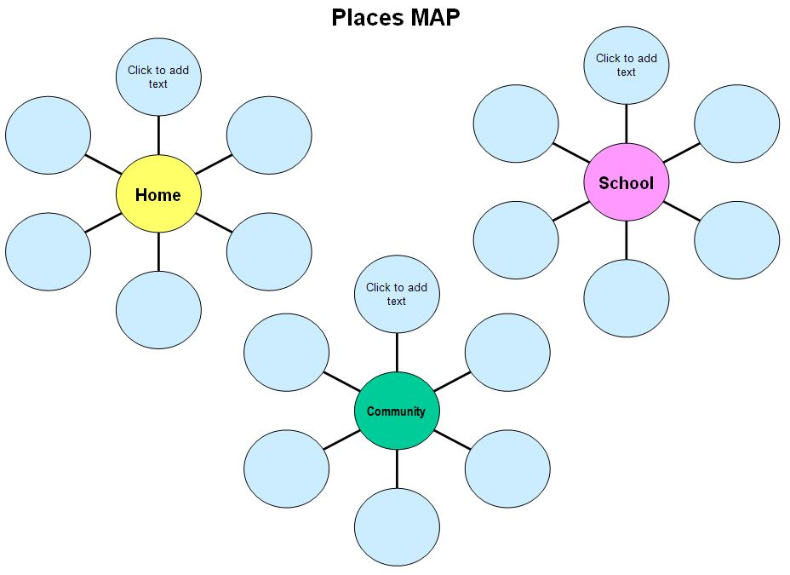
Identify Learning Opportunities

Slide 83
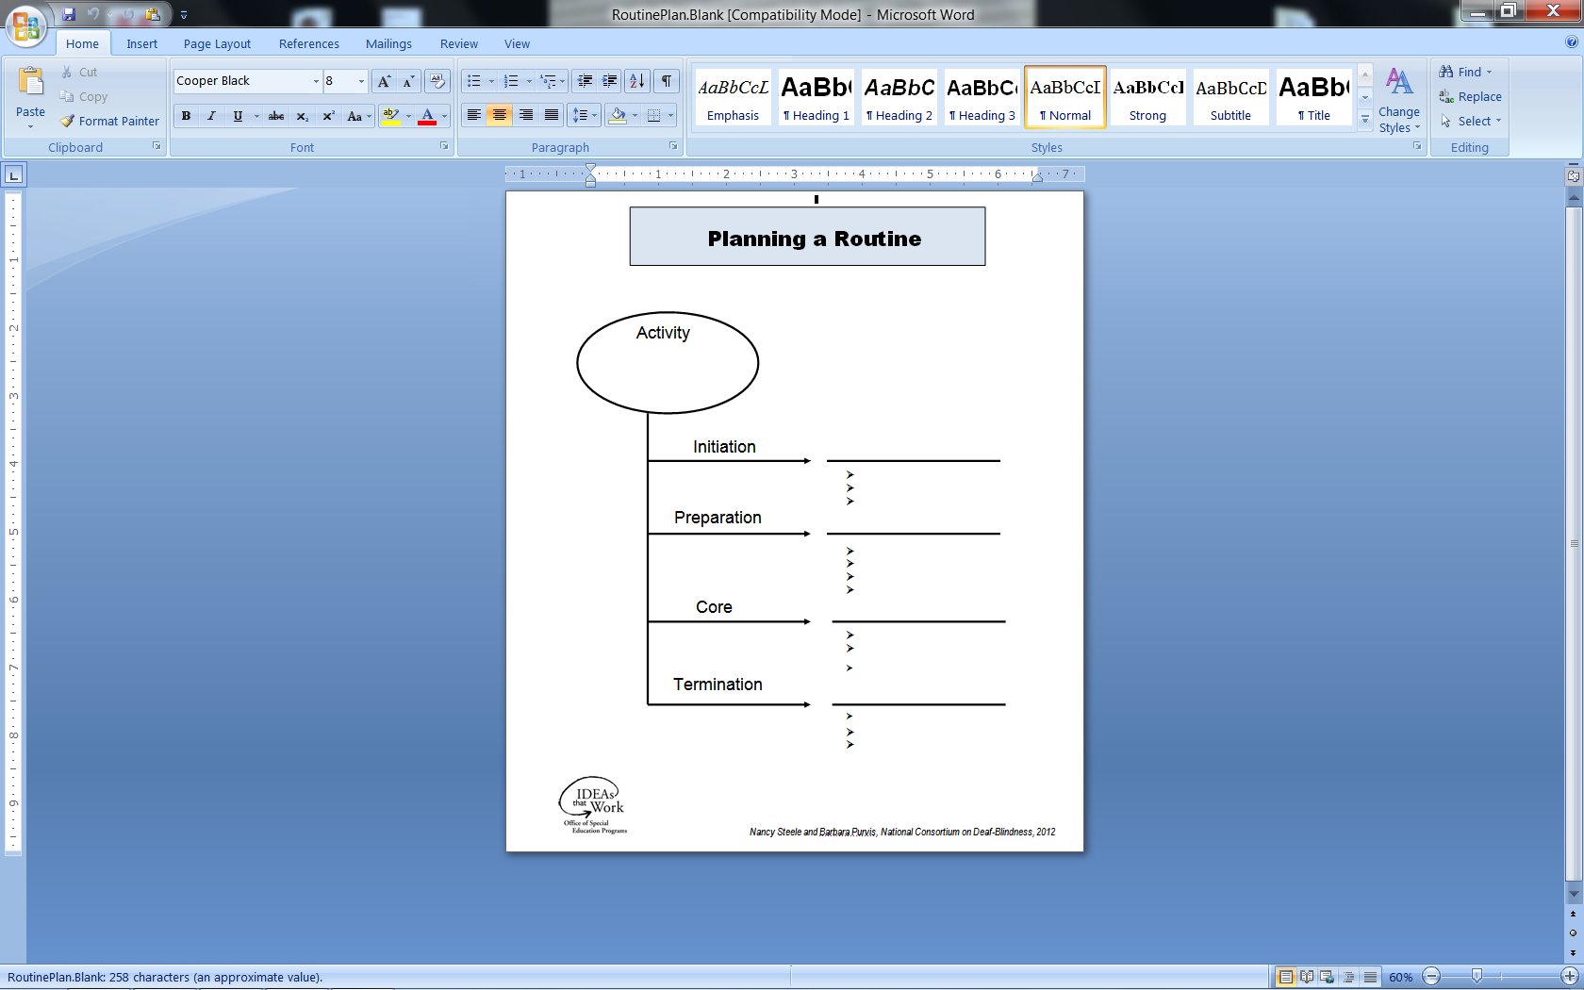
Planning a Routine

Slide 84
REFERENCES ( 1 of 2)
Chen, D. (Ed.). (2014). Essential Elements in Early Intervention: Visual Impairment and Multiple Disabilities. New York, NY: AFB Press.
Chen, D. with Klein, M.D., Holloway, E., Myck-Wayne, J., Saledo, P., Snell, R. (2008). Early Intervention in Action: Working Across Disciplines to Support Infants with Multiple Disabilities and Their Families. Brookes Publishing Company. Baltimore, MD.
Dunst, C.J. & Bruder, M.B. (1999). Increasing children’s learning opportunities in the context of family and community life. Children’s Learning Opportunities Report. Vol. 1, No. 1. http://www.puckett.org
Dunst, C.J. & Bruder, M.B. (1999) Family and community activity settings, natural learning environments and children’s learning opportunities. Children’s Learning Opportunities Report. Vol. 1, No. 2. http://www.puckett.org
Dunst, C.J., Hamby, D., Trivette, C., Raab, M. & Bruder, M.B. (2000), Everyday family and community life and children’s naturally occurring learning opportunities. Journal of Early Intervention, 23(3), 151-164.

Slide 85
REFERENCES (2 of 2)
Gleason, D. (2005). Sensory Functioning Assessment and Intervention Strategies: Children with Visual Impairment and Multiple Disabilities; Perkins School for the Blind- Hilton/Perkins Program.
McWilliam, R. A. (2010). Routines-Based Early Intervention: Supporting Young Children and Their Families. Baltimore, MD: Paul H. Brooks Publishing Co.
Miles, B. & Riggio, M. (Ed.) (1999). Remarkable Conversations: Guide to Developing Meaningful Communication with Children and Young Adults Who are Deafblind. Perkins School for the Blind.
Rush, D.D., Shelden, M.L., & Hanft, B.E. (2003). Coaching families and colleagues: A process for collaboration in natural settings. Infants and Young Children, 16(1), 33-47.
Rush, D.D. & Shelden, M.L. (2005). Implementing evidence-based practices in early childhood intervention: Coaching in early childhood. Training materials, Sept. 12-14, 2005, Topeka, KS.

